Slide 1

The Ultimate Solution for Context Based Video Generation

Slide 2




Where do we dwell
Articulate App
And Website as well

Slide 3
What we deal :-
Just type in the text on our frontend (Maybe Ctrl C + Ctrl V)
Let our algorithm work out the relevant images
BOOM !!! You have your video ready

Slide 4
How do we do ???
Nltk analysis on article
Followed by text ranking
Finally , Sentiment Analysis for relevant background music

Slide 5
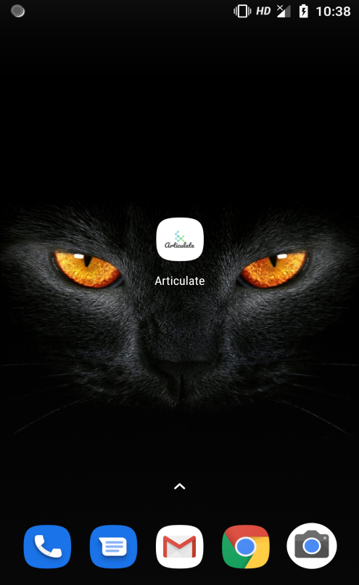

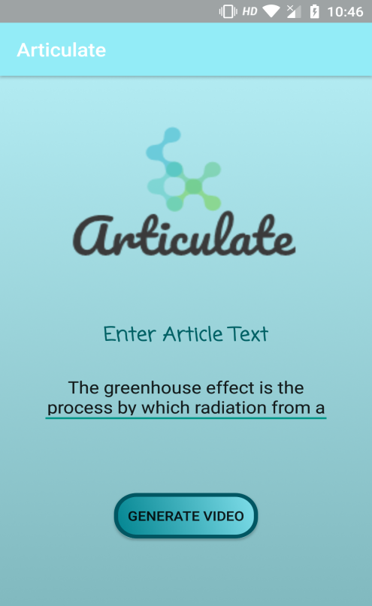
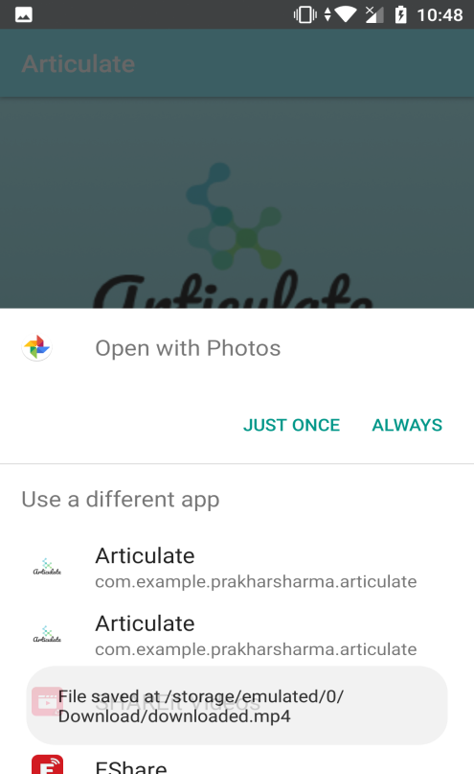
Lets dive into a DEMO …

Slide 6
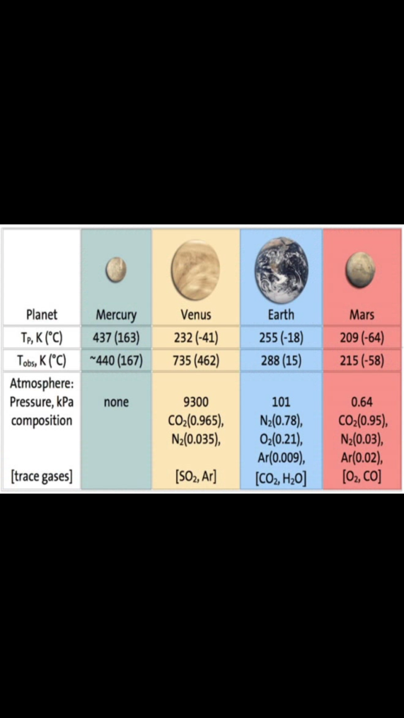
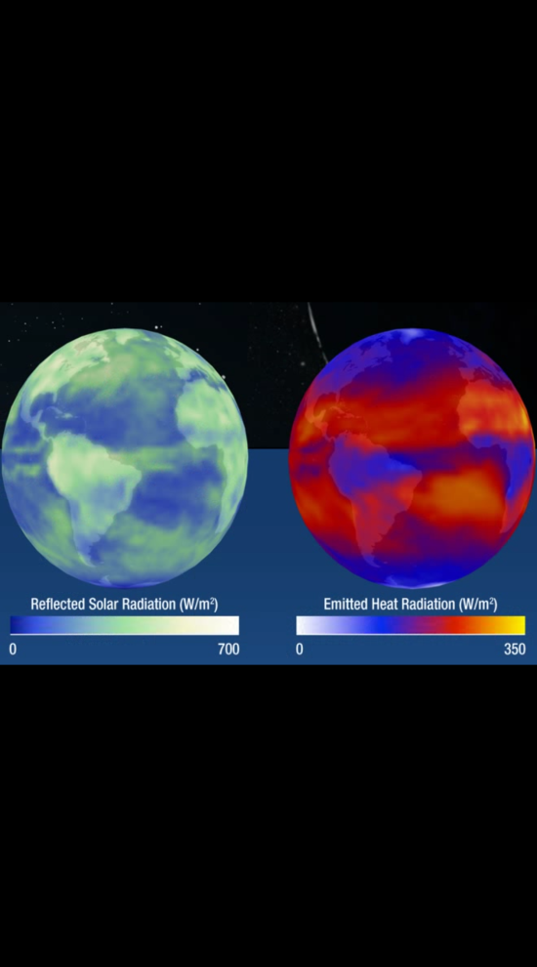
Results ….

Slide 7
Satisfied ????
We have done that using our app .
Just kidding we’ll show this live as well !!!!

Slide 8
Future Prospectus :-
Optimization for context evaluation of Article
Receive data from multiple File Format
Image based context generation
AND Improve UI :P

Slide 9
TEAM – MANIT_MANIACS
Hridyansh Sahu
Rishabh Tripathi
Prakhar Sharma
Ishaan Dwivedi

Slide 10
THE END

