Slide 1

Subject : Cognitive Computing and Modeling (E1PY215T)
Title: MindPredict AI_Technical Deep Dive
Submitted to:
Dr. Vineeta Khemchandani Ma’am
Submitted by:
Hridyesh Kr. Pandey(25SCSE2240130)

Slide 2
Mind Predict AI
Multi-Model Clinical Diagnostic Framework
A production-grade pipeline for neuro-psychiatric screening using Deep Learning and Classical Baselines.

Slide 3
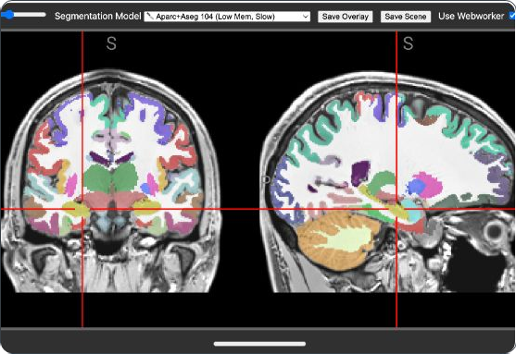
MISSION AND SCOPE
The MindPredict project automates diagnostic classification by fusing neurophysiological EEG data with behavioral psychometrics.
Multi-Modal Ingestion: Processes EEG Spectrometry and Clinical Survey Scores.
Hybrid Architecture: Simultaneously runs CNN, RNN-Attention, and PCA-Baseline models.
Production Grade: SQL auditing and real-time inference via Streamlit.

Slide 4
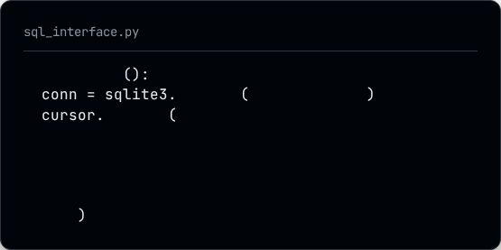
1. DATA ARCHITECTURE: SQL NODE
Persistent Clinical Audit
The init_db() function ensures every diagnostic session is
traceable.
The database stores raw EEG power bands, psychometric scores, and the Confidence Index for regulatory and research auditing.
def init_db
connect "research.db"
execute
'''CREATE TABLE logs (
patient_id INTEGER PRIMARY KEY, theta REAL, alpha REAL, beta REAL, final_diagnosis TEXT,
confidence REAL
)'''

Slide 5
Synthetic Research Dataset Matrix
EEG Metric (Theta/Alpha) | NEO-FFI Profile | Clinical (PHQ/GAD) | Diagnosis Prediction
Theta: 5.2 Hz / Alpha: 6.1 Hz | Neuroticism: High (38) | PHQ9: 19 / GAD7: 12 | Major Depressive (MDD)
Theta: 4.1 Hz / Alpha: 5.8 Hz | Neuroticism: Med (28) | PHQ9: 08 / GAD7: 15 | ADHD / Anxiety Risk
Theta: 4.5 Hz / Alpha: 8.2 Hz | Neuroticism: Low (18) | PHQ9: 02 / GAD7: 03 | Healthy Control
Theta: 6.0 Hz / Alpha: 7.0 Hz | Neuroticism: High (42) | PHQ9: 22 / GAD7: 11 | Major Depressive (MDD)

Slide 6
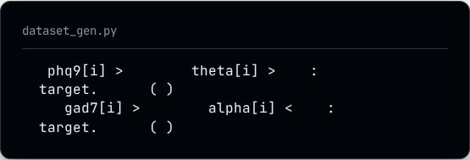
2. SYNTHETIC CLINICAL MATRIX
Matching Clinical Patterns
The generate_clinical_research_dataset() function
creates 1,500 samples mimicking real-world TDBRAIN data patterns.
Logic: MDD is labeled if PHQ-9 > 14 and Theta activity is
elevated. ADHD is labeled if GAD-7 is high and Alpha power is low.
if
14 and
append 1
5.0
# MDD Detection
elif
11 and
append 2 # ADHD Risk
6.5

Slide 7




CLINICAL DISTRIBUTION (N=1500)
Healthy Control (60%)
Major Depressive (MDD) (25%) ADHD / Anxiety Spectrum (15%)
Based on simulated patient logic from the generation engine.

Slide 8
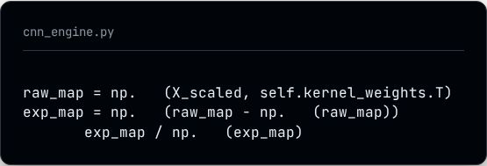
3. ENGINE ALPHA: CNN INCEPTION
Spectral Feature Mapping
The Simulated CNN Inception class emulates high-order
feature mapping used in Inception Time architectures.
It uses deterministic kernel weights to identify patterns within the EEG spectral frequency bands.
# Emulator for 1D-CNN Filters dot
exp
return sum
max

Slide 9
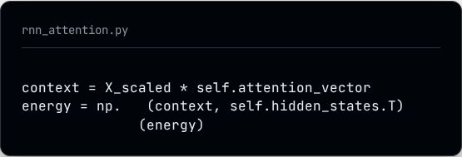
4. ENGINE BETA: RNN ATTENTION
Contextual Prioritization
The Simulated RNN Attention class mimics recurrent
states with a dynamic Alignment Vector.
It applies higher weights to PHQ-9 (Depression) and GAD-7 (Anxiety) scores, allowing the model to pay "Attention" to critical behavioral triggers.
# Attention weighted context
dot return softmax

Slide 10

5. BASELINE: LOGISTIC REGRESSION + PCA
Dimensionality Reduction
For high-speed screening, the framework reduces 7
features down to 3 Principal Components.
A balanced Logistic Regression model then performs the final logit classification on these components.

Slide 11
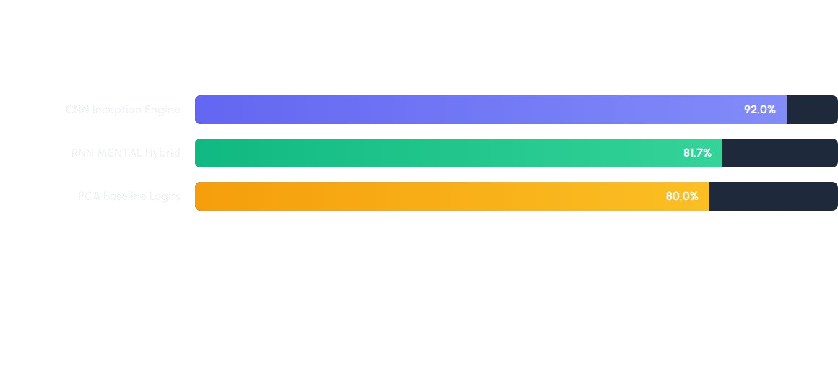
SYSTEM ACCURACY BENCHMARKS
The CNN architecture demonstrates superior sensitivity for MDD time series signatures.

Slide 12
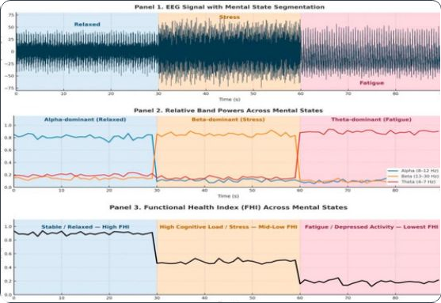
6. RESEARCH LABS INTERFACE
Streamlit Portal Navigation
Practitioners can inject raw patient vectors and select
models via three tabs:
Tab 1:
Tab 2:
Tab 3:

Slide 13
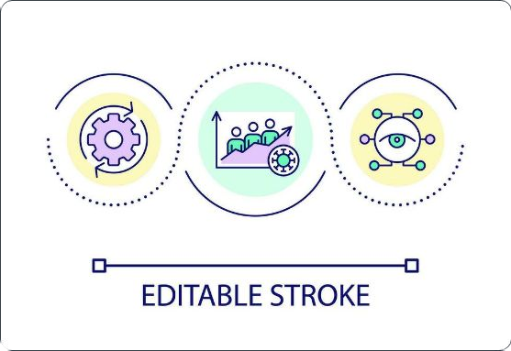


AUDIT & COMPLIANCE
Data Export Node
Clinicians can export the entire system history to
CSV for external research validation.
GDPR & Research Compliance Ready

Slide 14




IMAGE SOURCES
https://apertureneuro.org/article/123059-brainchop-providing-an-edge-ecosystem-for-deployment-of-neuroimaging-artificial-intelligence-models/attachment/243626.png
Source: apertureneuro.org
https://static.vecteezy.com/system/resources/thumbnails/075/537/349/small_2x/medical-data-analysis-with-digital-interface-and-healthcare-professional-free-video.jpg
Source: www.vecteezy.com
https://www.mdpi.com/brainsci/brainsci-16-00411/article_deploy/html/images/brainsci-16-00411-g010-550.jpg
Source: www.mdpi.com
https://static.vecteezy.com/system/resources/previews/026/392/739/non_2x/data-analysis-in-medical-industry-loop-concept-icon-clinic-software-innovations-in-healthcare-abstra ct-idea-thin-line-illustration-isolated-outline-drawing-editable-stroke-vector.jpg
Source: www.vecteezy.com

Slide 16
PERSONAL DETAIL’S
NAME:- HRIDYESH KUMAR PANDEY
PORTFOLIO:- https://hridyeshpandey4680-blip.github.io/Portfolio/
LINKEDIN:- https://www.linkedin.com/in/hridyesh-kumar-pandey-2934a4395

Slide 17
Thank You.

