Slide 1
A Hybrid, Density-based Clustering Approach for Spatial Settlement Graphs
Hripsime Sarkisyan
Advisor: Lorenz Gruber
02.07.2025
Notes:
A Hybrid, Density-based Clustering Approach for Spatial Settlement Graphs

Slide 2
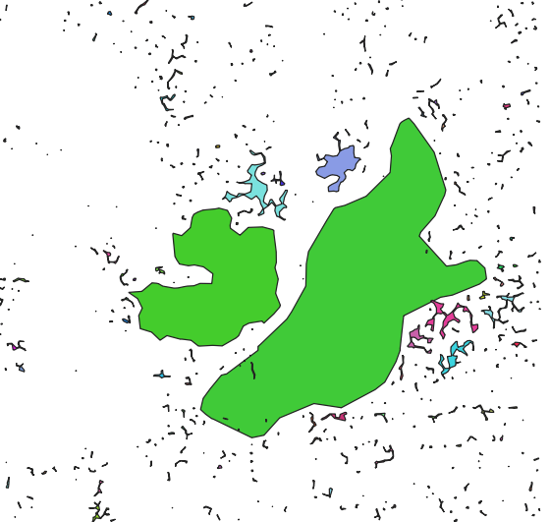
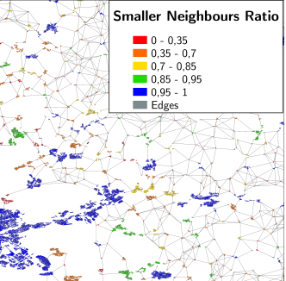
Motivation
Motivation Related Work Approach Risk Analysis Conclusion
Fig. 1: Smaller settlement areas near major clusters are not grouped together, highlighting a limitation in spatial compactness [Africapolis]
Fig. 2: Settlement chain formed within a single settlement cluster, highlighting how distant built-up areas are incorrectly grouped together [1].
Notes:
Urban areas are very important for economic growth and technological innovation problem raised with spatial compactness in 1, big green
problem with settlements forming a chain within one cluster
This can lead to misrepresentations of urban density and connectivity, and urban planning outcomes

Slide 3
Related Work
Motivation Related Work Approach Risk Analysis Conclusion
Comparison Clustering Algorithms
Algorithm | Handles noise | Compactness (chaining) | Semantic Attributes
DBSCAN | ✓ | ✓ | ✗
GMM | ✗ | ✗ | ✓
Spectral clustering | ✗ | ✓ | ✗
Graph-based (current) | ✓ | ✗ | ✗
DBSC (proposed) | ✓ | ✓ | ✓
Notes:
Density-based spatial clustering of applications with noise
Gaussian Mixture Model, probabilistic, It models the data distribution as a weighted sum of Gaussian component densities, probabilistic nature.
Spectral clustering uses the eigenvalues of a graph Laplacian to project data into a k-dimensional spectral space before applying a standard clustering algorithm, does not differentiate noise.
Current graph-based framework is less prone to compactness of the clusters
Density-based spatial clustering algorithm

Slide 4
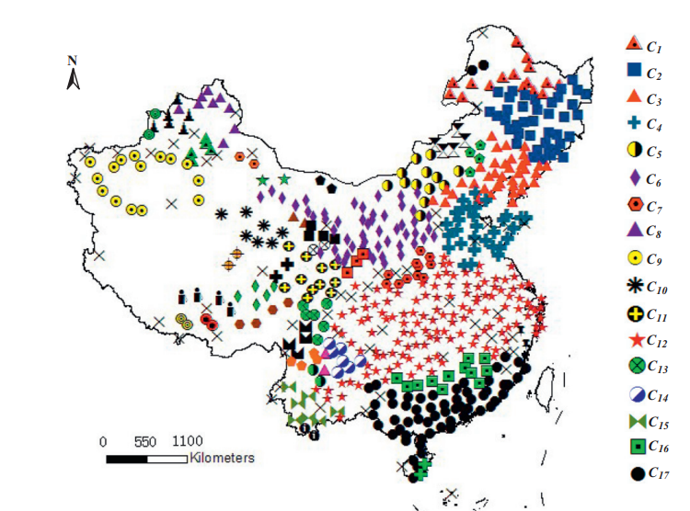
Related Work
Motivation Related Work Approach Risk Analysis Conclusion
DBSC (Density-based spatial clustering algorithm)
Step 1: Construction of spatial neighborhood using Delaunay triangulation
Step 2: Computation of density indicator and determination of an average threshold T.
Step 3: Implementation of spatial clustering.
Fig. 3. Spatial clustering result for temperature data obtained from DBSC algorithm ($T_{1}={2.2 }^{°}C$, X is noise) [2]
Notes:
Construction of spatial neighborhood
Computation of density indicator and determination of an average threshold T. A density indicator is employed to measure the ‘density’ of an object with a given threshold T.
Implementation of spatial clustering is carried out, where the algorithm iteratively adds reachable objects that meet both spatial and attribute similarity criteria until no more can be included

Slide 5
Related Work
Motivation Related Work Approach Risk Analysis Conclusion
Research questions
How can alternative clustering algorithms, such as DBSC, address the issue of settlement chains resulting from the current graph-based clustering approach?
How can the DBSC algorithm or other identified clustering techniques be effectively integrated into the existing graph-based settlement delineation framework?
What evaluation methods can be employed to objectively assess the quality of the proposed clustering algorithms?
Notes:
alternative clustering algorithms, such as DBSC
effectively integrated into the existing graph-based settlement delineation framework
What evaluation methods can be employed

Slide 6

Approach
Motivation Related Work Approach Risk Analysis Conclusion
Workflow Overview
Preprocessing
Graph Generation
Clustering
Visualization
Input Data WSF
Output
Notes:
preprocessing steps, such as filtering and polygon distance calculation
graph with the required spatial data as an input for clustering, my focus is on clustering
visualization stage is taking place using cluster attributes

Slide 7
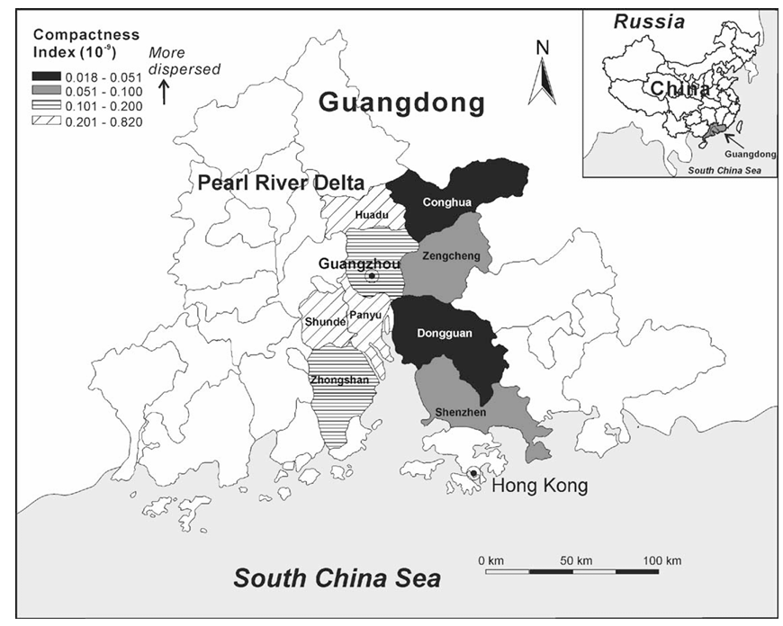
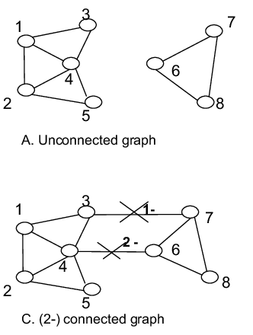
Approach
Motivation Related Work Approach Risk Analysis Conclusion
The term compactness usually relates to a spatial metric used to evaluate the shape and cohesion of a cluster [3].
In graph theory, the concept of connectivity describes the stability and integrity of a graph’s structure [4].
Optional: Expert validation (if feasible)
Fig. 3. The compactness of land development in the cities of Pearl River Delta in 1988-1997 [5]
Fig. 4. Illustration of graph connectivity [6].
Notes:
spatial term used to evaluate the shape and cohesion of a cluster
connectivity, which describes the stability and integrity of a graph’s structure
It asks minimum how many elements can be removed from the graph, so that a subgraph can be formed.

Slide 8
Risk Analysis
Motivation Related Work Approach Risk Analysis Conclusion
Resource Limitations with Computing
Utilize computing infrastructure provided by the university, including access to lab workstations or remote servers with higher processing capabilities.
Risks in Evaluation Methods
Expert surveys may be treated as an optional evaluation method in cases where an insufficient number of qualified experts can be consulted to provide objectively reliable feedback.
Notes:
large amount of geographic data computing resources can be limited - use remote servers with higher processing capabilities
In cases where an insufficient number of qualified experts can be consulted to provide objectively reliable feedback

Slide 9
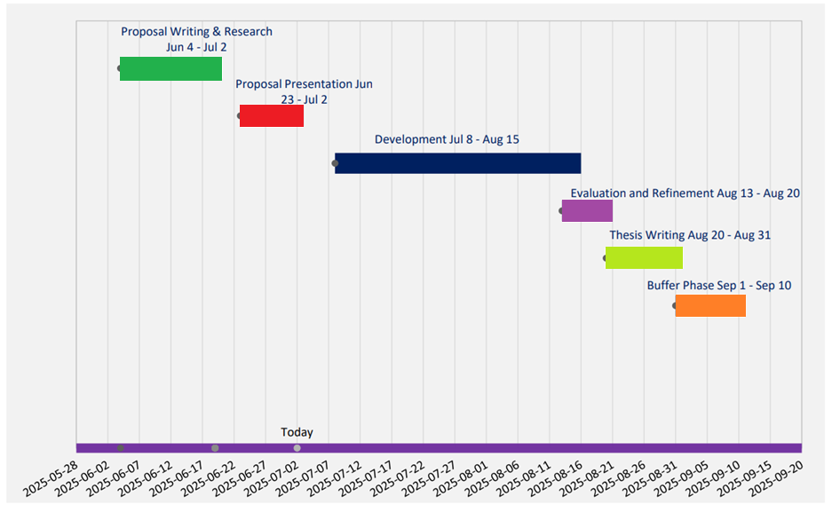
Schedule

Slide 10
Conclusion
Motivation Related Work Approach Risk Analysis Conclusion
Problem
Lack of integration of semantic attributes and poor spatial coherence.
Idea
Adapt the DBSC algorithm to include both geometric proximity and population similarity.
Benefits
Action
Produces more compact and semantically meaningful urban clusters that better reflect real-world settlement patterns.
Implement the new clustering approach within the existing geospatial pipeline, evaluate with spatial metrics.
Notes:
- lack of integration of semantic attributes and poor spatial coherence
- adapt the DBSC algorithm to include geometric proximity and population similarity
- more compact and semantically meaningful urban clusters, which can be beneficial in real-world settlement analysis and improve
- urban planning, resource allocation, and environmental management
To Implement the new clustering approach within the existing geospatial pipeline and evaluate with spatial metrics

Slide 11
Bibliography
[1] Gruber, Lorenz (2024): A Processing Framework for Graph-based Urban Area Delineation and Analysis. Julius-Maximilians-Universität Würzburg.
[2] Qiliang Liu; Min Deng; Yan Shi; Jiaqiu Wang (2012): A density-based spatial clustering algorithm considering both spatial proximity and attribute similarity. In: Computers & Geosciences 46, S. 296–309. DOI: 10.1016/j.cageo.2011.12.017.
[3] Shirowzhan, Sara; Sepasgozar, Samad M.E.; Li, Heng; Trinder, John (2018): Spatial compactness metrics and Constrained Voxel Automata development for analyzing 3D densification and applying to point clouds: A synthetic review. In: Automation in Construction 96, S. 236–249. DOI: 10.1016/j.autcon.2018.09.018.
[4] Voloshin, V. I. (2009): Introduction to Graph Theory: Nova Science Publishers. Online verfügbar unterhttps://books.google.de/books?id=Mmp7PAAACAAJ.
[5] Li, Xia; Yeh, Anthony Gar-On (2004): Analyzing spatial restructuring of land use patterns in a fast growing region using remote sensing and GIS. In: Landscape and Urban Planning 69 (4), S. 335–354. DOI: 10.1016/j.landurbplan.2003.10.033.
[6] Adamu, Murtala & Ang, Li-Minn & Seng, Kah. (2013). A formal mathematical framework for modeling and simulation of wireless sensor network environments utilizing the hill-building behavior of termites. SIMULATION. 89. 589-615. 10.1177/0037549712466706.

