Slide 1

COMPTEL
SUMMER
PRACTICE

Slide 2

FIRST IMPRESSIONS
The people
The monitors <3333333
More…

Slide 3

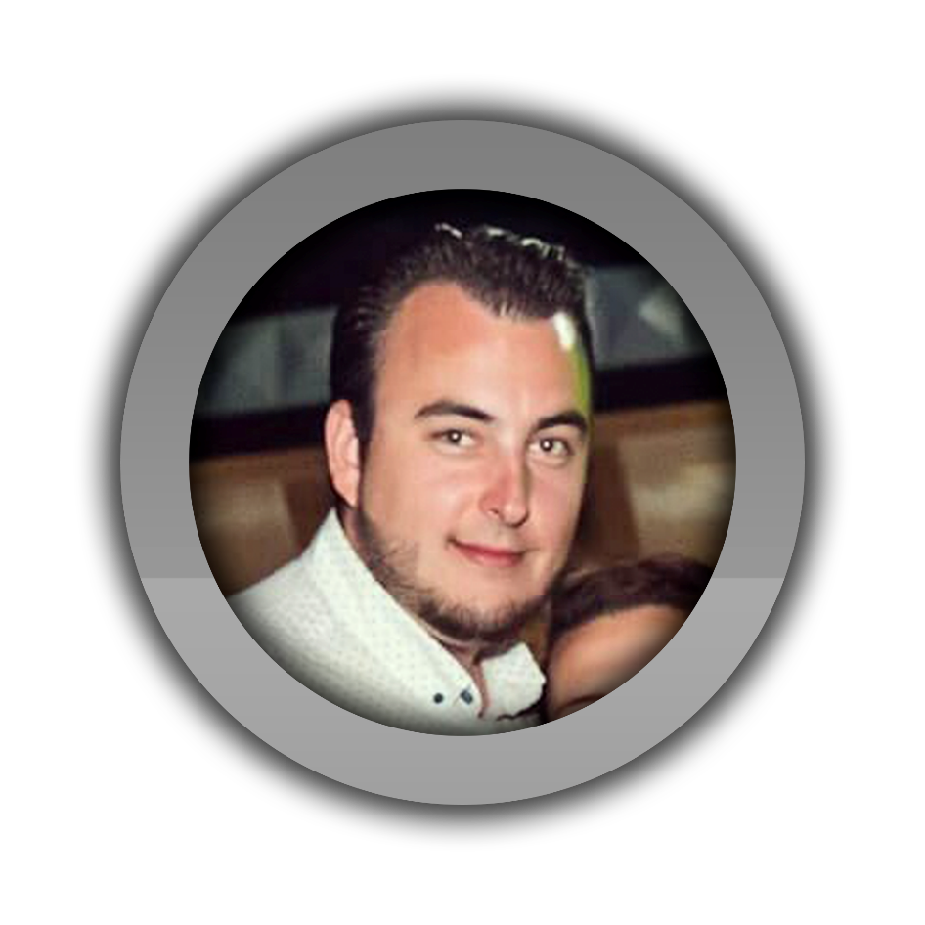

BEST PRESENTATORS

Slide 4




WHAT I LEARNED

Slide 5

WHAT I LIKE MOST

Slide 6
ATTENTION!!!
THANKS FOR YOUR ATTENTION :D

