Slide 1
Sample Presentation
A test deck from Pine & Birch
pine-and-birch.com/sample-files

Slide 2
Slide 2: How to use this file
Download the file size that matches your test case.
Upload it to the system under test, or pass its path to your parser.
Compare the extracted text, page count, and metadata with the values shown on the download page.
Keep the file in your repository as a fixture; it will not change.
Notes:
Speaker notes for slide 2. Generated by Pine & Birch.

Slide 3
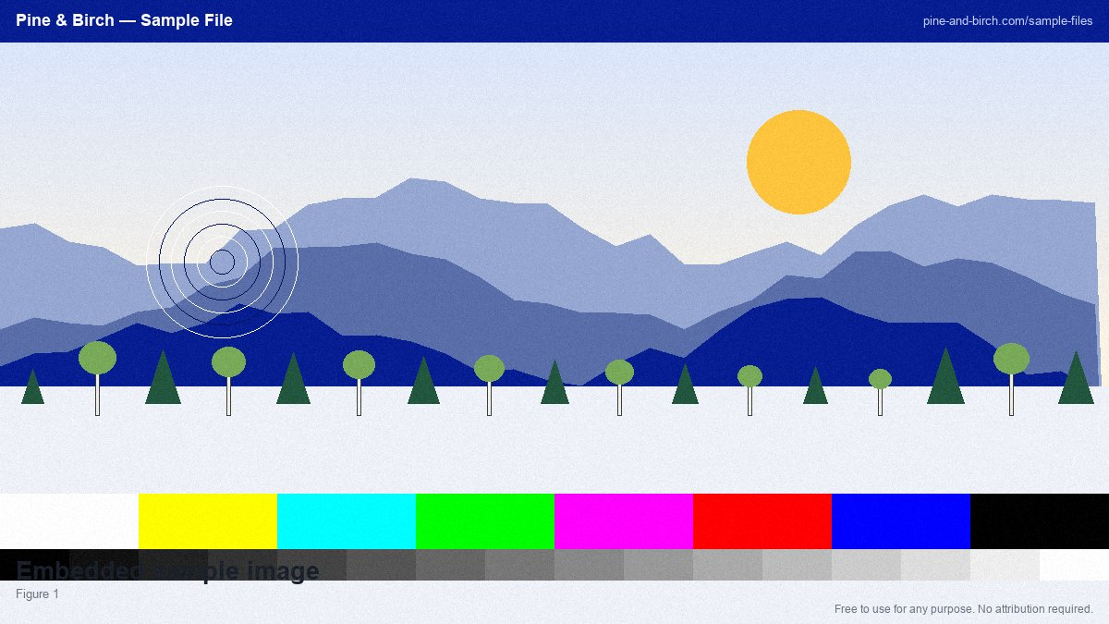
Slide 3: Figure
Notes:
Speaker notes for slide 3. Generated by Pine & Birch.

Slide 4
Slide 4: Notes
When testing a document-processing pipeline, check the details that break silently: non-ASCII characters such …
Accessibility matters even in test data. This document uses real heading styles rather than bold text, so scre…
Notes:
Speaker notes for slide 4. Generated by Pine & Birch.

Slide 5
Slide 5: Figure
Notes:
Speaker notes for slide 5. Generated by Pine & Birch.

Slide 6
Slide 6: How to use this file
Download the file size that matches your test case.
Upload it to the system under test, or pass its path to your parser.
Compare the extracted text, page count, and metadata with the values shown on the download page.
Keep the file in your repository as a fixture; it will not change.
Notes:
Speaker notes for slide 6. Generated by Pine & Birch.

Slide 7
Slide 7: Figure
Notes:
Speaker notes for slide 7. Generated by Pine & Birch.

Slide 8
Slide 8: Notes
When testing a document-processing pipeline, check the details that break silently: non-ASCII characters such …
Accessibility matters even in test data. This document uses real heading styles rather than bold text, so scre…
Notes:
Speaker notes for slide 8. Generated by Pine & Birch.

Slide 9
Slide 9: Figure
Notes:
Speaker notes for slide 9. Generated by Pine & Birch.

Slide 10
Slide 10: How to use this file
Download the file size that matches your test case.
Upload it to the system under test, or pass its path to your parser.
Compare the extracted text, page count, and metadata with the values shown on the download page.
Keep the file in your repository as a fixture; it will not change.
Notes:
Speaker notes for slide 10. Generated by Pine & Birch.

