Slide 1
Sample Presentation
A test deck from Pine & Birch
pine-and-birch.com/sample-files

Slide 2
Slide 2: How to use this file
Download the file size that matches your test case.
Upload it to the system under test, or pass its path to your parser.
Compare the extracted text, page count, and metadata with the values shown on the download page.
Keep the file in your repository as a fixture; it will not change.
Notes:
Speaker notes for slide 2. Generated by Pine & Birch.

Slide 3
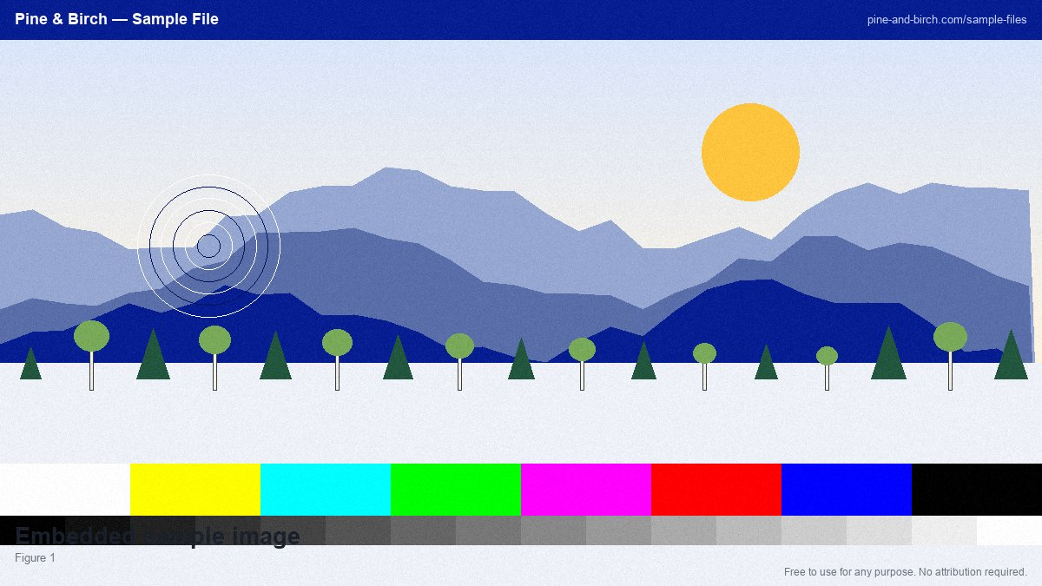
Slide 3: Figure
Notes:
Speaker notes for slide 3. Generated by Pine & Birch.

Slide 4
Slide 4: Notes
When testing a document-processing pipeline, check the details that break silently: non-ASCII characters such …
Accessibility matters even in test data. This document uses real heading styles rather than bold text, so scre…
Notes:
Speaker notes for slide 4. Generated by Pine & Birch.

Slide 5
Slide 5: Figure
Notes:
Speaker notes for slide 5. Generated by Pine & Birch.

Slide 6
Slide 6: How to use this file
Download the file size that matches your test case.
Upload it to the system under test, or pass its path to your parser.
Compare the extracted text, page count, and metadata with the values shown on the download page.
Keep the file in your repository as a fixture; it will not change.
Notes:
Speaker notes for slide 6. Generated by Pine & Birch.

Slide 7
Slide 7: Figure
Notes:
Speaker notes for slide 7. Generated by Pine & Birch.

Slide 8
Slide 8: Notes
When testing a document-processing pipeline, check the details that break silently: non-ASCII characters such …
Accessibility matters even in test data. This document uses real heading styles rather than bold text, so scre…
Notes:
Speaker notes for slide 8. Generated by Pine & Birch.

Slide 9
Slide 9: Figure
Notes:
Speaker notes for slide 9. Generated by Pine & Birch.

Slide 10
Slide 10: How to use this file
Download the file size that matches your test case.
Upload it to the system under test, or pass its path to your parser.
Compare the extracted text, page count, and metadata with the values shown on the download page.
Keep the file in your repository as a fixture; it will not change.
Notes:
Speaker notes for slide 10. Generated by Pine & Birch.

Slide 11
Slide 11: Figure
Notes:
Speaker notes for slide 11. Generated by Pine & Birch.

Slide 12
Slide 12: Notes
When testing a document-processing pipeline, check the details that break silently: non-ASCII characters such …
Accessibility matters even in test data. This document uses real heading styles rather than bold text, so scre…
Notes:
Speaker notes for slide 12. Generated by Pine & Birch.

Slide 13
Slide 13: Figure
Notes:
Speaker notes for slide 13. Generated by Pine & Birch.

Slide 14
Slide 14: How to use this file
Download the file size that matches your test case.
Upload it to the system under test, or pass its path to your parser.
Compare the extracted text, page count, and metadata with the values shown on the download page.
Keep the file in your repository as a fixture; it will not change.
Notes:
Speaker notes for slide 14. Generated by Pine & Birch.

Slide 15
Slide 15: Figure
Notes:
Speaker notes for slide 15. Generated by Pine & Birch.

Slide 16
Slide 16: Notes
When testing a document-processing pipeline, check the details that break silently: non-ASCII characters such …
Accessibility matters even in test data. This document uses real heading styles rather than bold text, so scre…
Notes:
Speaker notes for slide 16. Generated by Pine & Birch.

Slide 17
Slide 17: Figure
Notes:
Speaker notes for slide 17. Generated by Pine & Birch.

Slide 18
Slide 18: How to use this file
Download the file size that matches your test case.
Upload it to the system under test, or pass its path to your parser.
Compare the extracted text, page count, and metadata with the values shown on the download page.
Keep the file in your repository as a fixture; it will not change.
Notes:
Speaker notes for slide 18. Generated by Pine & Birch.

Slide 19
Slide 19: Figure
Notes:
Speaker notes for slide 19. Generated by Pine & Birch.

Slide 20
Slide 20: Notes
When testing a document-processing pipeline, check the details that break silently: non-ASCII characters such …
Accessibility matters even in test data. This document uses real heading styles rather than bold text, so scre…
Notes:
Speaker notes for slide 20. Generated by Pine & Birch.

Slide 21
Slide 21: Figure
Notes:
Speaker notes for slide 21. Generated by Pine & Birch.

Slide 22
Slide 22: How to use this file
Download the file size that matches your test case.
Upload it to the system under test, or pass its path to your parser.
Compare the extracted text, page count, and metadata with the values shown on the download page.
Keep the file in your repository as a fixture; it will not change.
Notes:
Speaker notes for slide 22. Generated by Pine & Birch.

Slide 23
Slide 23: Figure
Notes:
Speaker notes for slide 23. Generated by Pine & Birch.

Slide 24
Slide 24: Notes
When testing a document-processing pipeline, check the details that break silently: non-ASCII characters such …
Accessibility matters even in test data. This document uses real heading styles rather than bold text, so scre…
Notes:
Speaker notes for slide 24. Generated by Pine & Birch.

Slide 25
Slide 25: Figure
Notes:
Speaker notes for slide 25. Generated by Pine & Birch.

Slide 26
Slide 26: How to use this file
Download the file size that matches your test case.
Upload it to the system under test, or pass its path to your parser.
Compare the extracted text, page count, and metadata with the values shown on the download page.
Keep the file in your repository as a fixture; it will not change.
Notes:
Speaker notes for slide 26. Generated by Pine & Birch.

Slide 27
Slide 27: Figure
Notes:
Speaker notes for slide 27. Generated by Pine & Birch.

Slide 28
Slide 28: Notes
When testing a document-processing pipeline, check the details that break silently: non-ASCII characters such …
Accessibility matters even in test data. This document uses real heading styles rather than bold text, so scre…
Notes:
Speaker notes for slide 28. Generated by Pine & Birch.

Slide 29
Slide 29: Figure
Notes:
Speaker notes for slide 29. Generated by Pine & Birch.

Slide 30
Slide 30: How to use this file
Download the file size that matches your test case.
Upload it to the system under test, or pass its path to your parser.
Compare the extracted text, page count, and metadata with the values shown on the download page.
Keep the file in your repository as a fixture; it will not change.
Notes:
Speaker notes for slide 30. Generated by Pine & Birch.

