Slide 1

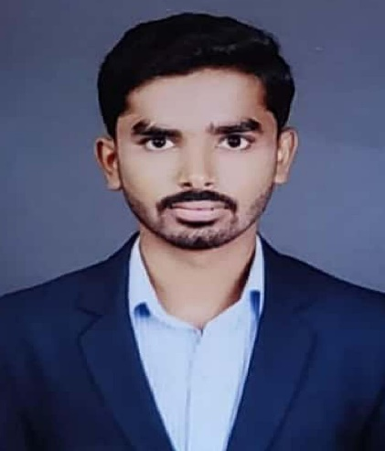


HRISHIKESH PRATAP PADALKAR
Education and certificates
Bachelor of Technology In Automobile Engineering: 2017 - 2021
Skills
Core Java
React Framework
Database
Spring Boot
Spring MVC
Node JS
Analyst/Software Engineer
Base Location: MUMBAI
Email ID:
PADALKAR.HRISHIKESH-PRATAP@CAPGEMINI.COM
Mobile No: +917083386160
Grade: A4
EMP ID-46205940
Strengths
Full Stack Developer
Good Knowledge of java programming.
Backend
Spring Boot
Spring MVC
REST-API
Database
Postgres SQL
Mongodb
Web Technologies
Achievement
Online Railway Reservation System Application
Completed end to end case study of Online Railway Reservation System Application using Spring boot and React used for user interface. It is a double-role application project i.e. Admin and User, where Admin will have the main control over the system.
Admin will be responsible for maintaining the system and also, keeping a check on the availability
of trains, and updating any details related to the reservation system. On the other hand, Users can register themselves and can do online booking of trains.
•Good Knowledge of Spring Framework
•Good in developing web pages using HTML, CSS.
•Currently learning on iTransform: Full Stack With React, Spring Boot MS & MongoDB
HTML5
CSS 3
JavaScript
Bootstrap
Full Stack developer with React and Full Stack Java Developer
Hands on experience in developing web pages
using HTML5, CSS3, REACT. Good understanding of Document Object Model (DOM) and DOM Functions.
Add-ons
GitHub
Maven
Postman
Additional Details
Excellent Communication Skills
Leadership quality
Proficient in creating Single page Web Application in
REACT with routing.
Presentation Title | Author | Date © Capgemini 2017. All rights reserved | 1

