Slide 1

SOCIAL GUARD AI: DEEPFAKE DETECTION SYSTEM
Multi-Layered Detection using EfficientNet-B0, ELA, DCT, Face Forensics & Grad-CAM
Group Members :
Abdul Taufique
BTAI-01
Altamash Tirandaz
BTAI-58
Pratik Nannajkar
BTAI-30
Hrishshikesh Nikam
BTAI-31
Department of Artificial Intelligence | Dr. D. Y. Patil Vidyapeeth, Pune

Slide 2
Problem Statement
Deepfake technology has made it nearly impossible to distinguish real images from AI-generated ones with the naked eye, creating serious threats to trust, security, and privacy.
Misinformation & Fraud
Deepfake images are used for spreading fake news, financial scams, and identity theft
Indistinguishable Fakes
Modern AI (GANs, Diffusion Models) generates faces that fool even trained experts
Single-Method Weakness
Existing tools use only one detection technique -- easily bypassed by attackers
No Explainability
Current systems provide a verdict but never explain WHY an image is flagged
Growing Threat
Deepfake generation tools are free and accessible, making the problem worse every day

Slide 3
Our Solution: Social Guard AI
A multi-layered deepfake detection platform with 4 independent analysis methods working together, providing both accurate detection and clear explanations.
1
ELA
2
DCT
3
Face Forensics
4
EfficientNet-B0
Error Level Analysis
Frequency Analysis
Biometric Analysis
Deep Learning (CNN)
Detects compression inconsistencies. Manipulated regions have different JPEG error levels than the original.
Converts image to frequency domain. AI-generated images have abnormal frequency patterns (GAN fingerprints).
Checks eye reflections, facial symmetry, boundary blending, and skin texture. AI fails at biological accuracy.
Custom-trained on 190K+ images. Learns patterns invisible to humans. 80% weight in final decision.

Slide 4
System Architecture
Data Flow Pipeline
Technology Stack
User Uploads Image (Web Frontend) | FastAPI Backend (main.py) | +---------+---------+---------+ | | | | ELA DCT Face EfficientNet Analysis Analysis Forensics B0 Model | | | | +---------+---------+---------+ | Classifier (80/20 Score Fusion) | Grad-CAM Heatmap + XAI Report | JSON Response --> Frontend Display (Verdict + Confidence + Explanation)
Backend: Python 3.10 + FastAPI + Uvicorn
Deep Learning: PyTorch + torchvision
CNN Model: EfficientNet-B0 (4M params, 15.6MB)
Image Processing: OpenCV + Pillow
Face Detection: MediaPipe (468 landmarks)
Frontend: HTML5 + CSS3 + JavaScript
Explainability: Grad-CAM (gradient-based)
Training: Transfer Learning (ImageNet)
Loss Function: CrossEntropyLoss
Optimizer: Adam (adaptive LR)
Project Structure:
backend/main.py - API endpoints
backend/analyzers/ela.py - Error Level Analysis
backend/analyzers/dct.py - Frequency Analysis
backend/analyzers/face_forensics.py
backend/analyzers/classifier.py - Fusion
backend/analyzers/model_loader.py - CNN
backend/models/efficientnet_deepfake.pth
frontend/ - Web Interface
train_model.py - Training Script

Slide 5
Layer 1: Error Level Analysis (ELA)
How ELA Works
Parameters
1. Take the uploaded image
2. Re-save it as JPEG at quality 90%
3. Compare original with re-saved version (pixel by pixel)
4. Compute the DIFFERENCE between original and re-saved
What the difference tells us:
REAL images:
Difference is UNIFORM across the entire image.
All regions have same compression history.
FAKE / MANIPULATED images:
Edited regions show DIFFERENT error levels.
Pasted face has different compression than background.
AI-GENERATED images:
Unnaturally UNIFORM noise (too perfect).
Real cameras always add natural noise variation.
JPEG Quality: 90%
Multi-quality sweep: 75%, 85%, 95%
Face vs Background differential
Noise consistency analysis
Output
ELA Score: 0-100
Max Error, Mean Error, Error Std Dev
Region Variance (face vs background)
ELA Heatmap (visual map of errors)
ELA Overlay on original image
Verdict: Clean / Moderate / Suspicious

Slide 6
Layer 2: DCT Frequency Analysis
How DCT Works
Output Metrics
DCT = Discrete Cosine Transform
(Converts pixels to frequency components)
1. Divide image into 8x8 pixel blocks
(same block size used by JPEG compression)
2. Apply DCT to each block
Think of it like a music equalizer:
Low freq = bass = smooth areas
High freq = treble = sharp edges/noise
3. Analyze the frequency distribution:
REAL photos: smooth, natural frequency decline
AI images: abnormal spikes = 'GAN fingerprints'
4. Also check for periodic artifacts:
GAN upsampling creates repeating patterns
visible only in frequency domain
DCT Score: 0-100
Low Frequency Ratio (%)
Mid Frequency Ratio (%)
High Frequency Ratio (%)
Periodic Artifact Detection (Yes/No)
AC Energy Peak Count
Spectral Map visualization
Spectral Overlay on original image
Why 8x8 blocks?
JPEG compression uses 8x8 DCT.
Edited or double-compressed images
create detectable artifacts at these
block boundaries.
Detects:
- GAN-generated images
- AI-upscaled images
- Face-swapped images
- Double-compressed images

Slide 7
Layer 3: Face Forensics (Biometric Analysis)
Uses Google MediaPipe to detect 468 facial landmarks, then checks 4 biometric properties:
1
Eye Reflections
2
Facial Symmetry
Both eyes should reflect the same light sources from the same positions. In deepfakes, reflections often don't match or are missing entirely. We compare reflection patterns between left and right eyes.
Real human faces are naturally asymmetric (no face is perfectly symmetric). AI-generated faces can be unnaturally symmetric. We measure asymmetry ratios across 468 landmark points.
3
Boundary Artifacts
4
Skin Texture / Mouth
Where the fake face is blended onto the real body (chin, hairline, ears), there are often blending artifacts and color discontinuities. We analyze edge gradients at the face boundary.
Real skin has pores and natural micro-texture. AI skin is often too smooth. Teeth rendering is especially hard for AI -- teeth may be blurred, misshapen, or have incorrect count.

Slide 8
Layer 4: EfficientNet-B0 (Deep Learning)
Model Architecture
Two-Phase Transfer Learning
Architecture: EfficientNet-B0 (Google Brain, 2019)
Pre-trained on: ImageNet-1K (1.3M general images)
Fine-tuned on: Our 190K deepfake dataset
Total Parameters: 4,010,110
Model File Size: 15.6 MB
Input Size: 224 x 224 x 3 (RGB)
Output: 2 classes (Fake=0, Real=1)
Classifier Head: Dropout(0.3) --> Linear(1280, 2)
Why EfficientNet-B0?
Model Params ImageNet Acc
VGG-16 138M 71.3%
ResNet-50 25.6M 76.1%
EfficientNet-B0 4.0M 77.1% <-- Best ratio!
6x fewer params than ResNet-50,
HIGHER accuracy. Loads in 2 seconds on CPU.
PHASE 1: HEAD TRAINING (Backbone FROZEN)
- Freeze all 4M backbone parameters
- Train ONLY the classifier head (2,562 params)
- Learning Rate: 1e-3 (high)
- Epochs: 2
- Result: 75.28% validation accuracy
PHASE 2: FINE-TUNING (Last 3 blocks UNFROZEN)
- Unfreeze last 3 convolutional blocks
- Now 3,158,302 trainable parameters
- Learning Rate: 1e-5 (very low -- careful!)
- ReduceLROnPlateau scheduler
- Epochs: 3 more
- Result: 83.04% validation accuracy
Analogy:
Phase 1 = Medical student learns anatomy
Phase 2 = Practices on real patient X-rays

Slide 9
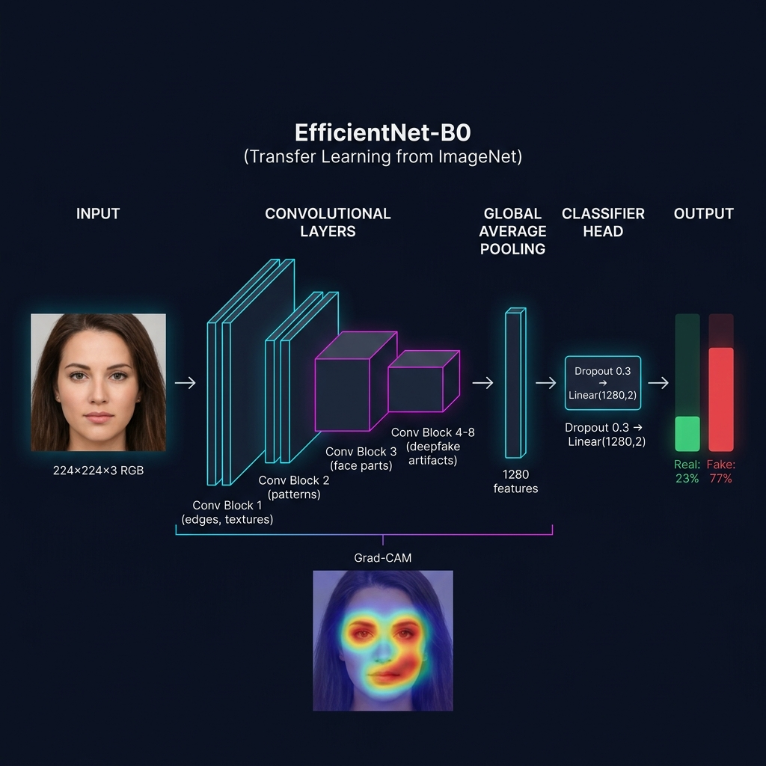
How CNN Works in This Project
Step-by-Step: Image to Prediction
STEP 1: PREPROCESSING
Image --> Resize 256px --> CenterCrop 224px
Convert to tensor --> Normalize (ImageNet stats)
STEP 2: CONVOLUTIONAL FEATURE EXTRACTION
8 MBConv blocks extract features:
Block 1-2: Low-level (edges, color boundaries)
Block 3-4: Mid-level (face parts, textures)
Block 5-8: High-level (deepfake artifacts)
STEP 3: GLOBAL AVERAGE POOLING
7x7x1280 feature maps --> 1x1280 vector
(summarizes entire image into 1280 numbers)
STEP 4: CLASSIFICATION HEAD
Dropout(0.3) --> Linear(1280, 2)
STEP 5: SOFTMAX + DECISION
Convert to probabilities (Fake%, Real%)
If fake_prob > 50% --> FAKE, else --> REAL
What Each Layer 'Sees'
Layer 1-2: Edges, corners, simple textures (from ImageNet)
Layer 3-4: Face boundaries, skin patches, eye regions
Layer 5-6: Blending artifacts, unnatural transitions
Layer 7-8: GAN fingerprints, deepfake features (from our dataset)

Slide 10
Training Results & Accuracy Metrics
Dataset: 190,335 Images
Epoch-by-Epoch Training Log
Train: 140,002 images (70K Real + 70K Fake)
Validation: 39,428 images (19.7K + 19.7K)
Test: 10,905 images (5.4K + 5.5K)
Balance: ~50:50 (Real : Fake)
Source: Face swaps + DeepFaceLab + AI-generated
Phase Epoch Train Loss Val Acc Notes
P1 1 0.5559 75.28% Initial head
P1 2 0.4887 71.04%
P2 3 0.4667 78.88% Fine-tuning starts
P2 4 0.3964 81.44% Improving
P2 5 0.3534 83.04% BEST MODEL SAVED
Accuracy Metrics
Classification Report
Data Augmentation
Best Val Accuracy: 83.04%
Test Accuracy: 76.64%
Test Loss: 0.4714
Weighted F1 Score: 76.64%
Loss Reduction:
0.5559 --> 0.3534 (36.4% drop)
Accuracy Gain:
70.20% --> 83.04% (+12.84%)
Precision Recall F1-Score
Fake: 0.7638 0.7762 0.7700
Real: 0.7692 0.7565 0.7628
Confusion Matrix (10,905 test):
Pred Fake Pred Real
Actually Fake: 4,263 1,229
Actually Real: 1,318 4,095
RandomResizedCrop (224px)
RandomHorizontalFlip (p=0.5)
RandomRotation (+/-15 deg)
ColorJitter (brightness,
contrast, saturation, hue)
RandomGrayscale (p=0.05)
ImageNet Normalization
Optimizer: Adam
Loss: CrossEntropyLoss
Scheduler: ReduceLROnPlateau

Slide 11
Explainability: Grad-CAM (XAI)
Gradient-weighted Class Activation Mapping
Why XAI Matters
Answers: 'WHY did the model think this image is fake/real?'
Without XAI:
Model is a BLACK BOX
Says 'FAKE' but gives no reason
Users can't trust or verify
With Grad-CAM:
Model is TRANSPARENT
Shows exactly which pixels mattered
Users can verify the decision
Builds trust and accountability
Real Code (model_loader.py):
target_layer = model.features[-1]
Uses register_forward_hook()
and register_full_backward_hook()
for TRUE gradient computation
Our Implementation:
Not an approximation --
Real gradients from real backprop
Target: last conv block of EfficientNet
How Grad-CAM works (5 steps):
1. FORWARD PASS
Feed image through EfficientNet, get prediction
2. BACKWARD PASS
Compute gradients of the 'fake' class score
with respect to last convolutional layer
3. WEIGHT FEATURE MAPS
Each channel gets weight = avg of its gradients
4. COMBINE
Weighted sum of all feature maps --> Apply ReLU
5. VISUALIZE
Resize to image size --> Overlay as colored heatmap
RED = model focused here (suspicious)
BLUE = model ignored (normal)

Slide 12
Score Fusion: Final Decision Logic
Final Score = 80% x EfficientNet Model + 20% x Forensic Heuristics
Where Forensic Heuristics = weighted average of ELA + DCT + Face Forensics scores
Score >= 50
FAKE
Image classified as manipulated or AI-generated
Score 35-50
SUSPICIOUS
Evidence is inconclusive, needs manual review
Score 20-35
LIKELY REAL
Minor anomalies found, probably authentic
Score < 20
REAL
All 4 layers confirm authentic photograph
Why 80/20? The trained CNN leads, but physics-based heuristics (ELA, DCT) provide a safety net for unseen deepfake types.

Slide 13
Live Demo & How to Run
Steps to Run the Project
What the User Sees
Step 1: Install Python dependencies
pip install -r backend/requirements.txt
Step 2: (One-time) Train the model
python train_model.py --max-samples 5000
(Creates efficientnet_deepfake.pth)
Step 3: Start the API server
uvicorn backend.main:app --reload
Step 4: Open browser
http://localhost:8000
Step 5: Upload any image
--> Real photo --> Should say REAL
--> AI image --> Should say FAKE
All analysis completes in < 5 seconds on CPU
1. Premium dark-themed web interface
2. Drag & drop image upload
3. Real-time loading animation
(shows each analysis step)
4. Overall Verdict with confidence ring
REAL / SUSPICIOUS / FAKE
5. AI Explanation panel (NEW):
- Per-layer score breakdown
- FLAGGED / PASS badges per layer
- Human-readable explanations
- Score fusion formula shown
6. 4 Analysis tabs:
- Grad-CAM heatmap overlay
- ELA heatmap + overlay
- DCT spectral map
- Face Forensics biometric checks
7. All visuals downloadable

Slide 14
Limitations & Future Scope
Current Limitations
Future Improvements
1. CPU-only training is slow
Used 5K subset; full 140K needs GPU (10+ hours)
2. Static images only
No video deepfake detection yet
3. Dataset bias
New deepfake techniques not in training data
may be missed
4. Adversarial attacks
A determined attacker could craft images
specifically designed to fool the model
5. Face-dependent forensics
Layer 3 only works when a face is detected
1. Full dataset training (140K images)
Expected: 90%+ accuracy
2. Video deepfake detection
Frame-by-frame temporal consistency
3. Deeper models (EfficientNet-B3/B4)
Higher capacity for better accuracy
4. Adversarial training
Make model robust against attacks
5. Real-time browser extension
Detect deepfakes while browsing web
6. Audio deepfake detection
Voice cloning detection for video calls

Slide 15
Thank You!
Social Guard AI -- Multi-Layered Deepfake Detection with Explainable AI
Questions?
Abdul Taufique | Altamash Tirandaz | Pratik Nannajkar | Hrishshikesh Nikam
Department of Artificial Intelligence | Dr. D. Y. Patil Vidyapeeth, Pune

