Slide 1
Spanning Tree

Slide 2
Spanning tree
A spanning tree is a sub-graph of an undirected connected graph, which includes all the vertices of the graph with a minimum possible number of edges.
The edges may or may not have weights assigned to them.

Slide 3
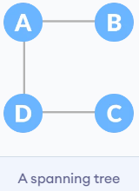
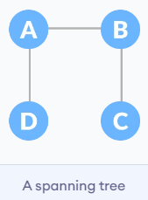
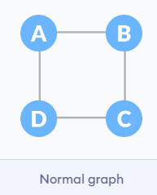
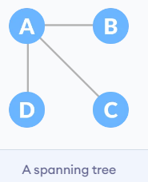
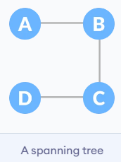
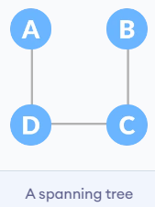
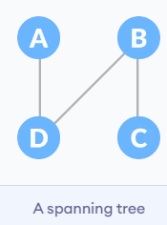
Example of a Spanning Tree

Slide 4
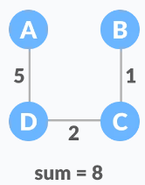
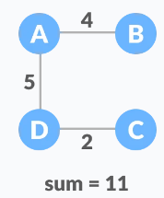
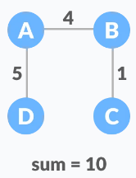
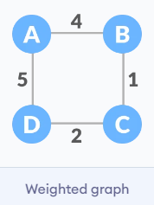
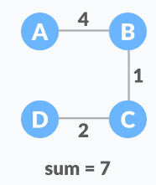
Minimum Spanning Tree
A minimum spanning tree is a spanning tree in which the sum of the weight of the edges is as minimum as possible.

Slide 5
Minimum Spanning Tree
The minimum spanning tree from a graph is found using the following algorithms:
Prim's Algorithm
Kruskal's Algorithm

Slide 6
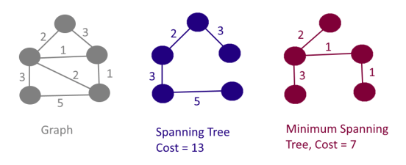
Kruskal's algorithm
Kruskal's algorithm is a minimum spanning tree algorithm that takes a graph as input and finds the subset of the edges of that graph which
form a tree that includes every vertex
has the minimum sum of weights among all the trees that can be formed from the graph

Slide 7
Kruskal's algorithm
We start from the edges with the lowest weight and keep adding edges until we reach our goal.
The steps for implementing Kruskal's algorithm are as follows:
Sort all the edges from low weight to high
Take the edge with the lowest weight and add it to the spanning tree. If adding the edge created a cycle, then reject this edge.
Keep adding edges until we reach all vertices.

Slide 8
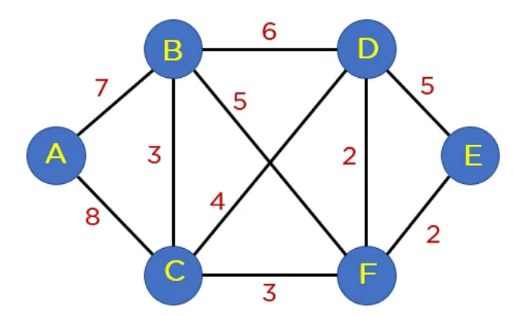
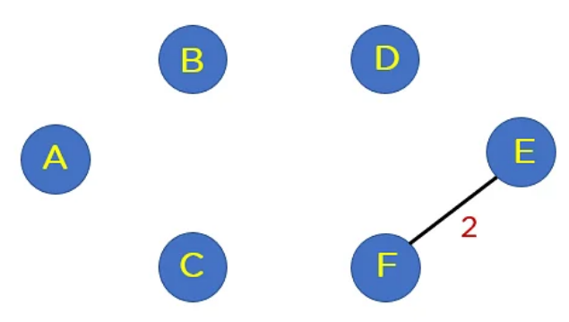
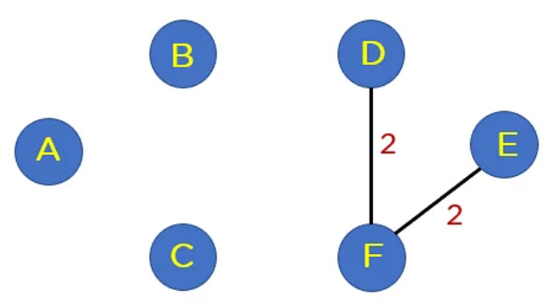
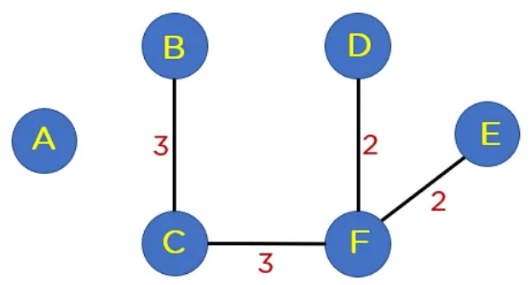
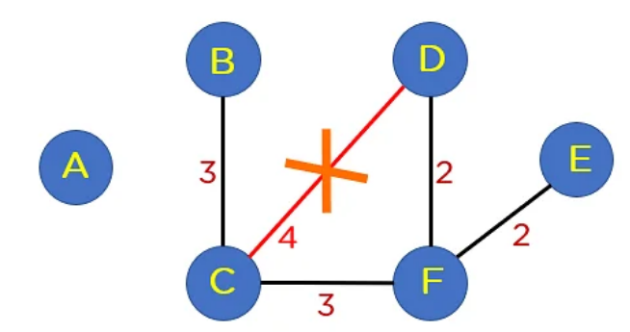
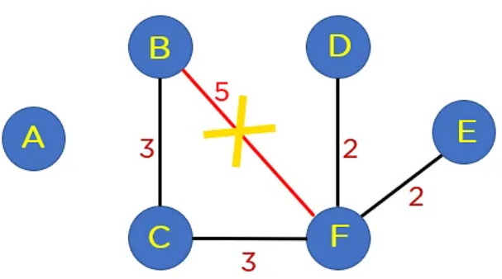
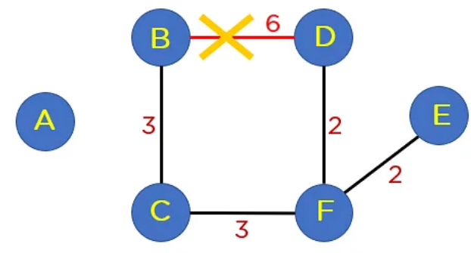
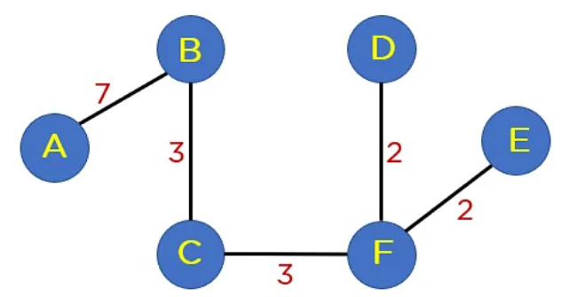

Slide 9
Prim's algorithm
We start from one vertex and keep adding edges with the lowest weight until we reach our goal.
The steps for implementing Prim's algorithm are as follows:
Initialize the minimum spanning tree with a vertex chosen at random.
Find all the edges that connect the tree to new vertices, find the minimum and add it to the tree
Keep repeating step 2 until we get a minimum spanning tree

