Slide 1
Complexity
Shrinivas Dudhani

Slide 2

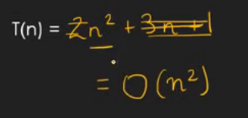
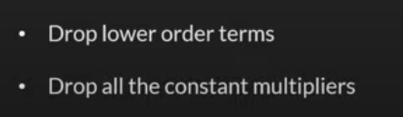

Slide 3
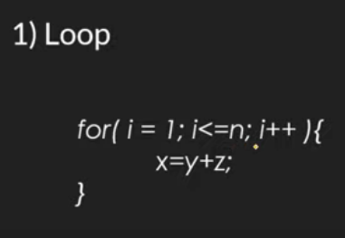
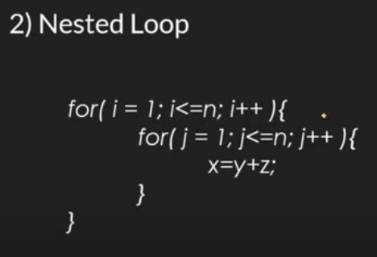
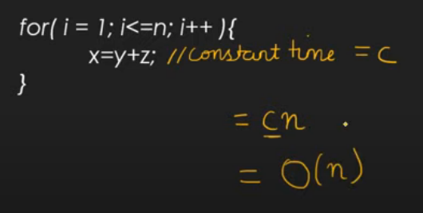
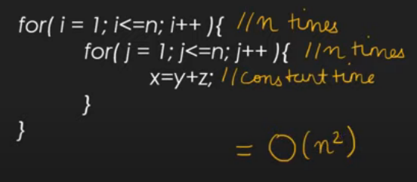

Slide 4
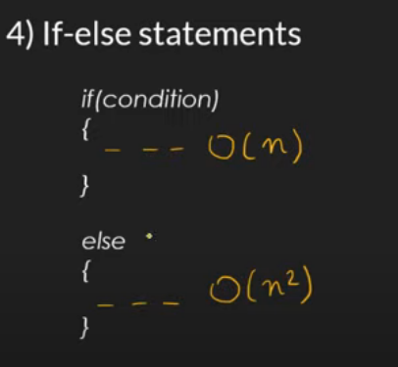
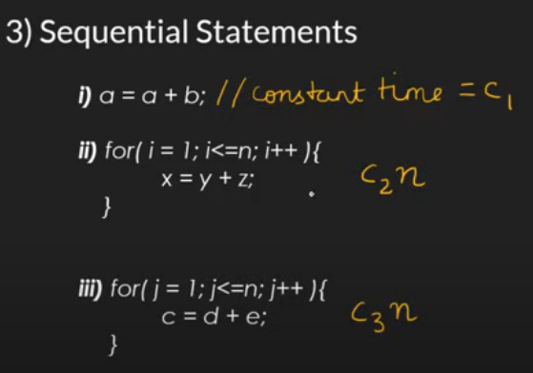
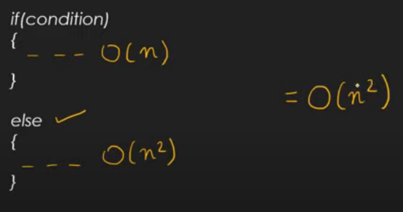
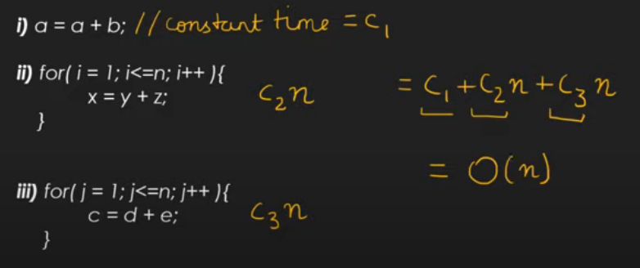

Slide 5
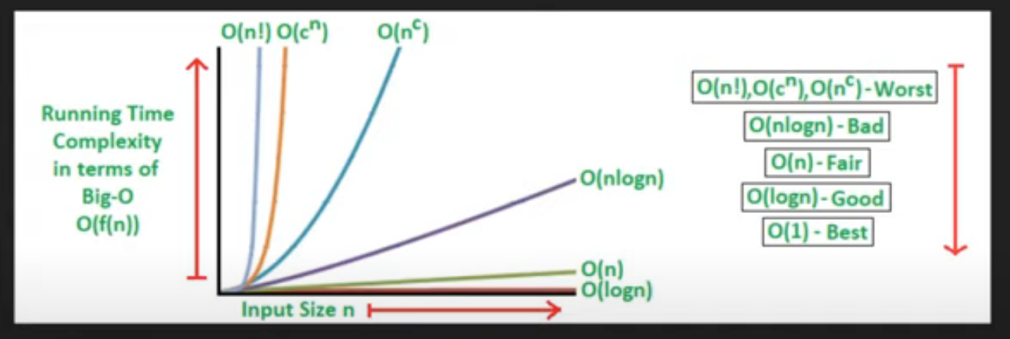

Slide 6

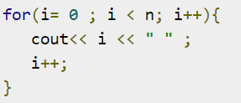


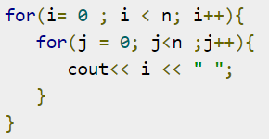
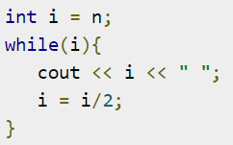
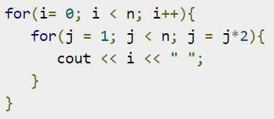



Slide 7
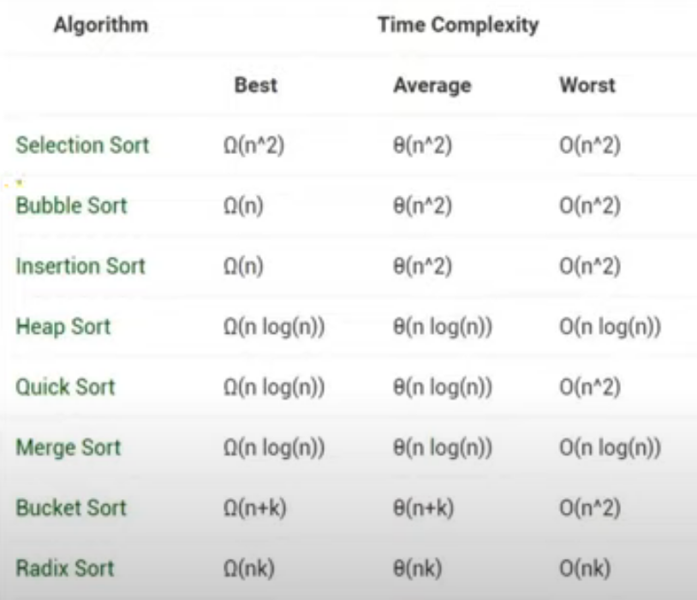

Slide 8



function(int n)
{
if (n==1)
return;
for (int i=1; i<=n; i++)
{
for (int j=1; j<=n; j++)
{
printf("*");
break;
}
}
}
int a = 0;
for (i = 0; i < N; i++) {
for (j = N; j > i; j--) {
a = a + i + j;
}
}
int i, j, k = 0;
for (i = n / 2; i <= n; i++) {
for (j = 2; j <= n; j = j * 2) {
k = k + n / 2;
}
}
static void function(int n)
{
int count = 0;
for (int i = n / 2; i <= n; i++)
for (int j = 1; j <= n; j = 2 * j)
for (int k = 1; k <= n; k = k * 2)
count++;
}
int a = 0, i = N;
while (i > 0) {
a += i;
i /= 2;
}

Slide 9
Algorithm classification
Algorithms that use a similar problem-solving approach can be grouped together
This classification scheme is neither exhaustive nor disjoint
The purpose is not to be able to classify an algorithm as one type or another, but to highlight the various ways in which a problem can be attacked

Slide 10
A short list of categories
Algorithm types we will consider include:
Simple recursive algorithms
Backtracking algorithms
Divide and conquer algorithms
Dynamic programming algorithms
Greedy algorithms
Branch and bound algorithms
Brute force algorithms
Randomized algorithms

Slide 11
Simple recursive algorithms I
A simple recursive algorithm:
Solves the base cases directly
Recurs with a simpler subproblem
Does some extra work to convert the solution to the simpler subproblem into a solution to the given problem

Slide 12
Example recursive algorithms
To count the number of elements in a list:
If the list is empty, return zero; otherwise,
Step past the first element, and count the remaining elements in the list
Add one to the result
To test if a value occurs in a list:
If the list is empty, return false; otherwise,
If the first thing in the list is the given value, return true; otherwise
Step past the first element, and test whether the value occurs in the remainder of the list

Slide 13
Backtracking algorithms
Backtracking algorithms are based on a depth-first recursive search
A backtracking algorithm:
Tests to see if a solution has been found, and if so, returns it; otherwise
For each choice that can be made at this point,
Make that choice
Recur
If the recursion returns a solution, return it
If no choices remain, return failure

Slide 14
Divide and Conquer
A divide and conquer algorithm consists of two parts:
Divide the problem into smaller subproblems of the same type, and solve these subproblems recursively
Combine the solutions to the subproblems into a solution to the original problem
Traditionally, an algorithm is only called divide and conquer if it contains two or more recursive calls
Notes:
2

Slide 15
Examples
Quicksort:
Partition the array into two parts, and quicksort each of the parts
No additional work is required to combine the two sorted parts
Mergesort:
Cut the array in half, and mergesort each half
Combine the two sorted arrays into a single sorted array by merging them
Notes:
3

Slide 16
Dynamic programming algorithms
A dynamic programming algorithm remembers past results and uses them to find new results
Dynamic programming is generally used for optimization problems
Multiple solutions exist, need to find the “best” one
Requires “optimal substructure” and “overlapping subproblems”
Optimal substructure: Optimal solution contains optimal solutions to subproblems
Overlapping subproblems: Solutions to subproblems can be stored and reused in a bottom-up fashion
This differs from Divide and Conquer, where subproblems generally need not overlap

Slide 17
Fibonacci numbers again
To find the n^{th} Fibonacci number:
If n is zero or one, return one; otherwise,
Compute, or look up in a table, fibonacci(n-1) and fibonacci(n-2)
Find the sum of these two numbers
Store the result in a table and return it
Since finding the n^{th} Fibonacci number involves finding all smaller Fibonacci numbers, the second recursive call has little work to do
The table may be preserved and used again later

Slide 18
Greedy algorithms
An optimization problem is one in which you want to find, not just a solution, but the best solution
A “greedy algorithm” sometimes works well for optimization problems
A greedy algorithm works in phases: At each phase:
You take the best you can get right now, without regard for future consequences
You hope that by choosing a local optimum at each step, you will end up at a global optimum
Notes:
2

Slide 19
Example: Counting money
Suppose you want to count out a certain amount of money, using the fewest possible bills and coins
A greedy algorithm would do this would be: At each step, take the largest possible bill or coin that does not overshoot
Example: To make $6.39, you can choose:
a $5 bill
a $1 bill, to make $6
a 25¢ coin, to make $6.25
A 10¢ coin, to make $6.35
four 1¢ coins, to make $6.39
For US money, the greedy algorithm always gives the optimum solution
Notes:
3

Slide 20
Brute force algorithm
A brute force algorithm simply tries all possibilities until a satisfactory solution is found
Such an algorithm can be:
Optimizing: Find the best solution. This may require finding all solutions, or if a value for the best solution is known, it may stop when any best solution is found
Example: Finding the best path for a travelling salesman
Satisficing: Stop as soon as a solution is found that is good enough
Example: Finding a travelling salesman path that is within 10% of optimal

Slide 21
Randomized algorithms
A randomized algorithm uses a random number at least once during the computation to make a decision
Example: In Quicksort, using a random number to choose a pivot
Example: Trying to factor a large prime by choosing random numbers as possible divisors

