Slide 1
Heapsort

Slide 2
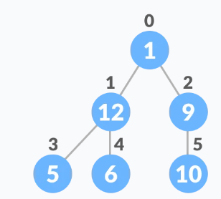
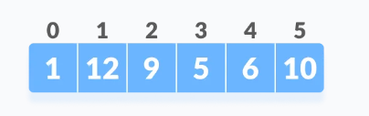
Relationship between Array Indexes and Tree Elements
A complete binary tree has an interesting property that we can use to find the children and parents of any node.
If the index of any element in the array is i
the element in the index 2i+1 will become the left child
the element in the index 2i+2 will become the right child
Also, the parent of any element at index i is given by the lower bound of (i-1)/2.

Slide 3
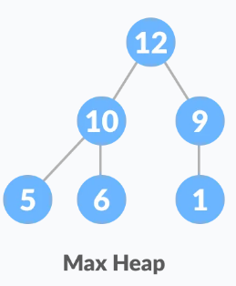
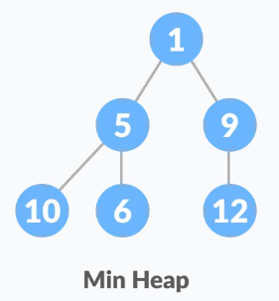
Heap Data Structure
Heap is a special tree-based data structure
A binary tree is said to follow a heap data structure if
it is a complete binary tree
All nodes in the tree follow the property that
They are greater than their children : Max-Heap
Or all nodes are smaller than their children : Min-Heap

Slide 4
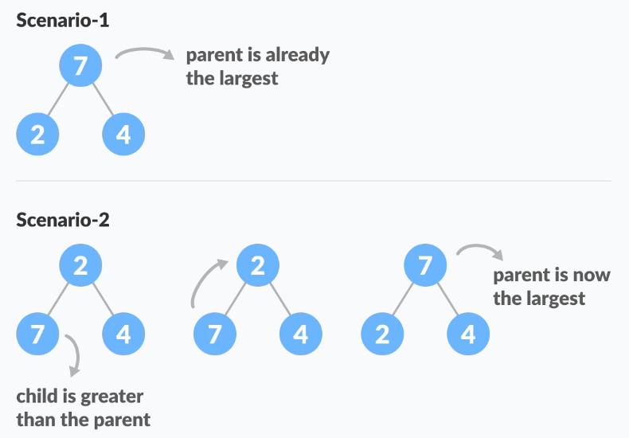
What is Heapify
Heapify is the process of creating a heap data structure from a binary tree.

Slide 5
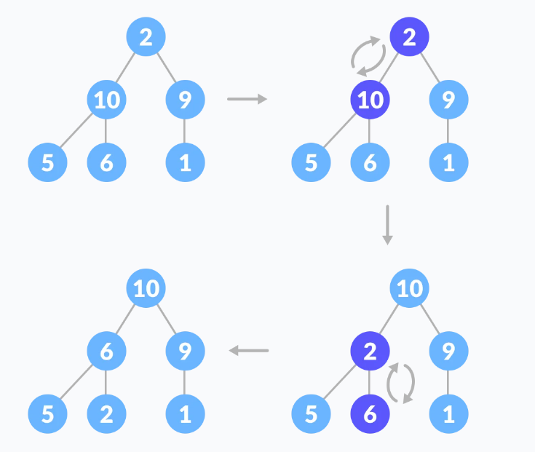

Slide 6
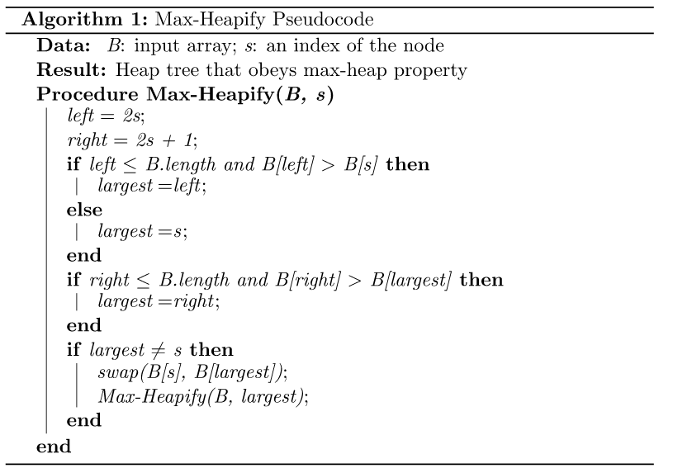
Max-Heapify Operation

Slide 7

Building max-heap
To build a max-heap from any tree, we can thus start heapifying each sub-tree from the bottom up and end up to the root element.
Start our algorithm with a node that is at the lowest level of the tree and has children node (n/2 - 1)
Continue this process and make sure all the subtrees are following the max-heap property

Slide 8
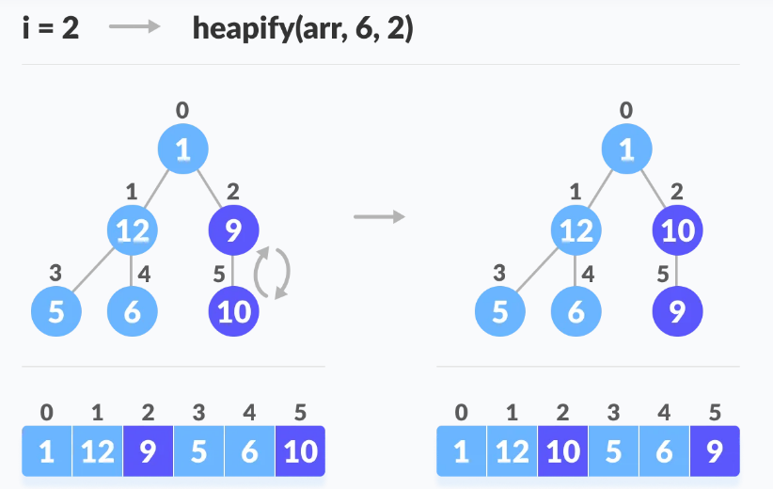
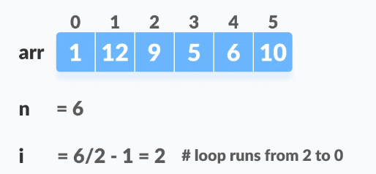
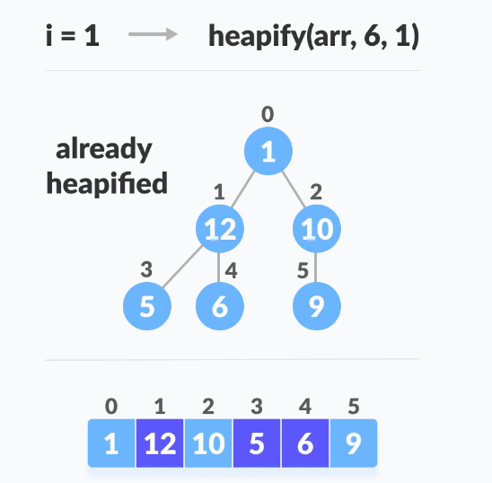
Example

Slide 9
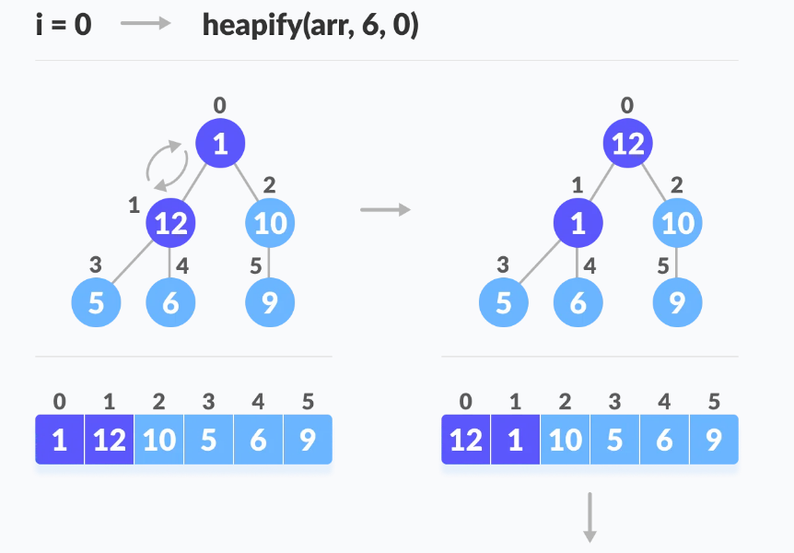
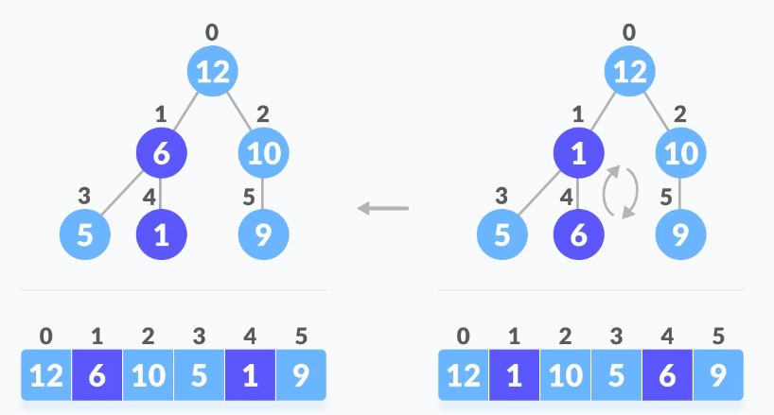

Slide 10




Heap Sort
Since the tree satisfies Max-Heap property, then the largest item is stored at the root node.
Swap: the root element and the last array element
Remove: Reduce the size of the heap by 1.
Heapify: Heapify the root element again so that we have the highest element at root.

Slide 11
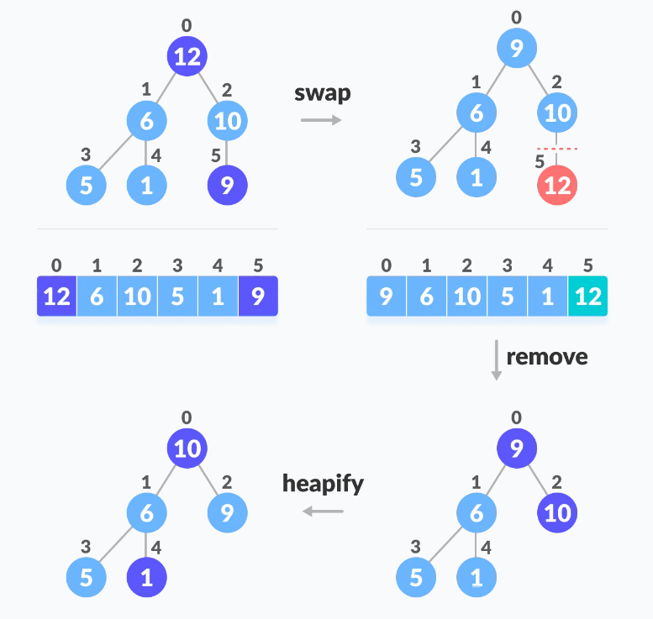
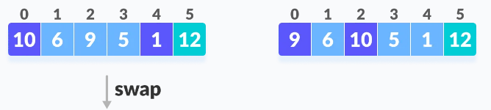

Slide 12
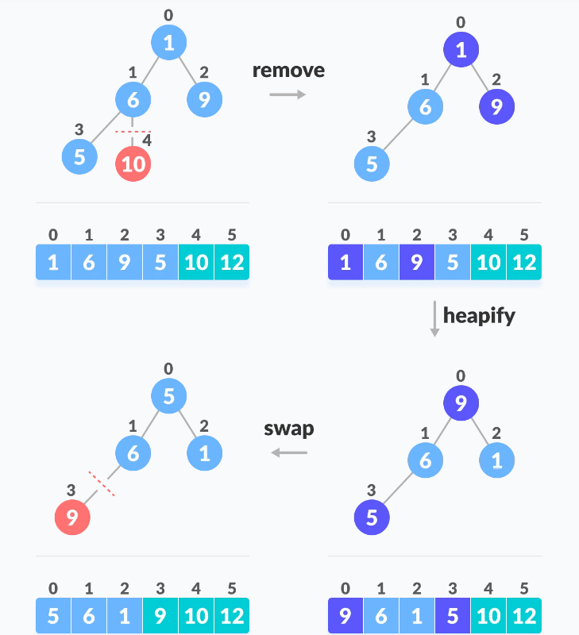

Slide 13
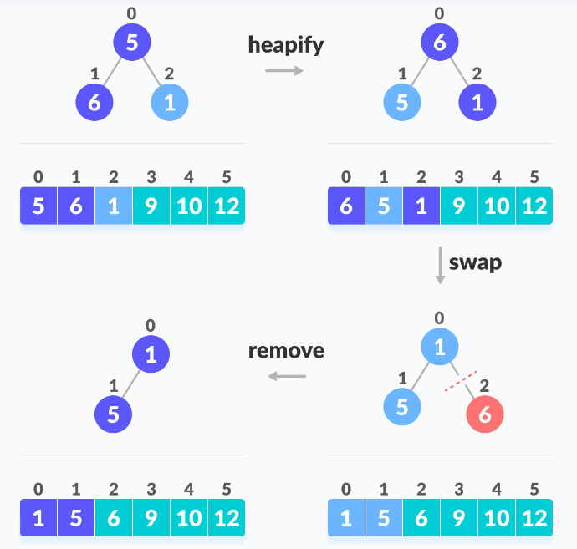

Slide 14
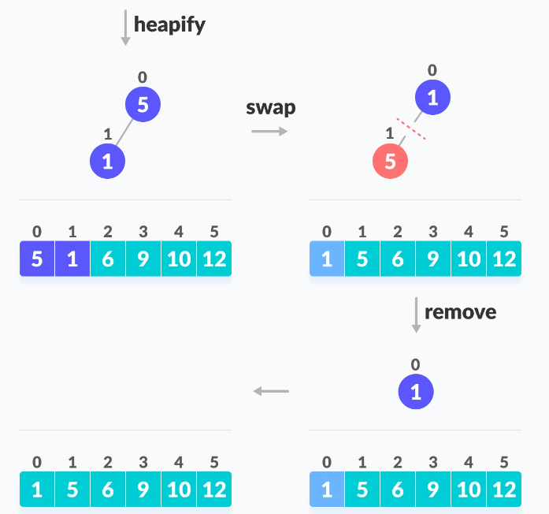

Slide 15
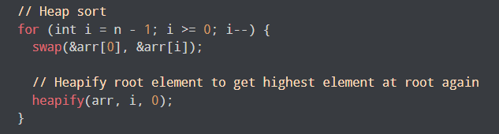
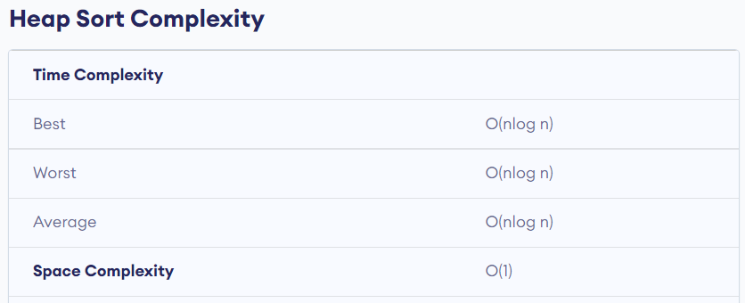

Slide 16
void heapify(int arr[], int n, int i) {
// Find largest among root, left child and right child
int largest = i;
int left = 2 * i + 1;
int right = 2 * i + 2;
if (left < n && arr[left] > arr[largest])
largest = left;
if (right < n && arr[right] > arr[largest])
largest = right;
// Swap and continue heapifying if root is not largest
if (largest != i) {
swap(&arr[i], &arr[largest]);
heapify(arr, n, largest);
}
}

