Slide 1


BIG DATA
RISK MANAGEMENT: AZ NATIONAL TRUCKING
By:
Rishika R, Jahnani N S, Hrishikesh H, Nitisha V, Thejeswari D

Slide 2
Overview and Objective
Overview
Az National Trucking specializes in long haul trucking services in North America
ANT drivers must be compliant with the company’s rules and regulations in order to mitigate insurance risks associated with risky driving
Objective:
Help ANT recognize patterns with risky events and risk factor to help mitigate risk
Notes:
T
**Overview:**
- The overarching goal is to enhance safety by tackling the issue of large truck accidents.
- To achieve this goal, the plan is to employ advanced methodologies for a comprehensive analysis of truck fleet data.
**Objectives:**
1. **Employ HDP Tools:** The plan includes the use of High-Definition Positioning (HDP) tools for processing and analyzing truck fleet data. This likely involves using precise location tracking to gather detailed information on truck movements.
2. **Analyze Truck Movements:** By examining the data on truck movements, the goal is to develop improved safety measures within the fleet. This can help in understanding patterns that may contribute to accidents and in designing interventions.
3. **Integrate Geographic Data:** The objective is to merge geographic information with specific details about the truck fleet to inform decision-making. This integration is crucial for spatial analysis that can reveal location-based risk factors.
**Details:**
- The plan involves identifying high-risk commercial truck drivers across the nation, which could mean drivers with histories of accidents or violations.
- It seeks to address common questions in the trucking industry, such as identifying high-risk trucks based on location and time, possibly to predict and prevent future incidents.
- The dataset mentioned includes an array of information such as geographic details (routes, locations of events), vehicle specifics (make, model, condition), mileage, fuel usage, and risk indicators. These indicators are probably derived from tracking technology equipped in trucks, which may include telematics devices that monitor vehicle health, driving patterns, and other important metrics.
In summary, this presentation slide outlines a strategic approach to improve road safety by analyzing extensive data on truck fleets, which includes the application of technology for tracking and analytics, focusing on risk management, and making informed decisions based on a combination of geographic and fleet data.

Slide 3








Project Workflow
2
Moving the data files into HDFS and Loading data and Creating tables in HIVE
4
Create visualizations in tableau
1
Download the dataset and Load the files in cloudera server
3
Connection establishment and data modelling in tableau
*Populated risk factor using PIG*
5
Predictions and insights in Tableau and R

Slide 4
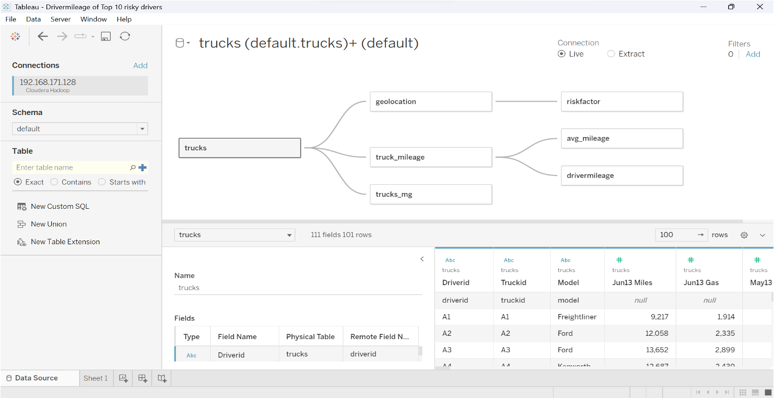
Data Schema in Tableau

Slide 5
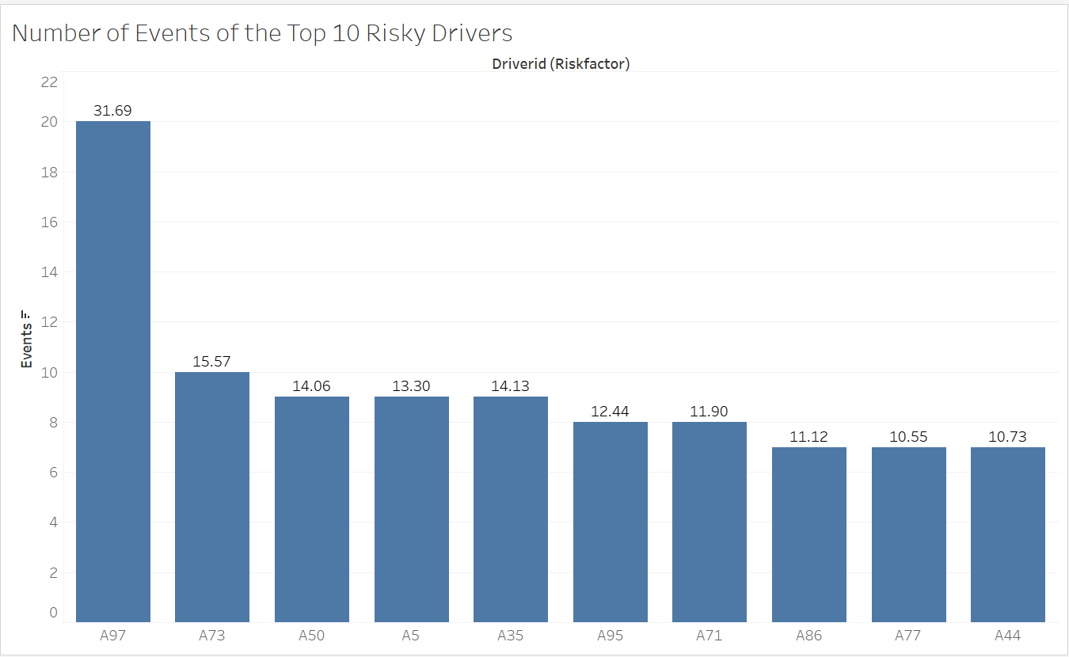
Number of Events of the Top 10 Riskiest Drivers
By analyzing the number of events, we could determine the riskiest driver is A97, with close to 20 events.
How many events did the riskiest drivers have?

Slide 6
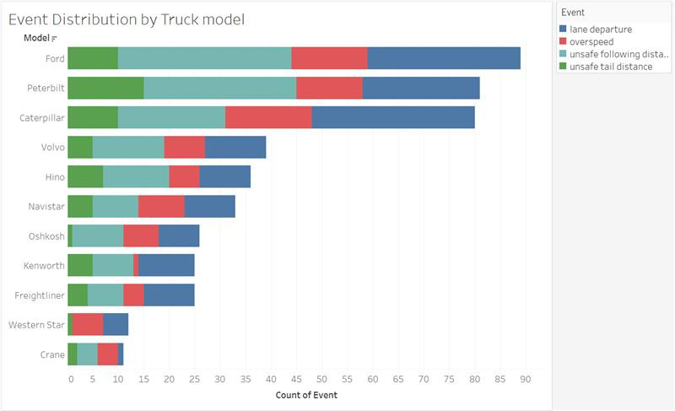
Event Distribution by Truck Model
With the help of the truck model, we determined that the Ford model truck can cause a high number of non-normal events
What is the distribution on events for each truck model?

Slide 7
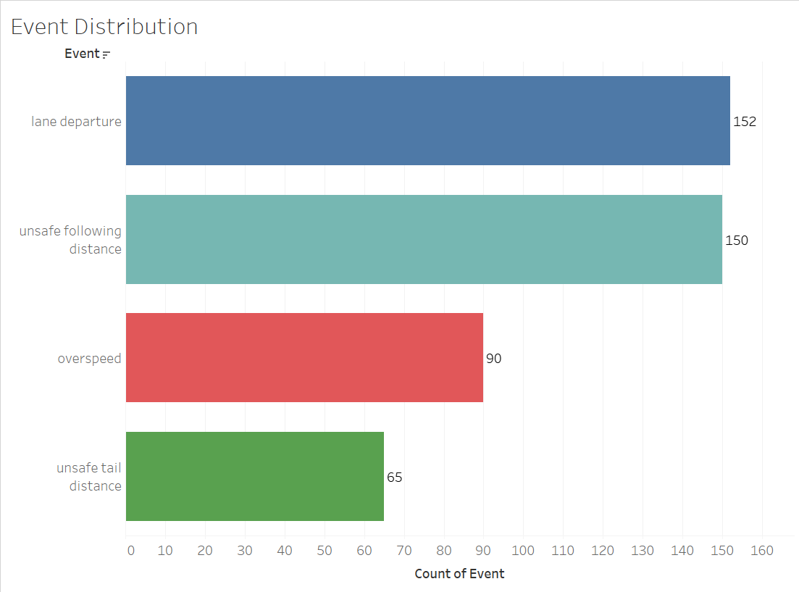
Event Distribution
The highest event is Lane Departure, which can cause the vehicle to drift from its actual lane and increase the risk factor
How many instances of each type of event were recorded?

Slide 8
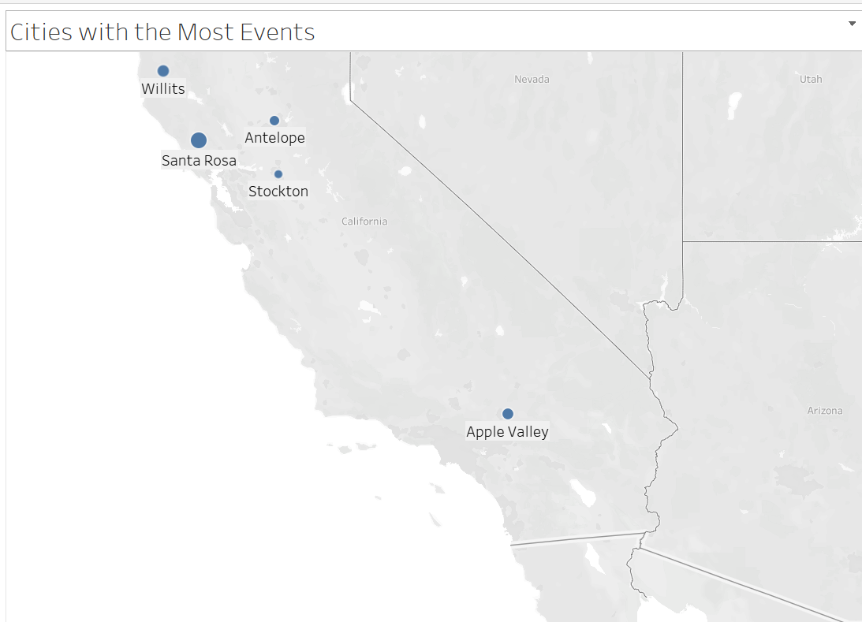
Cities With the Most Events
The cities with the most events, describes that the lane or roads might be risky for the drivers. ANT can impose stricter regulations for drivers when they are traveling in these cities. They can also encourage the city to add rest stops or update roads.
Which 5 cities had the most events?

Slide 9
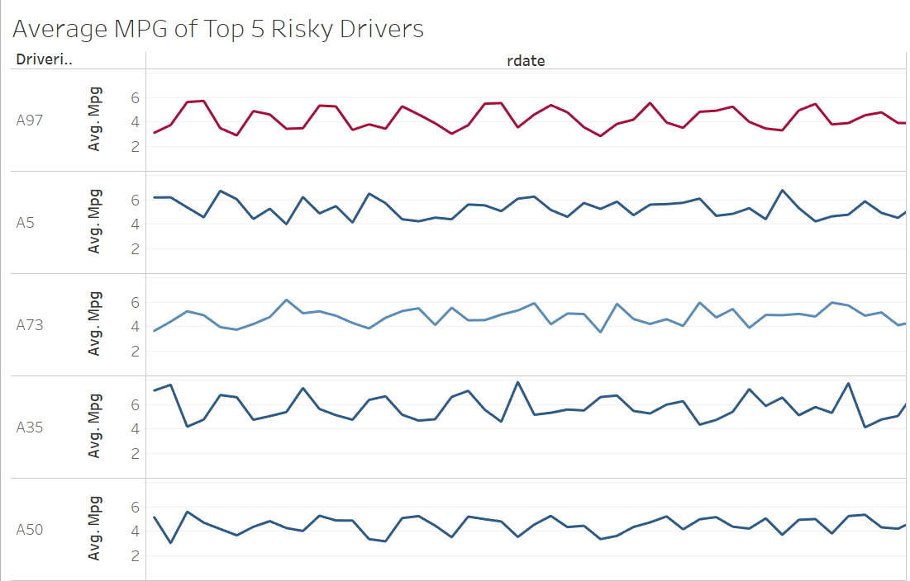
Average MPG of Top 5 Risky Drivers
After knowing who the top 5 risky drivers are, we understood the average MPG trends of their vehicles across recorded dates.
What are the MPG trends of the 5 riskiest drivers?

Slide 10
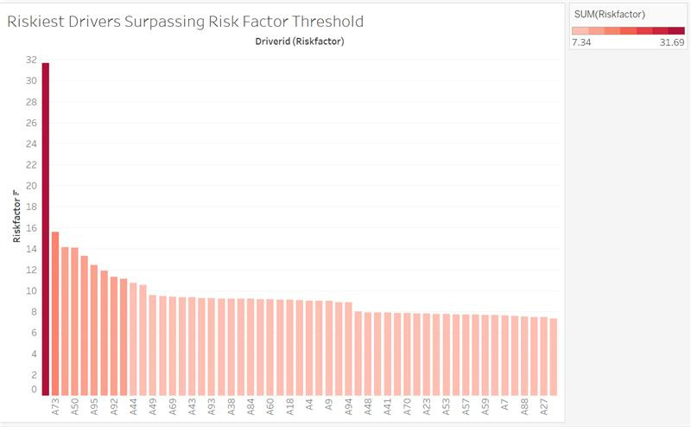
Drivers Surpassing Risk Factor Treshold
Filtered and Sorted the drivers who surpassed the risk factor threshold . (7)

Slide 11
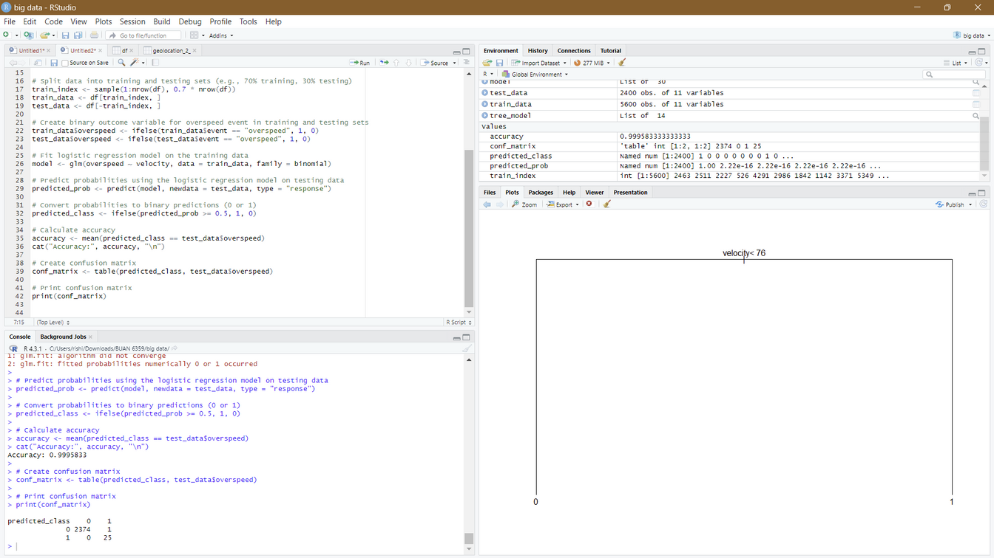
Predicting Overspeeding using Velocity in R
Created a binary feild for overspeeding (0,1)
Split the dataset into training and testing (70/30)
Performed a logistic regression using velocity to predict overspeeding
Created a decision tree to reveal the velocity at which overspeeding is identified
Calculated accuracy and printed a confusion matrix (on test dataset)
With ~99% accuracy we predict that when there is an event of overspeeding the driver is traveling at least 76 mph.

Slide 12
Conclusion
With almost 20 events, we were able to identify A97 as the most dangerous driver.
We discovered that the Ford model truck can result in a significant number of anomalous events with the aid of the truck model.
Lane departure is the most dangerous event since it might lead a car to stray from its intended lane and raise the danger level.
We were able to comprehend the average MPG trends of the vehicles driven by the top 5 dangerous drivers over the course of the recorded period.
Drivers who above the risk factor threshold were filtered and sorted. (7)

