Slide 1


Multimedia Preprocessing and Analysis
Breast Cancer Classification using Generative AI for Data Augmentation
Team Members
1. P.L.N. Nikhil (CS23B1038)
2. G. Hrishik Reddy (CS23B1083)
3. P. Aditya (CS23B1087)

Slide 2
Problem Statement
Breast cancer classification using ultrasound images faces several critical challenges:
Limited Labeled Data: Availability is restricted due to high annotation costs and privacy constraints.
Dataset Imbalance: Significantly fewer malignant cases compared to benign and normal classes leads to biased learning.
Clinical Performance Gap: Models may show high overall accuracy but perform poorly on critical malignant cases.
Need for Robust Augmentation: Enhanced techniques are required to improve model generalization and reliability.

Slide 3
Motivation
Traditional data augmentation (rotation, flipping, scaling) increases dataset size but only creates variations of existing images without new features.
Generative Models (GANs):
Synthesize entirely new images by learning the underlying data distribution, making them ideal for medical imaging where data is scarce and diversity is limited.
Research Focus:
To explore whether GAN-based augmentation can significantly improve classification performance in breast cancer diagnostics.

Slide 4

Project Objectives
Primary Goal
Improve breast cancer classification performance by incorporating generative AI techniques.
Strategy Evaluation
Compare effectiveness of classical vs. GAN-based augmentation strategies.
Malignancy Detection
Enhance detection of malignant cases through additional synthetic samples.
Impact Analysis & Optimization
Analyze synthetic data's effect on model generalization and identify the most effective augmentation approach for diagnostics.

Slide 5


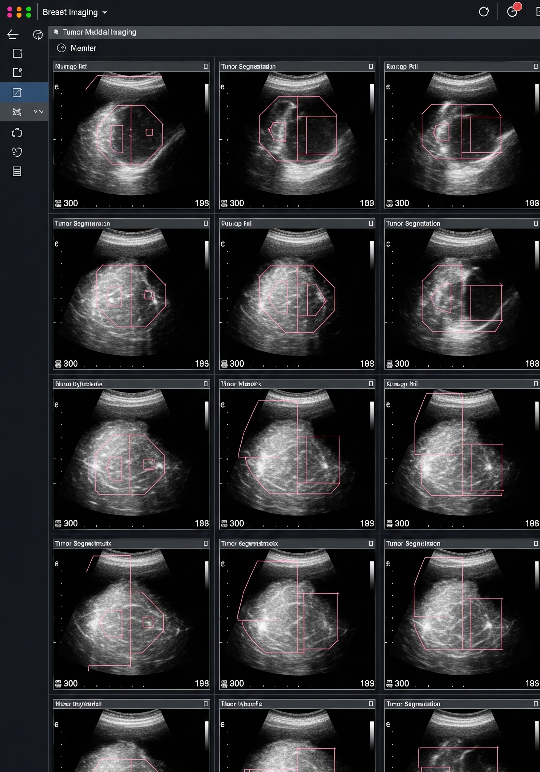
Dataset Overview
The project utilizes the Breast Ultrasound Images (BUSI) dataset, featuring ultrasound scans across three distinct categories:
Normal: Baseline healthy tissue samples.
Benign: Non-cancerous growth scans.
Malignant: Confirmed cancerous tumor images.
Includes segmentation masks for tumor region highlighting.
Note: Small size and class imbalance make it an ideal testbed for evaluating GAN-based augmentation.

Slide 6
Proposed Approach
The proposed approach integrates generative models into the classification pipeline to address data scarcity and improve diagnostic accuracy.
STEP 01
GAN Training
Preprocessing and training a GAN to learn the distribution of ultrasound images.
STEP 02
Data Synthesis
Producing synthetic images, particularly for underrepresented malignant classes.
STEP 03
Augmented Dataset
Combining original and generated images to create a robust training set.
FINAL STAGE
Classification & Evaluation
A deep learning classifier is trained on the augmented data and evaluated using standard clinical metrics to verify performance improvements.

Slide 7
Methodology
To systematically evaluate the effectiveness of different augmentation strategies, an ablation study was conducted with four experimental regimes.
REGIME 01
Baseline Model
The control group where the model is trained without any augmentation techniques.
REGIME 02
Classical
Standard geometric variations including horizontal flipping and rotation.
REGIME 03
WGAN-GP
Incorporates GAN-based augmentation using Wasserstein GAN with Gradient Penalty.
REGIME 04
Mask-Aware GAN
Utilizes segmentation masks to improve the realism and anatomical accuracy of generated images.
This structured comparison allows for a comprehensive evaluation of each approach.

Slide 8
GAN Architecture: WGAN-GP
WGAN-GP improves training stability by minimizing the Wasserstein distance and enforcing Lipschitz continuity via gradient penalty.
CORE MECHANISM
Wasserstein Distance
Instead of minimizing divergence, it minimizes the distance between distributions for smoother gradients.
NETWORK COMPONENTS
Generator vs. Discriminator (Critic)
The generator produces synthetic images while the critic evaluates authenticity to guide learning.
STABILITY FEATURE
Gradient Penalty
Introduces a penalty term to enforce Lipschitz continuity, ensuring stable and reliable training cycles.

Slide 9

Mask-Aware GAN
To further enhance the quality of generated images, a mask-aware GAN approach utilizes segmentation masks to guide the generation process.
CORE INNOVATION
Anatomical Guidance
Incorporates anatomical information so the generator focuses on realistic tumor structures and spatial consistency.
OBJECTIVE
Clinical Relevance
Aims to address limitations of standard GANs by preventing the creation of medically inaccurate samples.
DATASET SYNERGY
Segmentation Masks
Directly leverages existing BUSI dataset masks as a spatial prior for synthetic image synthesis.

Slide 10



Training Strategy
The training process balances adversarial optimization with Transfer Learning to ensure robust performance on medical imaging tasks.
OPTIMIZATION
Adam & Hyperparams
Uses the Adam optimizer with fine-tuned parameters for both generator and discriminator networks.
STABILIZATION
Label Smoothing
Applied to prevent discriminator overconfidence and stabilize the competitive GAN training loop.
REGULARIZATION
Convergence Control
Learning rate scheduling and early stopping prevent overfitting and ensure optimal convergence.
CLASSIFICATION
ResNet Fine-Tuning
Leverages a pretrained ResNet via transfer learning to maximize performance on limited BUSI data.

Slide 11
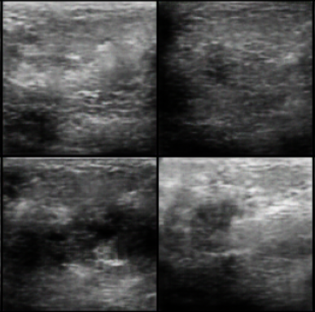
Generated Images Analysis
Comparative analysis shows significant quality improvements through advanced GAN architectures while noting existing clinical limitations.
EVOLUTION
Baseline vs. WGAN-GP
Initial outputs are noisy; WGAN-GP provides crucial stability and texture improvements.
PRECISION
Mask-Aware Enhancements
Preserves critical anatomical features by leveraging spatial priors for higher quality.
OUTLOOK
Clinical Impact & Limitations
While fine-grained details may still lack, synthetic images effectively increase dataset diversity and model robustness.

Slide 12
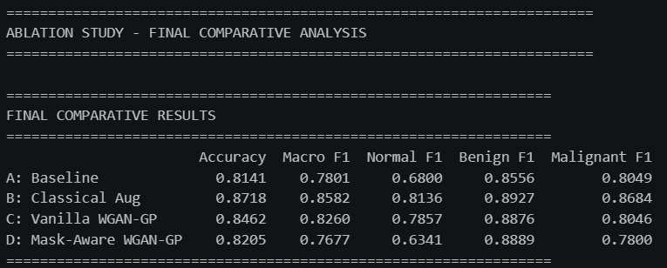
Results: Classification Performance
AUGMENTATION
Classical vs. Baseline
Standard augmentation techniques show a clear performance boost over the baseline control group.
DIVERSITY
WGAN-GP Impact
WGAN-GP enhances results in specific cases by significantly increasing training data diversity.
SUPERIORITY
Mask-Aware Synthesis
Demonstrates the most structured imaging and improved classification metrics across all regimes.
Mask-aware GANs provide the most promising improvements in metrics, though challenges in malignant recall persist.

Slide 13
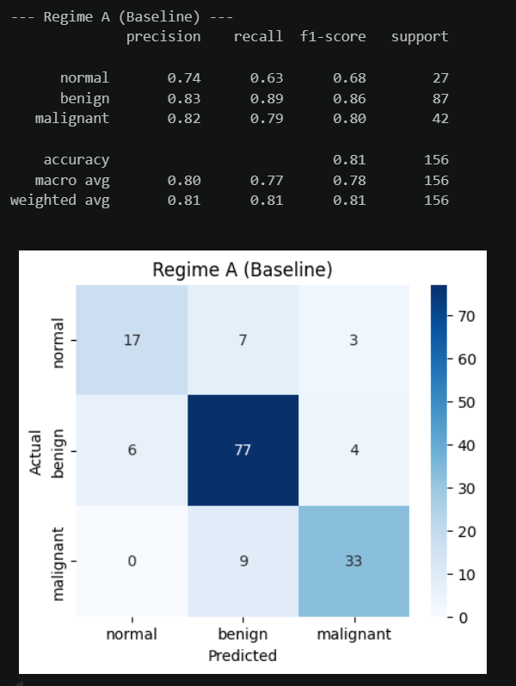
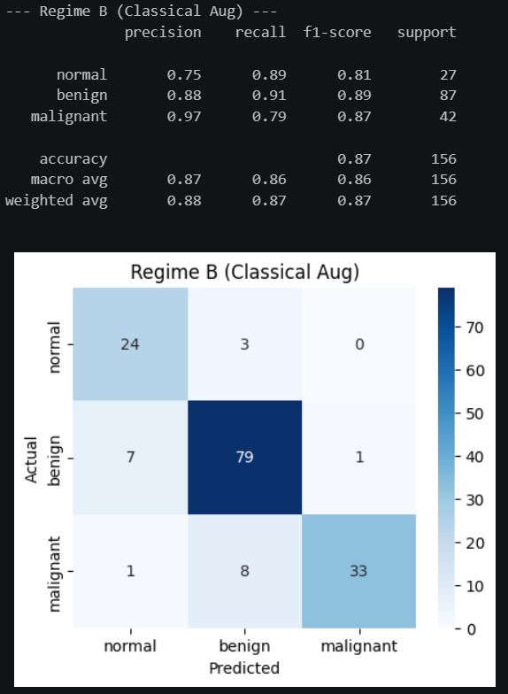

Slide 14
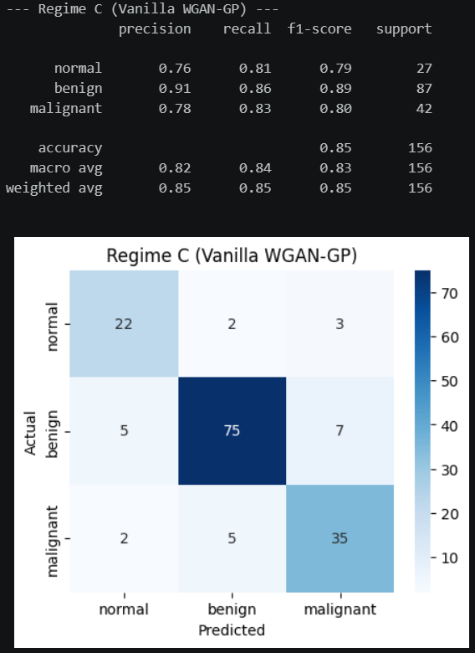
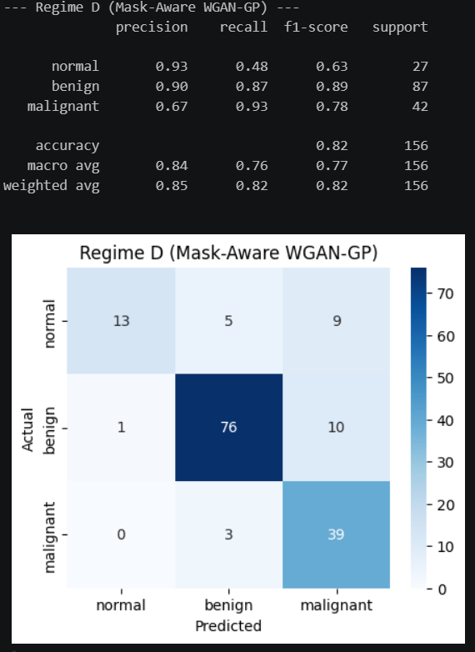

Slide 15
Contribution of Team Members
Each member contributed specialized technical expertise to bridge generative AI with medical diagnostics.
DATA & BASELINE
Hrishik (CS23B1083)
Led data preprocessing and dataset management. Designed the custom dataset class and applied transformations. Implemented the ResNet-based baseline model and integrated classical augmentation (flipping/rotation) to boost initial performance.
GENERATIVE MODELING
Aditya (CS23B1087)
Implemented the WGAN-GP architecture, including generator and critic networks. Developed the training procedure using Wasserstein loss with gradient penalty. Focused on generating synthetic malignant samples to address critical dataset imbalance.
REFINEMENT & EVAL
Nikhil (CS23B1038)
Developed the mask-aware GAN to enhance image realism. Retrained classification models on the hybrid augmented dataset. Conducted performance evaluation (Accuracy, FID, etc.) and utilized Grad-CAM for model interpretability.

Slide 16
Key Insights: GAN-Based Augmentation
Effectiveness depends heavily on image realism; quantity alone does not guarantee performance gains. Combining generative models with domain-specific information is crucial for success.
DATA FIDELITY
Quality vs. Quantity
Study results reveal that the study's effectiveness relies on the quality and realism of generated images. Simply increasing data volume without realism fails to improve metrics.
HYBRID STRATEGY
Classical Baselines
Classical augmentation remains a strong baseline and should be utilized alongside generative methods for optimal performance.
DOMAIN KNOWLEDGE
Synthetic Data Usefulness
Incorporating segmentation masks significantly improves synthetic data utility, underscoring the importance of combining generative models with domain-specific information.

Slide 17
Conclusion: Project Outcomes
This project demonstrates that generative AI can be effectively integrated into medical image classification pipelines.
PERFORMANCE GAINS
Augmentation & Diversity
While GAN-based augmentation improves data diversity and model performance, its impact is limited by the quality of generated images.
METHODOLOGY
Stability & Guidance
Advanced approaches like WGAN-GP and mask-aware GANs show improved results, indicating stability and domain guidance are crucial.
FINAL SUMMARY
Overall Study Perspective
Overall, the study highlights both the potential and limitations of generative AI in medical imaging.

