Slide 1
Preventing Information Leakage from Encoded Data in Lattice Based Cryptography
Hrishik Sancheti
16010120134
B-3

Slide 2
Index
Introduction
Abstract
Lattice theory
GGH cryptosystem
Algorithm
Security
Weakness
Proposed Methodology
Result and analysis
Conclusion

Slide 3
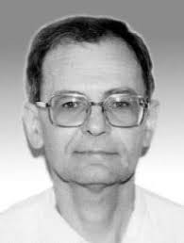

Smart Men
Daniele Micciancio
Mikl’os Ajtai
A Computer scientist at IBM and member of National Academy of Sciences
Professor at University of California

Slide 4

INTRODUCTION
Quantum computer generation
Rise in cryptanalytic attacks
Enhanced cryptosystem

Slide 5
ABSTRACT
Quantum Computer
Lattice cryptography
Exploits
Improvision

Slide 6
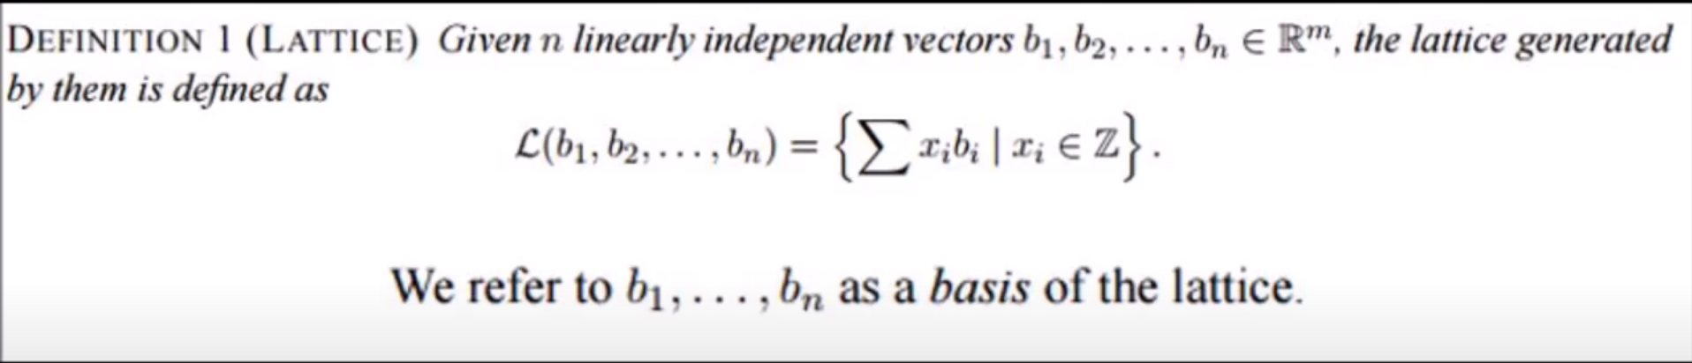
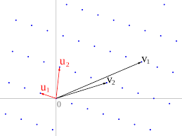
LATTICE THEORY
1.
2.
5.
2.
DEFINATION
Here you could describe the topic of the section
SIP – AJTAI’96
PROJECT STAGES
Here you could describe the topic of the section
Here you could describe the topic of the section
Good and bad basis
Good basis – u1,u2
Bad basis – v1,v2

Slide 7
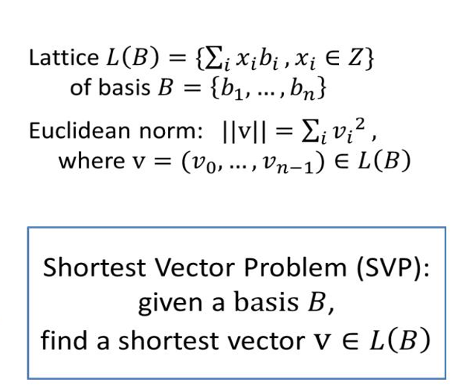
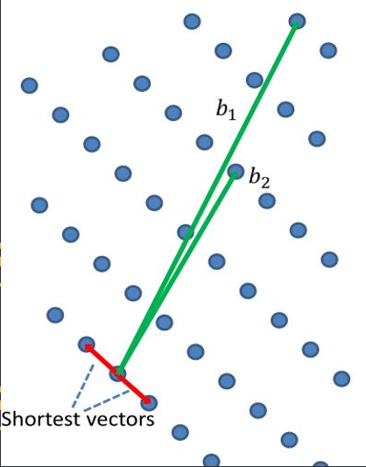
LATTICE THEORY
3.
2.
5.
2.
SVP-Shortest Vector problem
SIP – AJTAI’96
PROJECT STAGES
Here you could describe the topic of the section
Here you could describe the topic of the section
Good and bad basis
Good basis – u1,u2
Bad basis – v1,v2

Slide 8
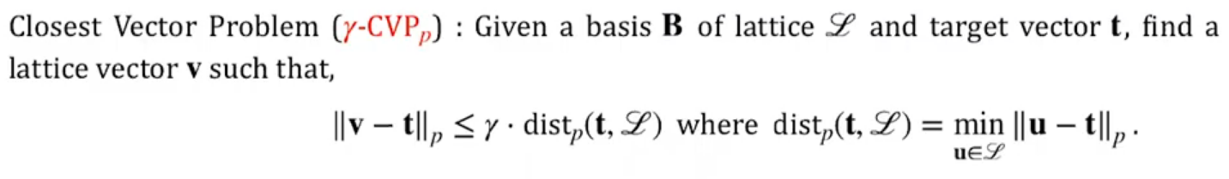
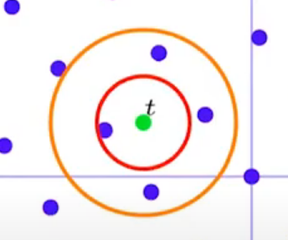
LATTICE THEORY
4.
5.
CVP-Closest Vector problem
PROJECT STES
The Goldreich–Goldwasser Halevi(GGH) cryptosystem is designed on the basis of the fact of hard lattice problem to find closest vector in lattice.

Slide 9
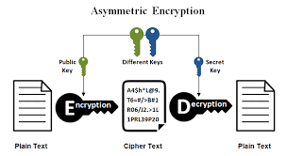
GGH-Cryptosystem
The Goldreich–Goldwasser–Halevi (GGH) cryptosystem is an equated asymmetric public-key cryptosystem based on lattices.

Slide 10
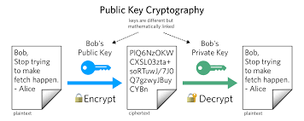
GGH Cryptosystem
Lattice Theory
CVP – bad basis
Babai’s algorithm

Slide 11
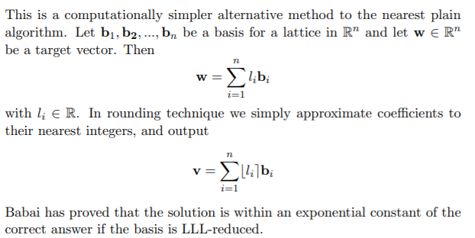
GGH-Cryptosystem
Babai’s Algorithm

Slide 12
ALGORITHM
Parameters
Encryption
Basis
N (dimension)
σ (Security parameter)
Cipher text: c=m .B + e
error matrix e ∈{±σ}
Public key:Bad basis
Private key:Good basis
Key generation
Private key: R=k . In + Q
k=√n .l. Value of l=4
Q is a random perturbation
Public key: B =U . R
U is a unimodular matrix
Decryption
Decrypted text: round(c . R ^ -1 )
round() is Babai’s rounding technique

Slide 13
SECURITY
Thus in order to determine the private key given only the public key, an eavesdropper would again need to solve an instance of hard problem.
if a third person listens
Public key
no known
polynomial time algorithm to solve CVP
CVP
Pb
high orthogonality defect
R
far away from orthogonality

Slide 14
Weakness
Special form of error vector
Short Vector Error
GGH error vectors are significantly shorter than the
lattice vectors, making GGH CVP instances much
easier than that of general Closest Vector instances.
GGH cryptosystem selects the value of the error
vector e as either +σ or -σ, where σ is security
parameter.
“Leaky remainder” Attack
The error vector from the ciphertext could be
removed with a well-chosen modulus. By adding σ
to every element of the ciphertext, the error vector
changes from {-σ, σ}^n to {0, 2σ}^n.

Slide 15
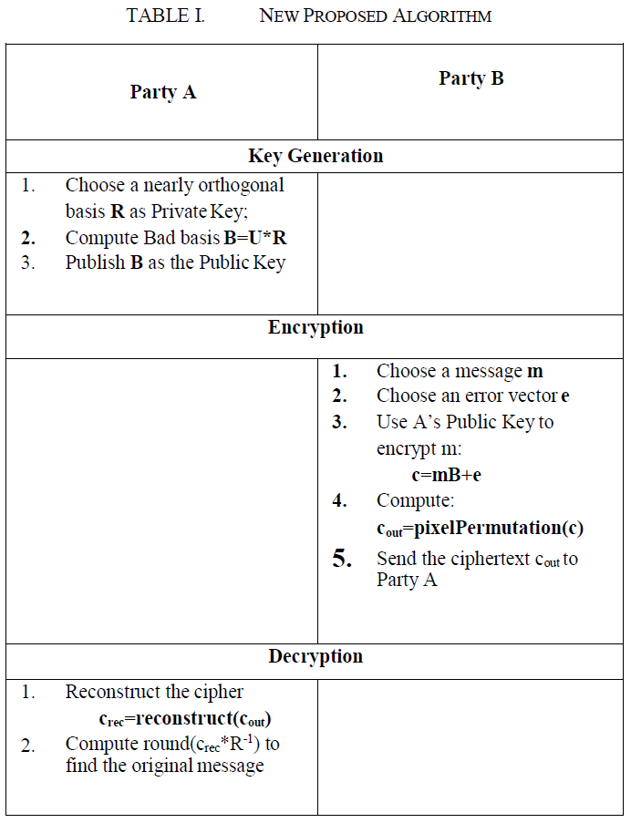
Proposed Methodology Table

Slide 16
New Functions
pixelPermutation()
Reconstruct()
The function will take input a
ciphertext c generated by GGH encryption algorithm and output a new ciphertext cout with shuffled pixels values.
It reconstruct the ciphertext c (here
symbolize as crec) from cout .

Slide 17
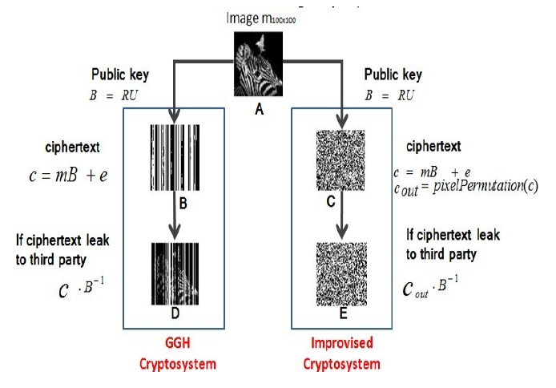
Result and Analysis
For experimental purpose we have choose a image of size 100x100 as input message i.e. the value of n=100 and apply both GGH encryption algorithm and New proposed encryption algorithm on this same message and analyze their respective ciphertexts against “information leakage” attack.
The person tries to get information out of ciphertext by multiplying the cipher with inverse of Public key. In this case the GGH’s ciphertext reveals the information where as ciphertext generated by proposed scheme is robust against such attacks and reveals no information.

Slide 18
Conclusion
In this work, we implemented GGH cryptosystem using some advanced function by which the problem of information leakage can be prevented. The improved efficiency allows using wider range of security parameter while maintaining the scheme reasonably practical. This new scheme is presented for grayscale images, work can also be done on text and colored images in future. Also scheme can be improve in terms of space complexity as the size of public key and their corresponding ciphertext is much larger.

Slide 19
THANK YOU

