Slide 1
P5: Prediction of Particle Trajectories using AI
AMS Lab Projects Final Presentation
Guru Prasad Vastrala
Hari Charan Hosakote Lokesh
Hrishikesh Vijay Joshi
Jayakrishna Ajithkumar Jayasree
Autonomous Multisensor Systems Group
Institute for Intelligent Cooperating Systems
Faculty of Computer Science
Otto von Guericke University Magdeburg
17.09.2026

Slide 2
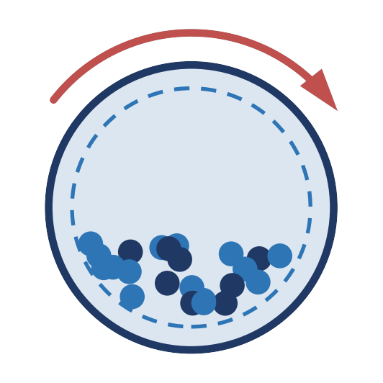
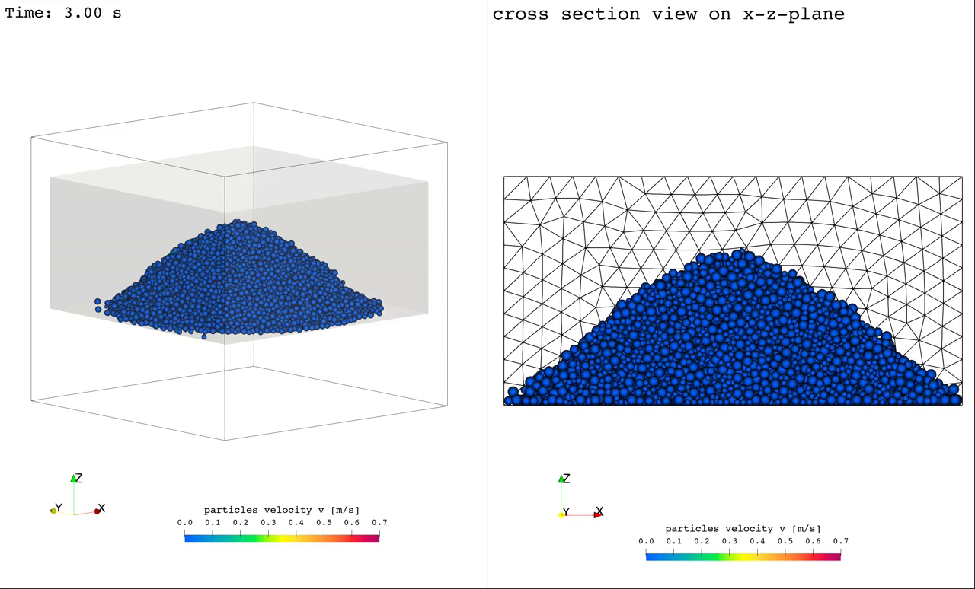
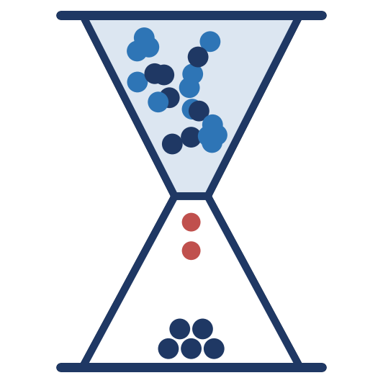
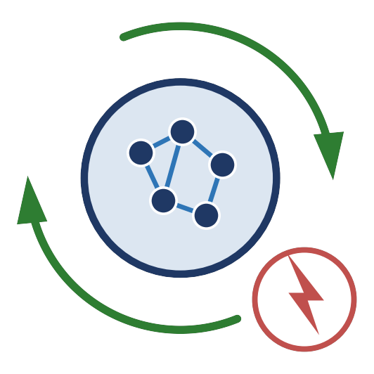
Motivation
1. Industrial Need
Rotating drums and mixers: cement, pharma, food.
DEM reference run — Angle of Repose
2. Computational Bottleneck
DEM resolves every contact — hours of HPC per run.
3. Real-time Control
A trained surrogate runs the same case in seconds.
This is exactly what the GNN surrogate learns to reproduce with the same settling behaviour, without re-running the solver.

Slide 3
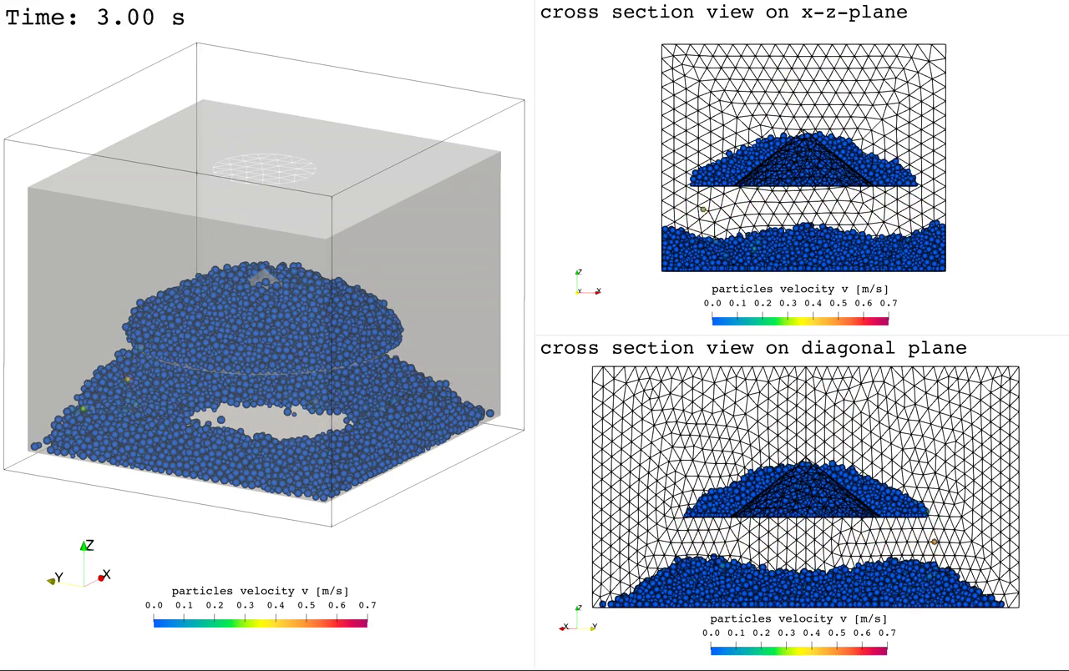
AI Surrogates: Advantages & Limitations
Advantages:
Replaces the DEM solver at inference. Real-time twins.
Learns contact behaviour from data, no calibration.
Limitations:
Needs expensive high-fidelity DEM runs up front.
Accuracy is limited to the trained domain.
DEM reference run — MoreFlow (granular flow)
Dynamic flow — the harder case for the surrogate.

Slide 4
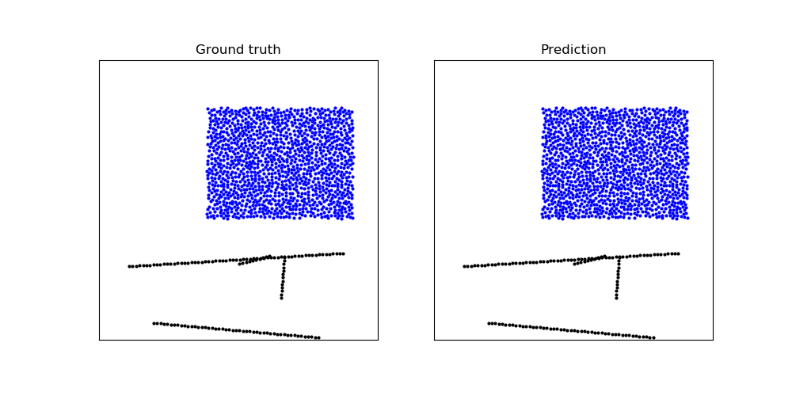
Machine Learning as an Alternative to DEM
How ML replaces DEM:
Graph Representation: Particles are nodes, neighbour interactions are edges.
GNN Modelling: Learns physics from trajectory data to predict future positions without runtime solvers.
Why it's a strong alternative:
Performance & Flexibility: Achieves massive speedups over DEM and generalizes to unseen conditions.
Efficiency & Integration: Learns contact parameters implicitly and supports real-time control or digital twins.
DEM (classical solver)
Detect
contacts
Contact-force
law
Integrate
positions
hours
per run
GNN surrogate (GNS)
Particles →
graph
Learned
update
Next
positions
seconds
per rollout
Fig 1
Fig 2

Slide 5
Literature Review
Kumar & Vantassel (2023) GNS: A Generalizable Graph Neural Network-based Simulator for Particulate and Fluid Modeling (JOSS, 2023)
Main principle: an open-source PyTorch simulator that learns particle dynamics straight from trajectory data — no contact laws to calibrate.
Sanchez-Gonzalez et al. (2020) Learning to Simulate Complex Physics with Graph Networks(2020)
Main principle: encode the particles into a neighbour graph, process it by message passing, then decode each particle’s acceleration.
Input state X
GNN – Message Passing
Processor
Encoder
Decoder
Encoder
GN¹
GNᴹ
Decoder
⋯
G⁰
Gᴹ
Fig 3
Fig 4

Slide 6
Overall Workflow
1. DEM Simulation
LIGGGHTS solver
AOR + MoreFlow
Δt = 10⁻⁴ s
→
2. Data Preparation
400 CSV → .npz
Honest train/test split
(dynamic phase held out)
→
3. Graph Construction
particles → nodes
R = 6 mm, ~50 neighbours
pos + 5 velocities
→
4. GNS Training
encode-process-decode
200,000 steps
NVIDIA H100 (ANTS)
↓
8. Transfer Study (planned)
AOR ↔ MoreFlow
does the surrogate
generalize?
←
7. Ensemble Kalman Filter (EnKF)
corrects long-rollout drift
stabilises trajectories
correction interval = 20
←
6. Rollout Evaluation
RMSE · MAE · R²
3,000 & 4,000 particles
vs DEM ground truth, full range
←
5. Hyperparameter DOE
R ∈ {1.2, 2.5, 6.0} mm
10k vs 200k steps
AOR vs MoreFlow
6

Slide 7
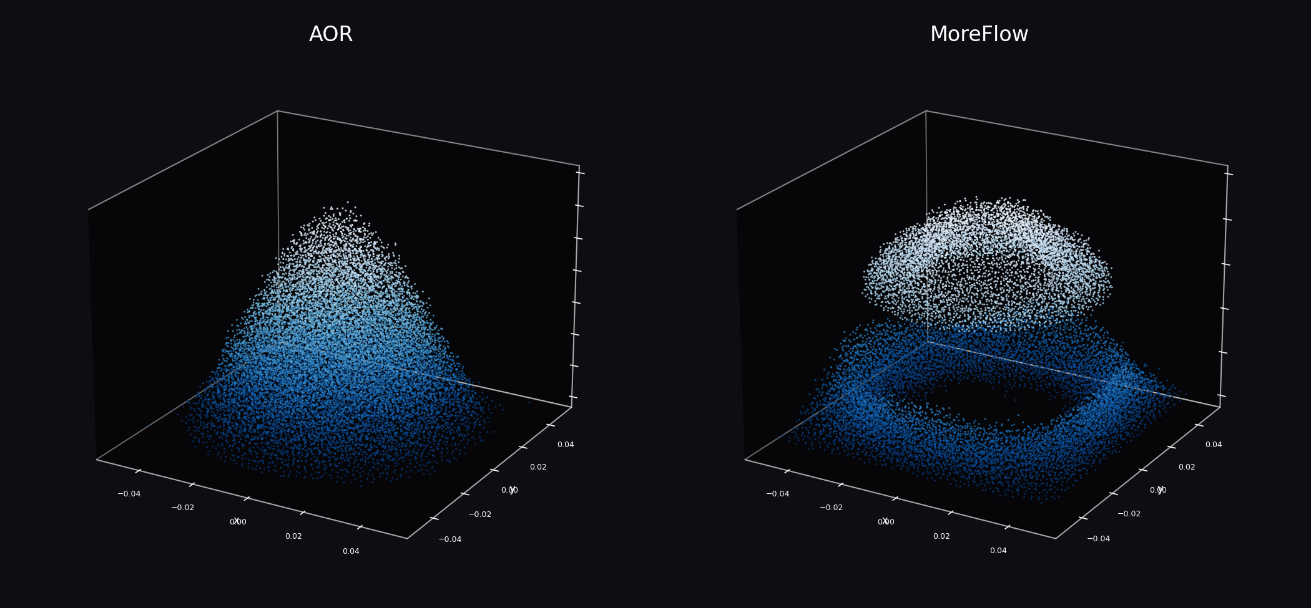
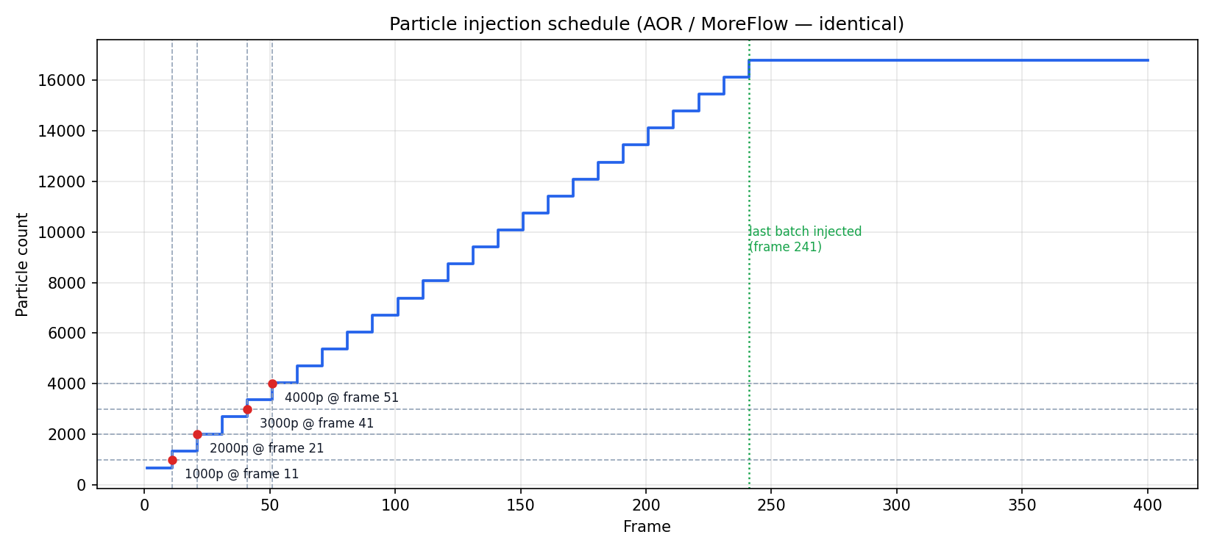
Dataset Details
Fig 5: Actual frame-400 particle positions,
both datasets: AOR settles into a dome| MoreFlow into a ring.
Fig 6: 25 batches of ~672 particles inject every 10 frames
7

Slide 8
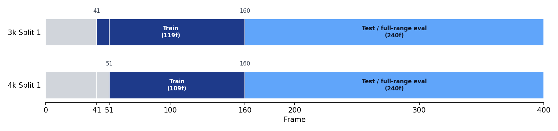
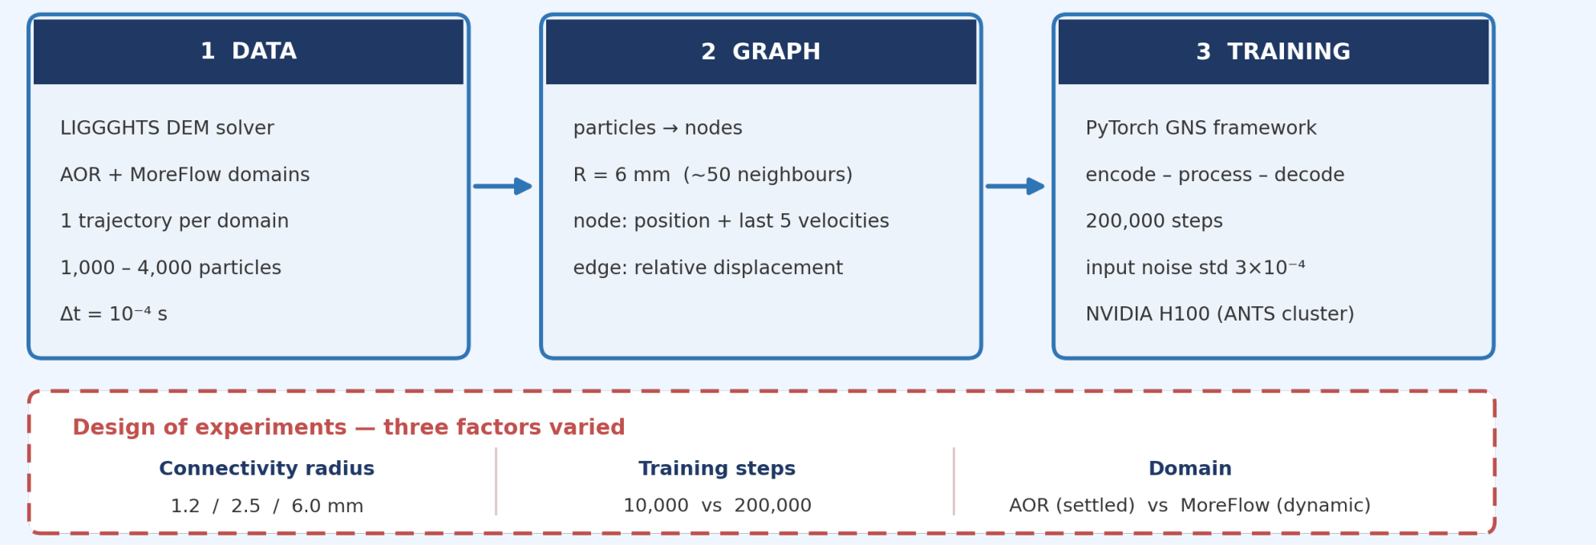
Data, Graph Construction & Training Setup
Train / evaluation split actually used for the AOR results shown
8

Slide 9
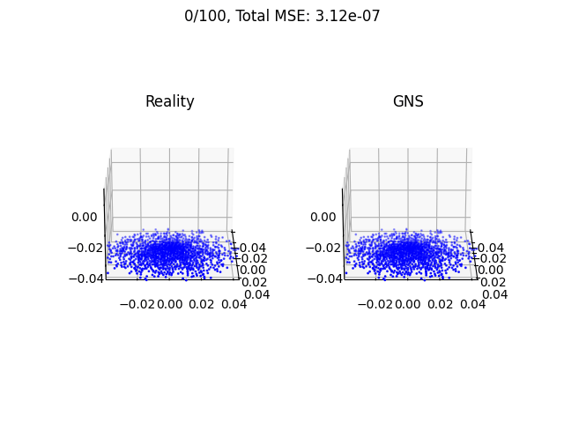
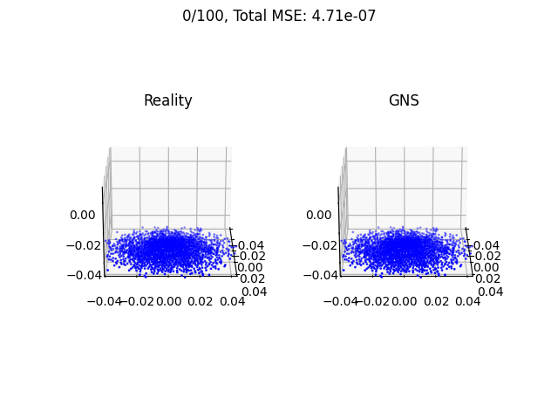
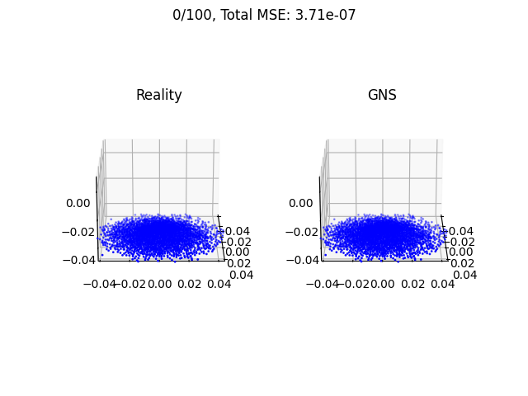
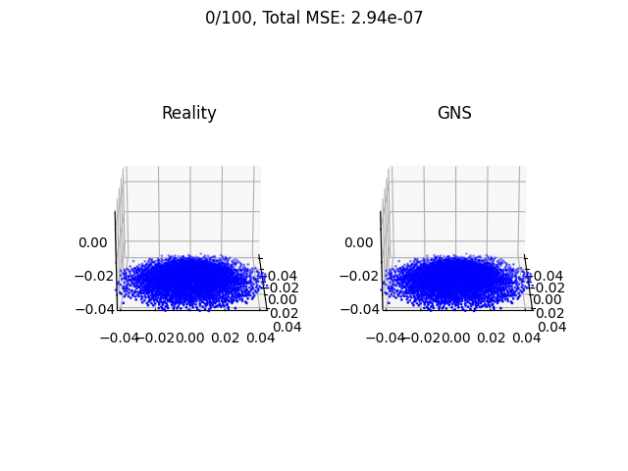
Intermediate Results: AOR
1000 Particles
2000 Particles
3000 Particles
4000 Particles
Metric | Value
RMSE | 5.58e-04 m
MAE | 3.38e-04 m
R² | 0.9996
Training Time | 2h 26m
Metric | Value
RMSE | 6.86e-04 m
MAE | 4.35e-04 m
R² | 0.9993
Training Time | 4h 42m
Metric | Value
RMSE | 6.90e-04 m
MAE | 4.12e-04 m
R² | 0.9995
Training Time | 8h 30m
Metric | Value
RMSE | 5.42e-04 m
MAE | 3.87e-04 m
R² | 0.9995
Training Time | 9h 30m

Slide 10
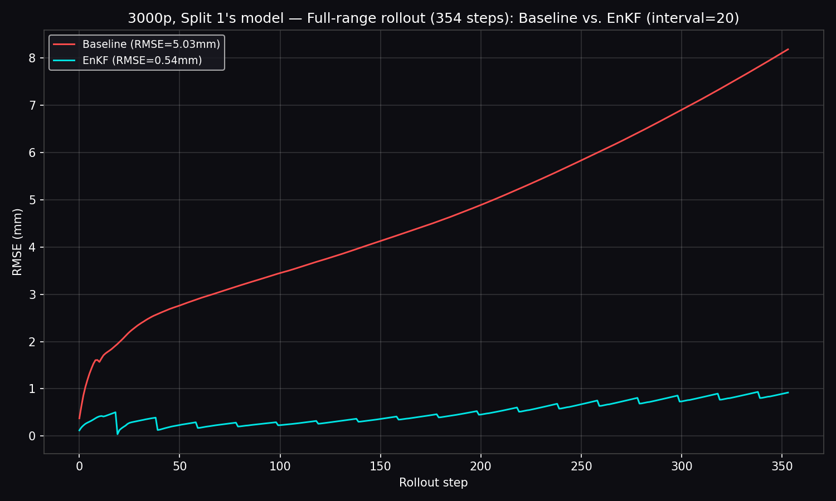
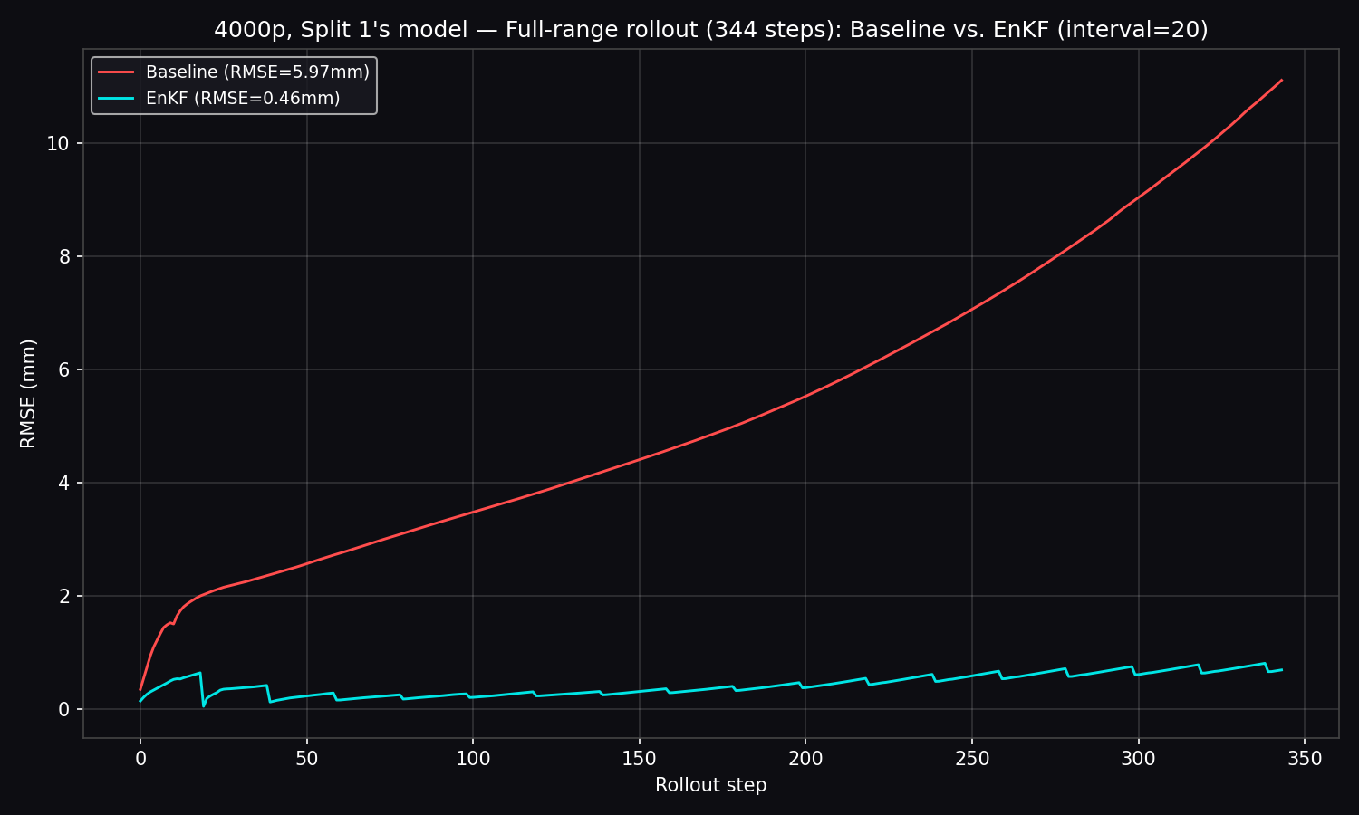
Results AOR
Fig 7
Fig 8
 | Baseline RMSE | EnKF RMSE | R² (base→EnKF) | Improvement
3000p | 5.03e-03 m | 5.40e-04 m | 0.9617 → 0.9996 | 9.3x
4000p | 5.97e-03 m | 4.62e-04 m | 0.9451 → 0.9997 | 12.9x
10

Slide 11
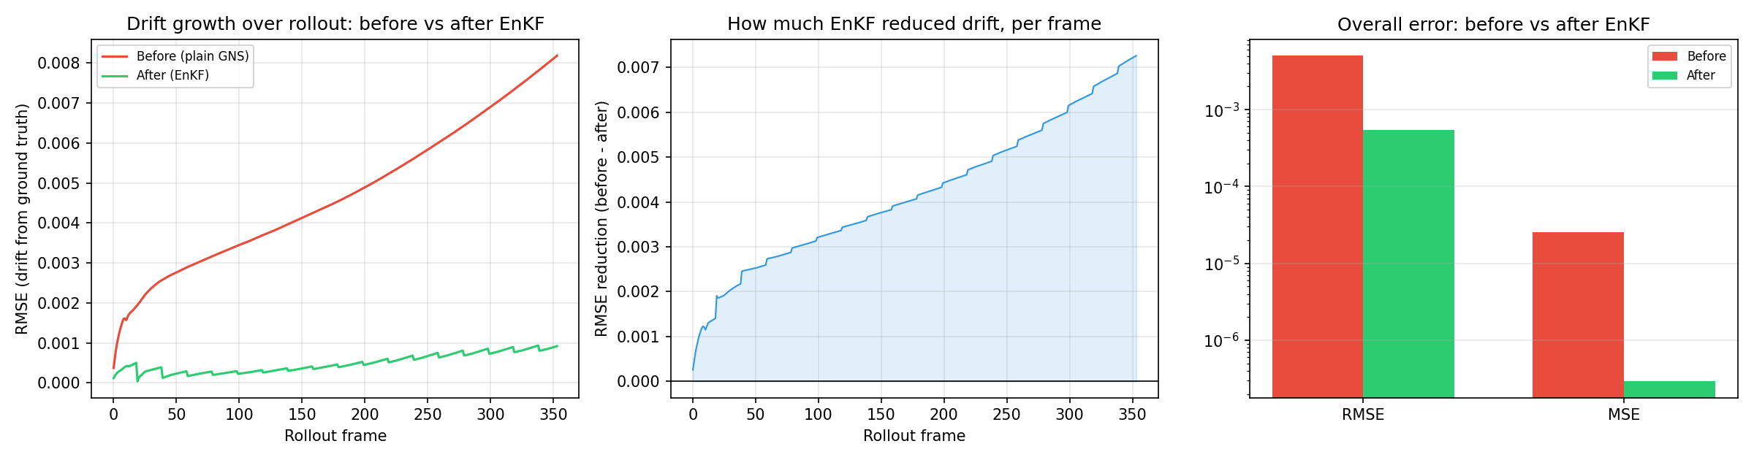
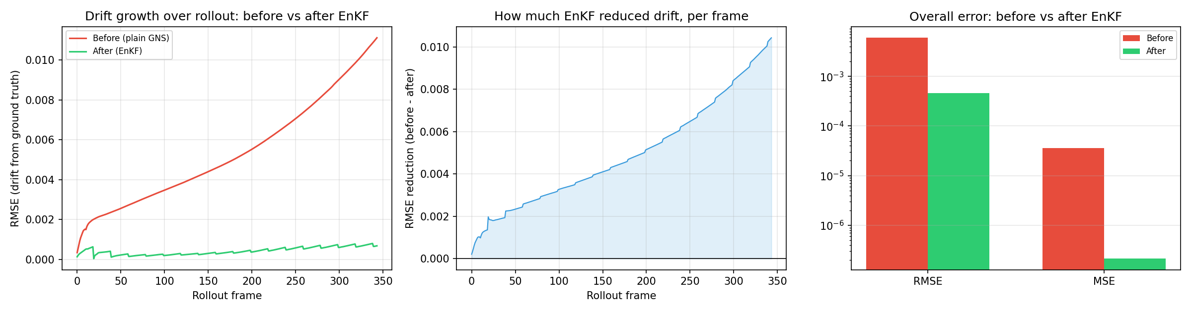
Drift Correction – Error Reduction
3000-Particles
4000-Particles
11

Slide 12
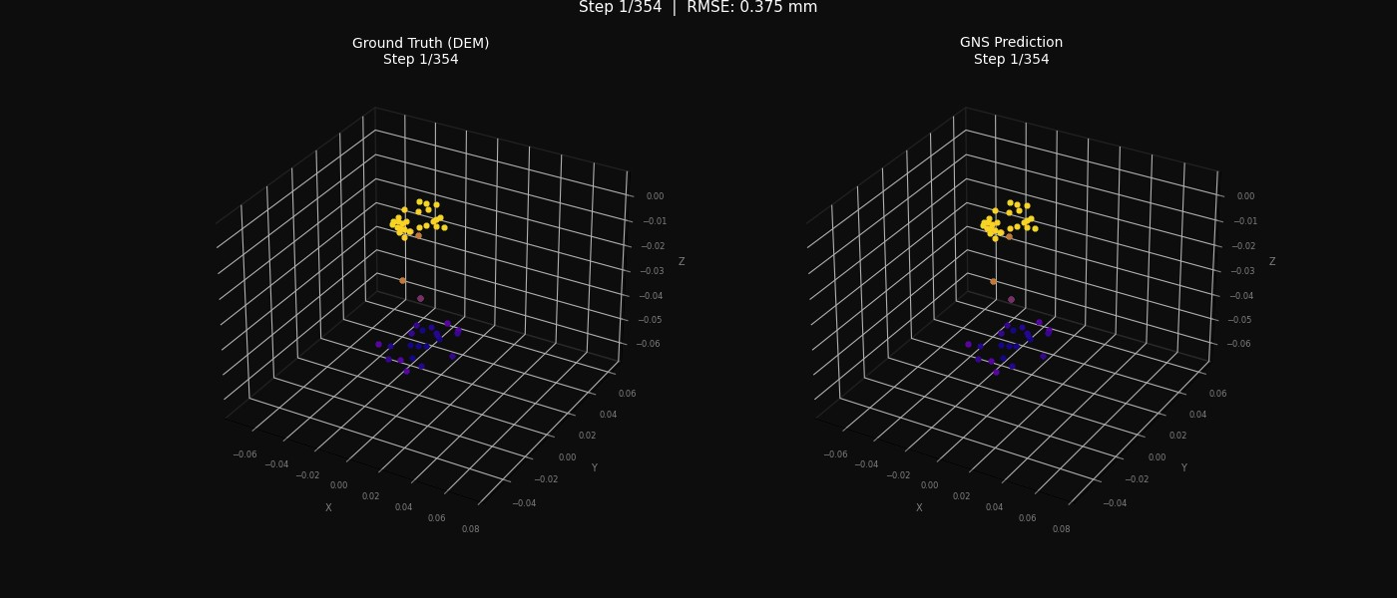
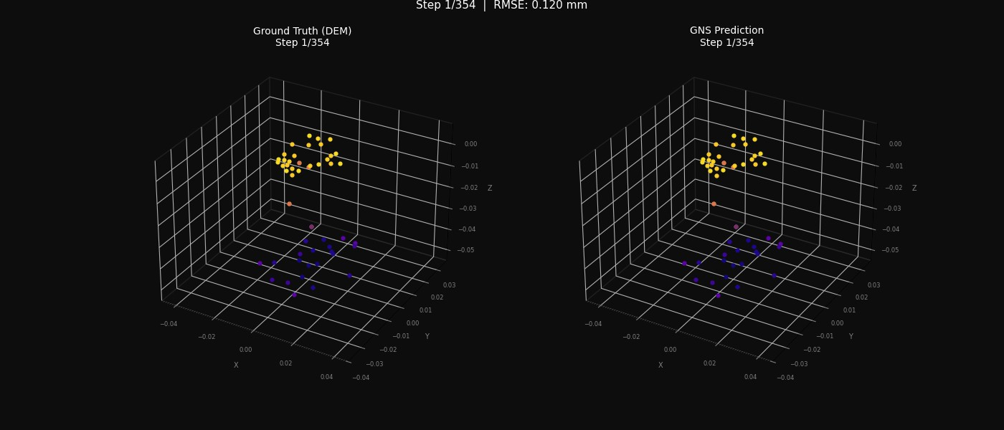
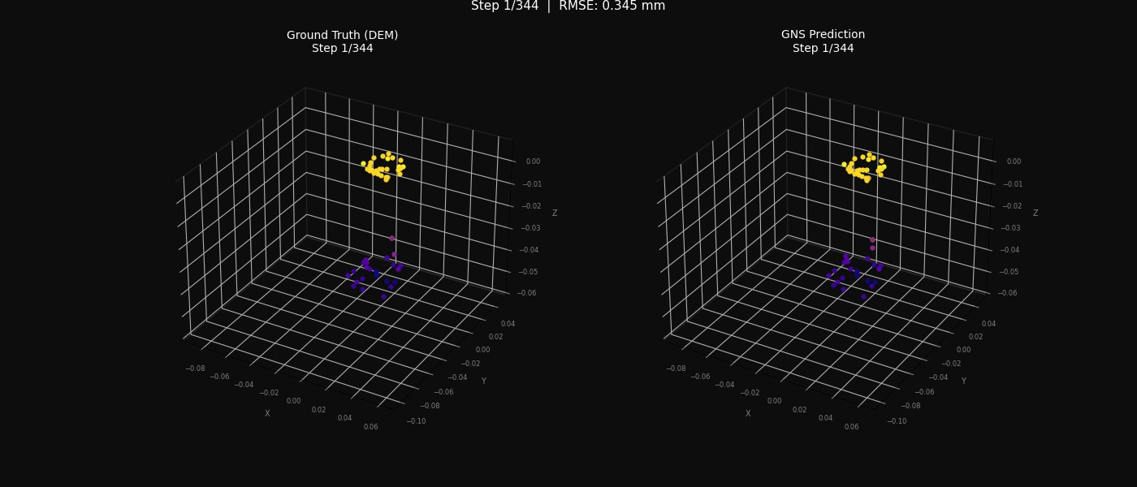
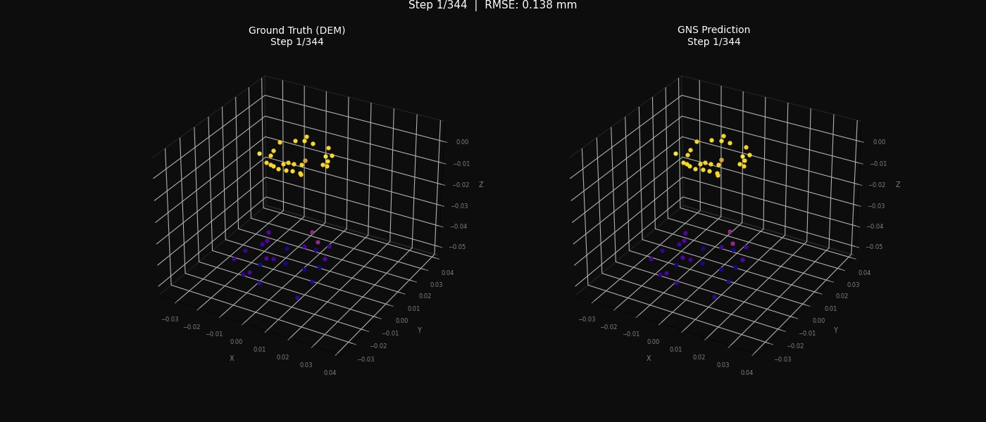
Dynamic GNS + EnKF Rollout
3000p — Baseline
3000p — EnKF (interval = 20)
4000p — Baseline
4000p — EnKF (interval = 20)
Click each clip to play. Left: ground truth vs. prediction rendered side by side.
12

Slide 13
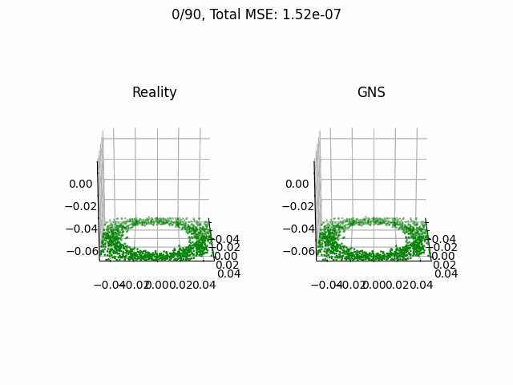
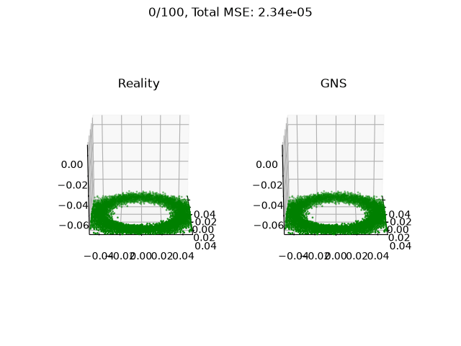
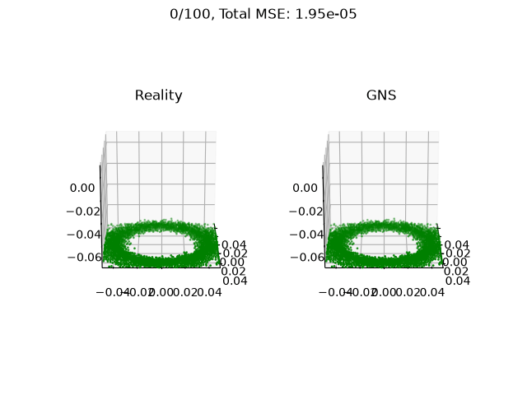
Intermediate Results: MoreFlow
1000 Particles
2000 Particles
3000 Particles
4000 Particles
Metric | Value
RMSE | 3.90e-04 m
MAE | 2.72e-04 m
R² | 0.9999
Training Time | 0h 45m
Metric | Value
RMSE | 4.61e-04 m
MAE | 3.31e-04 m
R² | 0.9997
Training Time | 1h 15m
Metric | Value
RMSE | 4.41e-03 m
MAE | 3.08e-03 m
R² | 0.9902
Training Time | 5h 07m
Metric | Value
RMSE | 4.84e-03 m
MAE | 3.69e-03 m
R² | 0.9881
Training Time | 7h 08m
Takeaway: error stays below 5×10⁻⁴ m up to 2,000 particles, then rises an order of magnitude at 3,000+.

Slide 14
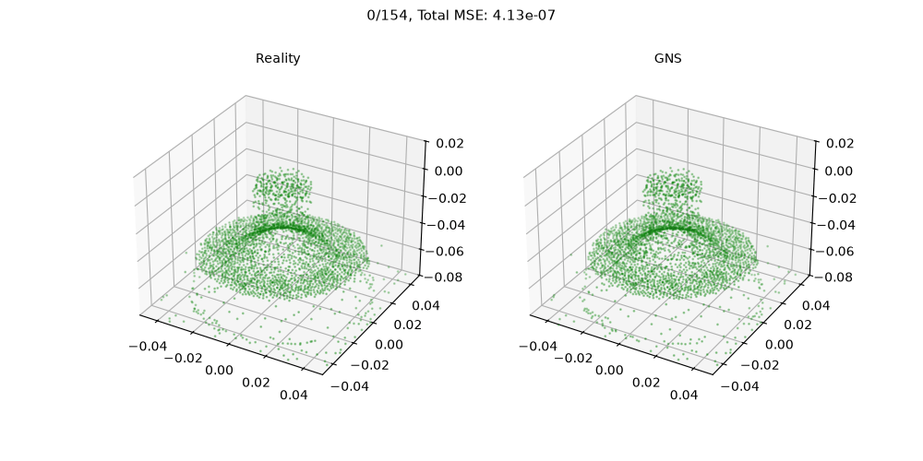
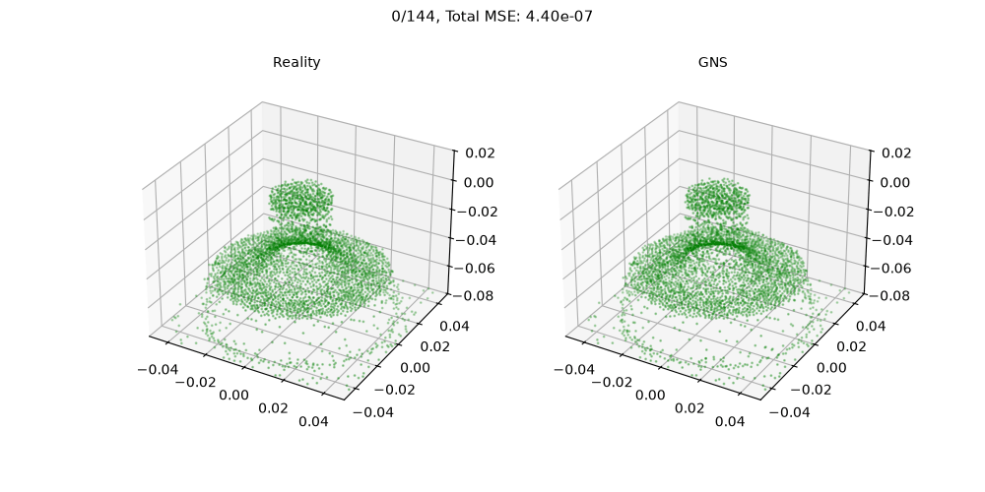
Dynamic GNS Rollout Result
3000-Particles
4000-Particles
Baseline GNS rollout(without the Kalman filter) tracks the DEM reference closely frame-by-frame at both particle counts, confirming the surrogate reproduce the granular flow before any correction

Slide 15
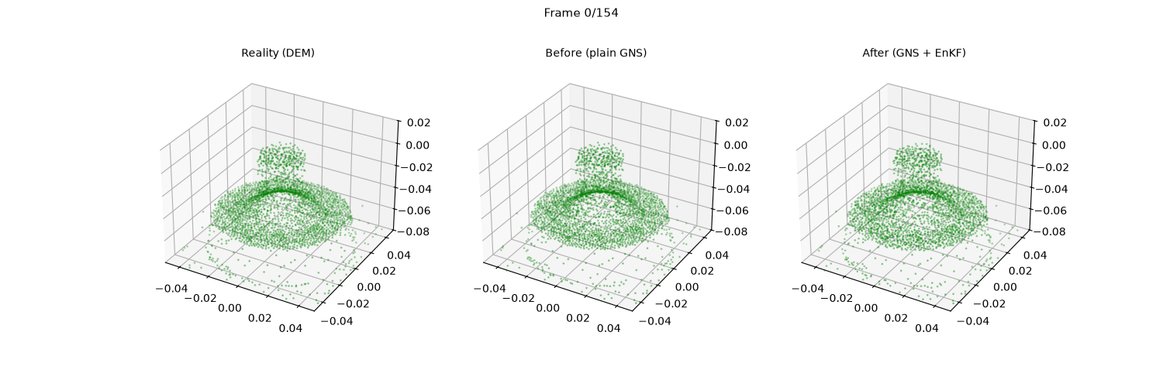
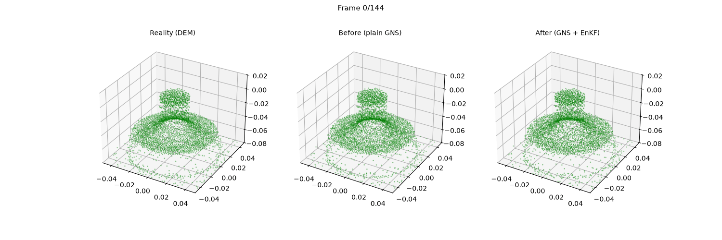
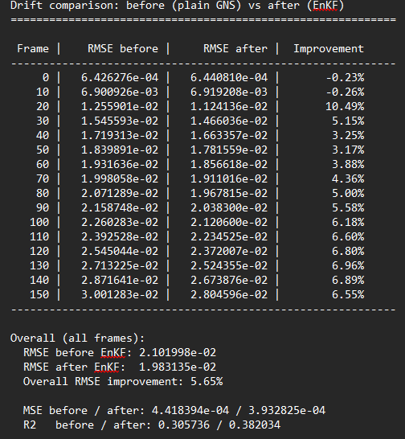
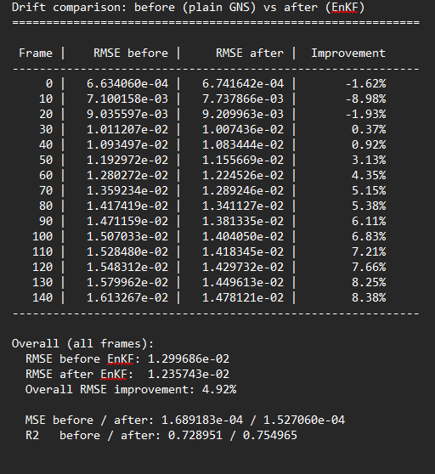
Dynamic GNS + EnKF Rollout Result
3000-Particles
4000-Particles
GNS+EnKF
Left to right in each clip: Reality(DEM)
Plain GNS

Slide 16
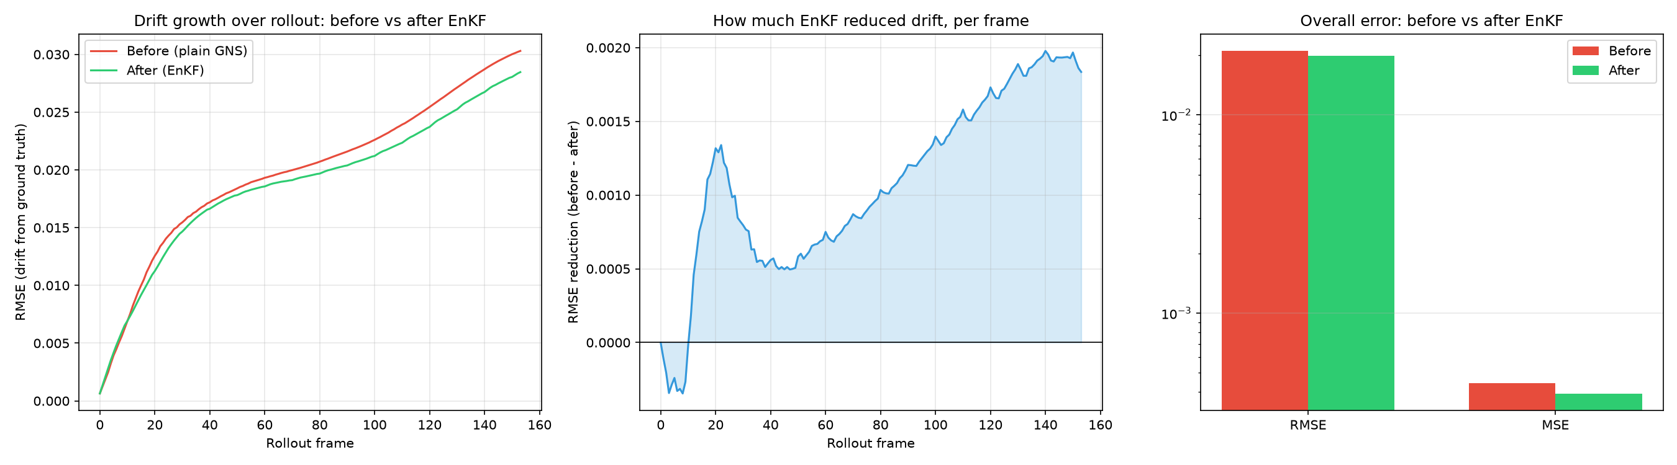
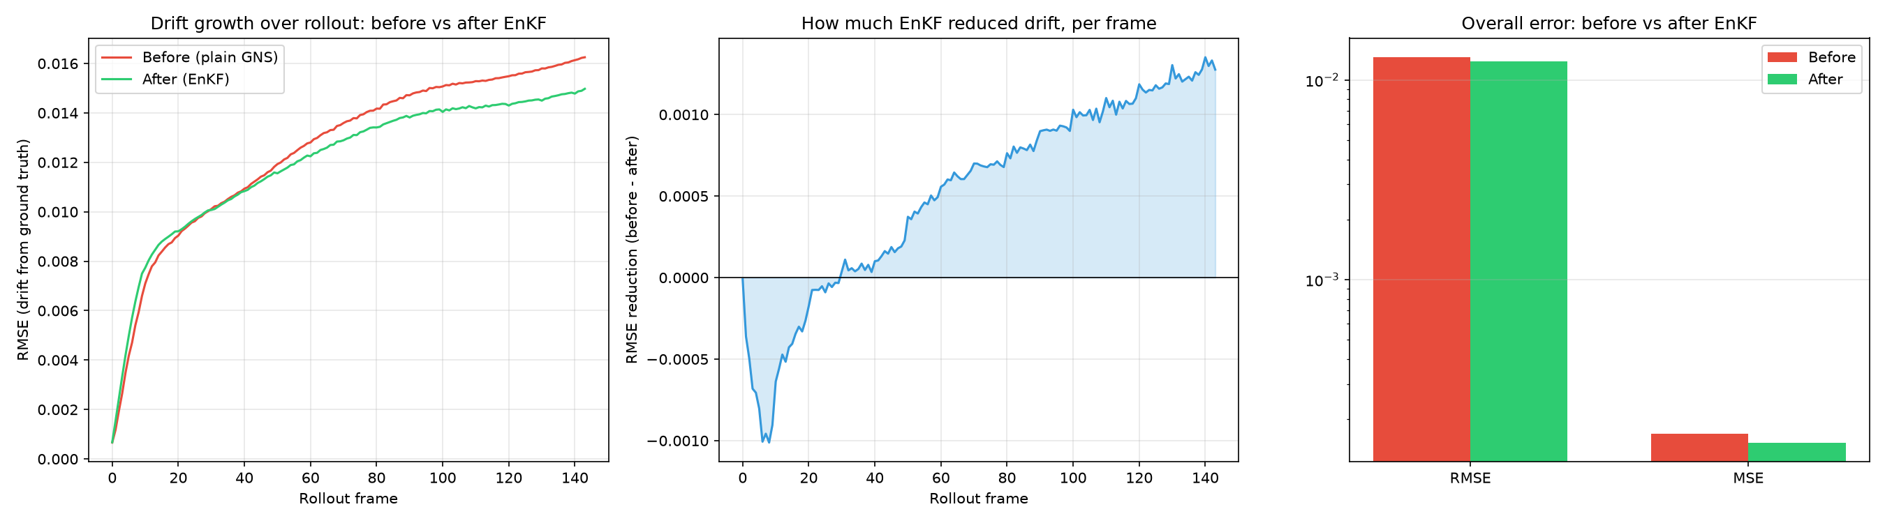
Drift Correction-Error Reduction
3000-Particles
4000-Particles

Slide 17
Conclusion
Built a GNS surrogate trained on DEM
Baseline rollout tracks the DEM reference
Left uncorrected, drift still accumulates over long rollouts.
The EnKF correction layer brings this back down by roughly an order of magnitude (9.3x at 3k, 12.9x at 4k) over the full-length rollout.
Together, this moves the surrogate closer to the real-time, reliable prediction industrial control loops (rotating drums, mixers) actually need — closing the loop back to the original motivation.

Slide 18
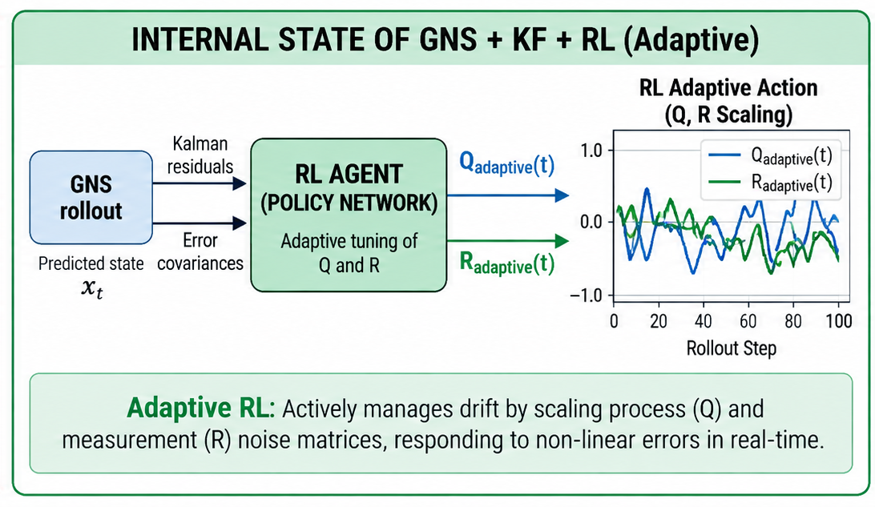
Future Work-Reinforcement Learning
Our future work, RL would learn how to dynamically adjust the Kalman Filter parameters so that
EnKF can apply the appropriate correction to particle trajectories.
Cross Domain Transfer Study

Slide 19
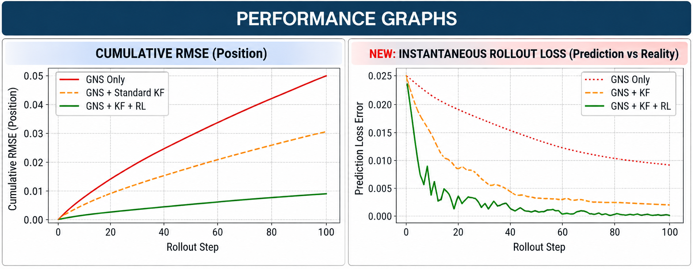
Impact
EnKF: It see’s an error, so it correct the particle trajectory
EnKF + RL : It learns how strongly EnKF should correct it.

Slide 20
Project Timeline & Future Work
Apr ‘26
May '26
Jun '26
Jul '26
Aug '26
Sep '26
Literature Review
Dataset Prep & Graph Construction
GNS Model Training (AOR/MoreFlow)
Hyperparameter Tuning (DOE)
Rollout Evaluation (RMSE, MAE, R²)
Kalman Filter
Future Work : Cross-Domain Transfer Study and RL + Enkf
Completed / In Progress
Planned (Future Work)

Slide 21
References
Research Papers
Learning to Simulate Complex Physics with Graph Networks
Sanchez-Gonzalez, A., et al., International Conference on Machine Learning (ICML), 2020
GNS: A Generalizable Graph Neural Network-based Simulator for Particulate and Fluid Modeling
Kumar, K. & Vantassel, J., Journal of Open Source Software, 2023.
Discrete Covariance Adaptation: Xiong, Wei, & Zhang (2021), Asian Journal of Control — Employs Q-learning to adapt EKF noise covariance, stabilizing non-linear tracking tasks.
Adaptive Noise Tuning: Gu, Li, & Tei (2022), IMCEC — Demonstrates reinforcement learning agents choosing dynamic covariance matrices under uncertain sensor and model noise.
Simulation & Dataset
LIGGGHTS – DEM simulation software used to generate the AOR and MoreFlow datasets.
Software & Frameworks
PyTorch
PyTorch Geometric
Graph Network Simulator (GNS)

Slide 22
P5: Prediction of Particle Trajectories using AI
AMS Lab Projects — Final Presentation
Thank You For Your Attention!
Sai Preetham Sata
Web: ams.ovgu.de
Mail: sai.sata@ovgu.de

