Slide 1
P5: Prediction of Particle Trajectories using AI
AMS Lab Projects-Intermediate Presentation
Guru Prasad Vastrala
Hari Charan Hosakote Lokesh
Hrishikesh Vijay Joshi
Jayakrishna Ajithkumar Jayasree
Autonomous Multisensor Systems Group
Institute for Intelligent Cooperating Systems
Faculty of Computer Science
Otto von Guericke University Magdeburg
02.07.2026

Slide 2
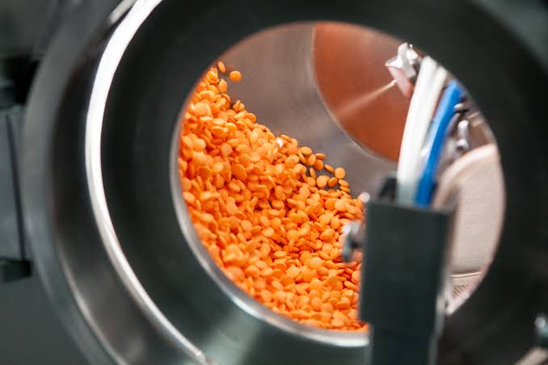
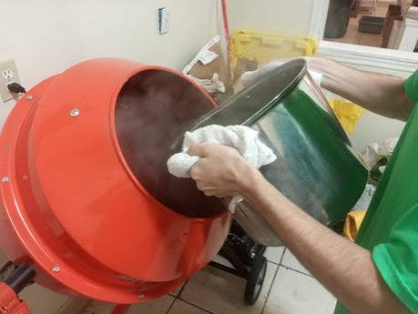
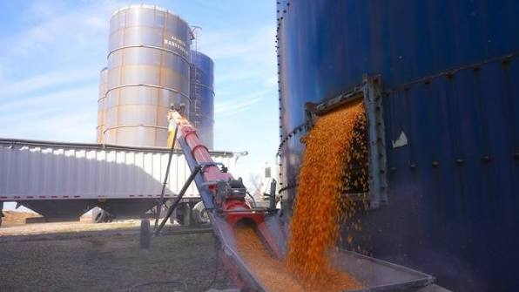
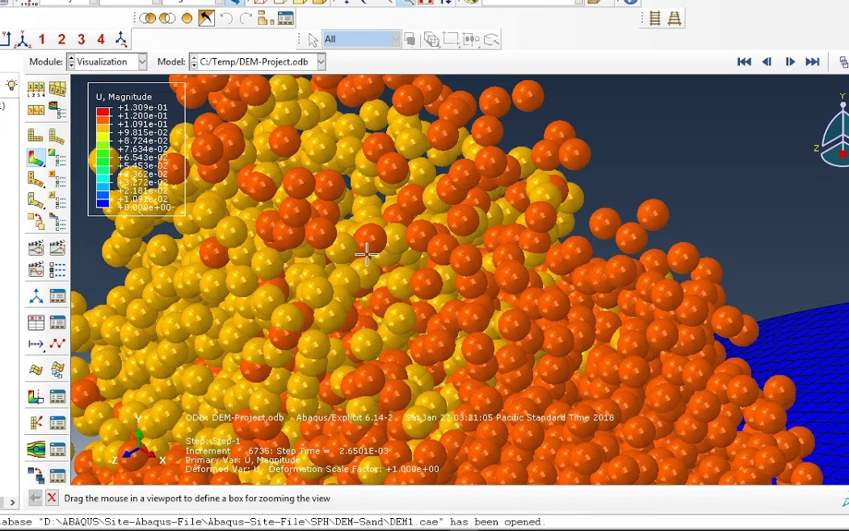
MOTIVATION
1. Industrial Need
Pharmaceutical tablet coating
Cement mixing
Grain silo filling
2. Computational Bottleneck
3. AI as Solution and its Challenges
GNS trained as a surrogate for DEM
Learn the physics once, deploy it fast
Inference in seconds vs hours for DEM
4.Disadvantages
Requires large DEM dataset to train on
Poor generalisation across different domains
Training itself is computationally expensive

Slide 3
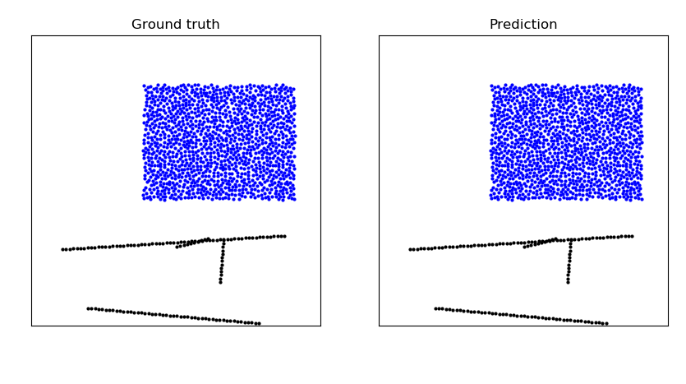
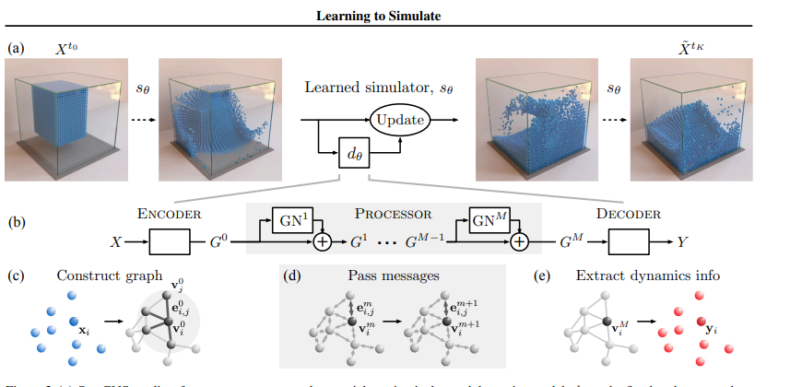
Machine Learning as an Alternative to DEM
How ML replaces DEM:
Graph Representation: Particles are nodes, neighbor interactions are edges.
GNN Modeling: Learns physics from trajectory data to predict future positions without runtime solvers.
Why it's a strong alternative:
Performance & Flexibility: Achieves massive speedups over DEM and generalizes to unseen conditions.
Efficiency & Integration: Learns contact parameters implicitly and supports real-time control or digital twins.
Fig 1
Fig 2

Slide 4
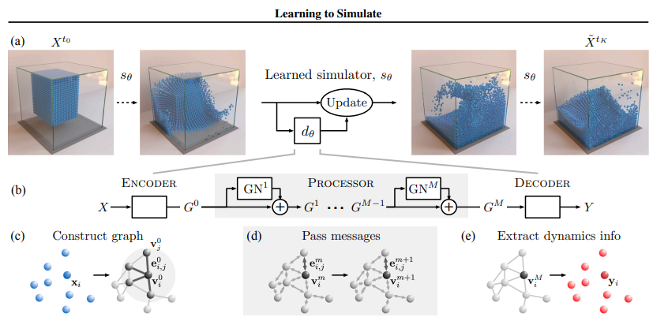
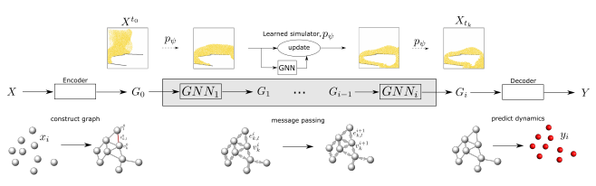
Literature Review
Kumar & Vantassel (2023) GNS: A Generalizable Graph Neural Network-based Simulator for Particulate and Fluid Modeling (JOSS, 2023)
PyTorch implementation of GNS for particulate and fluid systems.
This is the codebase we directly extend.
The PyTorch GNS framework, its training pipeline, and .npz data format serve as the starting point for training our AI surrogate on DEM particle trajectory data.
Sanchez-Gonzalez et al. (2020) Learning to Simulate Complex Physics with Graph Networks(2020)
Learning to simulate complex physical systems (fluids, sand, deformable materials) directly from data, replacing expensive traditional solvers.
Provides the foundational GNS architecture we build upon.
The encode-process-decode pipeline and noise-augmented training strategy directly inspire our surrogate model design for DEM particle trajectory prediction.
Fig 3
Fig 4

Slide 5
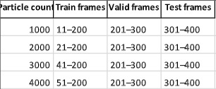
Introduction of Tasks
Dataset
LIGGGHTS DEM simulation data (AOR + MoreFlow scenarios)
1 trajectory per domain, 390 timesteps, 1344 particles
Data Split (temporal)
Train: frames 11–200 (190 timesteps)
Validation: frames 201–300 (100 timesteps)
Test: frames 301–400 (100 timesteps)
Graph Construction
Connectivity radius R = 0.006 m (~50 neighbours/particle)
Node features: position + last 5 velocity timesteps
Edge features: relative displacement between particle pairs
Training Setup
Framework: PyTorch GNS (Kumar & Vantassel, 2023)
Training steps: 200,000 (paper: 20M; limited by compute)
Input noise std: 3×10⁻⁴
Hardware: NVIDIA H100, OVGU ANTS HPC cluster
Hyperparameters Tested (DOE)
Connectivity radius: R ∈ {0.0012, 0.0025, 0.006} m
Training steps: 10,000 vs 200,000
Domains: AOR (settled) vs MoreFlow (dynamic)

Slide 6
Dataset Details
Dataset 1 — AOR (Angle of Repose)
Source: LIGGGHTS DEM simulator
400 CSV snapshots, 1 simulation run
3 particle sizes: 0.7mm, 1.0mm, 1.2mm (polydisperse)
Simulation box: ±0.05m (X,Y), –0.05 to +0.01m (Z)
Physics: particles settle into static dome/cone pile
Timestep dt = 0.0001 s
Shared Properties (Both Datasets)
Particle growth: 672 → 16,793 (batch injection every 10 files)
Stable particle count from file 241 onwards (16,793)
GNS particle type: 5 (granular), 3D coordinates
Dataset 2 — MoreFlow (Granular Flow)
Source: LIGGGHTS DEM simulator
400 CSV snapshots, 1 simulation run
3 particle sizes: 0.7mm, 1.0mm, 1.2mm (polydisperse)
Simulation box: ±0.049m (X,Y), –0.079 to –0.017m (Z)
Physics: active granular flow settling into donut/ring shape
Timestep dt = 0.0001 s
Key Difference from AOR
AOR captures settled physics (easy to learn)
MoreFlow captures dynamic flow (harder, higher training loss)
Used to study cross-domain surrogate transfer learning

Slide 7
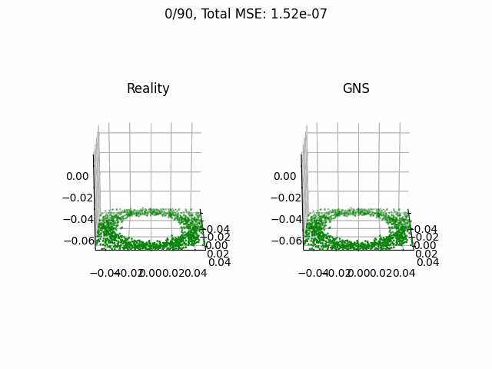
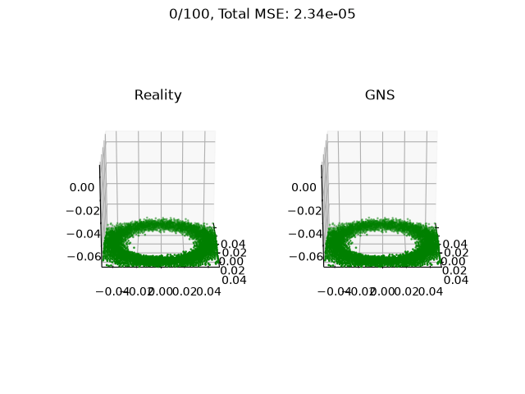
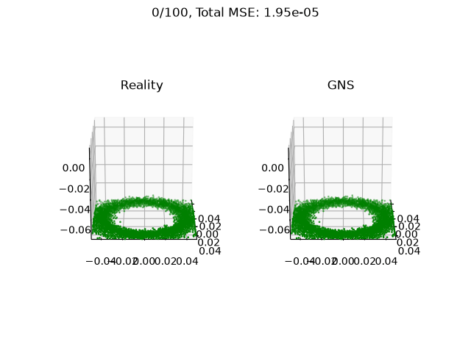
Current Results
MoreFlow
1000 Particles
2000 Particles
3000 Particles
4000 Particles
Metric | Value
RMSE | 3.899005e-04
MAE | 2.720306e-04
R² | 0.999925
Training Time | 45mins
Metric | Value
RMSE | 4.6094408026e-04
MAE | 3.3105502371e-04
R² | 0.9996961951
Training Time | 1 hrs 15mins
Metric | Value
RMSE | 0.00441
MAE | 0.00308
R² | 0.9902
Training Time | 5 hrs 07mins
Metric | Value
RMSE | 0.00484
MAE | 0.00369
R² | 0.9881
Training Time | 7 hrs 08 mins

Slide 8
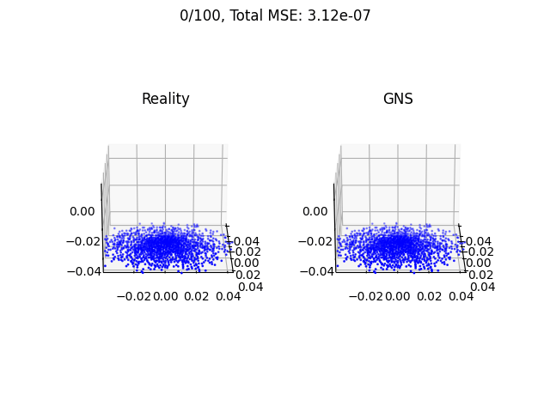
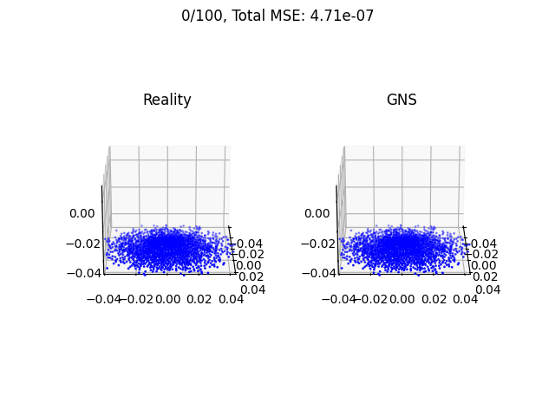
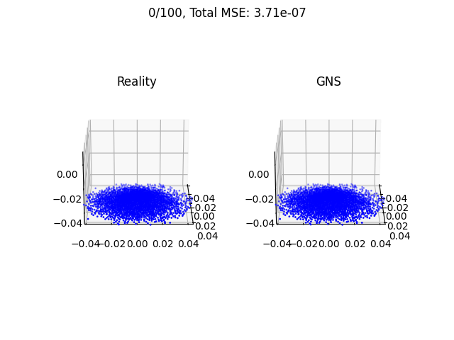
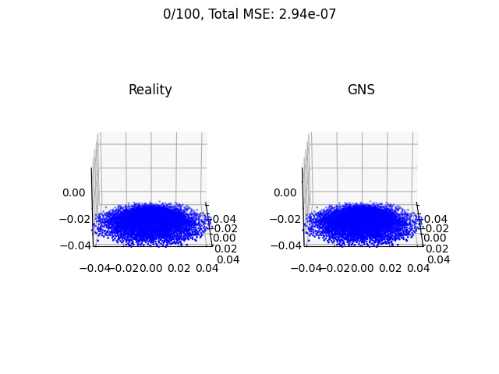
Current Results
AOR – Angle of Repose
1000 Particles
2000 Particles
3000 Particles
4000 Particles
Metric | Value
RMSE | 5.58e-04 m
MAE | 3.38e-04 m
R² | 0.9996
Training Time | 2h 26mins 15s
Metric | Value
RMSE | 6.86e-04 m
MAE | 4.35e-04 m
R² | 0.9993
Training Time | 4h 42mins 21s
Metric | Value
RMSE | 6.90e-04
MAE | 4.12e-04
R² | 0.9995
Training Time | 8h 30mins
Metric | Value
RMSE | 5.4198e-04 m
MAE | 3.8739e-04 m
R² | 0.9995
Training Time | 12h 10min

Slide 9
Project Timeline & Future Work
Apr ‘26
May '26
Jun '26
Jul '26
Aug '26
Sep '26
Literature Review
Dataset Prep & Graph Construction
GNS Model Training (AOR/MoreFlow)
Hyperparameter Tuning (DOE)
Rollout Evaluation (RMSE, MAE, R²)
Cross-Domain Transfer Study
Future Work: Kalman Filter
Completed / In Progress
Planned (Future Work)

Slide 10
Conclusion
To conclude, we successfully developed a GNN model that can predict particle trajectories with high accuracy while reducing the computational effort compared to DEM simulations.
Moving forward, we plan to improve the model using an Extended Kalman Filter and cross-domain transfer learning to make it more accurate and generalizable
Build a GNS surrogate trained on DEM data
Predict future particle trajectories
Reduce computational cost
Connectivity Radius Ablation Study

Slide 11
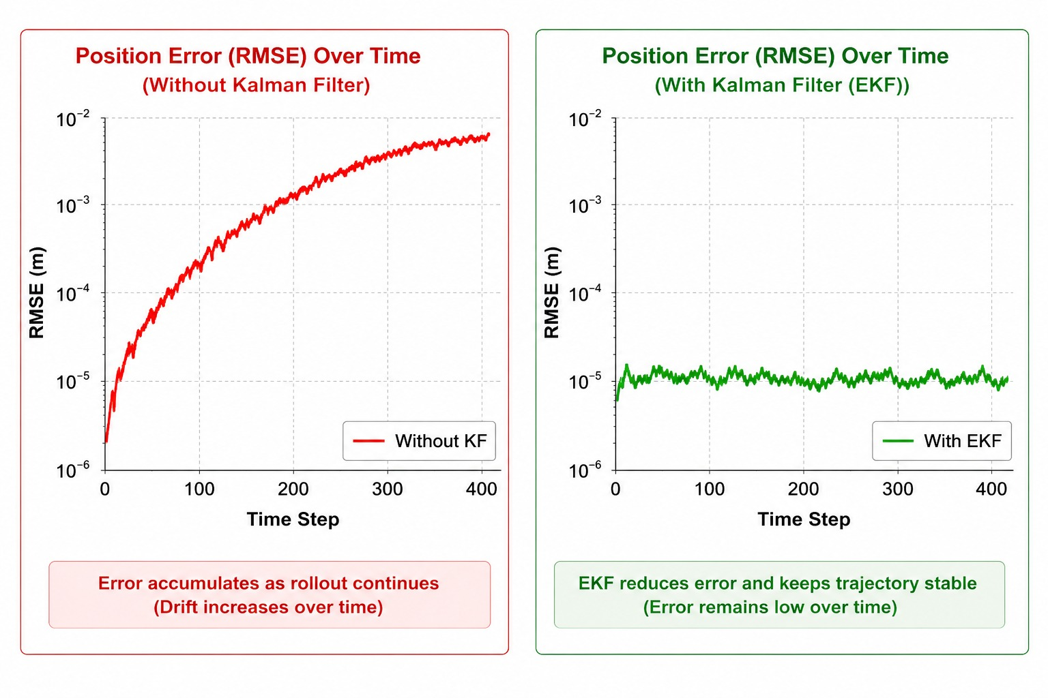
Future Work
Kalman Filter
Reduce long-rollout prediction errors.
Improve trajectory stability and accuracy.
Support real-time trajectory prediction.

Slide 12
References
Research Papers
Learning to Simulate Complex Physics with Graph Networks
Sanchez-Gonzalez, A., et al., International Conference on Machine Learning (ICML), 2020
GNS: A Generalizable Graph Neural Network-based Simulator for Particulate and Fluid Modeling
Kumar, K. & Vantassel, J., Journal of Open Source Software, 2023.
Simulation & Dataset
LIGGGHTS – DEM simulation software used to generate the AOR and MoreFlow datasets.
Software & Frameworks
PyTorch
PyTorch Geometric
Graph Network Simulator (GNS)

Slide 13
P5: Prediction of Particle Trajectories using AI
AMS Lab Projects-Intermediate Presentation
Thank You For Your Attention!

Slide 14
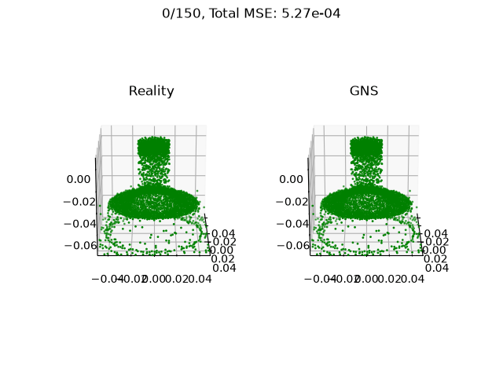
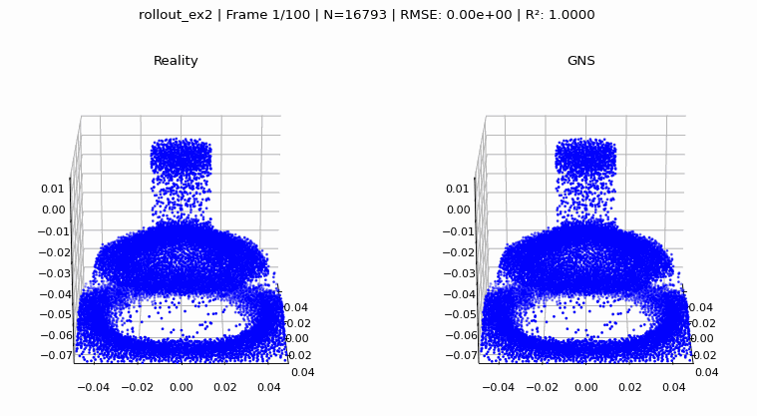
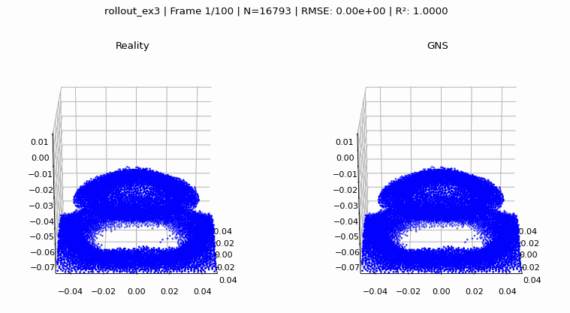
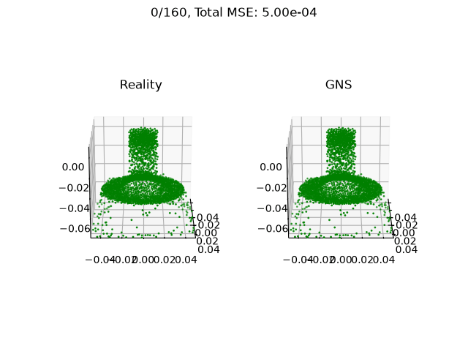
Appendix
Results for dynamical Flow
DEM Simulation

