Slide 1


DAA: CS321
Tutorial 7: Advanced DAA concepts
Paper Details:
Panel | Roll No. | Student name
E | 06 | Hrishikesh Vaze
‹#›
Notes:
‹#›

Slide 2
Paper 1
Parallel Algorithms for Adding a Collection of Sparse Matrices
‹#›
Notes:
‹#›

Slide 3
Findings
SpKAdd Algorithm is about adding k sparse matrix
SpKAdd is a much needed operation in many application including distributed memory sparse matrix-matrix multiplication(SpGEMM), streaming accumulations of graphs, and algorithmic sparsification of the gradient updates in deep learning
‹#›
Notes:
‹#›

Slide 4
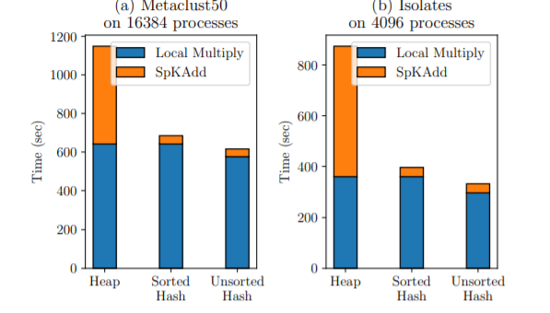
Comparison
‹#›
Notes:
‹#›

Slide 5
Limitations
Limitation is the assumption that all the sparse matrix will get fitted in main memory.
‹#›
Notes:
‹#›

Slide 6
Future Scope
As SpKAdd Algorithm assumes that all matrices will be fitted in main memory,
We know that main memory is limited.
SpKAdd processes in batch, taken from main memory.
Making of such algorithm which also supports streaming process instead of batch is the future work.
‹#›
Notes:
‹#›

Slide 7
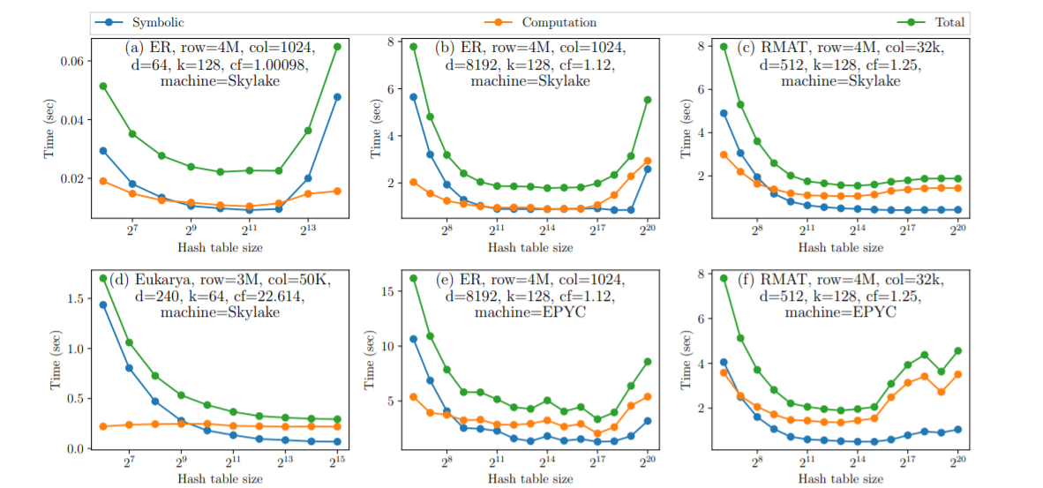
Experimental Results
‹#›
Notes:
‹#›

Slide 8
Conclusion
SpKAdd implemented using off-the-shelf 2-way additions is not work efficient and accesses more data from memory.
A family of shared-memory parallel SpKAdd algorithms is developed that rely on heap, SPA, and hash table data structures to add matrices column by column.
Among all these family of algorithms, the variant using hash table is efficient and works with both sorted and unsorted input matrices.
‹#›
Notes:
‹#›

Slide 9
Paper 2
Simple Parallel Algorithms for Single-Site Dynamics
‹#›
Notes:
‹#›

Slide 10
Findings
The single-site dynamics are a canonical class of Markov chains for sampling from high dimensional probability distributions.
Sampling from high-dimensional distributions is one of the central problems in various fields of modern computer science.
Parallel MCMC sampling - The samples produced by single-site dynamics are crucial for the Monte Carlo calculations of partition functions whose computation in turn is crucial for statistical inference, a task that is more and more frequently asked to be resolved by parallel computing.
*
‹#›
Notes:
‹#›

Slide 11
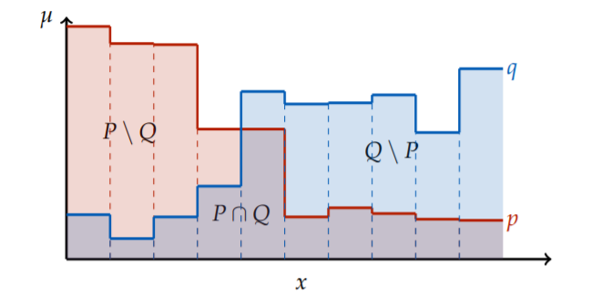
Optimality of Algorithm in Worst Case
‹#›
Notes:
‹#›

Slide 12
Limitations
As this algorithm is generic algorithm, we didn’t found any limitations.
‹#›
Notes:
‹#›

Slide 13
Future Scope
Randomisation of the same algorithm is the future scope
‹#›
Notes:
‹#›

Slide 14
Conclusion
Thus given a simple and generic parallel algorithm for faithful simulation of single-site dynamics.
our parallel simulation algorithm transforms single-site dynamics with optimal O(n log n) mixing time to RNC algorithms for sampling.
In the heart of this algorithm, there is a universal coupling protocol, which universally couples all distributions over the same finite sample space.
‹#›
Notes:
‹#›

