Slide 1
Micro Frontends
Seminar Review 2
Guide Name: Prof. Aparna Kamble
By Hrishikesh Vaze
Panel B
Roll No 76

Slide 2
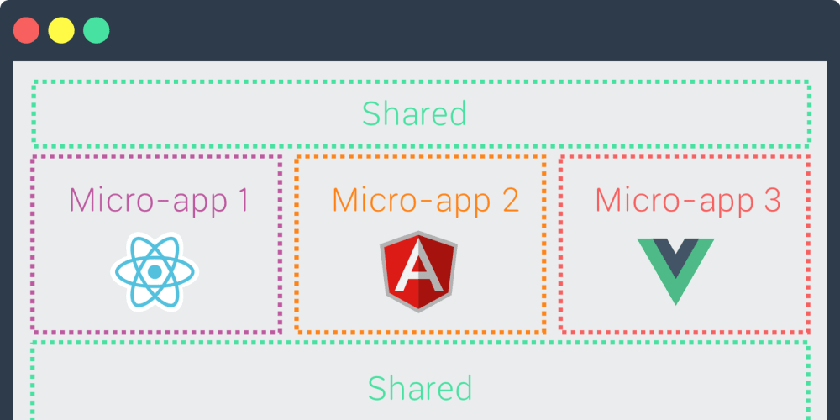
Introduction
Micro Frontends is a new architecture inspired by Micro Services.
Here, We try to break a Monolithic big codebase into Smaller codebases.
Notes:
Recently started in late 2016

Slide 3
Literature Review
Sr No. | Title of the Paper | Year of Publication | Advantages | Gap of the Paper
1 | Microservices: Yesterday, Today, and Tomorrow | 2017 | All the information of service-oriented architecture is given in detail. | No gap was found in this paper.
2 | Research and Application of Micro Frontends | 2019 | Paper neatly presents the real concept of micro frontends with a good example, covering every methods of achieving it. | They have given more practical knowledge, instead of theory knowledge.

Slide 4
Literature Review
Sr No. | Title of the Paper | Year of Publication | Advantages | Gap of the Paper
3 | Motivations, benefits, and issues for adopting Micro-Frontends: A Multivocal Literature Review | 2021 | They have explained in detailed each and every part of micro frontends, from reasons to its issues. | Their data used in their research might be inaccurate, or may be incomplete.
4 | A platform for enhancing application developer productivity using microservices and micro-frontends | 2020 | Paper discusses about a complete system design using microservices and micro frontends. | They have only mentioned an abstract way of achieving requirements with the help of MSs and MFs.

Slide 5
Literature Review
Sr No. | Title of the Paper | Year of Publication | Advantages | Gap of the Paper
5 | Micro-frontends: application of microservices to web front-ends | 2020 | They have discussed history of MFs and theoretical knowledge along with an example. | They have discussed types of achieving MFs in brief.
6 | From Backend to Frontend Case study on adopting Micro Frontends from a Single Page ERP Application monolith | 2021 | They have done excellent case study on micro frontends, discussing advantages, disadvantages, reasons, threats, and quality assurance testing with examples. | No gap was found in this paper.

Slide 6
References
Dragoni, N. et al. (2017). Microservices: Yesterday, Today, and Tomorrow. In: Mazzara, M., Meyer, B. (eds) Present and Ulterior Software Engineering. Springer, Cham. https://doi.org/10.1007/978-3-319-67425-4_12
Caifang Yang et al 2019 IOP Conf. Ser.: Mater. Sci. Eng. 490 062082. https://doi.org/10.1088/1757-899X/490/6/062082
Severi Peltonena, Luca Mezzalirab, Davide Taibia 2021. Motivations, benefits, and issues for adopting Micro-Frontends: A Multivocal Literature Review. https://doi.org/10.1016/j.infsof.2021.106571
P. Y. Tilak, V. Yadav, S. D. Dharmendra and N. Bolloju, "A platform for enhancing application developer productivity using microservices and micro-frontends," 2020 IEEE-HYDCON, 2020, pp. 1-4, doi: 10.1109/HYDCON48903.2020.9242913.
Pavlenko, Andrei & Askarbekuly, Nursultan & Megha, Swati & Mazzara, Manuel. (2020). Micro-frontends: application of microservices to web front-ends. 10.22667/JISIS.2020.05.31.049.

