Slide 1

Computer Organization and Architecture
(CET205A)
Shamla Mantri
Department of Computer Science and Engineering

Slide 2

Name of Subject :
Computer Organization and Architecture (CET215A) (Credits 2)
Module 1: (7)
Computer Function, Interconnections and Evolution
===============================================
Module 2: (8)
Computer Arithmetic
===============================================
Module 3: (8)
Processor Organization and Control Unit
===============================================
Module 4: (7)
Memory and Parallel Processor Organizations

Slide 3
Objectives & Outcomes
Objectives :
To acquire the knowledge of structure, function and evolution of computer systems.
To design Arithmetic Logical Unit and Control Unit of digital computers.
To understand instruction level parallelism and internal processor organization.
To gain the conceptual knowledge of Cache memory and multiple processor organization.
Outcomes :
On completion of the course, student will be able to –
Demonstrate computer architecture concepts related to design of modern processors and compare various generation of processors.
Design arithmetic functional units such as: Adder, Subtractor , Multiplier and Division units.
Obtain the knowledge of processor structure and its functions for internal designing of processor organization.
Design the size of the cache for the various processor organizations.

Slide 4
Contents
Module 1
Computer Function, Interconnections and Evolution
Computer Organization and Architecture,
Structure and Function
A brief history of computer
Evolution of Intel microprocessor from 4004 to core i7
Comparison of various generations of microprocessor
Computer components and functions
Characteristics of Reduced Instruction Set Architectures
CISC versus RISC Characteristics.

Slide 5
Objectives & Outcomes
Module_1
Objective
To acquire the knowledge of structure, function and evolution of computer systems.
Outcome:
On completion of the course, student will be able to –
Demonstrate computer architecture concepts related to design of modern processors and compare various generation of processors.

Slide 6
List of References
Sr. No. | Name of Topic | Name of Web links or Ref. Book | Chapter Number and Page no
1. | Computer Organization and Architecture, Structure and Function | William Stallings, “Computer Organization and Architecture: Designing for performance” Pearson Education/ Prentice Hall of India, 2003, ISBN 978-93-325-1870-4, 8th Edition | T1 ( Chapter No.1) Page No. 8 to 15
2. | A brief history of computer |  | T1 ( Chapter No.2) Page No. 17 to 22
3. | Evolution of Intel microprocessor from 4004 to core i7 | Page No. 45 to 47 PPT | T1 (7th Edition/ Chapter No.2)

Slide 7
-cont
Sr.No. | Name of Topic | Name of Books ( write Edition also) / Weblinks | /Chapter No and Page no
4. | Comparison of various generations of microprocessor | Page No. 36 to 38 Source: Intel Corp. http://www.intel.com/intel/museum | T1 (7th Edition/ Chapter No.2)
5. | Computer components and functions | Page No. 65 to 74 | T1( Chapter No.3)
6. | Characteristics of Reduced Instruction Set Architectures, | Page No. 496 to 499 | T1( Chapter No.3)
7. | CISC versus RISC Characteristics. |  | T1( Chapter No.13)

Slide 8
Computer Organization and Architecture
Computer Organization | Computer Architecture
Concern with structure and behavior of system as seen by user. | Concerned with the way hardware component are connected together
Deals with component connection in a system | Acts as interface between hardware and software
Specifies How all the all units in system are arranged and interconnected. | Helps us to understand functionality of system
Organization is based on architecture | While designing the system architecture is considered first
Computer Organization deals with low-level design issues. | Computer Architecture deals with high-level design issues.
Organization involves Physical Components (Circuit design, Adders, Signals, Peripherals) | Architecture involves Logic (Instruction sets, Addressing modes, Data types, Cache optimization)

Slide 9
Computer Organization and Architecture
Computer Organization:
The internal arrangement of computer, which includes the design of the processor, memory and input/output circuits.
Computer Architecture:
Describes features of a computer family (notably the instructions) and not the specific implementation, just like architecture of a house. Instruction set, Addressing types.
Computer Architecture = Instruction Set Architecture + Machine Organization

Slide 10
The Five Classic Components of a Computer
Input (mouse, keyboard, …)
Output (display, printer, …)
Memory
main (DRAM), cache (SRAM)
secondary (disk,
CD, DVD, …)
Datapath
Control
Input
Output
Processor
Control
Memory
1001010010110000
0010100101010001
Datapath
1111011101100110
1001010010110000
1001010010110000
1001010010110000

Slide 11
The Instruction Set: a Critical Interface
software
instruction set
hardware

Slide 12
Instruction Set Architecture
A very important abstraction:
interface between hardware and low-level software
standardizes instructions, machine language bit patterns, etc.
advantage: allows different implementations of the same architecture
disadvantage: sometimes prevents adding new innovations
Modern instruction set architectures:
80x86/Pentium/K6, PowerPC, DEC Alpha, MIPS, SPARC, HP

Slide 13
What is Computer Architecture? Better (More Detailed) Answer
Application
Operating
System
Compiler
Firmware
Instruction Set
Architecture
Instars. Set Proc.
I/O system
Datapath & Control
Digital Design
Circuit Design
Layout

Slide 14
Forces on Computer Architecture
Technology
Programming
Languages
Applications
Computer
Architecture
Operating
Systems
History

Slide 15
Computer Organization and Architecture
All Intel x86 family share the same basic architecture
The IBM System/370 family share the same basic architecture
Structure & Function:
Structure is the way in which components relate to each other (interrelated)
Function is the operation of individual components as part of the structure

Slide 16
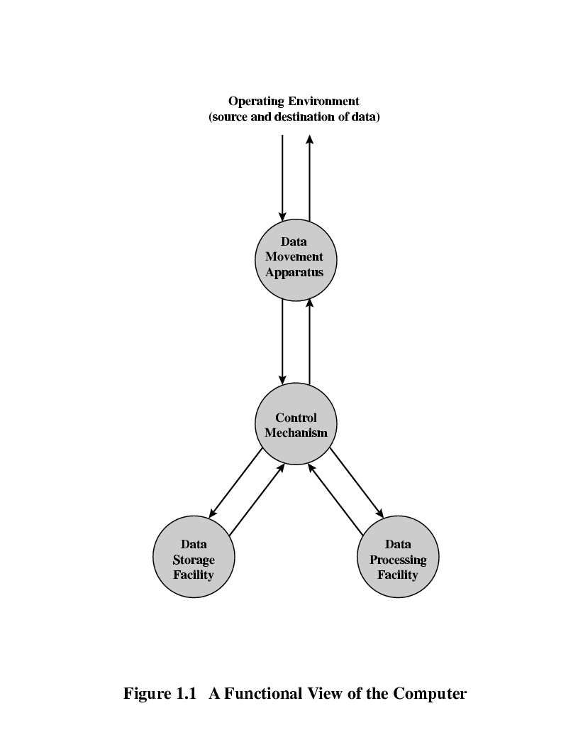
Function
All computer functions are:
Data movement
Data storage
Data processing
Control
A Functional view of the Computer

Slide 17
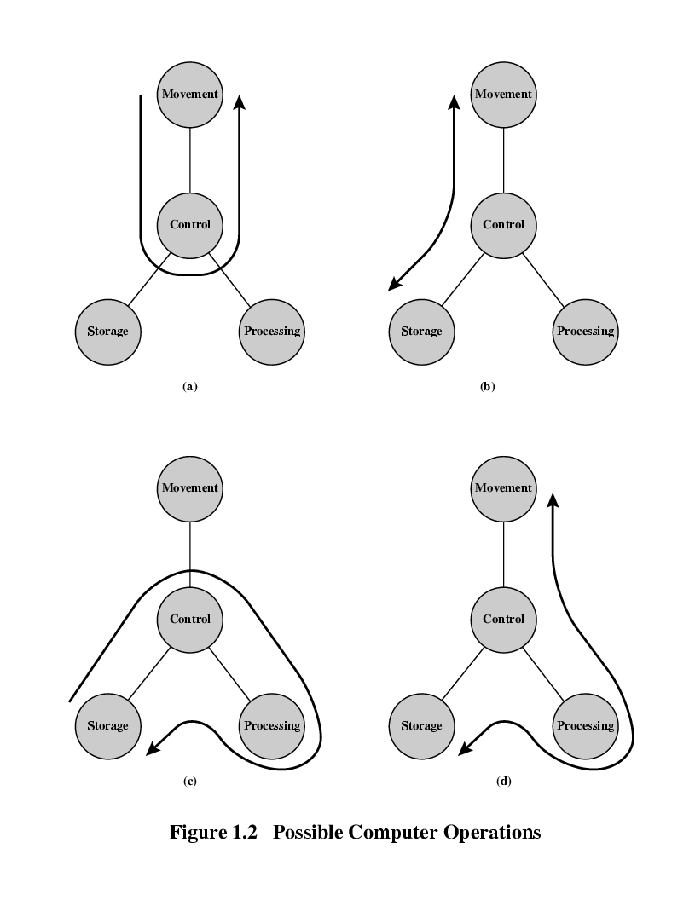
Operations (1) Data movement

Slide 18
Operations (2) Storage (Read or Write)

Slide 19
Operation (3) Processing from/to storage

Slide 20
Operation (4) Processing from storage to I/O

Slide 21
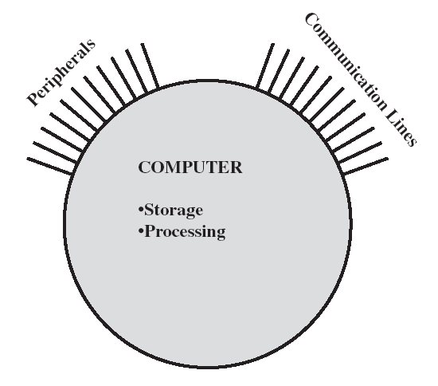
Structure
Two methods: Top-Down and Down-Top
The Computer
CPU
Controls the operation of the computer and performs its data processing functions.
Main memory
Stores data
I/O
Moves data between the computer and its external environment
System interconnection
Provides for communication among CPU, main memory, and I/O

Slide 22
Structure - Top Level
Peripherals
Computer
Central
Processing
Unit
Main
Memory
Computer
Systems
Interconnection
Input
Output

Slide 23
Structure - The CPU
CPU
Computer
Arithmetic
and
Logic Unit
I/O
Registers
System
Bus
CPU
Internal CPU
Interconnection
Memory
Control
Unit

Slide 24
Structure - The Control Unit
Control Unit
CPU
Sequencing
Logic
ALU
Control Unit
Registers and
Decoders
Internal
Bus
Control
Unit
Registers
Control
Memory

Slide 25
A brief history of computer https://www.youtube.com/watch?v=xrUvFJWlYCY
The First Generation (Electronic Computer): Vacuum Tubes
Electronic Numerical Integrator and Computer (ENIAC)
John Presper Eckert and John Mauchly
University of Pennsylvania
Trajectory tables for weapons (World War II)
Started 1943
Finished 1946
Decimal rather than binary machine
-Too late for war effort
Used until 1955
Weight-30 tons,
Space-1500 square feet
Vacuum tubes-18,000
Power-140 kilowatts

Slide 26
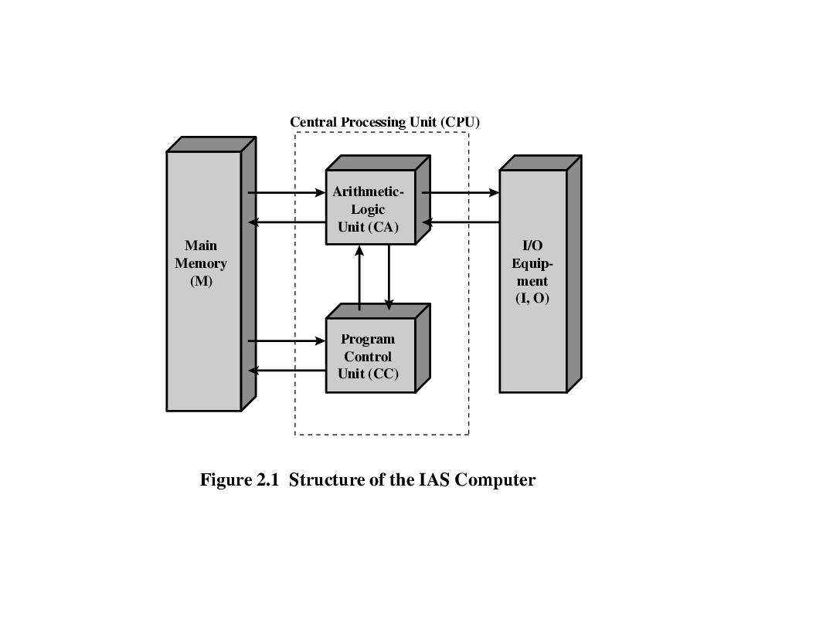
Structure of Von Neumann Machine (General purpose computer-Store program concept)

Slide 27
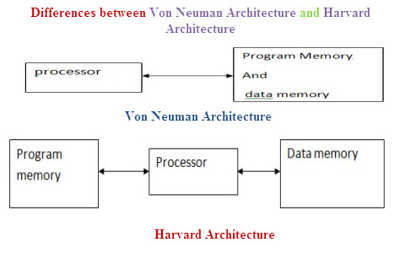
Structure of Von Neumann and Harvard Architecture

Slide 28
Von Neumann Machine
Stored Program concept
Main memory storing programs (code) and data
ALU operating on binary data
Control unit interpreting instructions from memory and executing
Input and output equipment operated by control unit
Princeton Institute for Advanced Studies (IAS)
Completed 1952

Slide 29
Difference between Von Neumann and Harvard Architecture
Von Neumann Architecture | Harvard Architecture
It is named after the mathematician and early computer scientist John Von Neumann. | The name is originated from “Harvard Mark I” a relay based old computer.
It required only one memory for their instruction and data. | It required two memories for their instruction and data.
Design of the von Neumann architecture is simple. | Design of Harvard architecture is complicated.
Von Neumann architecture is required only one bus for instruction and data. | Harvard architecture is required separate bus for instruction and data.
Processor needs two clock cycles to complete an instruction. | Processor can complete an instruction in one cycle
Low performance as compared to Harvard architecture. | Easier to pipeline, so high performance can be achieve.
It is cheaper. | Comparatively high cost.

Slide 30

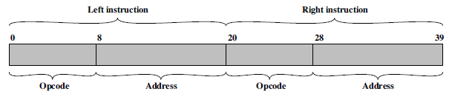
IAS (Institute for Advanced Studies) - details
1000 (storage locations) x 40 bit (of each) words
Binary number
2 x 20 (8 bit-opcode+12 bit-address) bit instructions
(b) Instruction word
Set of registers (storage in CPU)
Memory Buffer Register (MBR)
Memory Address Register (MAR)
Instruction Register (IR)
Instruction Buffer Register (IBR)
Program Counter (PC)
Accumulator (AC)
Multiplier Quotient (MQ)

Slide 31
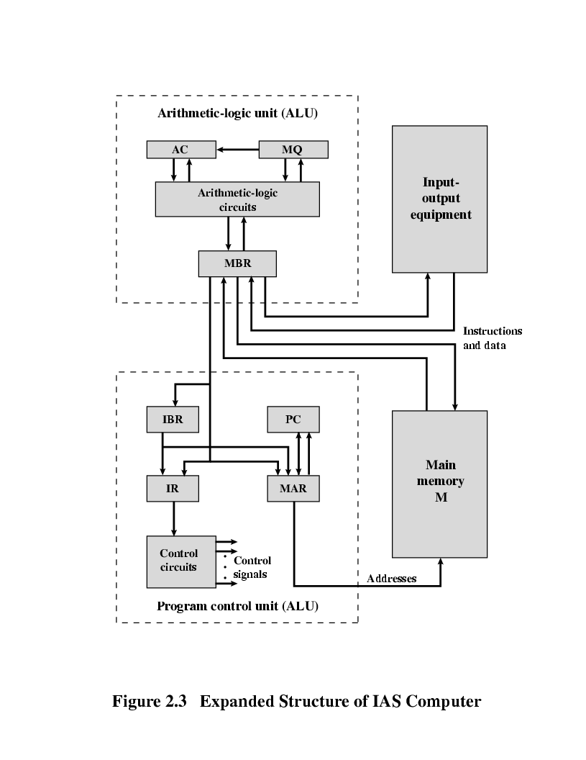
Structure of IAS (Institute for Advanced Studies) – detail
https://www.youtube.com/watch?v=mVbxrQE4f90 (up to time 5.17)
Memory:
1. LOAD M(X) 500, ADD M(X) 501
2. STOR M(X) 500, (Other Instruction)
3
4

Slide 32
Structure of IAS (Institute for Advanced Studies) – Registers
Memory buffer register (MBR):
Contains a word to be stored in memory or sent to the I/O unit, or is used to receive a word from memory or from the I/O unit.
Memory address register (MAR):
Specifies the address in memory of the word to be written from or read into the MBR.
Instruction register (IR):
Contains the 8-bit opcode instruction being executed.
Instruction buffer register (IBR):
holds temporarily the right hand instruction from a word in memory.
PC:
Connected to the internal address bus, the Program Counter holds the address in memory of the next program instruction. Notice that it doesn’t connect directly to the memory, but must go via the MAR.
Accumulator (AC) and Multiplier Quotient (MQ):
Hold temporary operands and result of ALU operation.
Ex. 40bit *40 bit=80 bit then AC=MSB (40 bit) and MQ=LSB (40 bit)

Slide 33
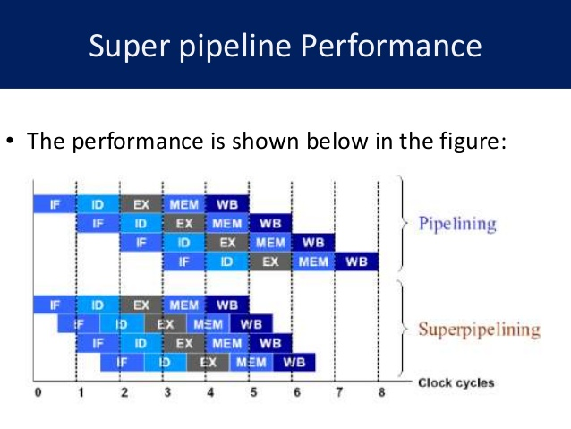
Intel Pentium Pro
Super pipelining (increase performance by reducing the clock cycle time)
Integrated Level 2 Cache
32-Bit Optimization
Wider Address Bus
Greater Multiprocessing
Out of Order Completion (dynamic execution)
Speculative Execution (an optimization technique where a computer system performs some task that may not be needed)

Slide 34
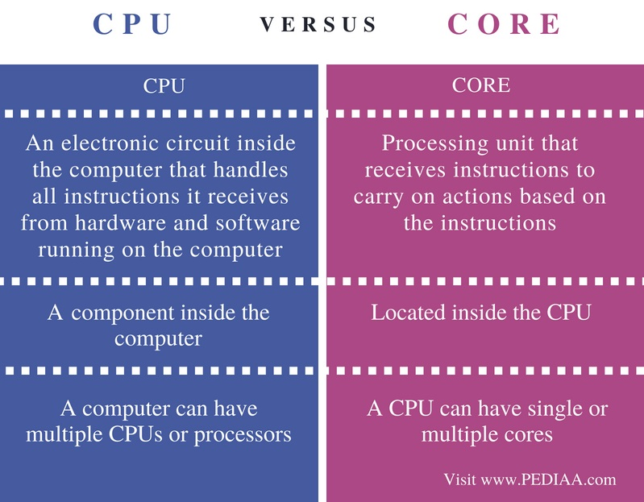
CPU and Core Difference

Slide 35
Core Processor
Core
First x86 with dual core
Core 2
64 bit architecture
Core 2 Quad – 3GHz – 820 million transistors
Four processors on chip
x86 architecture dominant outside embedded systems
Organization and technology changed dramatically
Instruction set architecture evolved with backwards compatibility
~1 instruction per month added
500 instructions available
See Intel web pages for detailed information on processors

Slide 36
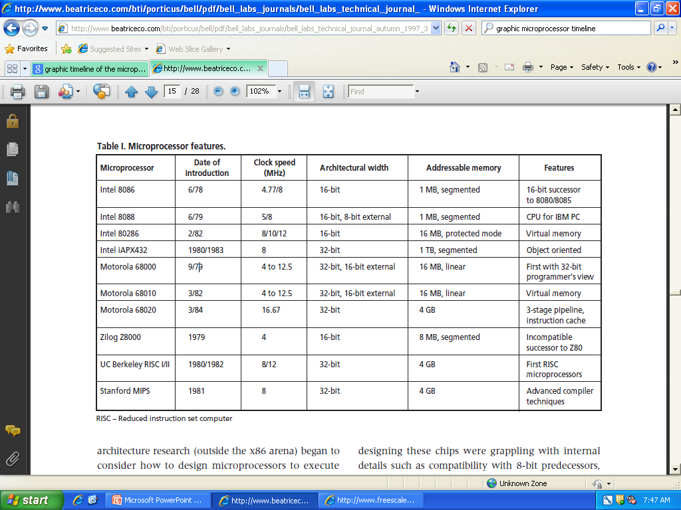
Comparison of various generations of microprocessor
https://www.youtube.com/watch?v=xrUvFJWlYCY

Slide 37
The Modern Difference
The Intel 4004 | Intel Core Processor
3mm by 4mm chip. | 37.5mm x 37.5mm.
10 micron technology. | Ball micro technology.
2300 transistors. | Over 2,000,000,000 transistors.
Initially US $200. | Initially US $294.
Can address 640 bytes. | Can address 8 Megabytes
500 kHz to 740 kHz. | 9.29 GHz.
Typically 60000 instructions/sec. | Typically 68,719,476,736 instructions/sec.
50-- 8 bit instructions (originally only had 46 instructions). | Latest 64 Bit instructions.

Slide 38
Computer Components and Functions
CU and ALU: The Control Unit and the Arithmetic and Logic Unit constitute the Central Processing Unit
I/O: Data and instructions need to get into the system and results out
Input/output
Memory: Temporary storage of code and results is needed
Main memory

Slide 39
Function of Control Unit
For each operation a unique code is provided. e.g. ADD, MOV.
A hardware segment accepts the code and issues the control signals.
The basic function performed by a computer is execution of a program, which consists of a set of instructions stored in memory.
The processor does the actual work by executing instructions specified in the program

Slide 40
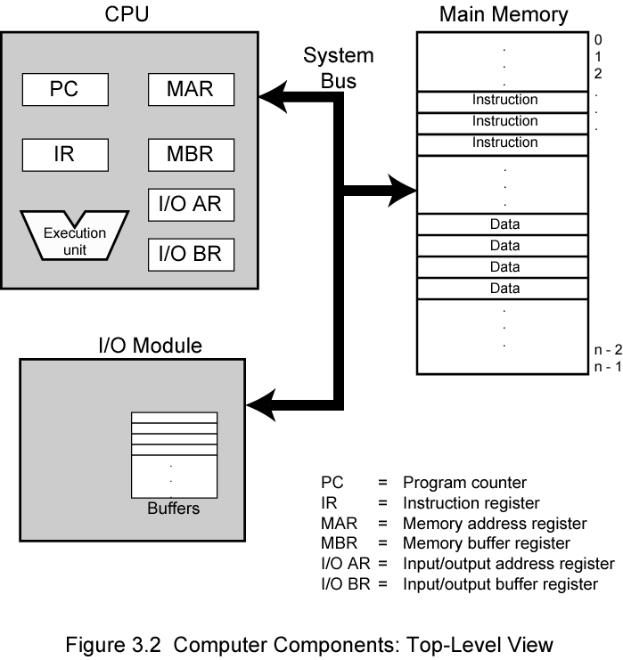
Computer Components: Top Level View

Slide 41
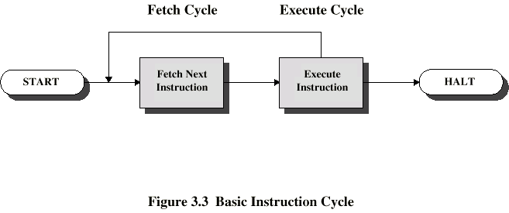
Instruction Cycle
Two steps:
Fetch
Execute

Slide 42
Fetch Cycle
Program Counter (PC) holds address of next instruction to fetch
Processor fetches instruction from memory location pointed to by PC
Increment PC
Unless told otherwise
Instruction loaded into Instruction Register (IR)
Processor interprets instruction and performs required actions

Slide 43
Execute Cycle
Processor-memory
data transfer between CPU and main memory
Processor I/O
Data transfer between CPU and I/O module
Data processing
Some arithmetic or logical operation on data
Control
Alteration of sequence of operations
e.g. jump
Combination of above

Slide 44
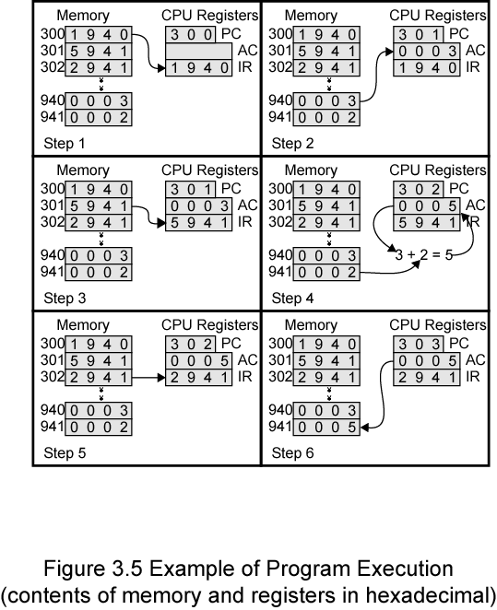
Example of Program Execution
Problem: Add the contains of memory word at address 940 to the memory word at address 941 and stores the result in the latter location (941).
Note: 300 address of first instruction.
The instruction 1940 Hex: load AC

Slide 45
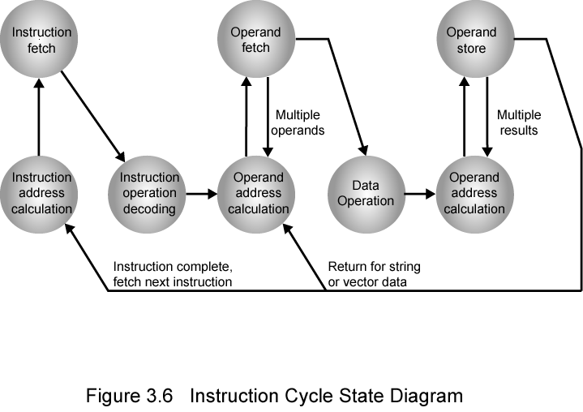
Instruction Cycle State Diagram

Slide 46
Difference between RISC and CISC
BASIS FOR COMPARISON | RISC (Reduced Instruction Set Computer) | CISC (Complex Instruction Set Computer)
Emphasis on | Software | Hardware
Includes | Single clock | Multi-clock
Instruction-set size | Small | La7rge
Instruction formats | fixed (32-bit) format | Varying formats (16-64 bits each instruction).
Addressing modes used | Limited to 3-5 | 12-24
General purpose registers used | 32-192 | 8-24
Memory inferences | Register to register | Memory to memory
Cache design | Split data cache and instruction cache. | Unified cache for instructions and data.
Clock rate | 50-150 MHz | 33-50 MHz
CPU Control | Hardwired without control memory. | Microcoded using control memory (ROM).

Slide 47
Difference between RISC and CISC
BASIS FOR COMPARISON | RISC (Reduced Instruction Set Computer) | CISC (Complex Instruction Set Computer)
Pipeline | High Pipelined | Not or less Pipelined
Data Transfer | Register to Register | Memory to Memory
Instruction refer to the Memory | Only load and store | All
Used in | Portable devices, Apple iPod, Smart phone, Tablets | Desktop, Laptops
Set of instructions | Highly optimized | Less optimized
RAM is required to store instruction | High | Very less
Instruction decoding logic | Simple | complex
Program length | Large | Small
Example: Multiply 2 Numbers | LW A, 203 ;Load LW B, 502 ;Load MULT A,B SW 203,A ;Store | MULT 203,502

Slide 48
Characteristics of Reduced Instruction Set Architectures
Large number of general purpose registers or use of compiler technology to optimize register use
Limited and simple instruction set
Emphasis on optimizing the instruction
Pipeline
One instruction per cycle
Register-to-register operations
Simple addressing modes

Slide 49
Characteristics of Reduced Instruction Set Architectures
Simple instruction formats
One machine instruction per machine cycle
Machine instruction is directly executed by H/W
Only LOAD/STORE instructions access memory
Instruction set and control unit can be simplified
RISC may have only one or two ADD instructions
VAX(CISC) has 25 different ADD instructions

Slide 50
Characteristics of Reduced Instruction Set Architectures
Simple addressing modes
– Almost all instructions use simple register addressing
—Simple instruction formats
– Only a few formats are used
– Instruction length is fixed and aligned on word boundaries

Slide 51
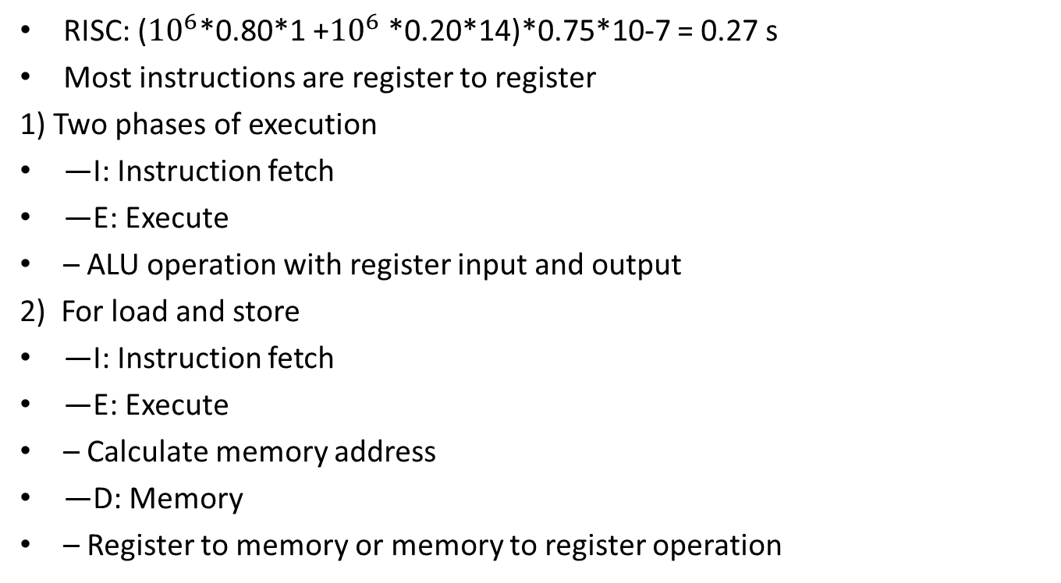
Characteristics of Reduced Instruction Set Architectures

Slide 52
Comparison of Processors

Slide 53
Driving force for CISC
Software costs far exceed hardware costs
• Increasingly complex high level languages
• Semantic gap
• Leads to:
—Large instruction sets
—More addressing modes
—Hardware implementations of HLL statements
– e.g. CASE (switch) on VAX

Slide 54
Intention of CISC
Ease compiler writing
Improve execution efficiency
Complex operations in microcode
Support more complex HLLs

Slide 55
Thank You

