Slide 1
Introduction to DELD Lab

Slide 2

Syllabus (Contd..)
List of Assignments:
To Realize 3 bit Binary to Gray and 3 bit Gray to Binary code converter using Logic Gates.
Realize following functions using IC 74153
a) Half adder b) 8:1 Mux ( Σ m (0,2,4,7) )
Design and implement 3 bit Synchronous Up Counter using IC7476.
Design and implement MOD 10, MOD 100 and MOD N counter using IC 7490.
Draw ASM chart for real life digital system ( e.g. Washing Machine, Vending Machine, Elevator control, ATM machine).
Design & simulate 4 bit up/down synchronous counter using Behavioral modeling in VHDL.
Design & simulate 4:1 Multiplexer using Dataflow modeling in VHDL.
Design & simulate Full adder using structural modeling in VHDL.

Slide 3
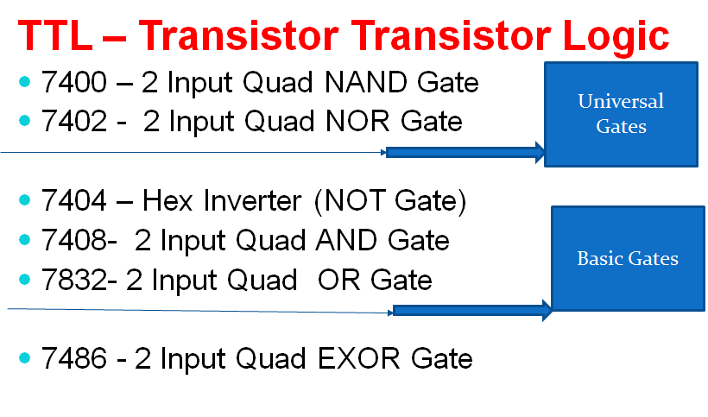
Logic Families and ICs

Slide 4
Logic Levels
Positive Logic levels

Slide 5
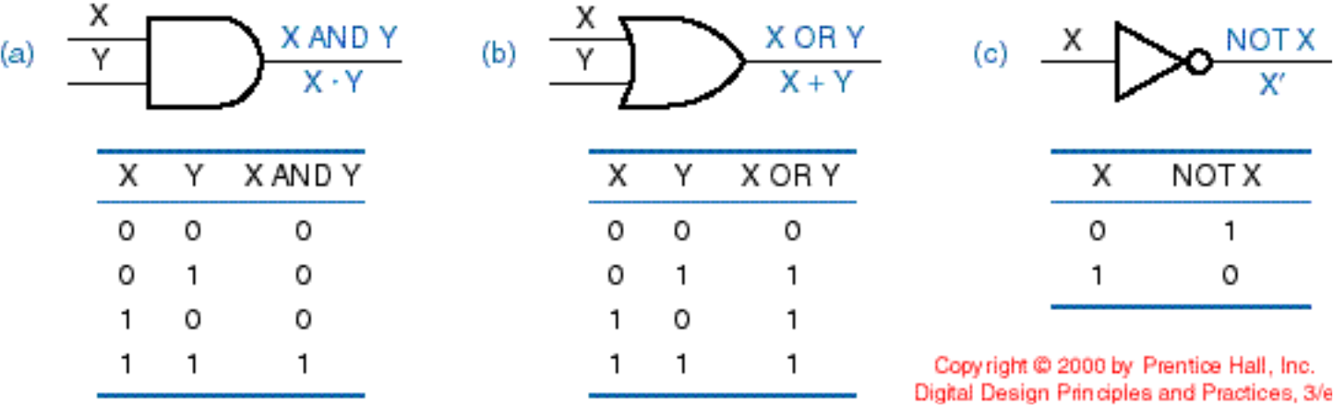
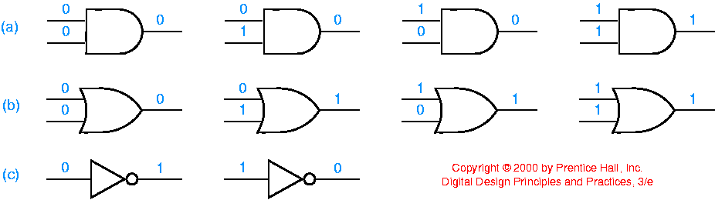

Slide 9
Universal Gates
NAND Gate
NOR Gate

Slide 10
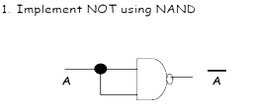
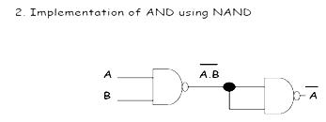
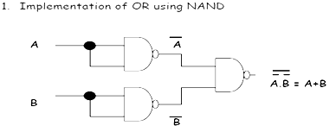
Universal Gates: NAND and NOR

Slide 11
Universal Gates: NAND and NOR

Slide 12
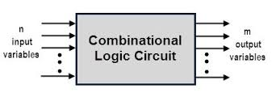
Combinational Logic Circuit

Slide 13
Combinational Logic Circuit
Half Adder: Logic Circuit which adds 2 inputs
Half Adder
A
Sum
B
Carry
A | B | Sum | Carry
0 | 0 | 0 | 0
0 | 1 | 1 | 0
1 | 0 | 1 | 0
1 | 1 | 0 | 1
Sum = A’ B + A B’ = A ⊕ B = A xor B
Carry = AB

Slide 14
Digital Trainer Kit Simulator
deldsim.com

Slide 15
Thank You

