Slide 1
Copy Constructors
Shallow Copy:
  The data members of one object are copied into the data members of another object without taking any dynamic memory pointed to by those data members into consideration. (“memberwise copy”)
Deep Copy:
  Any dynamic memory pointed to by the data members is duplicated and the contents of that memory is copied (via copy constructors and assignment operators -- when overloaded)

Slide 2
Copy Constructors
In every class, the compiler automatically supplies both a copy constructor and an assignment operator if we don't explicitly provide them.
Both of these member functions perform copy operations by performing a memberwise copy from one object to another.
In situations where pointers are not members of a class, memberwise copy is an adequate operation for copying objects.
However, it is not adequate when data members point to memory dynamically allocated within the class.

Slide 3
Copy Constructors
Problems occur with shallow copying when we:
  initialize an object with the value of another object: name s1; name s2(s1);
  pass an object by value to a function or when we return by value:
  name function_proto (name)
  assign one object to another:
  s1 = s2;

Slide 4

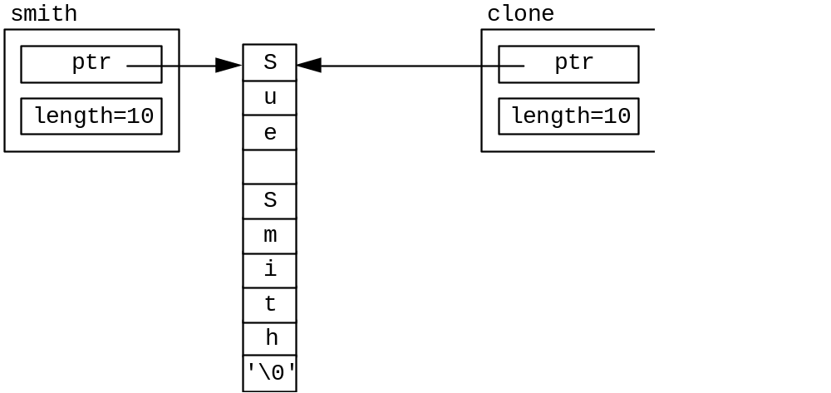
Copy Constructors
If name had a dynamically allocated array of characters (i.e., one of the data members is a pointer to a char),
  the following shallow copy is disastrous!

Slide 5
Copy Constructors
To resolve the pass by value and the initialization issues, we must write a copy constructor whenever dynamic member is allocated on an object-by-object basis.
They have the form:
class_name(const class_name &class_object);
Notice the name of the “function” is the same name as the class, and has no return type
The argument’s data type is that of the class, passed as a constant reference (think about what would happen if this was passed by value?!)

Slide 6
Copy Constructors
//name.h interface
class name {
public:
name(char* = ""); //default constructor
name(const name &); //copy constructor
~name(); //destructor
name &operator=(name &); //assignment op
private:
char* ptr; //pointer to name
int length; //length of name including nul char
};
#include "name.h" //name.c implementation
name::name(char* name_ptr) { //constructor
length = strlen(name_ptr); //get name length
ptr = new char[length+1]; //dynamically allocate
strcpy(ptr, name_ptr); //copy name into new space
}
name::name(const name &obj) { //copy constructor
length = obj.length; //get length
ptr = new char[length+1]; //dynamically allocate
strcpy(ptr, obj.ptr); //copy name into new space
}

Slide 7
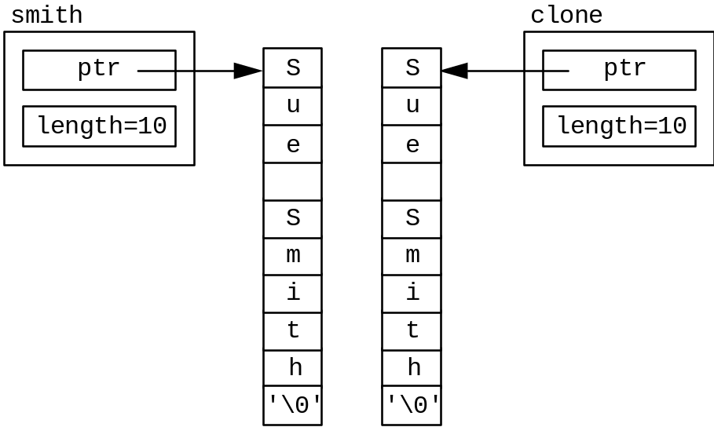
Copy Constructors
Now, when we use the following constructors for initialization, the two objects no longer share memory but have their own allocated

Slide 8
Copy Constructors
Copy constructors are also used whenever passing an object of a class by value: (get_name returns a ptr to a char for the current object)
int main() {
name smith("Sue Smith"); //constructor with arg used
//call function by value & display from object returned
cout <<function(smith).get_name() <<endl;
return (0);
}
name function(name obj) {
cout <<obj.get_name() <<endl;
return (obj);
}

Slide 9
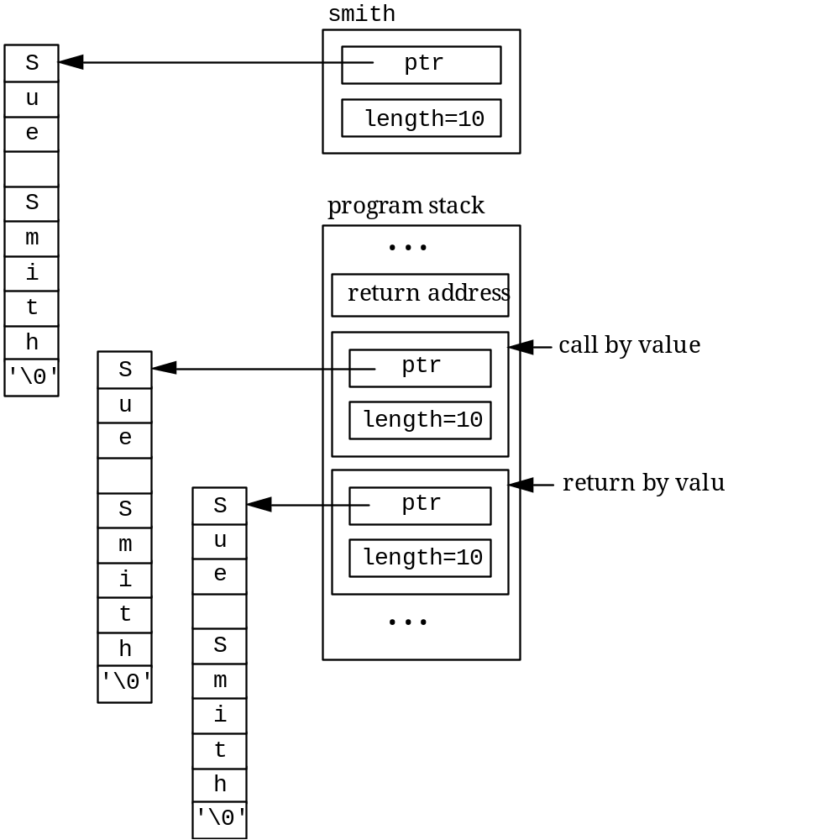
Copy Constructors
Using a copy constructor avoids objects “sharing” memory -- but causes this behavior
This should convince us to avoid pass by value whenever possible -- when passing or returning objects of a class!

Slide 10
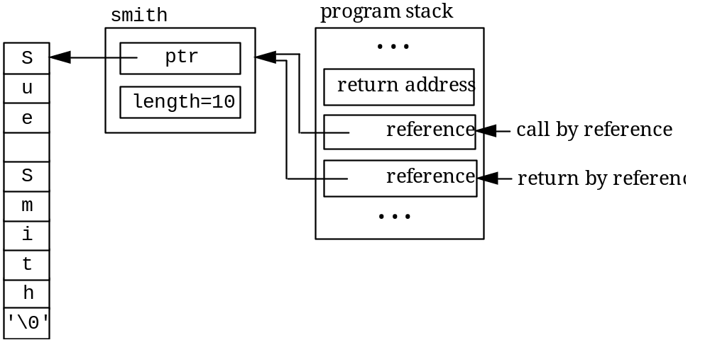
Copy Constructors
Using the reference operator instead, we change the function to be: (the function call remains the same)
name &function(name &obj) {
cout <<obj.get_name() <<endl;
return (obj);
}

