Slide 1

NETWORK SECURITY SPRING 2014
SYSTEMS & NETWORK SECURITY SPRING 2016
Renuka Kumar
amritanetsec@gmail.com
GDB Tutorial- Part1
"To kill the Enemy, you should know him as well as you know yourself."—Anonymous
Notes:
Network security is rather a complicated subject that can be tackled by experts in the field.

Slide 2
GNU Debugger
A debugger is a program that runs other programs, allowing the user to exercise control over these programs, and to examine variables when problems arise.
Needs debugging symbols stored in symbol table.
Symbol table may be a part of the program itself or stored separately
GCC has an option to generate symbol information

Slide 3
Symbol Table
A data structure created by compilers to store info about occurrence of various entities such as variable names, function names, objects, classes, interfaces etc.
Serves following purpose:
To store names of all entities in a structured form at one place
To verify if a variable has been declared
To implement type checking,
To determine scope resolution
Maybe a hash table or a linear table

Slide 4
#include <stdio.h>
#include <stdlib.h>
int add(int x, int y) {
int z = 10;
z = x+y;
return z;
}
void main(int argc, char** argv) {
int a = atoi(argv[1]);
int b = atoi(argv[2]);
int c;
char buffer[40];
gets(buffer);
puts(buffer);
c= add(a,b);
printf("Sum of %d + %d = %d\n", a, b, c);
exit(0);
}

Slide 5
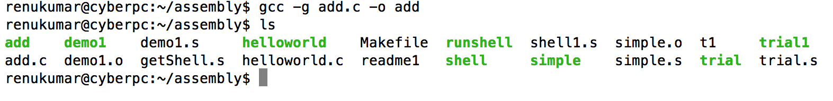
Compile

Slide 6
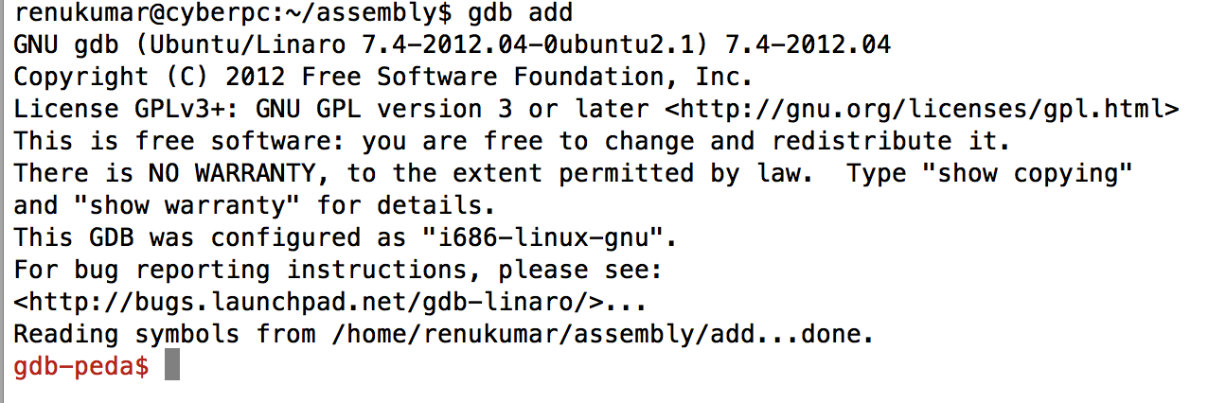
Start GDB

Slide 7
‘list’ command
To list the source file
Try ‘list 0’

Slide 8
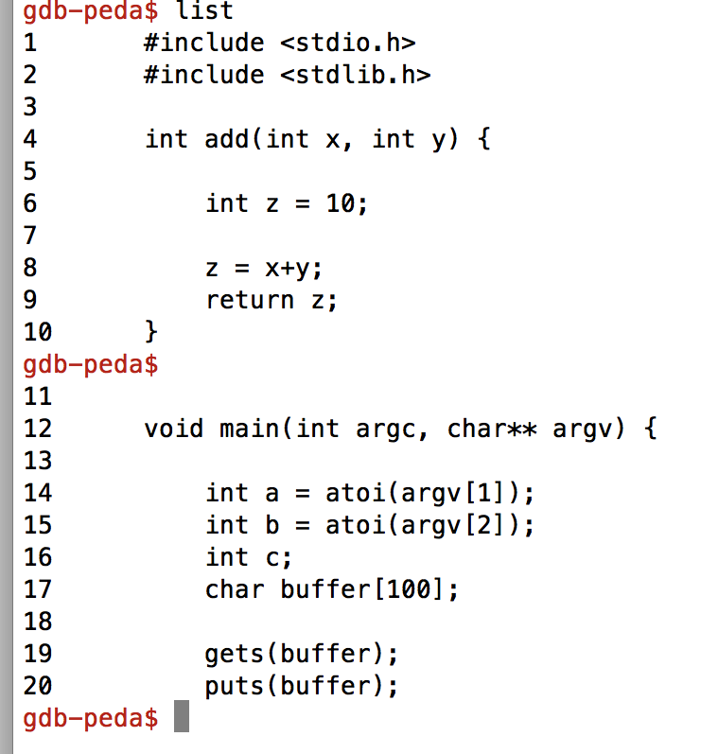
‘list’ command
hit ‘Enter’ here

Slide 9
‘Disassemble main’
Disassembles function main
Short form : ‘disass’

Slide 10
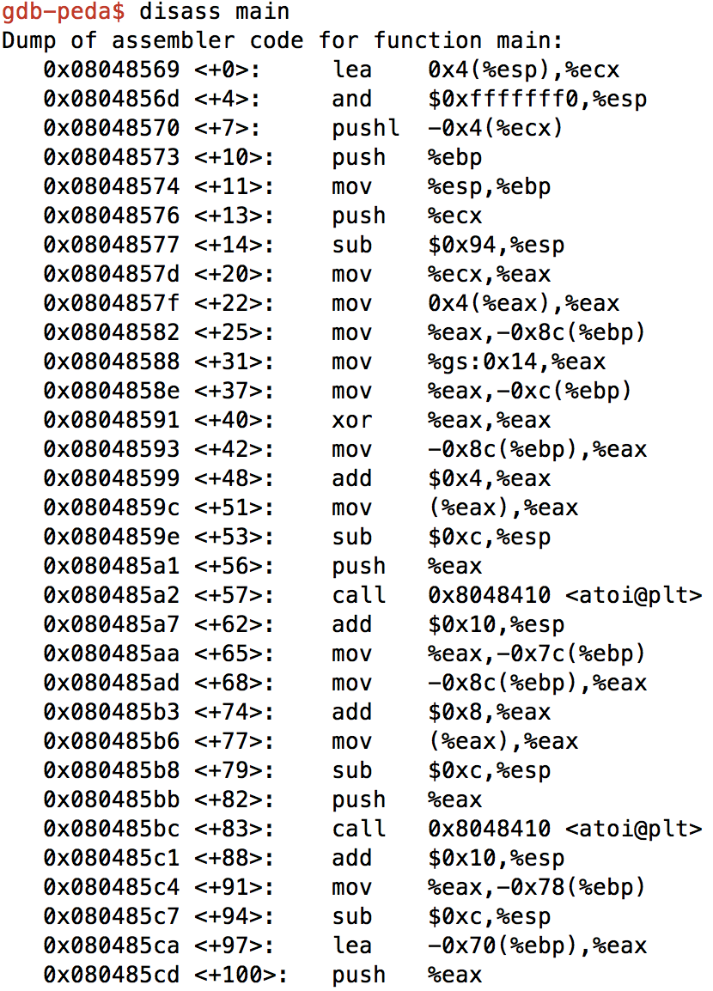
Disassemble
Left-most column contain addresses of the instruction
What does atoi do?
Why is it there?

Slide 11
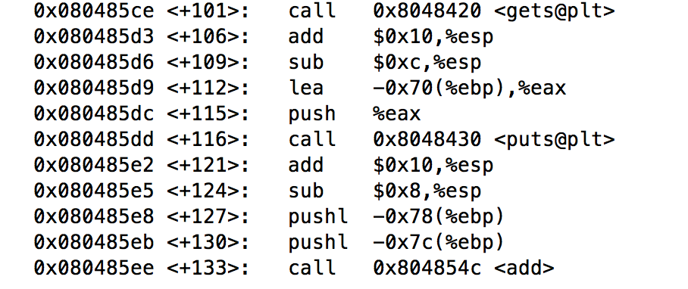
Disassembled output
Function calls from program

Slide 12
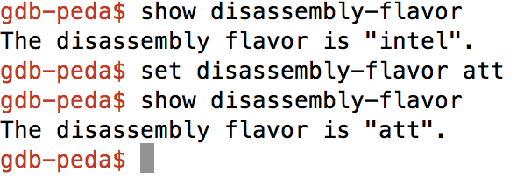
‘show disassembly-flavor’
2 flavors intel and att
Linux uses AT&T

Slide 13
Setting Breakpoint
Breakpoint is a signal that tells the debugger to temporarily suspend execution of your program at a certain point .
The program at that time enters ‘break mode’
Program is not terminated and execution can be resumed at any time
Functions, variables and objects remain in memory, but the execution is suspended
Helps examine their state to look for violations or bugs
Command: ‘break’ or ‘b’

Slide 14
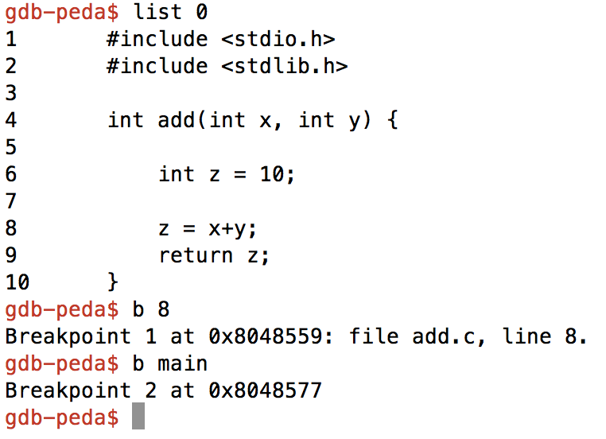
Setting Breakpoint

Slide 15
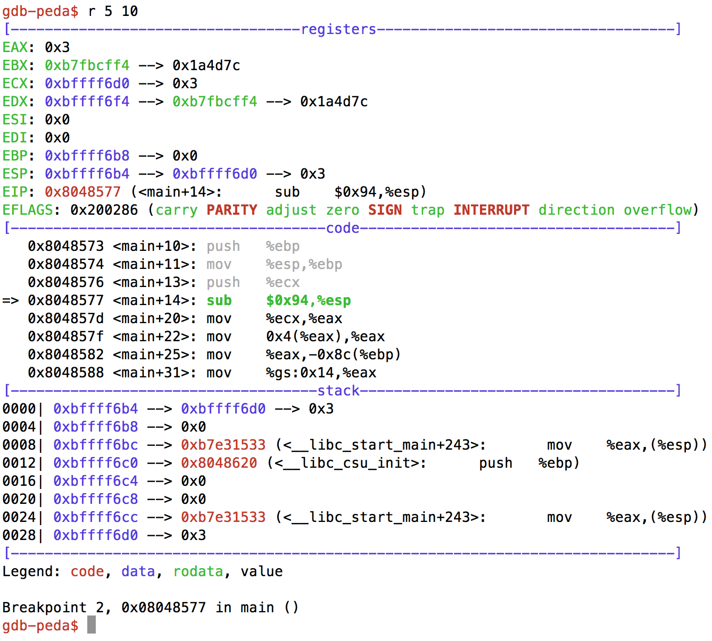
Running the program
Run with args

Slide 16
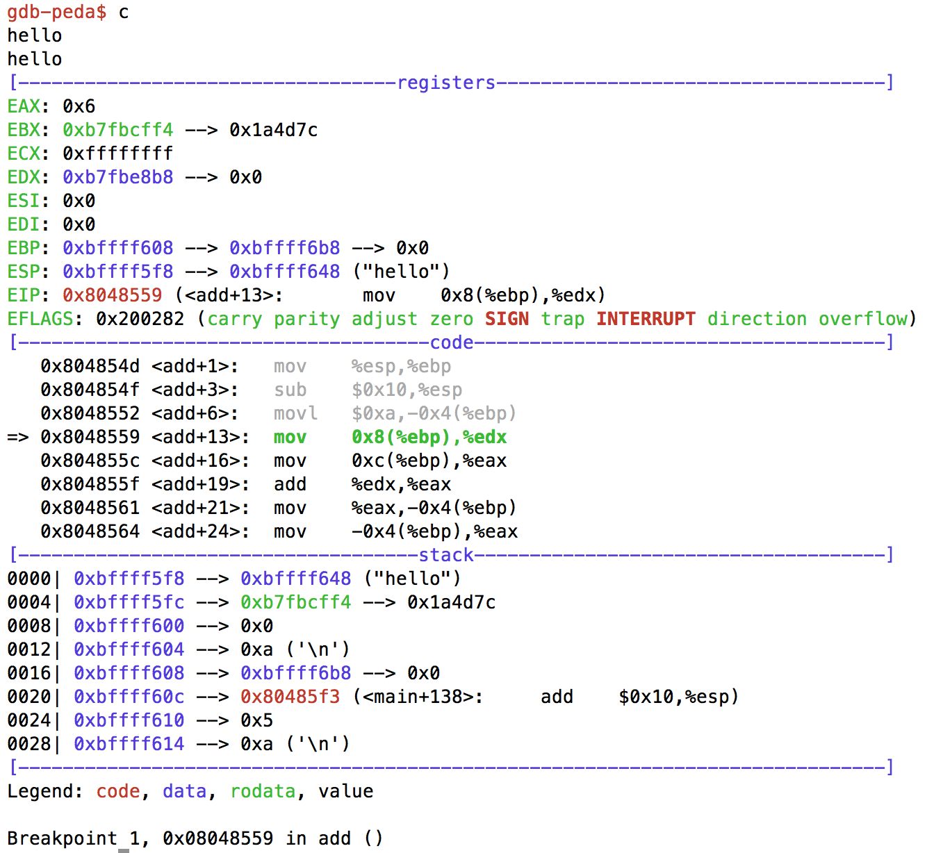
‘continue’
Next pointer in function ‘add’

Slide 17
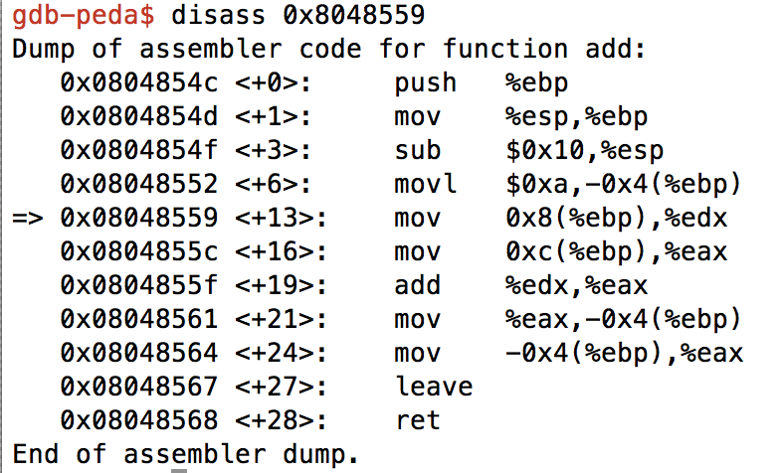
Disassmbled using address
Address of instruction pointer at EIP

Slide 18
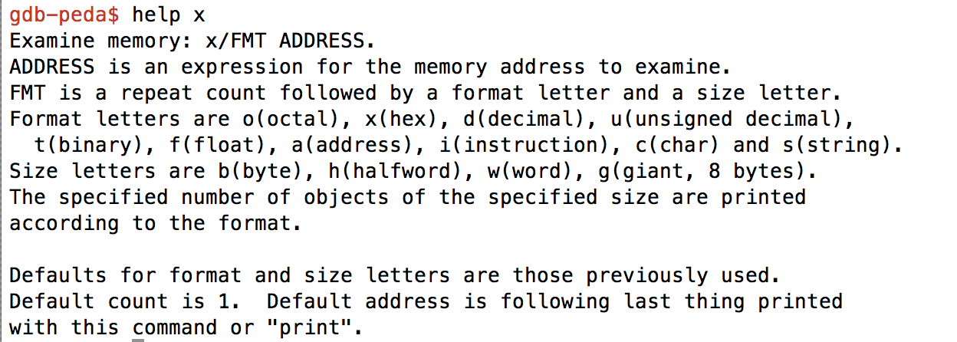
Examine Stack
Examine Command

Slide 19
QUIZ
Where does ESP point to ?

Slide 20
QUIZ
Difference between ESP and EBP

Slide 21
QUIZ
Is ESP smaller or greater than EBP?
Notes:
Smaller since top of stack

Slide 22
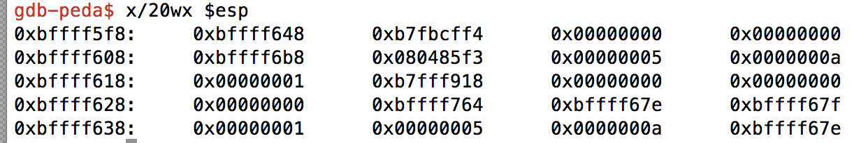
Examine Stack
What are these values
‘$’ is used to access convenience variables. Convenience variables are used to hold on to value in gdb. They don’t exist outside of gdb
Registers are also access the same way
Push and Pop instructions pushes DWORDS

Slide 23
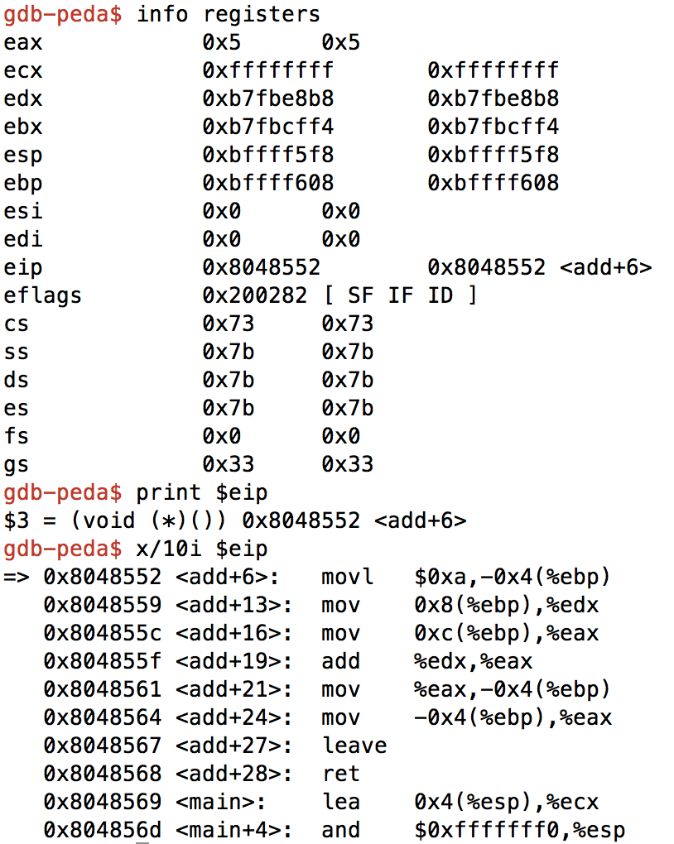
More of examine
Examine 10 instructions

Slide 24
Print
Print address and value of variables
print a
For a variable ‘a’ prints value of a
print &a
For a variable ‘a’ prints address of a

Slide 25
Step Command
Executes instruction by instruction
Steps into a function
Try by setting breakpoint at 22

Slide 26
‘Next’ Command
What is the difference?

