Slide 1
Wireless security
Dr. Sriram Sankaran, Amrita University

Slide 2

Course Objectives
Introduce students to the technical and practical aspects of Wireless Security
Study vulnerabilities in Wireless Network Standards
Identify research issues involved in the design and implementation of security solutions
Provide experience through simulating vulnerabilities in wireless networks
Develop critical thinking, writing and presentation skills of the students through research papers

Slide 3
Course Outline
Introduction to Cryptography
Introduction to Game Theory
Wireless Standards Security
Game Theory for Wireless Networks and Security
Physical Layer Security
MAC Layer Security
Network Layer Security
Ad hoc and Sensor Network Security
RFID Security
VANET Security
Intrusion Detection
Privacy and Trust
Security and Privacy for Internet of Things

Slide 4
Course Requirements
Read research papers
Students are expected to read research papers, critique and review them
Projects using ns-2
Familiarize yourself with ns-2 Network Simulator (Jan/Feb)
Student Participation
Necessary to be successful in this course

Slide 5
Why do you need to take this course?
If you are excited and curious about Wireless Security
If you are interested in Attack Modeling and Simulation for Security
If you want to face job interviews
Critical thinking and presentation skills are necessary

Slide 6
Wireless Security vs. Mobile Security vs. Software Security
This course
Studies Security from a Wireless Networks perspective
Embodies Cryptography, Game Theory and Intrusion Detection
Not an Android Security course
Does not focus on security in smartphones
Not a Software Security course
Does not deal with Malware or botnets in Software

Slide 7
Honor Code
Students are allowed to discuss approaches to solve problems
However, source codes and reports from assignments should be your own work
You are solely responsible for safeguarding your work
Plagiarism will be dealt with in a serious manner
May result in a failing grade

Slide 8
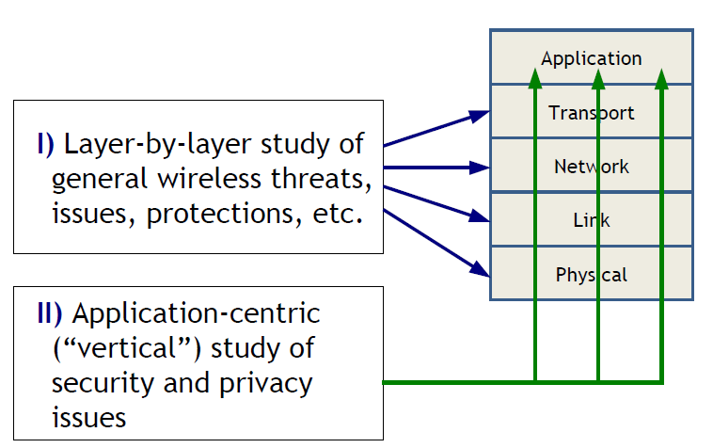
Course Roadmap

Slide 9
Books for the course
L. Buttyan, J. P. Hubaux, “Security and Cooperation in Wireless Networks”
Available online at http://secowinet.epfl.ch/fulltext/SeCoWiNetV1.5.1.pdf
K. Brown, Y. Shoham, Essentials of Game Theory: A Concise, Multidisciplinary Introduction
Of course research papers
Will be provided by the instructor

Slide 10
Course Grading
Category | Percentage of Grade
Midterm 1 | 15
Midterm 2 | 15
Final Exam | 30
Paper Presentation/Reviews | 15
Assignments | 25

Slide 11
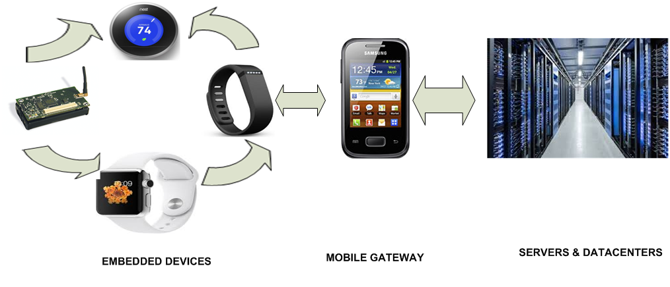
Wireless Everywhere

Slide 12
Need for Wireless Network Security
Ubiquitous nature of sensors and mobile devices
Vulnerabilities of wireless networks
Wireless link can be eavesdropped/spoofed
Data can be altered
Cheat on identities
Channel can be overused
Growing amount of sensitive data
Uses are usually mobile
Increasing needs of applications

Slide 13
Securing Wireless Networks: Challenges
Attackers equipped with powerful devices
Trade-offs between security, scalability, efficiency, performance
Mobile devices are resource-constrained
Security costs time, CPU cycles, energy, bandwidth, scalability
Not all wireless networks follow client-server computing

Slide 14
Security Requirements
Authentication
Access control
Confidentiality
Integrity
Privacy
Non-repudiation
Availability

Slide 15
Evolution of Wireless technologies
Wi-fi
IEEE 802.11b
IEEE 802.11g
IEEE 802.11e
IEEE 802.11n
IEEE 802.11ac
Cellular Networks
3G
4G
5G
Bluetooth

Slide 16
Wi-Fi Networks
Uses unlicensed spectrum – 2.4 GHz
Simple, flexible, cost effective
Covers MAC and physical layer
Speeds
2,9,11, 54 Mbps
Speed depends on
Modulation technique
Distance of the node to the Access Point
FEC level (Forward Error Correction)

Slide 17
Cellular Networks
Wireless Wide Area Networks
Connects to the office network wirelessly from home or while traveling
Use Radio waves
Coverage area – several miles
Transfer speeds: from 5 kbps – 20 kbps
Use open standards such as GSM, UMTS, TDMA, CDMA

Slide 18
Bluetooth
Cable replacement technology
Interconnect portable devices
2.45 Gigahertz frequency (GHz)
Transfer speeds: up to 1 Mbps
Range: 20-350 feet
Supports up to three simultaneous voice channels
IEEE 802.15 (Standardized within the IEEE 802.15 Working group

Slide 19
Radio Frequency Identification
Primarily used for identification
Can be classified into Active and Passive tags
Enables faster tracking of multiple objects without human assistance
Applications in tracking, security, authenticity, electronic payments and entertainment
Security
Tags can be eavesdropped/spoofed

Slide 20
Near Field Communication (NFC)
Active Signaling between mobile devices using NFC
Communicate with devices in the peer locality
Pass MAC address and channel encryption keys between radios
Applications in electronic processing, payments, scheduling services etc.

Slide 21
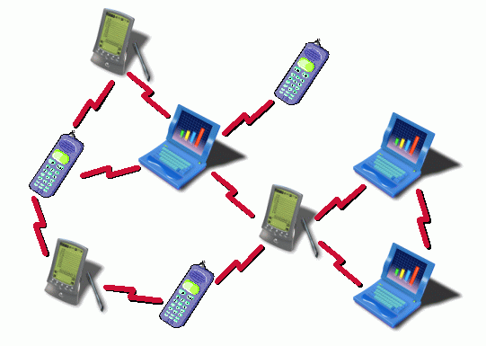
Ad hoc and Sensor Networks

Slide 22
Ad hoc and Sensor Networks
Nodes form networks on the fly
Consists of resource-constrained nodes
Sensor networks are even-more constrained
Does not require connection to the Infrastructure
Lot of work being done within the context of Routing, Power Management and Security
Applications in Military, Government and Industrial domains

Slide 23
Body Sensor Networks
Sensors capable of monitoring vital body conditions
Typically sensors send data to remote care providers for further processing
Perform analytics on the medical data for predicting medical conditions
Applications in disease detection, remote patient monitoring, fall detection etc.
Implications for security and privacy

Slide 24
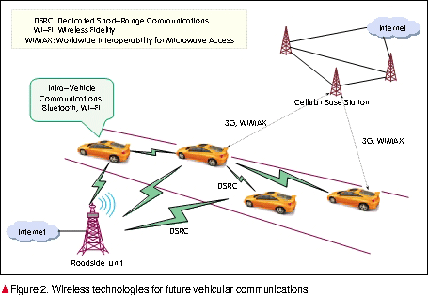
Vehicular Ad hoc Networks

Slide 25
Vehicular Ad hoc Networks
Enable Communication between Vehicles and between Vehicles and Road Side Infrastructure
Vehicles equipped with 802.11p wireless interfaces
Applications in Congestion Avoidance, Traffic Monitoring and Obstacle detection etc.
Security and privacy
False data injection attacks
Eavesdropping/Jamming
Tracking

Slide 26
Privacy and Trust
Increasing user mobility
Need for Location privacy
Impact of applications such as Facebook, Twitter cause privacy breaches
Ubiquitous nature of RFID tags and sensors raise privacy concerns
Trust, a necessary prerequisite for security

Slide 27
Intrusion Detection
Second-line of defense
Limited applicability of cryptography
Classification
Host-based
Network-based
Approaches
Anomaly Detection Systems
Misuse Detection systems

Slide 28
Internet of Things
Transition from Internet of People to Internet of Things
Application Domains: Smart Home, Healthcare, Transportation, Industrial etc.
Term arose from Sensor Networks
Sensors integrated into everyday objects
Real-time Communication and decision making

Slide 29
Conclusion
Wireless Networks have proliferated rapidly with applications in diverse domains
Securing wireless networks presents an interesting research challenge
Increasing needs of the applications and their corresponding security requirements
Privacy and trust also of increasing significance
Lot of interesting research problems

