Slide 1
Introduction to Cryptography
Dr. Sriram Sankaran, Amrita University

Slide 2
Lecture Outline
Introduction
Encryption
Hash functions
Message Authentication codes
Digital Signatures
Session key establishment protocols
Pseudo-random number generators
Advanced authentication techniques

Slide 3
Introduction to Cryptography
Cryptography focuses on the prevention of attacks
Not a panacea for security problems
Attacks can be classified into Passive and Active
Passive
Attempts to learn or make use of the system but does not affect system resources
Examples: eavesdropping, traffic analysis
Hard to detect
Active
Attempts to alter or affect system operation
Examples: Spoofing, reply, modification, DoS
Difficult to prevent

Slide 4
Security Mechanisms
Encryption
Symmetric, Asymmetric key protocols
Digital Signatures
Access Control Schemes
Access Control Lists, Capabilities, Security labels
Data Integrity Mechanisms
Message Authentication Codes, Sequence numbering, Timestamping, Cryptographic chaining
Authentication protocols
Passwords, Cryptographic challenge-response protocols, biometrics
Traffic padding, route control

Slide 5
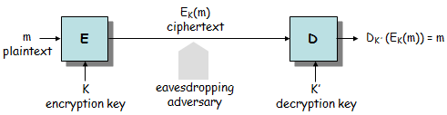
Classical Model of Encryption
Goal of the adversary
To systematically recover plaintexts from ciphertexts
To deduce the (decryption) key
Kerckhoff’s principle
We must assume that the adversary knows all details of E and D
Security of the system should be based on the protection of the decryption key

Slide 6
Adversary Models
Ciphertext-only attack
the adversary can only observe ciphertexts produced by the same encryption key
Known-plaintext attack
the adversary can obtain corresponding plaintext-ciphertext pairs produced with the same encryption key
(Adaptive) Chosen-plaintext attack
the adversary can choose plaintexts and obtain the corresponding ciphertexts
(Adaptive) Chosen-ciphertext attack
the adversary can choose ciphertexts and obtain the corresponding plaintexts
Related-key attack
the adversary can obtain ciphertexts, or plaintext-ciphertext pairs that are produced with different encryption keys that are related in a known way to a specific encryption key

Slide 7
Security of Encryption Schemes
An encryption scheme is secure in a given adversary model if it is computationally infeasible for the adversary to determine the target decryption key under the assumptions of the given model
For many encryption schemes used in practice, no proof of security exists
These schemes are used, nevertheless, because they are efficient and they resist all known attacks
Some encryption schemes are provably secure, however these schemes are often inefficient

Slide 8
Classification of Encryption Schemes
Symmetric-key encryption
it is easy to compute K’ from K (and vice versa)
usually K’ = K
two main types:
stream ciphers – operate on individual characters of the plaintext
block ciphers – process the plaintext in larger blocks of characters
Asymmetric-key encryption
it is hard (computationally infeasible) to compute K’ from K
K can be made public (→ public-key cryptography)

Slide 9
Popular Encryption Ciphers
Stream Cipher
One-Time-Pad
RC4
Block Cipher
DES/AES
RC5

Slide 10
Stream Ciphers
Processes the message bit by bit (as a stream)
Typically has a (pseudo) random stream key
Combined (XORed) with plaintext bit by bit
Randomness of stream key completely destroys any statistical properties in the message
C_{i} = M_{i} XOR StreamKey_{i}
Stream key should not be reused

Slide 11
Vernam Cipher and One-time pad
Vernam cipher
c_{i} = p_{i} ⊕ k_{i} for i = 1, 2, …
where p_{i} are the plaintext digits, k_{i} are the key stream digits, c_{i} are the ciphertext digits, and ⊕ is the bitwise XOR operation
One-time pad
a Vernam cipher where the key stream digits are generated independently and uniformly at random
the one-time pad is unconditionally secure [Shannon, 1949]
I(P; C) = H(P) - H(P|C) = 0
a necessary condition for a symmetric key cipher to be unconditionally secure is that H(K) ≥ H(P) [Shannon, 1949]
practically, the key must have as many bits as the compressed plaintext
impractical because of key management problems

Slide 12
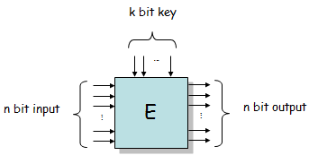
Block Ciphers
an n bit block cipher is a function E: {0, 1}^{n} x {0, 1}^{k} → {0, 1}^{n}, such that for each K ∈ {0, 1}^{k}, E(x, K) = E_{K}(x) is an invertible mapping from {0, 1}^{n} to {0, 1}^{n}

Slide 13
Block Cipher Design Criteria
Completeness
each bit of the output block should depend on each bit of the input block and on each bit of the key
Avalanche effect
changing one bit in the input block should change approximately half of the bits in the output block
similarly, changing one key bit should result in the change of approximately half of the bits in the output block
Statistical independence
input and output should appear to be statistically independent

Slide 14
Block Cipher modes of operation
ECB – Electronic Codebook
used to encipher a single plaintext block (e.g., a DES key)
CBC – Cipher Block Chaining
repeated use of the encryption algorithm to encipher a message consisting of many blocks
CFB – Cipher Feedback
used to encipher a stream of characters, dealing with each character as it comes
OFB – Output Feedback
another method of stream encryption, used on noisy channels
CTR – Counter
simplified OFB with certain advantages

Slide 15
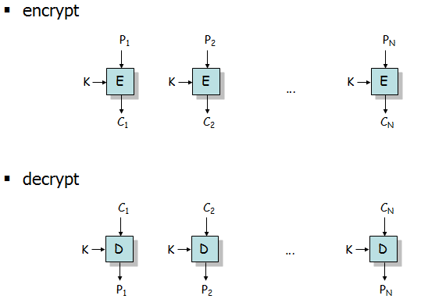
Block Cipher – ECB mode

Slide 16
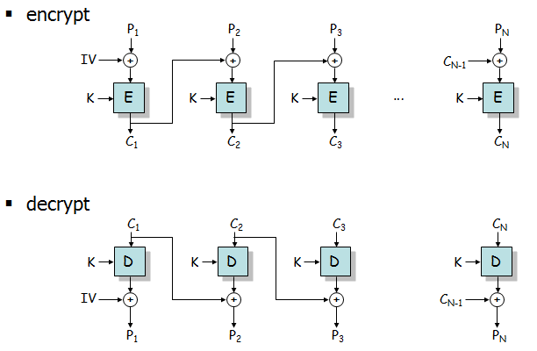
Block Cipher – CBC mode

Slide 17
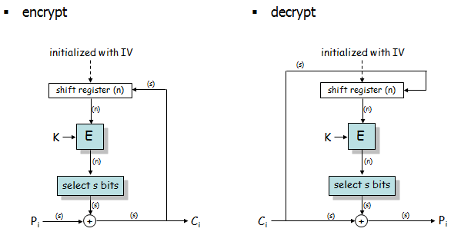
Block Cipher – CFB mode

Slide 18
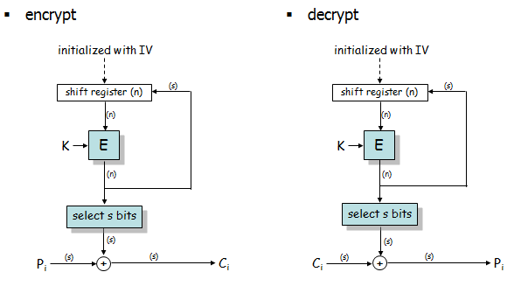
Block Cipher – OFB mode

Slide 19
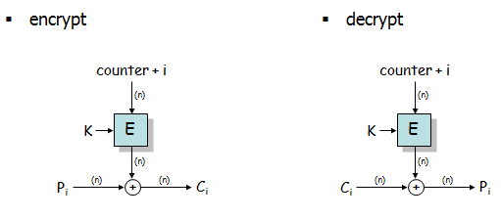
Block Cipher – CTR mode

Slide 20
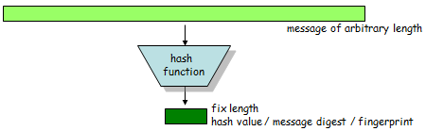
Hash Functions
a hash function maps bit strings of arbitrary finite length to bit strings of fixed length (n bits)
many-to-one mapping → collisions are unavoidable
however, finding collisions are difficult → the hash value of a message can serve as a compact representative image of the message (similar to fingerprints)

Slide 21
Desirable properties of Hash functions
Ease of computation
Given an input x, the hash value h(x) of x is easy to compute
Weak collision resistance (2nd preimage resistance)
Given an input x, it is computationally infeasible to find a second input x’ such that h(x’) = h(x)
Strong collision resistance (collision resistance)
It is computationally infeasible to find any two distinct inputs x and x’ such that h(x) = h(x’)
One-way property (preimage resistance)
Given a hash value y (for which no preimage is known), it is computationally infeasible to find any input x s.t. h(x) = y

Slide 22
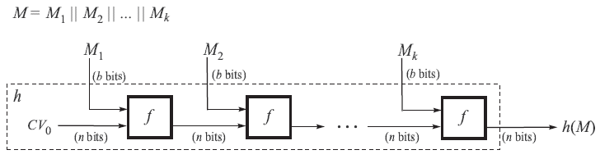
Iterated Hash Functions
Input is divided into fixed length blocks x₁, x₂, …, x_{L}
Last block is padded if necessary
Each input block is processed according to the following scheme
f is called the compression function
can be based on a block cipher, or
can be a dedicated compression function

Slide 23
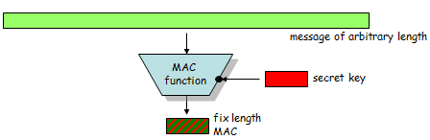
Message Authentication Codes
MAC functions can be viewed as hash functions with two functionally distinct inputs: a message and a secret key
They produce a fixed size output (say n bits) called the MAC
Practically it should be infeasible to produce a correct MAC for a message without the knowledge of the secret key
MAC functions can be used to implement data integrity and message origin authentication services

Slide 24
Desirable properties of MAC functions
Ease of computation
given an input x and a secret key k, it is easy to compute MAC_{k}(x)
Key non-recovery
it is computationally infeasible to recover the secret key k, given one or more text-MAC pairs (x_{i}, MAC_{k}(x_{i})) for that k
Computation resistance
given zero or more text-MAC pairs (x_{i}, MAC_{k}(x_{i})), it is computationally infeasible to find a text-MAC pair (x, MAC_{k}(x)) for any new input x ≠ x_{i}
computation resistance implies key non-recovery but the reverse is not true in general

Slide 25
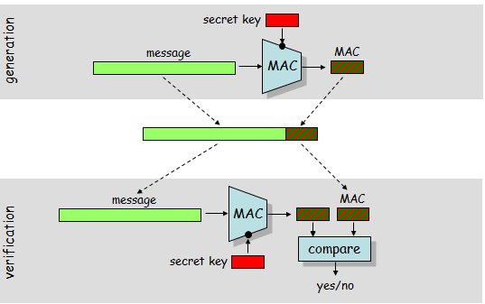
MAC generation and verification

Slide 26
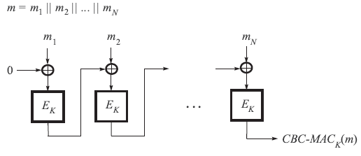
CBC-MAC
CBC-MAC is secure for messages of a fixed number of blocks
(Adaptive chosen-text existential) forgery is possible if variable length messages are allowed
→ It is recommended to involve the length of the message in the CBC MAC computation

Slide 27
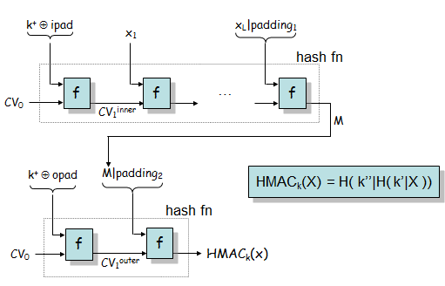
HMAC

Slide 28
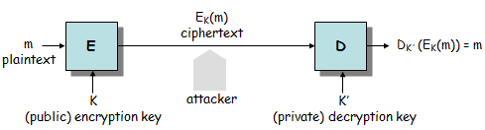
Asymmetric Cryptography
Asymmetric-key encryption
it is hard (computationally infeasible) to compute K’ from K
K can be made public (public-key cryptography)
no need for key setup before communication
Public-keys are not confidential but they must be authentic !
Security of asymmetric-key encryption schemes is usually based on some well-known or widely believed hard problems

Slide 29
Hardness of Asymmetric Cryptography
Discrete logarithm problem
Given a prime p, a generator g of Z_{p}*, and an element y in Z_{p}*, find the integer x, 0 ≤ x ≤ p-2, such that g^{x} mod p = y
true complexity is unknown
it is believed that it does not belong to P

Slide 30
RSA Scheme
Key generation
select p, q large primes (about 500 bits each)
n = pq, φ(n) = (p-1)(q-1)
select e such that 1 < e < φ(n) and gcd(e, φ(n)) = 1
compute d such that ed mod φ(n) = 1 (this is easy if φ(n) is known)
the public key is (e, n)
the private key is d
Encryption
represent the message as an integer m in [0, n-1]
compute c = m^{e} mod n
Decryption
compute m = c^{d} mod n

Slide 31
Relation to factoring
the problem of computing d from (e, n) is computationally equivalent to the problem of factoring n
if one can factor n, then one can easily compute d
if one can compute d, then one can efficiently factor n
the problem of computing m from c and (e, n) (called the RSA problem) is believed to be computationally equivalent to factoring
if one can factor n, then one can easily compute m from c and (e, n)
there’s no formal proof for the other direction

Slide 32
Need for Salting
let us assume that the adversary observes a ciphertext c = E_{K}(m)
let the set of possible plaintexts be M
if M is small, then the adversary can try to encrypt every message in M with the publicly known key K until she finds the message m that maps into c
the usual way to prevent this attack is to randomize the encryption
some random bytes are added to the plaintext message before encryption through the application of the PKCS #1 formatting rules
when the message is decrypted, the recipient can recognize and discard these random bytes

Slide 33
El-Gamal Encryption Scheme
Key generation
generate a large random prime p and choose generator g of the multiplicative group Z_{p}* = {1, 2, …, p-1}
select a random integer a, 1 ≤ a ≤ p-2, and compute A = gª mod p
the public key is (p, g, A)
the private key is a
Encryption
represent the message as an integer m in [0, p-1]
select a random integer r, 1 ≤ r ≤ p-2, and compute R = g^{r} mod p
compute C = m⋅A^{r} mod p
the ciphertext is the pair (R, C)
Decryption
compute m = C⋅R^{p-1-a} mod p
Proof of decryption
C⋅R^{p-1-a} ≡ m⋅A^{r}⋅R^{p-1-a} ≡ m⋅g^{ar}⋅g^{r(p-1-a)} ≡ m⋅(g^{p-1})^{r} ≡ m (mod p)

Slide 34
Relation to hard problem
Security of the ElGamal scheme is said to be based on the discrete logarithm problem in Z_{p}*, although equivalence has not been proven yet
Recovering m given p, g, A, R, and C is equivalent to solving the Diffie-Hellman problem

Slide 35
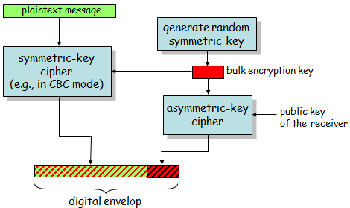
Digital Enveloping
Most popular public-key encryption methods are several orders of magnitude slower than the best known symmetric key schemes
→ Public-key encryption is used together with symmetric-key encryption; the technique is called digital enveloping

Slide 36
Digital Signatures

Slide 37
Digital Signatures
Similar to MACs but
unforgeable by the receiver
verifiable by a third party
Used for message authentication and non-repudiation (of message origin)
Based on public-key cryptography
private key defines a signing transformation S_{A}
S_{A}(m) = σ
public key defines a verification transformation V_{A}
V_{A}(m, σ) = true if S_{A}(m) = σ
V_{A}(m, σ) = false otherwise

Slide 38
Attacks on Digital Signature Schemes
Key-only attack
Only the public key is available to the adversary
Known-message attack
Adversary has signatures for a set of messages known to her but not chosen by her
Chosen-message attack
Adversary obtains signatures for messages chosen by her before attempting to break the signature scheme
Adaptive chosen-message attack
Adversary is allowed to use the signer as an oracle
she may request signatures for messages which depend on previously obtained signatures

Slide 39
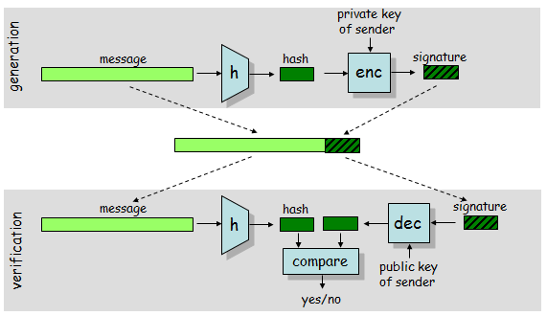
Hash and Sign paradigm
Public/private key operations are slow
Hash the message first and apply public/private key operations to the hash value only

Slide 40
Examples of Digital Signature Schemes
RSA
essentially identical to the RSA encryption scheme
signature = decryption with private key
typical signature length is 1024 bits
DSA (Digital Signature Algorithm)
based on the ElGamal signature scheme
typical signature length is 1024 bits
ECDSA (Elliptic Curve DSA)
same as DSA but works over elliptic curves
reduced signature length (typically 320 bits)

Slide 41
Session Key Establishment Protocols

Slide 42
Session key Establishment Protocols
Goal of session key establishment protocols
to setup a shared secret between two (or more) parties
it is desired that the secret established by a fixed pair of parties varies on subsequent executions of the protocol (dynamicity)
established shared secret is used as a session key to protect communication between the parties
Motivation for use of session keys
To limit available ciphertext for cryptanalysis
To limit exposure caused by the compromise of a session key
To avoid long-term storage of a large number of secret keys (keys are created on-demand when actually required)
To create independence across communication sessions or applications

Slide 43
Basic Classification
Key transport protocols
one party creates or otherwise obtains a secret value, and securely transfers it to the other party
Key agreement protocols
a shared secret is derived by the parties as a function of information contributed by each, such that no party can predetermine the resulting value

Slide 44
Further Services
Entity authentication
Implicit key authentication
one party is assured that no other party aside from a specifically identified second party (and possibly some trusted third parties) may gain access to the established session key
Key confirmation
one party is assured that a second (possibly unidentified) party actually possesses the session key
possession of a key can be demonstrated by
producing a one-way hash value of the key or
encryption of known data with the key
Explicit key authentication
implicit key authentication + key confirmation
Key freshness
one party is assured that the key is new (never used before)

Slide 45
Further protocol characteristics
Reciprocity
guarantees are provided unilaterally
guarantees are provided mutually
Efficiency
number of message exchanges (passes) required
total number of bits transmitted (i.e., bandwidth used)
complexity of computations by each party
possibility of precomputations to reduce on-line computational complexity
Third party requirements
on-line, off-line, or no third party at all
degree and type of trust required in the third party
System setup
distribution of initial keying material

Slide 46
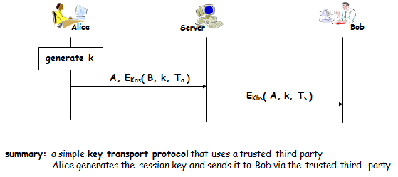
Wide Mouth Frog Protocol

Slide 47
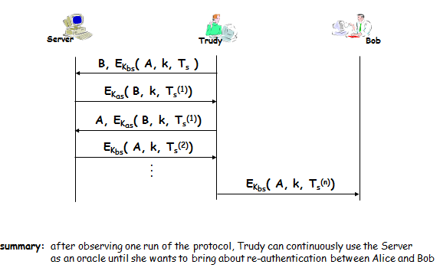
A flaw in the Wide Mouth Frog Protocol

Slide 48
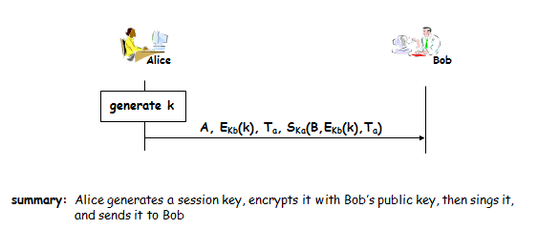
Signed Encrypted Keys

Slide 49
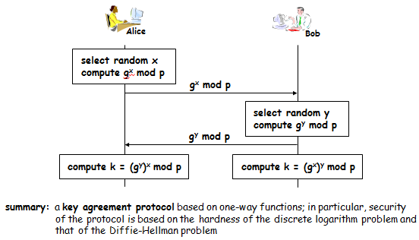
Diffie Hellman Protocol

Slide 50
Pseudorandom Number Generators

Slide 51
Pseudo-Random Number Generators
A random number is a number that cannot be predicted by an observer before it is generated
if the number is generated within the range [0, N-1], then its value cannot be predicted with any better probability than 1/N
the above is true even if the observer is given all previously generated numbers
A cryptographic pseudo-random number generator (PRNG) is a mechanism that processes somewhat unpredictable inputs and generates pseudo-random outputs
if designed, implemented, and used properly, then even an adversary with enormous computational power should not be able to distinguish the PRNG output from a real random sequence

Slide 52
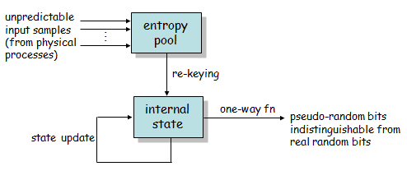
General Operation of PRNGs

Slide 53
Desirable properties of PRNGs
Adversary cannot compute the internal state of the PRNG, even if she has observed many outputs of the PRNG
Adversary cannot compute the next output of the PRNG, even if she has observed many previous outputs of the PRNG
If adversary can observe or even manipulate the input samples that are fed in the PRNG, but she does not know the internal state of the PRNG, then the adversary cannot compute the next output and the next internal state of the PRNG
If adversary has somehow learned the internal state of the PRNG, but she cannot observe the input samples that are fed in the PRNG, then the adversary cannot figure out the internal state of the PRNG after the re-keying operation

Slide 54
Advanced Authentication Techniques

Slide 55
Hash Chains
A hash chain is a sequence of hash values that are computed by iteratively calling a one-way hash function on an initial value v₀
Hash chains can be used for repeated authentications at the cost of a single digital signature
Alice computes a hash chain and commits to it by signing v_{n} and distributing it to potential verifiers
later on, Alice can authenticate herself repeatedly (at most n times) by revealing the elements of the hash chain in reverse order
when v_{n-i} is revealed, verifiers can check if h^{(i)}(v_{n-i}) = v_{n} (or h(v_{n-i}) = v_{n-i+1} if they remember the last revealed element)
each hash chain element can be used only once for authenticating Alice

Slide 56
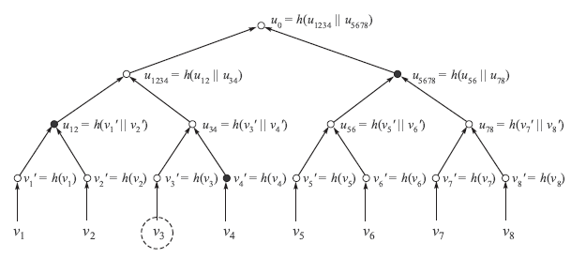
Merkle Trees

Slide 57
TESLA
Broadcast authentication mechanism based on symmetric key cryptographic primitives
Main idea: asymmetry through delayed disclosure of authentication keys
Alice wants to broadcast a message m
Alice computes a MAC on m with a key unknown to the verifiers
Verifiers receive message m with the MAC, but they cannot immediately verify authenticity
Later, Alice discloses the key used to compute the MAC
Verifiers can now verify the MAC; if it is correct, they know that the message was sent by Alice, because at the time of reception nobody else knew the key
Assumptions:
Loose time synchronization between the participants
Each party knows an upper bound on the maximum synchronization error
Initial secret between the parties to bootstrap the whole mechanism

Slide 58

TESLA (Contd..)
MAC keys are consecutive elements in a one-way key chain:
K₀ → K₁ → … → K_{n}
K_{i} = h(K_{i-1})
Protocol operation:
setup: Alice sends K_{n} to each verifier in an authentic manner
time is divided into epochs
each message sent in epoch i is authenticated with key K_{n-i}
K_{n-i} is disclosed in epoch i+d, where d is a system parameter
K_{n-i} is verified by checking h(K_{n-i}) = K_{n-i+1}

