Slide 1
TRUST IN WIRELESS NETWORKS

Slide 2
Trust
Trust model of current wireless networks is rather simple
subscriber – service provider model
subscribers trust the service provider for providing the service, charging correctly, and not misusing transactional data
service providers usually do not trust subscribers, and use security measures to prevent or detect fraud
In upcoming wireless networks the trust model will be much more complex
entities play multiple roles (users can become service providers)
number of service providers will dramatically increase
user – service provider relationships will become transient
how to build up trust in such a volatile and dynamic environment?
Trust is absolutely fundamental for the future of wireless networks
pervasiveness of these technologies means that all of us must rely on them in our everyday life!

Slide 3
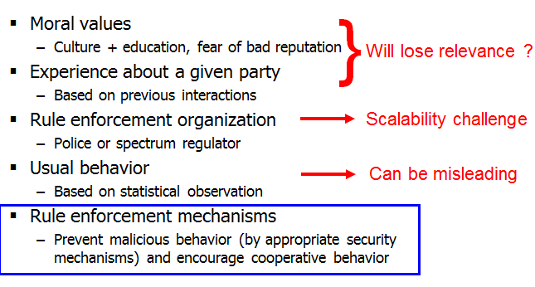
Reasons to trust organizations and individuals

Slide 4
Trust vs. Security and Cooperation
trust preexists security
all security mechanisms require some level of trust in various components of the system
security mechanisms can help to transfer trust in one component to trust in another component, but they cannot create trust by themselves
cooperation reinforces trust
trust is about the ability to predict the behavior of another party
cooperation (i.e., adherence to certain rules for the benefit of the entire system) makes predictions more reliable

Slide 5
Malice and Selfishness
malice
willingness to do harm no matter what
selfishness
overuse of common resources (network, radio spectrum, etc.) for one’s own benefit
traditionally, security is concerned only with malice
but in the future, malice and selfishness must be considered jointly if we want to seriously protect wireless networks

Slide 6
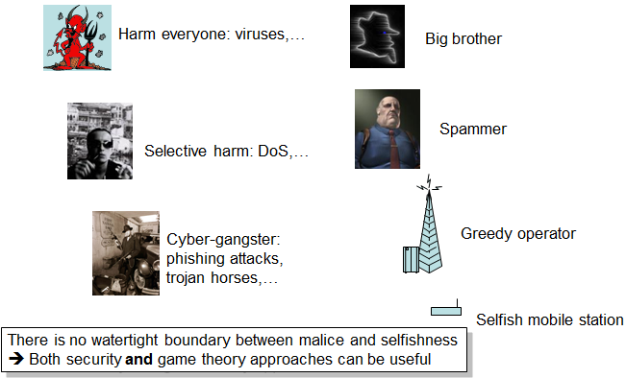
Who is malicious? Who is Selfish?

Slide 7
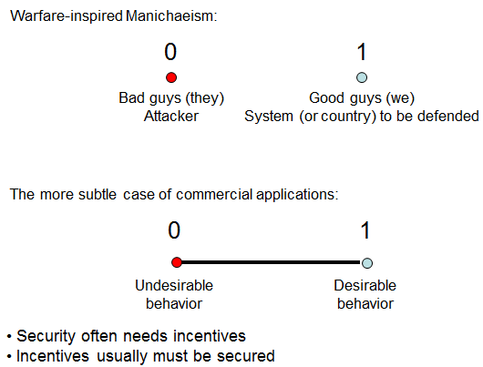
Defending against Attacks

Slide 8
Definitions
A misbehavior consists in deliberately departing from the prescribed behavior in order to reach a specific goal
A misbehavior is selfish (or greedy, or strategic) if it aims at obtaining an advantage that can be quantitatively expressed in the units (bitrate, joules, or coverage) or in a related incentive system (e.g., micropayments); any other misbehavior is considered to be malicious.

Slide 9
Research Challenge
Prevent ubiquitous computing from becoming a pervasive nightmare

