Slide 1
SecURITY FOR EXISTING wireless networks
Dr. Sriram Sankaran

Slide 2
Security for Existing Wireless Networks
Cellular
GSM, UMTS
WiFi
IEEE 802.11
Wireless Personal Area Networks
Bluetooth
Zigbee

Slide 3
Bluetooth

Slide 4
Bluetooth
Short-range communications, master-slave principle
Eavesdropping is difficult:
Frequency hopping
Communication is over a few meters only
Security issues:
Authentication of the devices to each other
Confidential channel
Based on secret link key

Slide 5
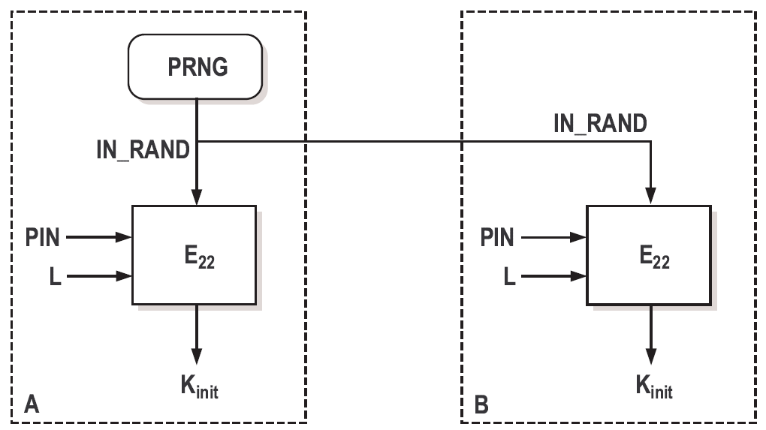
Bluetooth
When two devices communicate for the first time:
Set up the temporary initialization key

Slide 6
Bluetooth
Setting up the link key

Slide 7
Bluetooth Authentication protocol

Slide 8
Bluetooth
Generation of the encryption key and key stream

Slide 9
Weaknesses
The strength of the whole system is based on the strength of the PIN:
PIN: 4-digit number, easy to try all 10000 possible values.
PIN can be cracked off-line.
many devices use the default PIN.
For memory-constrained devices: the link key = the long-term unit key of the device.
Fixed and unique device addresses: privacy problem.
Weaknesses in the E₀ stream cipher.

Slide 10
Cellular Networks

Slide 11
GSM Security
main security requirement
subscriber authentication (for the sake of billing)
challenge-response protocol
long-term secret key shared between the subscriber and the home network operator
supports roaming without revealing long-term key to the visited networks
other security services provided by GSM
confidentiality of communications and signaling over the wireless interface
encryption key shared between the subscriber and the visited network is established with the help of the home network as part of the subscriber authentication protocol
protection of the subscriber’s identity from eavesdroppers on the wireless interface
usage of short-term temporary identifiers

Slide 12
SIM Card (Subscriber Identity Module)
Must be tamper-resistant
Protected by a PIN code (checked locally by the SIM)
Is removable from the terminal
Contains all data specific to the end user which have to reside in the Mobile Station:
IMSI: International Mobile Subscriber Identity (permanent user’s identity)
PIN
TMSI (Temporary Mobile Subscriber Identity)
K_{i} : User’s secret key
K_{c} : Ciphering key
List of the last call attempts
List of preferred operators
Supplementary service data (abbreviated dialing, last short messages received,...)

Slide 13
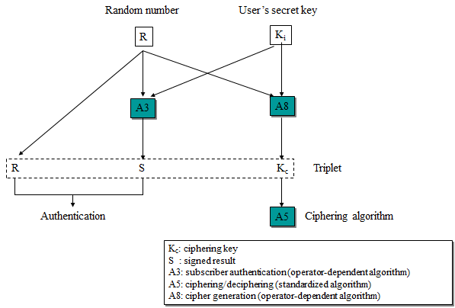
Cryptographic Algorithms for GSM

Slide 14
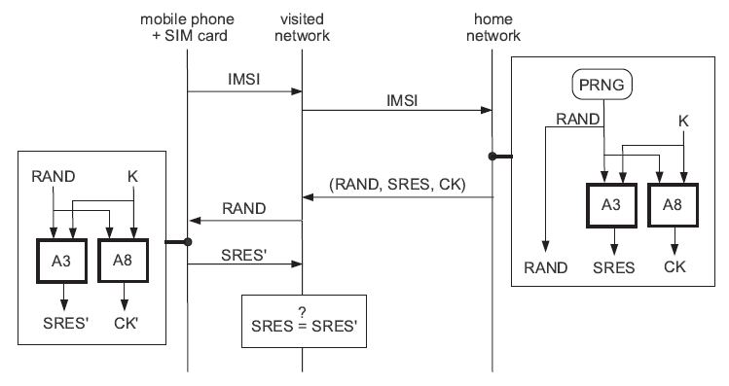
GSM Authentication Protocol

Slide 15
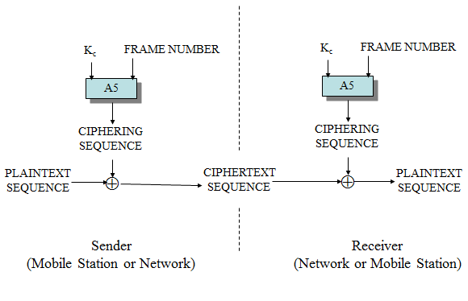
Ciphering in GSM

Slide 16
Conclusion on GSM Security
Focused on the protection of the air interface
The visited network has access to all data (except the secret key of the end user)
Generally robust, but a few successful attacks have been reported:
faked base stations
cloning of the SIM card

Slide 17
3GPP Security Principles
Reuse of 2nd generation security principles (GSM):
Removable hardware security module
In GSM: SIM card
In 3GPP: USIM (User Services Identity Module)
Radio interface encryption
Limited trust in the Visited Network
Protection of the identity of the end user (especially on the radio interface)
Correction of the following weaknesses of the previous generation:
Possible attacks from a faked base station
Cipher keys and authentication data transmitted in clear between and within networks
Encryption not used in some networks ➔ open to fraud
Data integrity not provided

Slide 18
3GPP Security Principles
New security features
New kind of service providers (content providers, HLR only service providers,…)
Increased control for the user over their service profile
Enhanced resistance to active attacks
Increased importance of non-voice services

Slide 19
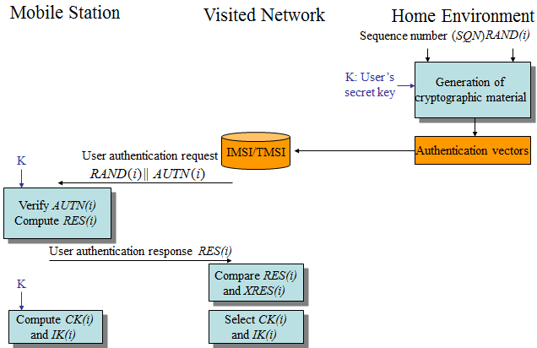
Authentication in 3GPP

Slide 20
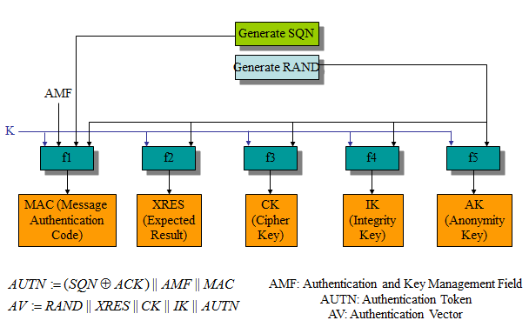
Generation of the Authentication Vectors

Slide 21
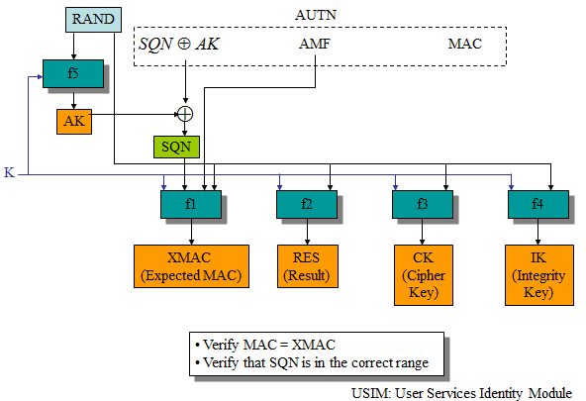
User Authentication Function in the USIM

Slide 22
More about Authentication and Key Generation
In addition to f1, f2, f3, f4 and f5, two more functions are defined: f1* and f5*, used in case the authentication procedure gets desynchronized (detected by the range of SQN).
f1, f1*, f2, f3, f4, f5 and f5* are operator-specific
However, 3GPP provides a detailed example of algorithm set, called MILENAGE
MILENAGE is based on the Rijndael block cipher
In MILENAGE, the generation of all seven functions f1…f5* is based on the Rijndael algorithm

Slide 23
Wi-Fi Networks

Slide 24
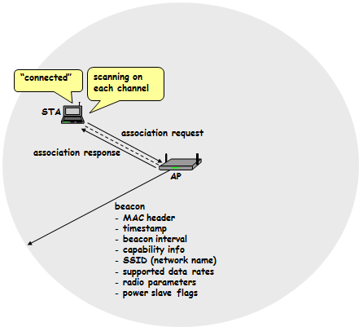
Introduction to Wi-Fi

Slide 25
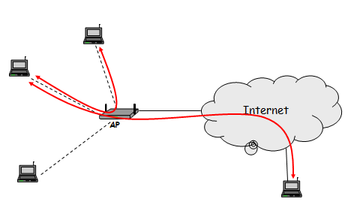
Introduction to Wi-Fi

Slide 26
Wired Equivalent Privacy
part of the IEEE 802.11 specification
goal
make the WiFi network at least as secure as a wired LAN (that has no particular protection mechanisms)
WEP was never intended to achieve strong security
services
access control to the network
message confidentiality
message integrity

Slide 27
WEP Access Control
Before association, the STA needs to authenticate itself to the AP
Authentication is based on a simple challenge-response protocol:
STA → AP: authenticate request
AP → STA: authenticate challenge (r) // r is 128 bits long
STA → AP: authenticate response (e_{K}(r))
AP → STA: authenticate success/failure
Once authenticated, the STA can send an association request, and the AP will respond with an association response
If authentication fails, no association is possible

Slide 28
WEP Message Confidentiality and Integrity
WEP encryption is based on RC4 (a stream cipher developed in 1987 by Ron Rivest for RSA Data Security, Inc.)
operation:
for each message to be sent:
RC4 is initialized with the shared secret (between STA and AP)
RC4 produces a pseudo-random byte sequence (key stream)
this pseudo-random byte sequence is XORed to the message
reception is analogous
it is essential that each message is encrypted with a different key stream
the RC4 generator is initialized with the shared secret and an IV (initial value) together
shared secret is the same for each message
24-bit IV changes for every message
WEP integrity protection is based on an encrypted CRC value
operation:
ICV (integrity check value) is computed and appended to the message
the message and the ICV are encrypted together

Slide 29
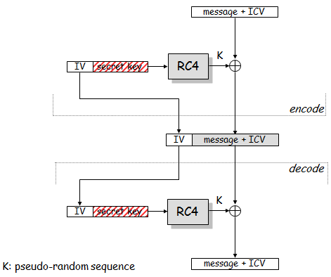
WEP Message Confidentiality and Integrity

Slide 30
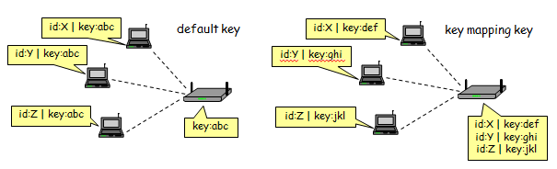
WEP Keys
two kinds of keys are allowed by the standard
default key (also called shared key, group key, multicast key, broadcast key, key)
key mapping keys (also called individual key, per-station key, unique key)
In practice, often only default keys are supported
the default key is manually installed in every STA and the AP
each STA uses the same shared secret key → in principle, STAs can decrypt each other’s messages

Slide 31
WEP flaws: Authentication and Access control
authentication is one-way only
AP is not authenticated to STA
STA is at risk to associate to a rogue AP
the same shared secret key is used for authentication and encryption
weaknesses in any of the two protocols can be used to break the key
no session key is established during authentication
access control is not continuous
once a STA has authenticated and associated to the AP, an attacker send messages using the MAC address of STA
correctly encrypted messages cannot be produced by the attacker, but replay of STA messages is still possible

Slide 32
WEP flaws: Authentication and Access Control
Recall that authentication is based on a challenge-response protocol:
…
AP → STA: r
STA → AP: IV | r ⊕ K
…
where K is a 128 bit RC4 output on IV and the shared secret
Attacker can compute r ⊕ (r ⊕ K) = K
Then it can use K to impersonate STA later:
…
AP → attacker: r’
attacker → AP: IV | r’ ⊕ K

Slide 33
WEP flaws: No integrity and replay protection
There’s no replay protection at all
IV is not mandated to be incremented after each message
The attacker can manipulate messages despite the ICV mechanism and encryption
CRC is a linear function wrt to XOR:
CRC(X ⊕ Y) = CRC(X) ⊕ CRC(Y)
attacker observes (M | CRC(M)) ⊕ K where K is the RC4 output
for any ΔM, the attacker can compute CRC(ΔM)
hence, the attacker can compute:
((M | CRC(M)) ⊕ K) ⊕ (ΔM | CRC(ΔM)) =
((M ⊕ ΔM) | (CRC(M) ⊕ CRC(ΔM))) ⊕ K =
((M ⊕ ΔM) | CRC(M ⊕ ΔM)) ⊕ K

Slide 34
WEP Flaws: Confidentiality
IV reuse
IV space is too small
IV size is only 24 bits → there are 16,777,216 possible IVs
after around 17 million messages, IVs are reused
a busy AP at 11 Mbps is capable for transmitting 700 packets per second → IV space is used up in around 7 hours
in many implementations IVs are initialized with 0 on startup
if several devices are switched on nearly at the same time, they all use the same sequence of IVs
if they all use the same default key (which is the common case), then IV collisions are readily available to an attacker
weak RC4 keys
for some seed values (called weak keys), the beginning of the RC4 output is not really random
if a weak key is used, then the first few bytes of the output reveals a lot of information about the key → breaking the key is made easier
for this reason, crypto experts suggest to always throw away the first 256 bytes of the RC4 output, but WEP doesn’t do that
due to the use of IVs, eventually a weak key will be used, and the attacker will know that, because the IV is sent in clear
→ WEP encryption can be broken by capturing a few million messages

Slide 35
WEP: Lessons learnt
Engineering security protocols is difficult
One can combine otherwise strong building blocks in a wrong way and obtain an insecure system at the end
Don’t do it alone (unless you are a security expert)
functional properties can be tested, but security is a non-functional property → it is extremely difficult to tell if a system is secure or not
Using an expert in the design phase pays out (fixing the system after deployment will be much more expensive)
experts will not guarantee that your system is 100% secure
but at least they know many pitfalls
they know the details of crypto algorithms
Avoid the use of WEP (as much as possible)

Slide 36
Overview of IEEE 802.11i
After the collapse of WEP, IEEE started to develop a new security architecture → 802.11i
Main novelties in 802.11i wrt to WEP
access control model is based on 802.1X
flexible authentication framework (based on EAP – Extensible Authentication Protocol)
authentication can be based on strong protocols (e.g., TLS – Transport Layer Security)
authentication process results in a shared session key (which prevents session hijacking)
different functions (encryption, integrity) use different keys derived from the session key using a one-way function
integrity protection is improved
encryption function is improved

Slide 37
Overview of IEEE 802.11i
802.11i defines the concept of RSN (Robust Security Network)
integrity protection and encryption is based on AES (and not on RC4 anymore)
nice solution, but needs new hardware → cannot be adopted immediately
802.11i also defines an optional protocol called TKIP (Temporal Key Integrity Protocol)
integrity protection is based on Michael (we will skip the details of that)
encryption is based on RC4, but WEP’s problems have been avoided
ugly solution, but runs on old hardware (after software upgrade)
Industrial names
TKIP → WPA (WiFi Protected Access)
RSN/AES → WPA2

Slide 38
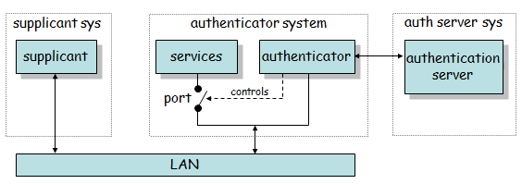
802.1X Authentication Model
the supplicant requests access to the services (wants to connect to the network)
the authenticator controls access to the services (controls the state of a port)
the authentication server authorizes access to the services
the supplicant authenticates itself to the authentication server
if the authentication is successful, the authentication server instructs the authenticator to switch the port on
the authentication server informs the supplicant that access is allowed

Slide 39
Mapping 802.1X model to WiFi
supplicant → mobile device (STA)
authenticator → access point (AP)
authentication server → server application running on the AP or on a dedicated machine
port → logical state implemented in software in the AP
one more thing is added to the basic 802.1X model in 802.11i:
successful authentication results not only in switching the port on, but also in a session key between the mobile device and the authentication server
the session key is sent to the AP in a secure way
this assumes a shared key between the AP and the auth server
this key is usually set up manually

Slide 40
Protocols: EAP, EAPOL and RADIUS
EAP (Extensible Authentication Protocol) [RFC 3748]
carrier protocol designed to transport the messages of “real” authentication protocols (e.g., TLS)
very simple, four types of messages:
EAP request – carries messages from the supplicant to the authentication server
EAP response – carries messages from the authentication server to the supplicant
EAP success – signals successful authentication
EAP failure – signals authentication failure
authenticator doesn’t understand what is inside the EAP messages, it recognizes only EAP success and failure
EAPOL (EAP over LAN) [802.1X]
used to encapsulate EAP messages into LAN protocols (e.g., Ethernet)
EAPOL is used to carry EAP messages between the STA and the AP
RADIUS (Remote Access Dial-In User Service) [RFC 2865-2869, RFC 2548]
used to carry EAP messages between the AP and the auth server
MS-MPPE-Recv-Key attribute is used to transport the session key from the auth server to the AP
RADIUS is mandated by WPA and optional for RSN

Slide 41
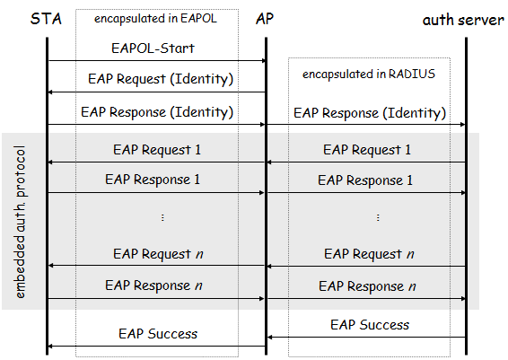
EAP in action

Slide 42
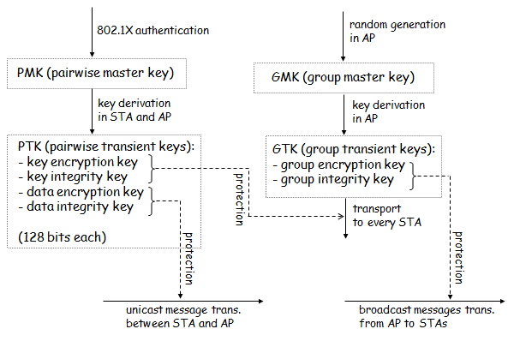
Key Hierarchies

Slide 43
Four-way handshake
Objective:
prove that AP also knows the PMK (result of authentication)
exchange random values to be used in the generation of PTK
Protocol:
AP : generate ANonce
AP → STA : ANonce | KeyReplayCtr
STA : generate SNonce and compute PTK
STA → AP : SNonce | KeyReplayCtr | MIC_{KIK}
AP : compute PTK, generate GTK, and verify MIC
AP → STA : ANonce | KeyReplayCtr+1 | {GTK}_{KEK} | MIC_{KIK}
STA : verify MIC and install keys
STA → AP : KeyReplayCtr+1 | MIC_{KIK}
AP : verify MIC and install keys

Slide 44
TKIP
runs on old hardware (supporting RC4), but …
WEP weaknesses are corrected
new message integrity protection mechanism called Michael
MIC value is added at SDU level before fragmentation into PDUs
implemented in the device driver (in software)
use IV as replay counter
increase IV length to 48 bits in order to prevent IV reuse
per-packet keys to prevent attacks based on weak keys

Slide 45
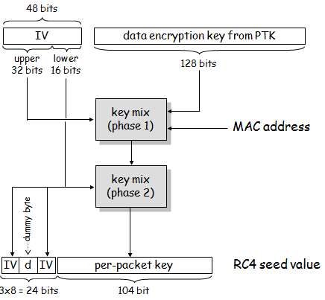
TKIP – Generating RC4 keys

Slide 46
AES-CCMP
CCMP means CTR mode and CBC-MAC
integrity protection is based on CBC-MAC (using AES)
encryption is based on CTR mode (using AES)
CBC-MAC
CBC-MAC is computed over the MAC header, CCMP header, and the MPDU (fragmented data)
mutable fields are set to zero
input is padded with zeros if length is not multiple of 128 (bits)
CBC-MAC initial block:
flag (8)
priority (8)
source address (48)
packet number (48)
data length (16)
final 128-bit block of CBC encryption is truncated to (upper) 64 bits to get the CBC-MAC value
CTR mode encryption
MPDU and CBC-MAC value is encrypted, MAC and CCMP headers are not
format of the counter is similar to the CBC-MAC initial block
“data length” is replaced by “counter”
counter is initialized with 1 and incremented after each encrypted block

Slide 47
Summary on Wi-Fi Security
security has always been considered important for WiFi
early solution was based on WEP
seriously flawed
not recommended to use
the new security standard for WiFi is 802.11i
access control model is based on 802.1X
flexible authentication based on EAP and upper layer authentication protocols (e.g., TLS, GSM authentication)
improved key management
TKIP
uses RC4 → runs on old hardware
corrects WEP’s flaws
mandatory in WPA, optional in RSN (WPA2)
AES-CCMP
uses AES in CCMP mode (CTR mode and CBC-MAC)
needs new hardware that supports AES

