Slide 1
NETWORK LAYER SECURITY
Dr. Sriram Sankaran

Slide 2
Network Layer Security
Threats at the Network Layer
Specific threats related to Identity
Routing and Forwarding Security
Defense Mechanisms

Slide 3
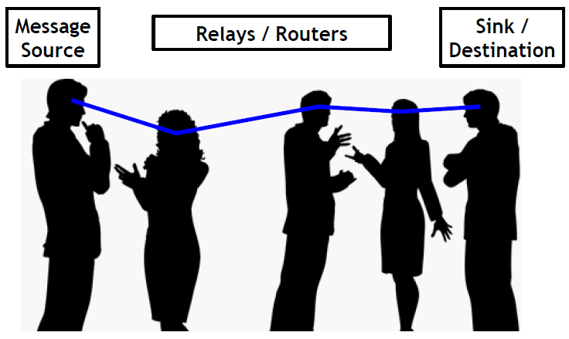
Wireless Networking

Slide 4
Network Layer Functionality
Network layer is primarily responsible for establishing end-to-end paths and delivering packets over them
Includes several fundamental services
Addressing: network ID management
Routing: finding/establishing paths
Forwarding: delivering packets
Interacts with Transport and LINK/MAC layer

Slide 5
Addressing
Before routing can be performed, nodes need some sort of ID or address
Address/ID types range from local to global, just like in the postal system (streets up to ZIP codes)
In very large-scale systems (eg. Internet), addresses must have some sort of structure
IP addresses follow a specific hierarchy and are reused within each domain
Within a domain and in small-scale systems (eg. MANET/WSN), addresses are typically unstructured or random
Address management needed within a domain to prevent duplication and other failure scenarios

Slide 6
Addressing Threats
Addresses can be changed arbitrarily
Allows for address spoofing
Masquerading as other node(s)
Potential for a large number of attacks
Changing identity to prevent detection/punishment
Attackers can infiltrate address management protocols (ARP, DHCP) to cause problems
Inducing address duplication
Forcing frequent address changes
Manipulating forwarding schemes

Slide 7
Routing
Routing = path management
Routing does not involve actual sending of packets from source to destination(s), only sets up the path
Lives in the “control plane”
Involves path setup/discovery, maintenance and tear-down
Challenges in MANET/WSN environments
Route using multiple untrusted relay nodes
Resource and capability limitations
No centralized authority or monitor
Secure routing often relies on existing key mgmt.

Slide 8
Routing Threats
Just as with other types of misbehavior, routers can be greedy, non-cooperative or malicious
Greedy routers can refuse route discovery requests in order to save their own resources
Non-cooperative routers can choose to selectively accept more requests to specific sources/destinations
Malicious routers can persuade route discovery protocols so paths pass through them, avoid them or take unnecessary detours

Slide 9
Path Attraction
Black-hole attack
A malicious router broadcasts false claims of being “close” to the destination in order to attract all traffic and drop it
Gray-hole attack
Similar to black-hole attack, except it only drops packets selectively
Ex: forward all routing control packets but drop all data
Worm-hole attack
Colluding routers create a low-latency long-distance out-of-band channel to attract routing paths and control data flow

Slide 10
Path Manipulation
Detours
A malicious router can modify/inject control packets to force selection of sub-optimal routes
“Gratuitous detours”
Greedy routers can avoid being on a selected route by advertising long delays or creating “virtual nodes”
Could be considered a form of Sybil attack, where all “personalities” are on the routing path

Slide 11
Route Subversion
Targeted blacklisting
In any routing protocol using blacklisting, attackers can accuse/slander/blame others to force them onto the blacklist
Rushing attacks
Attackers can quickly disseminate forged requests, causing later valid requests to be dropped

Slide 12
Forwarding
Forwarding = point-to-point data management
Forwarding involves actual sending of packets from source to destination(s) on given routing paths
Lives in the “data plane”
Correct forwarding involves
Sending the correct packets
Maintaining packet order
Respecting headers and rules
Relaying in a timely manner
Respecting rate control mechanisms

Slide 13
Forwarding Threats
Misbehavior in the forwarding mechanism (often called Byzantine forwarding) includes various ways of going against forwarding rules
Dropping packets
Modifying packet contents or header information
Injecting bogus packets on source’s behalf
Forwarding to the wrong next hop
Disrespecting rate control (flooding or throttling)

Slide 14
Network Privacy Threats
Routing protocols inherently reveal information to curious/malicious eavesdroppers
An attacker can listen to route discovery interactions and learn (1) locations of source and destination nodes, (2) type of interactions between nodes, (3) commonly used paths, (4) network events (5) data
These are all issues of location privacy, network privacy and data privacy due solely to the routing process

Slide 15
Network Layer Threats

Slide 16
Addressing
In traditional networking, each device (radio) has two identities, in the form of addresses
MAC address: hardware address of the radio needed for link layer communication (eg. 802.3, 802.11)
Hard-coded into the NIC
In theory, unique and static
IP address: network layer address used for routing and some other higher layer services
Virtual software address

Slide 17
MAC Addresses
MAC addresses in the Internet
Ethernet and WiFi use MAC addresses for link layer communication
Independent of any higher-layer functionality
Link layer frames carry source and destination MAC addresses (6B each)
MAC addresses in other systems
Not typically used in sensor networks due to overhead
Not needed if other addressing is available

Slide 18
IP Addresses
IP addresses in the Internet
Network layer and above use IP addresses for some identity purposes
Independent of whatever is below the network layer
IP addresses must be unique
IP addresses in other systems
To support common applications, most designers are aiming to support IP addressing (to some extent)

Slide 19
IP Address Resolution
In most Internet domains, IP addresses are assigned centrally using DHCP and bound to MAC addresses using ARP
DHCP = Dynamic Host Configuration Protocol: host asks server for IP address, which it keeps until expiry
ARP = Address Resolution Protocol: host asks other hosts for MAC address corresponding to an IP address

Slide 20
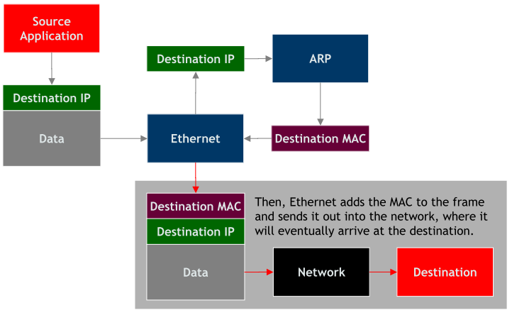
ARP

Slide 21
Limitations
MAC addresses are no longer hardware-bound
Most Linux-like systems allow software to change MAC address used, despite hard-coded MAC address
Many devices don’t have (unique) MAC addresses
DHCP is impractical for distributed systems
Requires centralization
High overhead in dynamic systems
ARP has high overhead in distributed systems
Requires request flooding

Slide 22
Distributed Addressing
Problem: How should IP addresses (or other suitable identities) be determined in a distributed system such that:
Addresses are compact (-able) for low-overhead communication in sensors or embedded devices
Network overhead is (relatively) low
Addresses are (sufficiently) unique
Systems can split and join
Duplicate addresses can be detected and fixed
Address space is large enough and dynamic

Slide 23
Routing and Forwarding Security
Basics of routing in ad hoc networks
Control-plane attacks and defenses
Data-plane attacks and defenses

Slide 24
Popular Routing Protocols
Link State (LS) routing
Optimized Link State Routing (OLSR)
Distance Vector (DV) routing
Destination Sequenced Distance Vector (DSDV)
Ad hoc On-demand Distance Vector (AODV)
Dynamic Source Routing (DSR)

Slide 25
On-Demand Routing
On-demand routing has several advantages and disadvantages in MANETs
Efficiency
Routing information isn’t constantly collected and updated only when needed
One-time cost of info collection can be higher
Security
Source nodes are aware of the entire path, unlike fully distributed algorithms that just focus on next hop
Long-term information typically isn’t available
Overall, advantages outweigh the disadvantages, so on-demand routing is popular

Slide 26
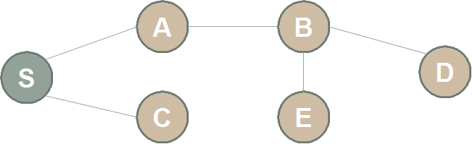
Route Discovery
Source S and neighboring nodes use control message exchanges to discover a route from S to destination D

Slide 27
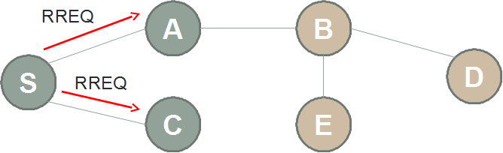
Route Discovery
Route request flooding:
Source S broadcasts a Route Request (RREQ) packet to its neighbors

Slide 28
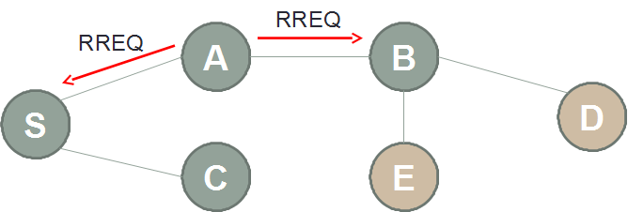
Route Discovery
RREQ forwarding:
If the neighbor has no prior relationship with the destination, it will further broadcast the RREQ

Slide 29
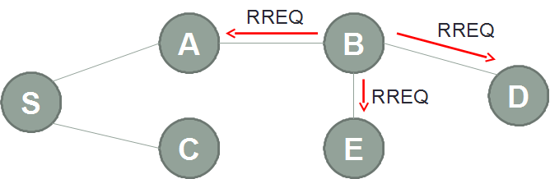
Route Discovery
Flooding of control packets to discover routes
Once RREQ packet reaches the destination, or a node that knows the destination, the node will unicast a RREP packet to the source via the routed path

Slide 30
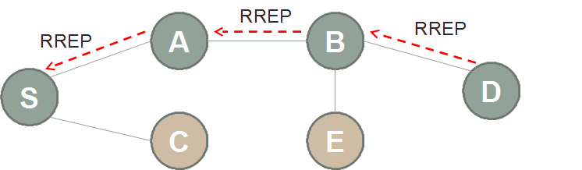
Route Discovery
Upon receiving the RREQ, D (or another node that knows D) will unicast a Route Reply (RREP) back to S along the found path

Slide 31
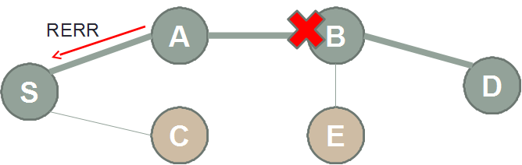
Route Maintenance
If a node can no longer reach the next hop
Sends Route Error (RERR) control packet to inform upstream neighbors
Route cache alternative (DSR) or rediscovery

Slide 32
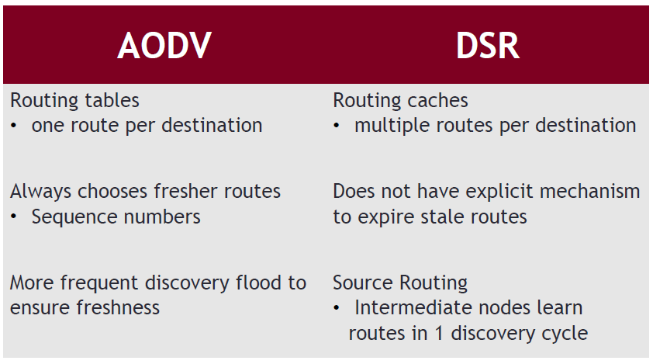
AODV vs. DSR

Slide 33
How could an attacker interfere or manipulate MANET routing?

Slide 34
Modification Attacks
AODV seq# modification
AODV uses seq# as a timestamp (high seq# - fresh)
Attacker can raise seq# to make its path attractive
DSR hop count modification
DSR uses #hops for efficiency (low #hops – cheap)
Attacker can lower/raise #hops to attract/repel

Slide 35
Modification attacks
DSR route modification
Non-existent route (DoS)
Loops (resource exhaustion, DoS)
No control to prevent loops after route discovery
Tunneling

Slide 36
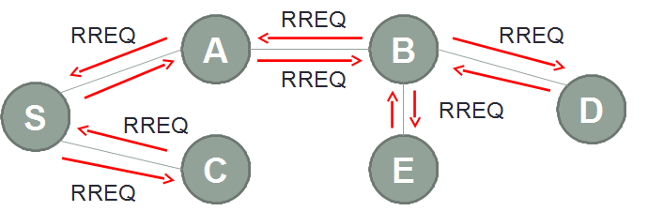

RREQ Flooding
Flood the network with RREQs to an unreachable destination address

Slide 37
AODV/DSR Spoofing
Attacker listens for RREQ/RREP from neighbors
Send an “attractive” RREP with spoofed ID
Spoof more IDs with interesting results

Slide 38
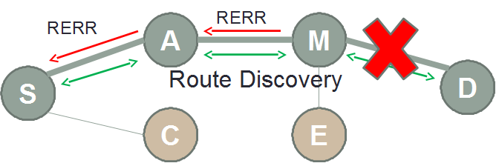
Fabrication Attacks
DoS against AODV/DSR by falsifying route errors

Slide 39
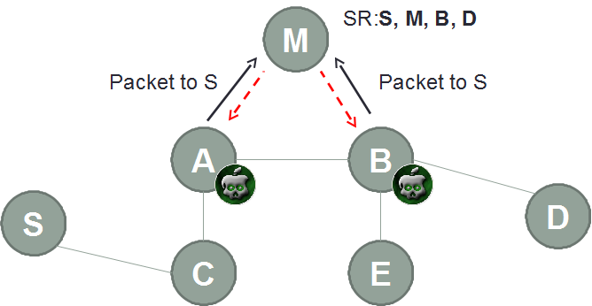
Fabrication Attacks
DSR route cache poisoning

Slide 40
Control Plane Security
How to guarantee that an established path can be efficient?
How to prevent attackers from manipulating path discovery/construction?
What metrics can be used to quantify the value of a path?
Length? Latency? Trust?

Slide 41
Securing DV routing
Distance vector routing is one of the classical approaches to network routing
SEAD: Secure Efficient Ad hoc DV Routing
[Hu et al. Ad hoc Networks 2003]
Based on DSDV protocol using sequence numbers to prevent routing loops
Uses hash chains to authenticate routing updates
Relies on existing mechanisms to distribute authentic hash chain end-elements

Slide 42
Securing LS Routing
Link State routing is another classical approach to network routing
SLSP: Secure Link-State Protocol
[Papadimitratos and Haas, WSAAN 2003]
MAC Address/ IP address pairs are bound using digital signatures
Allows for detection of address re-use and change
Uses hash chains for authentication

Slide 43
Secure Routing Protocol
SRP authenticates single-hop exchanges in DSR request and reply messages
Since protection is hop-by-hop, SRP over DSR is vulnerable to path modification

Slide 44
SAODV
Secure AODV introduces signatures into the AODV protocol to authenticate various message fields
RREQ and RREP are signed, hop counts are authenticated using hash chains

Slide 45
ARAN [Sanzgiri et al., ICNP 2002]
ARAN: Authenticated routing for Ad hoc networks
Make use of cryptographic certificates and asymmetric key to achieve authentication, message integrity and non-repudiation
Need preliminary certification process before a route instantiation process
Routing messages are authenticated at each hop from source to destination and vice versa

Slide 46
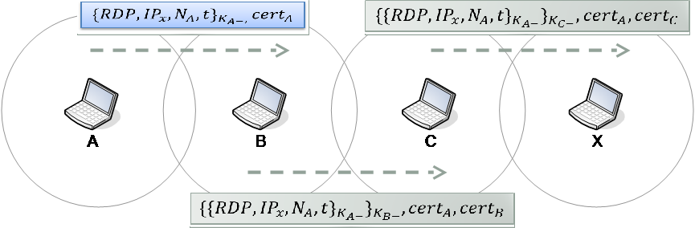
Authenticated Route Discovery

Slide 47
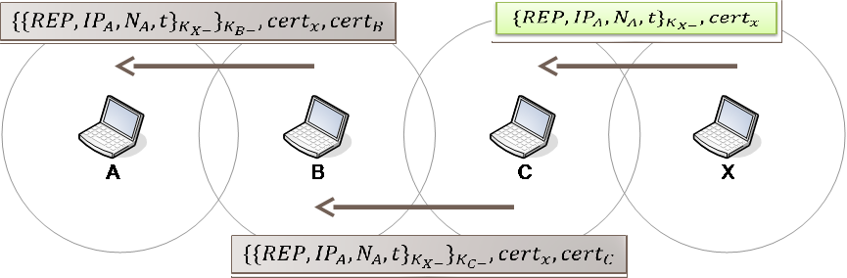
Authenticated Route Setup

Slide 48
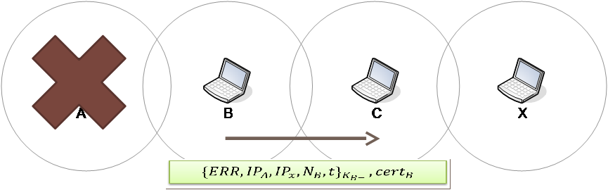
Route Maintenance
Send ERR message to deactivate route

Slide 49
ARAN Security
Modification attacks
Prevents redirection using seq# or #hops
Prevents DoS with modified source routes
Prevents tunneling attacks
Impersonation attacks
Prevents loop-forming by spoofing
Fabrication attacks
Prevents route error falsification

Slide 50
ARAN Limitations
ARAN relies on an underlying PKI
Requires a trusted third-party / infrastructure
Requires either:
Significant communication overhead to interact with the TTP for near-term updates/revocation
Long delays in certificate updates, revocation lists etc.

Slide 51

Ariadne [Hu, Perrig and Johnson, 2004]
Ariadne is a secure on-demand routing protocol built on DSR and Tesla
DSR: Dynamic Source Routing, Tesla: Timed Efficient Stream Loss-Tolerant Authentication (broadcast auth)
Route request and reply messages are authenticated

Slide 52
Forwarding security in the data plane

Slide 53
Data plane security
Injecting and modifying packets are issues of packet/data integrity, can be solved using cryptographic techniques
Forwarding to the wrong next hop is an issue of protocol compliance but can be checked and reported similar to packet/data integrity
Packet dropping is an issue of compliance and availability

Slide 54
Data Plane Availability
Cryptographic primitives alone cannot solve availability problems at the data plane
Cannot provide any sort of guarantee about delivering data through routers that misbehave
In general, crypto alone cannot solve DoS problems
Data plane availability is partially due to compliant behavior of routing nodes and partly due to natural non-deterministic faults, errors and failures

Slide 55
E2E Delivery Measures
Suppose packet delivery is measured end-to-end using signatures or MACs
Every message carries overhead for packet authentication, but message authentication is already desirable for many other reasons
Packet drop induces end-to-end retransmission
With high delay if the ACK is also dropped/modified
Packet modification forces routers to carry bogus message all the way to the destination node

Slide 56
Limitations
Paths can only be changed after a large number of end-to-end transactions, i.e. after enough data is available to make a decision
Path-based detection only identifies a bad path, not a bad node
Good nodes may be excluded from networking
May have to search a large number of paths to find one with good performance

Slide 57
Per-Node Delivery Measures
Suppose packet delivery is measured per node
Verification at finer granularity may require more overhead (eg. MAC per node)
Quicker retransmission requests can be issued by intermediate routers, but malicious routers can also request retransmissions
Routers are forced to do more computation and reporting
Neighbors may be required to “overhear” behavior

Slide 58
ShortMAC [Zhang et al., NDSS 2012]
Instead of reacting to poor performance, highly efficient monitoring can enable continuous monitoring with minimal overhead
A few key design insights allow for significant efficiency gains by making seemingly-significant trade-offs with detectability

Slide 59
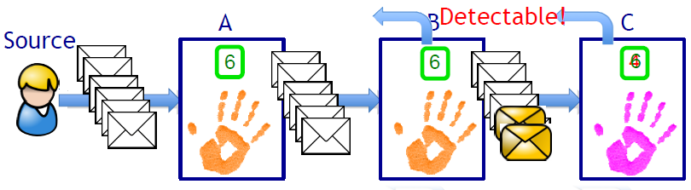
ShortMAC Counters
Fault localization -> Packet authentication
Fault localization -> monitor packet count, content
W/ pkt authentication, content -> count
Counters-only approach yields small state and low communication overhead

Slide 60
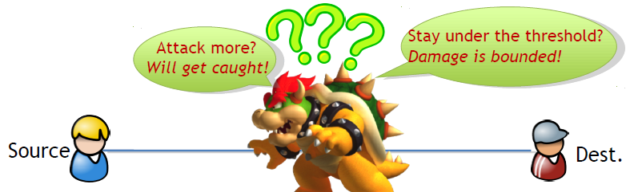
Limiting the Attacker
Limiting attacks instead of perfect detection
Detect every misbehavior? Costly! Error-prone!
Absorb low-impact attack: tolerance threshold
Trap the attacker into a dilemma
Enable probabilistic algorithms

Slide 61
Detection using Counters
High-level steps
Each node maintains two counters
Secure reporting
Threshold based detection robust to natural errors
Details in the paper

Slide 62
Limitations
ShortMAC was designed for the Internet and has some implicit assumptions that limit its use in wireless domains
Detection is based on a threshold value much higher than a natural packet loss threshold – in wireless, natural packet loss can be high
Source must share pairwise symmetric key with every node along the path

Slide 63
Random Audits in MANETs [Kozma and Lazos, WiSec 2009]
Instead of constantly monitoring every node’s forwarding behavior, only perform path audits when end-to-end performance degrades
To audit a path, source constructs a disjoint audit path to a node on the path and uses this path to carry audit request/response

Slide 64
Efficient Auditing
Upon request, a node generates a proof of which packets it has seen
Reporting a list of all packets is inefficient, so compression is required
Bloom Filter does lossy packet list compression

Slide 65
Random Audits
REAct = Resource Efficient ACcounTability
Audits are triggered by performance degradation
Source S audits a node N on the path
If the returned Bloom filter from N is sufficiently close to that of S, then audit a node downstream
Else, audit a node upstream of N
Eventually, search will converge to the lossy link
Source can change route around the lossy link to identify which node is misbehaving

Slide 66
Limitations
REAct assumes that attackers have a static attack strategy
Dropping packets only when not being audited will work
REAct assumes that multiple attackers do not collude
Colluding attackers can trade duties when being audited

