Slide 1
Attacks Against naming and addressing
Dr. Sriram Sankaran

Slide 2
Attacks against Naming and Addressing
Naming and addressing are fundamental for networking
notably, routing protocols need addresses to route packets
services need names in order to be identifiable, discoverable, and useable
Attacks against naming and addressing
Address stealing
adversary starts using an address already assigned to and used by a legitimate node
Sybil attack
a single adversarial node uses several invented addresses
makes legitimate nodes believe that there are many other nodes around
Node replication attack
dual of the Sybil attack
the adversary introduces replicas of a single compromised node using the same address at different locations of the network

Slide 3
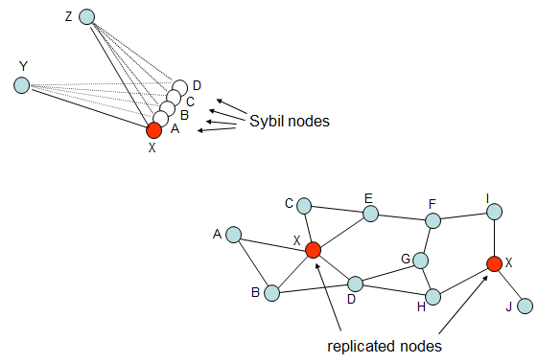
Illustration of Sybil and Replication attacks

Slide 4
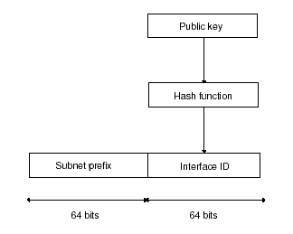
Cryptographically Generated Addresses (CGA)
Aims at preventing address stealing
General idea
Generate node address from a public key
corresponding private key is known only by the legitimate node
prove ownership of the address by proving knowledge of the private key
Example in the case of IPv6

Slide 5
A Potential Problem with CGA
Often only a limited number of bits of the address can be chosen arbitrarily (64 in our example)
This number may be too small to guarantee second pre-image resistance
An adversary could pre-compute a large database of interface identifiers from public keys generated by himself, and use this database to find matches to victims' addresses
A solution can be the technique called hash extension
Increase the cost of address generation, and hence the cost of brute-force attacks, while keep constant the cost of address usage and verification

Slide 6
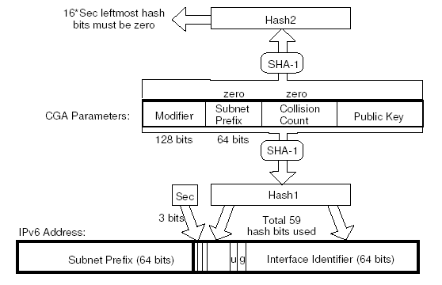
Hash Extension

Slide 7
Protocol for CGA Generation
Set the modifier field to a random 128-bit value.
Hash the concatenation of the modifier, 64+8 zero bits, and the encoded public key. The leftmost 112 bits of the result are Hash2.
Compare the 16*Sec leftmost bits of Hash2 with zero. If they are all zero (or if Sec=0), continue with Step (4). Otherwise, increment the modifier and go back to Step (2).
Set the collision count value to zero.
Hash the concatenation of the modifier, subnet prefix, collision count and encoded public key. The leftmost 64 bits of the result are Hash1.
Form an interface identifier by setting the two reserved bits in Hash1 both to 1 and the three leftmost bits to the value Sec.
Concatenate the subnet prefix and interface identifier to form a 128-bit IPv6 address.
If an address collision with another node within the same subnet is detected, increment the collision count and go back to step (5). However, after three collisions, stop and report the error.

Slide 8
Protocol for CGA Verification
Check that the collision count value is 0, 1 or 2, and that the subnet prefix value is equal to the subnet prefix (i.e. leftmost 64 bits) of the address. The CGA verification fails if either check fails.
Hash the concatenation of the modifier, subnet prefix, collision count and the public key. The 64 leftmost bits of the result are Hash1.
Compare Hash1 with the interface identifier (i.e. the rightmost 64 bits) of the address. Differences in the two reserved bits and in the three leftmost bits are ignored. If the 64-bit values differ (other than in the five ignored bits), the CGA verification fails.
Read the security parameter Sec from the three leftmost bits of the interface identifier of the address.
Hash the concatenation of the modifier, 64+8 zero bits and the public key. The leftmost 112 bits of the result are Hash2.
Compare the 16*Sec leftmost bits of Hash2 with zero. If any one of these is nonzero, CGA verification fails. Otherwise, the verification succeeds.

Slide 9
Thwarting the Sybil attack
note that CGAs do not prevent the Sybil attack
an adversary can still generate addresses for herself
a solution based on a central and trusted authority
the central authority vouches for the one-to-one mapping between an address and a device
e.g., a server can respond to requests concerning the legitimacy of a given address
other solutions take advantage of some physical aspects
e.g., identify the same device based on radio fingerprinting

Slide 10
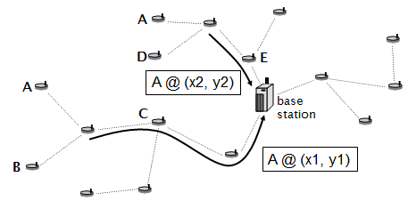
Thwarting the node replication attack
A Centralized solution
Each node reports its neighbors’ claimed locations to a central authority (e.g., the base station in sensor networks)
Central authority detects if the same address appears at two different locations
Assumes location awareness of the nodes

Slide 11
Node Replication attack
a decentralized variant
neighbors’ claimed location is forwarded to witnesses
witnesses are randomly selected nodes of the network
if a witness detects the same address appearing at two different locations then it broadcast this information and the replicated nodes are revoked

Slide 12
Summary
there are various attacks against naming and addressing
address stealing
Sybil attack
node replication attack
decentralization and lack of a central authority renders the defense against these attacks difficult
proposed solutions (CGA, node replication detection using witnesses) provide only probabilistic guarantees
parameters should be chosen carefully

