Slide 1
MAC-Layer SECURITY
Dr. Sriram Sankaran

Slide 2
MAC-LAYER SECURITY
IEEE 802.11 MAC LAYER
Misbehavior in 802.11 MAC
Threats at the MAC Layer

Slide 3
IEEE 802.11
Infrastructure mode
Many stations share an AP connected to internet
Distributed Coordination Function (DCF)
Point Control Function (PCF)
Rarely used due to inefficiency, vague standard specification and lack of interoperability support
Ad hoc mode
Multi-hop, no infrastructure, no Internet
Never really picked up commercially
Mesh mode (using 802.11s)

Slide 4
802.11 MAC
Responsibilities of the MAC layer
Logical responsibilities
Addressing
Fragmentation
Error detection, correction and management
Timing responsibilities
Channel Management
Link flow control
Collision avoidance
Our focus will be on timing-based vulnerabilities

Slide 5
CSMA
Carrier Sense Multiple Access
Listen to the channel before transmitting
If channel is quiet, transmit
After a short delay, (DIFS = DCF Inter-frame spacing)
If channel is busy
Wait until its quiet for a DIFS period
Wait for random backoff period
Send if still quiet
Wait for ACK or retransmit using random back-off

Slide 6
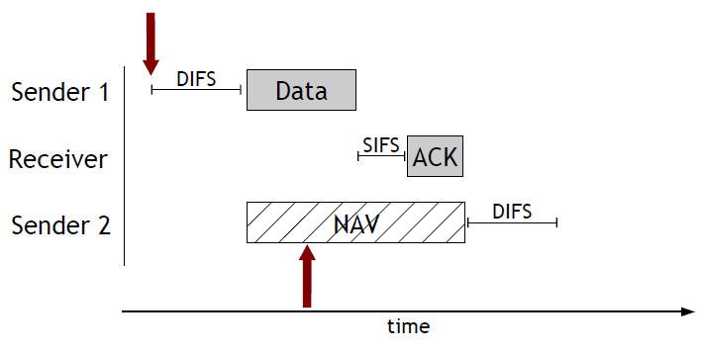
DCF operation using CSMA

Slide 7
Random back-off
Reduce the chance of collisions
Each device must wait a random duration depending on past contention – use “contention window” CW
If the medium is busy
Wait for DIFS period
Set backoff counter randomly in CW
Transmit after counter time expires
After failed retransmissions:
Increase CW exponentially
2^{n}-1 from CW_{min} to CWmax, eg., 7-> 15 -> 31

Slide 8
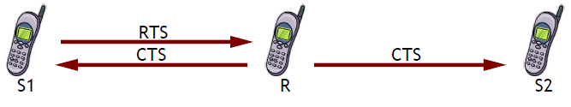
Collision Avoidance
Attempt to make channel reservation to avoid collisions by other senders
Request to Send (RTS)
Before transmitting data, sender transmits RTS
Clear to Send (CTS)
Receiver transmits CTS to tell sender to proceed
RTS and CTS use short IFS (SIFS < DIFS) to give priority over data packets

Slide 9
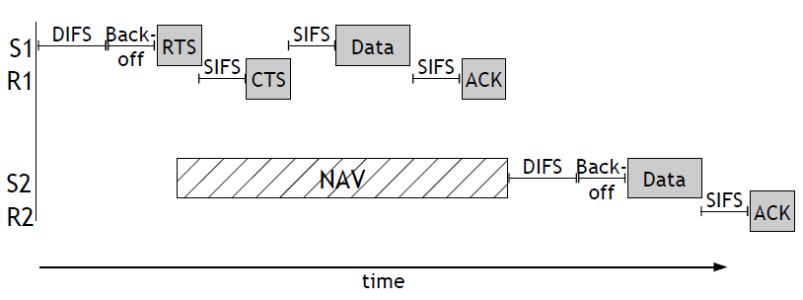
RTS/CTS Usage
RTS/CTS is not required
S1-R1 use RTS/CTS, S2-R2 do not

Slide 10
MAC-layer misbehavior
802.11 DCF works well under the assumption that everyone plays nicely together
This may have been a reasonable assumption when MAC protocols were hardware-bound
However, selfish and malicious nodes are free to arbitrarily break the rules
Software MAC makes this very easy to do

Slide 11
Question
What are some of the different ways to misbehave at the MAC layer?

Slide 12
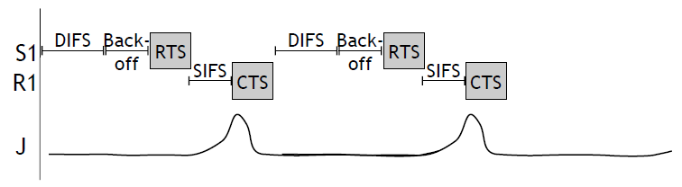
MAC Jamming
DCF structure and behavior gives advantages to jamming attackers
Jamming after RTS (and SIFS period) blocks CTS (prevents data flow) and occupies channel (prevents other senders from using it)
Low duty-cycle attack -> order-of-magnitude efficiency gain

Slide 13
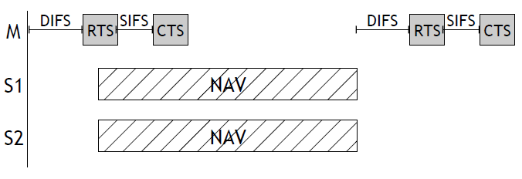
MAC Blocking
DCF structure and behavior gives advantages to other DoS attackers
RTS/CTS “flooding” – repeated sending of RTS/CTS exchanges while other senders obey the rules

Slide 14
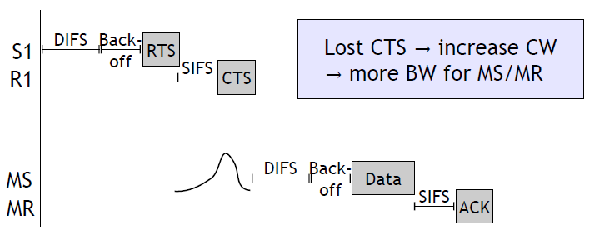
MAC Greed with Jamming
Greedy/malicious sources can block or collide with other sources, causing their sending rates to decrease
Gives more opportunity to greedy source

Slide 15
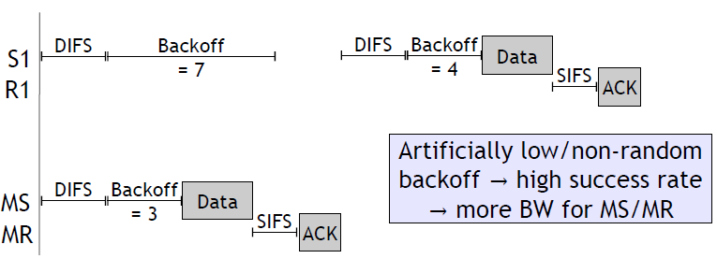
MAC Greed with Parameters
Greedy/malicious sources can manipulate protocol parameters for unfair resource usage

Slide 16
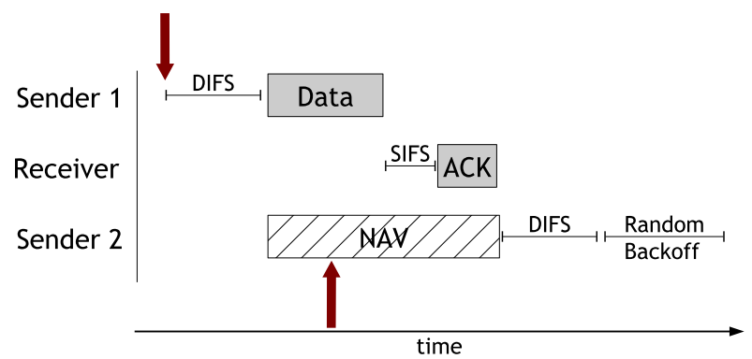
Cheating in CSMA/CA
“CSMA/CA was designed with the assumption that the nodes would play by the rules”
MAC cheaters deliberately fail to follow the IEEE 802.11 protocol, in particular in terms of the contention window size and back-off

Slide 17
System Game Model
N tx-rx pairs in a single collision domain, using 802.11, C of N are cheaters with control of MAC layer parameters
Cheaters want to maximize avg. throughput r_{i}
As a game:
Each player (cheater) adjusts its contention window size W_{i}
Players react to changes of remaining N-C users who play by the rules
Authors analyze relationships between throughput and contention window sizes

Slide 18
Single static checker
First case: a single cheater with a fixed strategy (ie. makes a decision and sticks with it)
A single cheater gets best throughput at W_{i} = 1
In fact W_{i} = 1 is the Nash Equilibrium for the static game

Slide 19
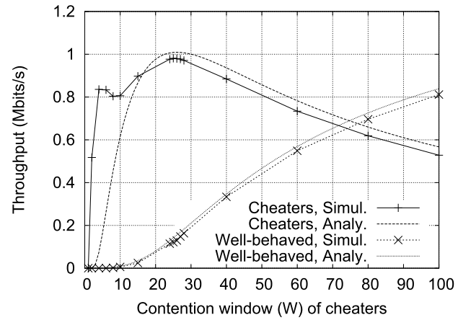
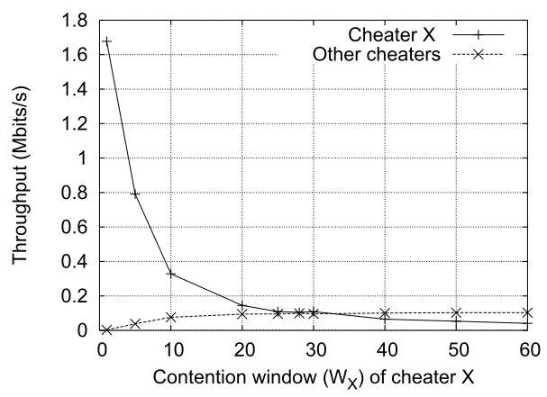
Multiple Static Cheaters
Second case: many cheaters with fixed strategy
Cheaters don’t know about each other
Cheaters are aware of the cheater v. cheater competition in forming strategies
Window size W_{i} = 1is no longer optimal

Slide 20
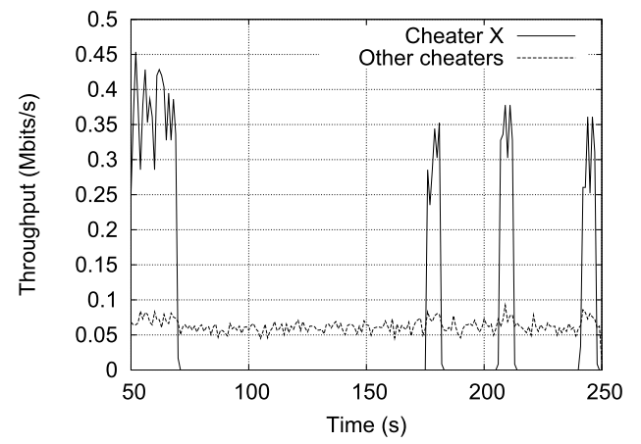
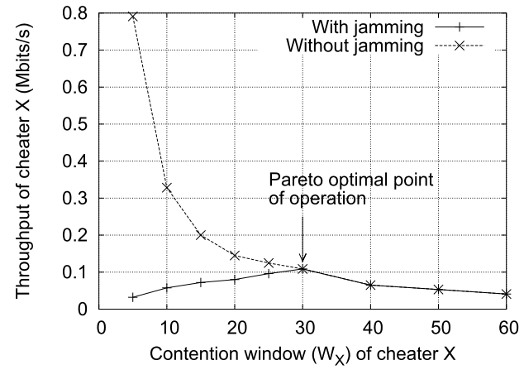
Dynamic Cheating game
In the dynamic game, cheaters can change their strategy in response to other players (including other cheaters)
A penalty is enforced on the utility function, so cheaters converge to the optimal operating point
“Cooperative cheaters” can inflict penalty on “non-cooperative cheaters” by jamming their packets

Slide 21
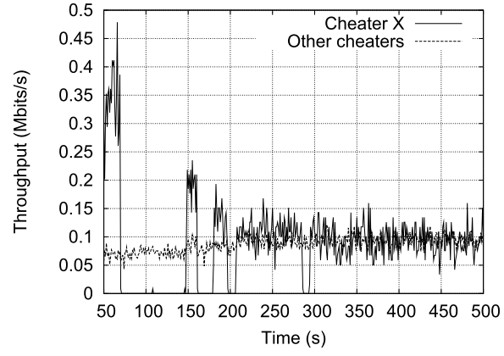
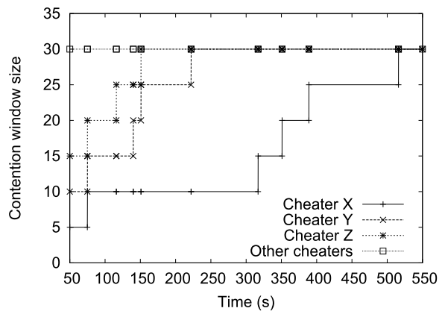
Distributed/Adaptive Cheating
Cheaters can observe actual throughput and jamming to adapt contention window size
Cheaters are forced to cooperate or get lower throughput due to penalization from other cheaters

Slide 22
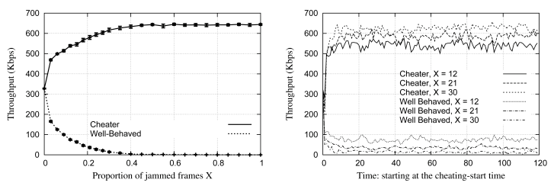
Detecting Greedy Behavior [Raya et al., 2006]
Detection of greedy behavior in the Mac layer of Ieee 802.11 public Networks (DOMINO)
Software installed at/near the access point that can detect and identify greedy players
No changes to software of benign players

Slide 23
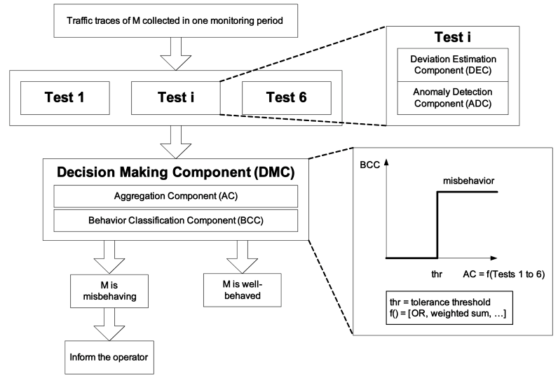
DOMINO Architecture

Slide 24
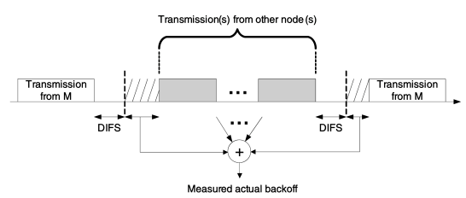
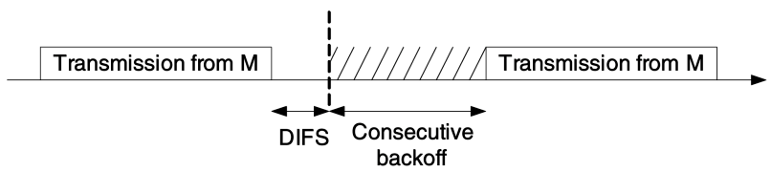
Behavior Tests
The DOMINO-enabled AP performs a number of behavioral tests as a decision-making basis
Scrambled/re-transmitted frames
Shorter than DIFS
Oversized NAV
Observed back-off
Consecutive back-off

Slide 25
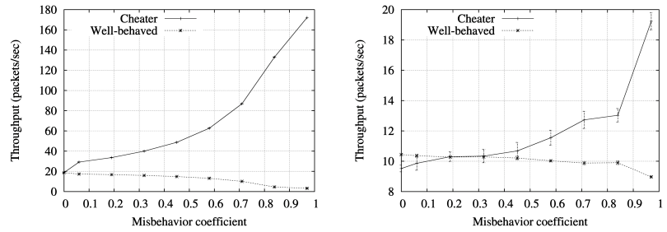
UDP vs. TCP Traffic
Impact of misbehavior varies for different types of target traffic
Disparity between cheater and benign users is higher in UDP case

Slide 26
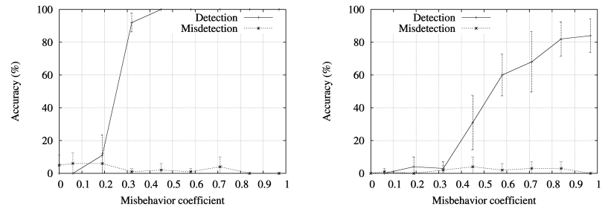
UDP vs. TCP Detection
Traffic type also has significant impact on detection capabilities of DOMINO
Actual back-off test in UDP vs. Consecutive back-off test in TCP
TCP Congestion control causes additional timing-related behaviors that can cause detection errors

Slide 27
Further Discussions in Paper
The DOMINO paper talks about a lot of different types of misbehavior
Jamming attacks, timing misbehavior etc.
Design of a deployable system
Lots of design parameters to choose
Analysis of numerous types of misbehavior
Incorporation of security mechanisms, quality of service, wireless error scenarios (eg. Hidden terminal)

Slide 28
Fairness in 802.11
802.11 incorporates various fairness mechanisms
Provides fairness regardless of connection quality
Allows low-quality connections to occupy the medium for much longer than high quality connections

Slide 29
Implicit Jamming in 802.11
802.11 has a built-in fairness mechanism that basically allows all users to get the same long-term throughput
A clever attacker can take advantage of this property to deny service to others by jamming a single user
Degradation of the single user effectively starves the other users
Jamming an end node is not necessarily observable by the AP, so detection is much harder

Slide 30
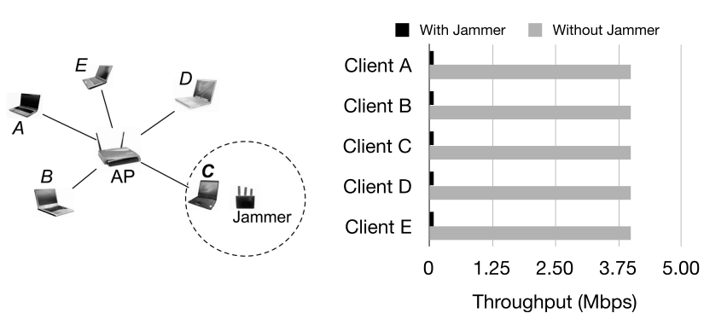
Implicit Jamming
Low-power jammer attacks a single nearby node, degrades throughput for every user using the same AP

Slide 31
Mitigating Implicit Jamming
FIJI: anti-jamming mitigation of the implicit jamming attack
Goal 1: ensure that nodes not under attack are not indirectly affected by the attack
Goal 2: ensure that the maximum amount of traffic is delivered to the node under attack, given that the node is under attack
Both goals rely on explicit detection of the jamming attack

Slide 32
FIJI Detection Component
Detection module
Since FIJI is run/managed entirely at the AP, detection must also take place there; not typical jamming attack detection
Standard jamming detection mechanisms (eg. Using RSSI + PDR) don’t apply, need other metrics
Instead, look for changes in transmission delay
Very large increment in measured transaction time indicates the node is under attack

Slide 33
FIJI Traffic Component
Adjust the traffic patterns to all clients based on detection events
Trivial solution: don’t send any data to jammed clients, but this is unfair and could lead to big problems if any detection errors occur
Accept traffic degradation to attacked node, but keep traffic patterns constant for other nodes
Two approaches to deal with the attacked node:
Adjust the data packet size: shorter packet fragments are more likely to get through
Adjust the data rate: send to the jammed nodes less often

Slide 34
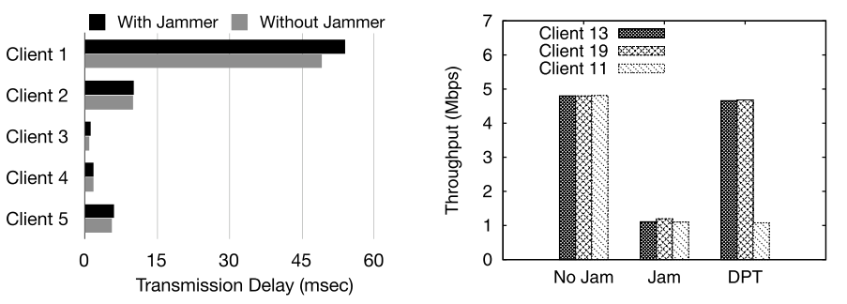
FIJI Evaluation

