Slide 1
Physical Layer Security

Slide 2
Wireless PHY
The wireless PHY is responsible for delivering a bit stream from a transmitter to one or more receivers. It's not as easy as it sounds.
Tx/Rxs need to be coordinated in time, space, frequency, phase, encoding/language
Wireless means there are many sources of error, reasons for failure, etc.

Slide 3
PHY Standards
In Wi-Fi networks, IEEE 802.11 defines several versions of the PHY, including extensions for mesh, vehicular, etc.
In telecom, the GSM 05.xx series defines the Um physical layer, and other standards build on it, including ITU-T standards like 4G.
• In PANs, standards like 802.15.1 (Bluetooth), .3 (high-rate, e.g., UWB), and .4 (low-rate, e.g., Zigbee) all define their own PHY models.

Slide 4
Wireless Phy Services
Various parts of PHY operation
Radio interface: spectrum allocation, signal strength, bandwidth, carrier sensing, phase sync
Signal processing: equalization, filtering, training, pulse shaping, signaling,…
Coding: channel coding, bit interleaving, forward error correction, …
Modulation (mapping bits to signals)
Topology, antennas, duplex/simplex, multiplexing and so much more
PHY is typically the most complex part of a wireless network

Slide 5
Physical Layer Threats

Slide 6

The Party Analogy

Slide 7
Physical Layer Misbehavior
Open, shared medium is vulnerable
Anyone can “talk” -> greedy or malicious nodes can easily interfere
Prevention/degradation of communication via jamming
Cutting off available resources influences network control, operation and performance
Anyone can “listen” -> curious or malicious nodes can easily eavesdrop on communication
Recovery of information exchanged by neighbors (violation of data, identity, operation/intention privacy)
Inference/learning, tracking, observing

Slide 8
Challenges
How can we prevent a curious or malicious party from eavesdropping on wireless transmissions at the physical layer?
How can we prevent a greedy or malicious party from interfering with PHY transmission and reception?

Slide 9
Spread Spectrum
Spread Spectrum is an extension of multiplexing that uses randomization to increase diversity and improve performance in various ways
Frequency-hopping spread spectrum (FHSS) builds on FDM allowing devices to pseudo-randomly move among frequency channels
Direct-sequence spread spectrum (DSSS) builds on CDM allowing devices to pseudo-randomly move among different code spaces
Code Spaces are analogous to frequency bands

Slide 10
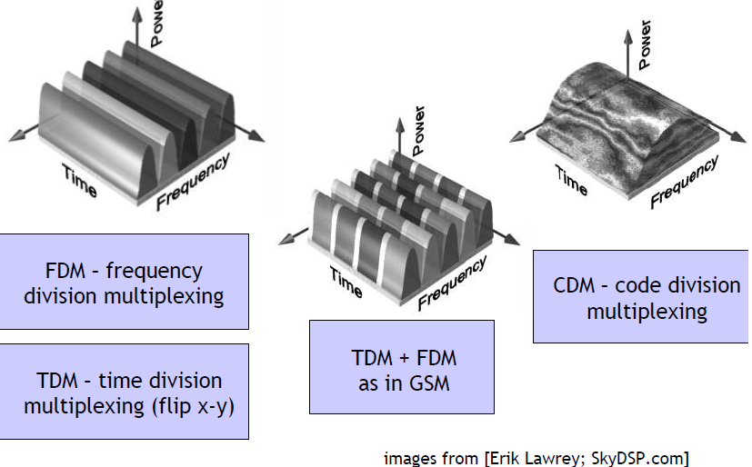
Multiplexing

Slide 11
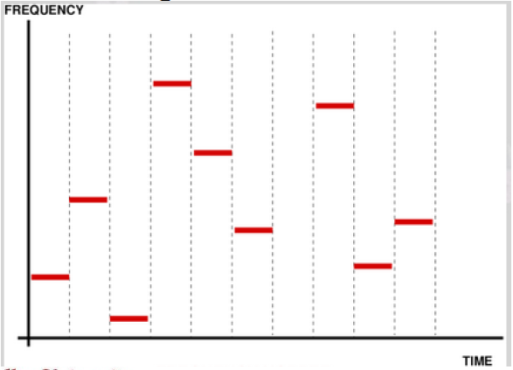
FHSS
Sender and receiver synchronize a hopping pattern over a large bandwidth

Slide 12
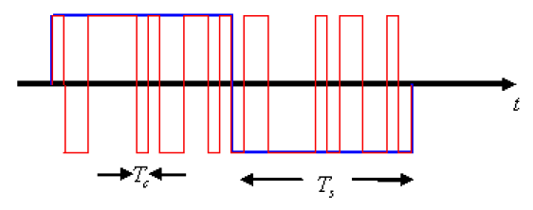
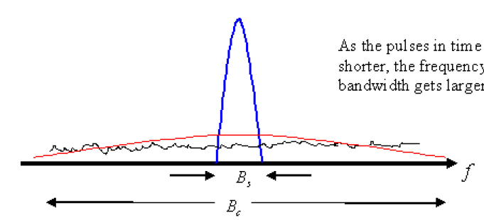
DSSS
DSSS encoding maps long symbols to sequences of short chips
Shorter chip duration means wider bandwidth

Slide 13
Benefits
FHSS
Narrow-band interference only has an effect for a small fraction of the time
Single-channel eavesdroppers can’t follow the signal, need to use much wider bandwidth to hear everything
DSSS
Narrow-band interference is despread at the receiver
Other signals are (nearly) orthogonal
Eavesdropper has to know/guess code to decide

Slide 14
Cryptographic SS
Building off basic spread spectrum, we can add cryptographic randomization to make hopping schedule and code sequences secret
Using a symmetric key as a seed to PRNG makes the hopping schedule or code sequence secret
In both cases, this requires symmetric key management, which has its own issues

Slide 15
Issues with Spread Spectrum
To be effective against curiosity/greed/malice , hopping sequences (FHSS) and spreading codes (DSSS) must be private
In many implementations, these codes are given to all group members – if becoming a group member is easy, there’s no barrier
If group membership is tightly guarded, can it be bought or stolen?
If codes can’t be obtained, can they be learned?
Code reuse allows for statistical analysis and recovery

Slide 16
Further hardening the PHY
If spread spectrum isn’t enough, what else?
Multiple diversity can protect against multiple threats at numerous levels
Implementations must consider the threat models and adapt to unexpected behaviors
Prevent statistical analysis, adapt to learning adversaries

Slide 17
Jamming and Physical Layer Security

Slide 18
Outline
Jamming attacks and defenses
Secrecy using physical layer properties
Authentication using physical layer properties

Slide 19
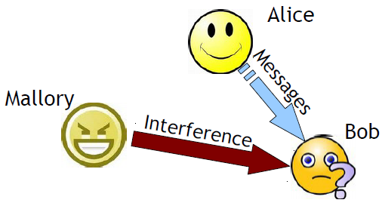
Jamming
A physical layer denial-of-service attack that aims to prevent communication between parties

Slide 20
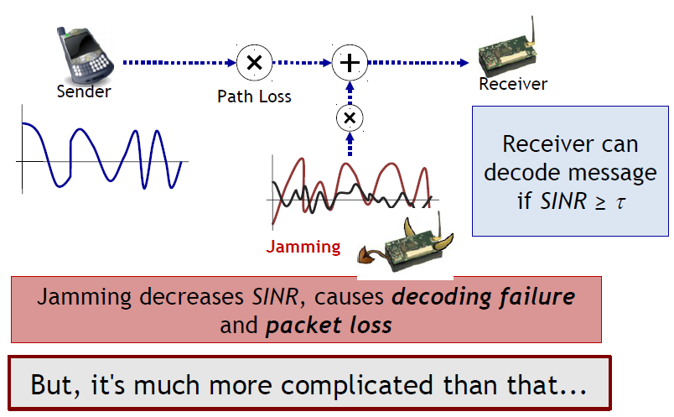
How does Jamming work?

Slide 21
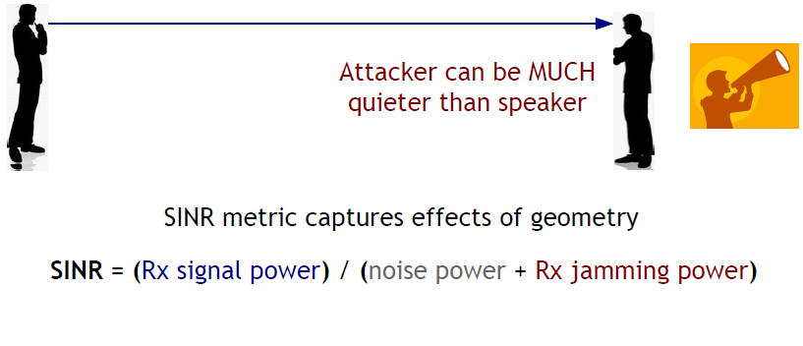
Geometry matters

Slide 22
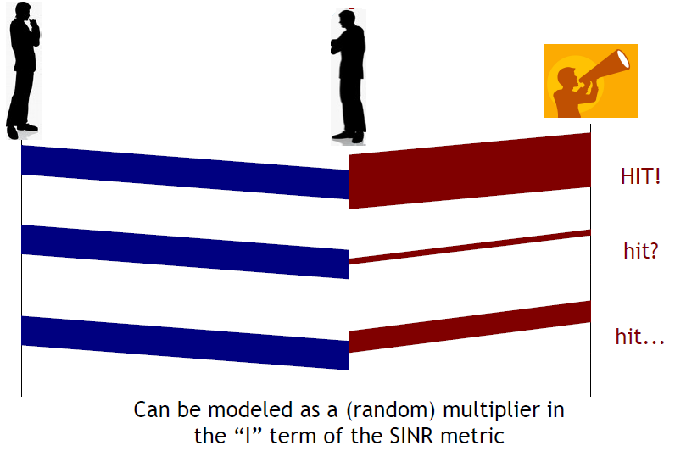
Timing Matters

Slide 23
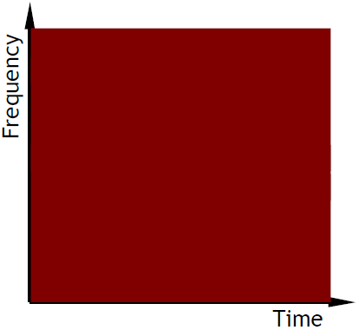
Generalized Jamming
A jammer allocates energy/signal to diverse time and freq resources according to an attack strategy S
Effect E(S) of the attack
Cost C(S) of the attack
Risk R(S) of being detected/punished
With other metrics, an optimization emerges

Slide 24
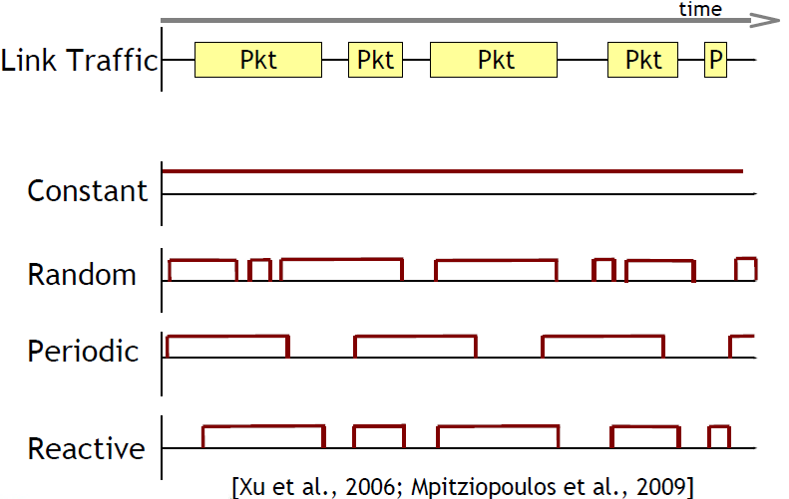
Jamming Strategies: Time Domain

Slide 25
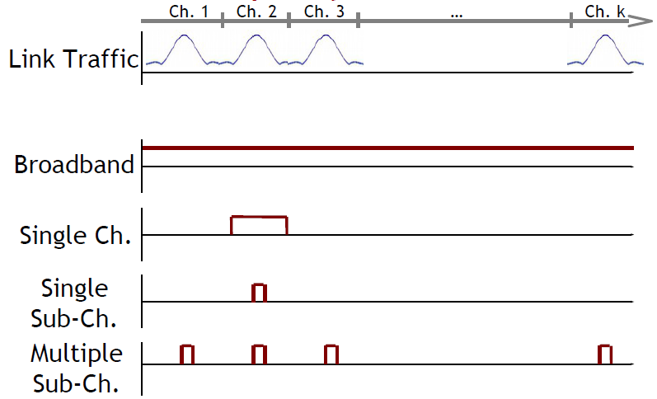
Jamming Strategies: Frequency Domain

Slide 26
How can we protect against Jamming?

Slide 27
Jamming Detection and Defense [Xu et al. IEEE Network 2006]
Goal: Detect and localize jamming attacks, then evade them or otherwise respond to them
Challenge: distinguish between adversarial and natural behaviors (poor connectivity, battery depletion, congestion, node failure etc.)
Certain level of detection error is going to occur
Appropriate for deployment in sensor networks
Approach: coarse detection

Slide 28
Basic Detection Strategies
Received Signal Strength (RSSI)
Jamming signal will affect RSSI measurements
Very difficult to distinguish between jamming/natural
Carrier Sensing Time
Helps to detect jamming as MAC misbehavior
Doesn’t help for random or reactive cases
Packet Delivery Ratio (PDR)
Jamming significantly reduces PDR (to ~0)
Robust to congestion, but other dynamics (node failure, outside comm range) also cause PDR -> 0

Slide 29
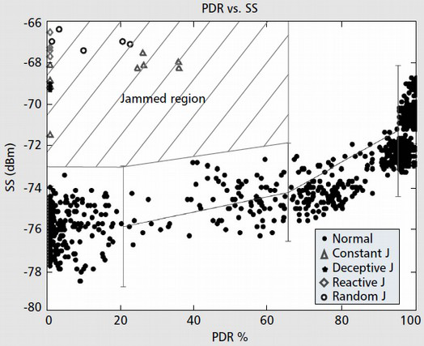
Advanced Detection
Combining multiple statistics in detection can help
High PDR + High RSSI -> OK
Low PDR + Low RSSI -> Poor Connectivity
Low PDR + High RSSI -> ? -> Jamming attack?

Slide 30
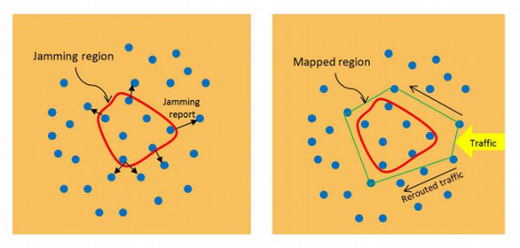
Jammed Area Mapping
Based on advanced detection technique, nodes can figure out when they are jammed
At the boundary of the jammed area, nodes can get messages out to free nodes
Free nodes can collaborate to perform boundary detection using location information

Slide 31
Evading Jamming
Nodes in the jammed region can evade the attack, either spectrally or spatially
Spectral evasion -> “channel surfing” to find open spectrum and talk with free nodes
Spatial evasion -> mobile retreat out of jammed area
Need to compensate for mobile jammers ability to partition the network

Slide 32
Dynamic attack and defense strategies

Slide 33
Optimal Jamming and Detection
Problem Setup: each of the network and the jammer have control over random jamming and transmission probabilities
Network parameter ‘alpha’ is probability each node will transmit in a time slot
Attack parameter ‘q’ is probability the jammer will transmit in a time slot
Opponents can learn about goals through observation and optimize for min-max/max-min

Slide 34
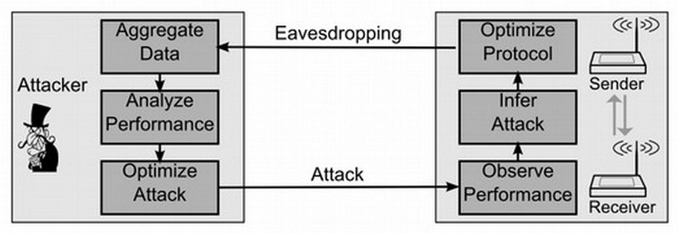
Jamming Games
What if both attacker and defender are freely adapting in response to each other?

Slide 35
Secure communication using properties of the wireless medium

Slide 36
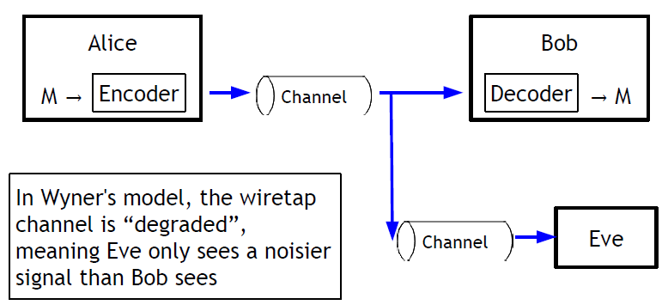
Wiretapping
In 1975, A. D. Wyner defined the wiretap channel to formalize eavedropping

Slide 37
Secrecy Capacity
Since the Alice -> Eve channel is noisier than Alice->Bob channel
Eve can’t decode everything that Bob can decode
There’s a really nice Information Theory formalization of the concept of secrecy capacity, namely the amount of secret information Alice can send Bob without Eve being able to decode

Slide 38
Degraded Eavesdropper?
In a practical scenario, is it reasonable to assume the eavesdropper’s signal is more degraded than the receiver’s?
Probably not
Can we exploit the diversity of receivers?

Slide 39
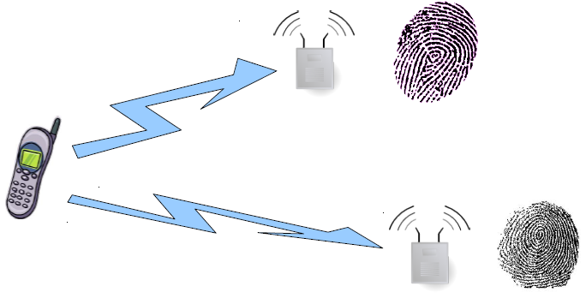
Diversity of Receivers
The signal emitted by a transmitter looks “different” to receivers in distinct locations

Slide 40
Measurement + Feedback
Channel State Information (CSI)
CSI is the term used to describe measurements of the channel condition
If Alice knows the CSI to Bob and to Eve, she can find an appropriate encoding using the measurements
If Alice and Bob interact repeatedly, measurement and feedback actually increase the secrecy capacity
This can allow for secrecy capacity > 0 even if Eve’s channel is less noisy than Bob’s channel

Slide 41
Jamming for Good
If Alice has diversity in the form of multiple radios or some collaborators
Alice and friends can use a jamming attack to prevent Eve from eavesdropping
As long as they don’t jam Bob at the same time
Ex: if the deployment geometry is known, Alice can adjust power, antenna config etc. so Bob’s SINR is high but Eve’s is low

Slide 42
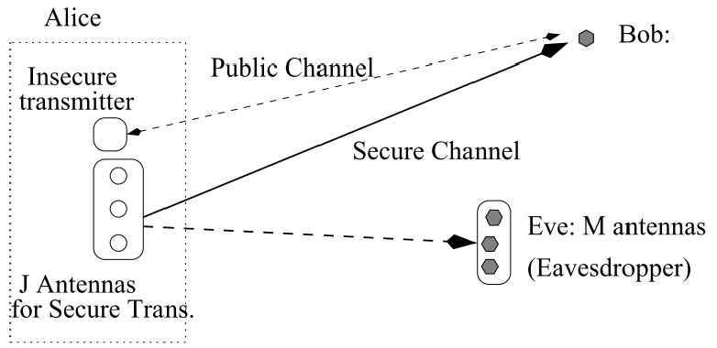
Antenna Control
Antenna control can be used for transmission with low probability of interception

Slide 43
Application
Building on secrecy capacity:
If two devices can communicate with a high probability guarantee that eavesdroppers cannot hear them, whatever they say is secret
Secret messages -> keys!
Secret key generation is now possible using inherent properties of the wireless medium

Slide 44
Further Reading
For a really good summary of secrecy capacity, the formalization, secret key generation and lots of excellent details
“Physical layer Security” by Bloch and Barros

Slide 45
Authentication using Physical Layer properties

Slide 46
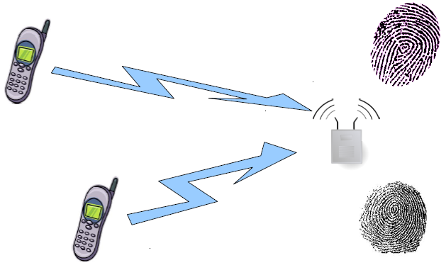
Diversity of Senders
Signals captured by a receiver from senders in distinct locations look “different”

Slide 47
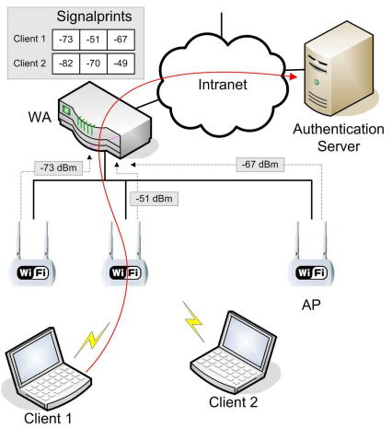
Signalprints [Wise 2006]
In a WLAN with multiple APs, each AP sees different characteristics of packets from each sender
Each AP can measure various packet features, some of which are relatively static over packets: eg. RSSI
A back-end server can collect measurements and keep history of packets from different senders

Slide 48
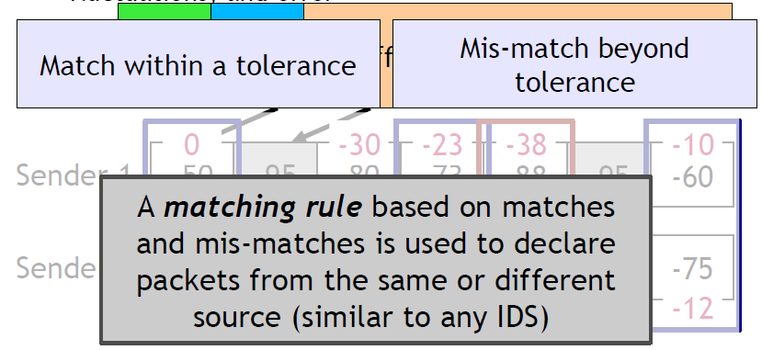
Verification and Matching
Requirements for verification:
Robust to transmission power control, random fluctuations and error

Slide 49
Signalprint Properties
Difficult to spoof?
Spoofing node would require control of medium
Transmission power control creates lower RSS at every AP; differential analysis reveals power control
Correlated with physical location
Attacker needs to be physically near target device
Sequential packets have similar signalprints
RSSI values are highly correlated for stationary sender and receiver
Note: not highly correlated with distance, but very highly correlated with subsequent transmissions

Slide 50
Limitations
Signalprints with any reasonable matching rule cannot differentiate between nearby devices
Masquerading/spoofing attacks are possible if physical proximity is easily achieved
Low-rate attacks cannot be detected
But, low-rate attacks have limited effects
Multi-antenna attackers can cheat

Slide 51
Summary
Interference and eavesdropping are two of the most fundamental yet least understood problems in wireless. There’s still a lot of work to be done.

