Slide 1
Privacy in WIRELESS NETWORKS
Dr. Sriram Sankaran

Slide 2
Lecture Overview
Privacy risks at the wireless network layer
Several different approaches in different systems/scenarios

Slide 3
Privacy Issues
Network layer interactions in wireless networks often expose information about identity, context, content, relationships etc.
In certain cases, cryptographic protections can help, but not always
In certain cases, pseudonyms help, but not always

Slide 4
ID Matching
Network IDs/addresses can facilitate tracking, profiling, inference etc.
Ex: a network service provider sees device A connect to a network in Pgh, then to another network in DC, then to another network in SF -> the service provider can create a profile of the device owner
Ex: an eavesdropper sees device A show up and connects to a network at the same time every day -> the eavesdropper can temporarily profile the user to learn when they will be away from home

Slide 5
Traffic Analysis
A curious or malicious party can observe network traffic and analyze flow patterns to infer relationships
Plaintext IDs can make this pretty easy
Something like “conservation of flow” can allow traffic flow decoupling
Inference capability depends on several factors:
Network visibility – global or local view?
Traffic density – dense or traffic distributions?

Slide 6
Timing Analysis
Since network operations are typically at least somewhat delay sensitive, there are end-to-end correlations between transmission events
Ex: node A transmit 10 packets, then neighboring node B transmits 10 packets of similar size -> maybe B is relaying A’s traffic
Depending on visibility and density, very little other information is needed, (eg. Strong hop-by-hop packet re-encryption doesn’t prevent timing analysis)

Slide 7
Understanding the risks
What type of network? Services? Etc. ?
WLAN, cellular, VANET, WSN ..
What is the attacker’s goal/ purpose?
Real-time tracking, recovering past traces
Robbery, personal safety, blackmail, mal-marketing, surveillance
What granularity is needed for attack success?
Relational, location-specific, region-specific

Slide 8
Privacy Challenges
Understanding the privacy goals
What needs to be protected?
What are the rules to be enforced?
Understanding the threat
What are attacker’s goals, capabilities, methods etc?
Practicality of attacker assumptions?
Metrics
How to measure privacy protection and enforcement?
How to evaluate and incorporate risk?

Slide 9
Different Privacy Concerns
Profiling and tracking WiFi users
Event/object inference in WSN
Unauthorized user/car tracking in VANET

Slide 10
Traffic Anonymization
In multi-hop networks (MANET/WSN), transmission linking can expose what path is used for a session
Traffic analysis
Analyzing flow of packets through a network (with global knowledge) allows decomposition into individual flows
Local traffic analysis
Without global knowledge, timing information can expose flow decomposition in a neighborhood

Slide 11
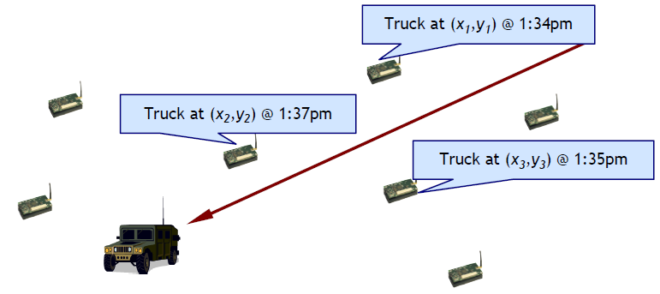
WSN Location Privacy
In sensor networks, we’re usually not concerned with protecting sensor locations, but what they’re sensing may be more sensitive

Slide 12
Source Location Privacy
One of the common goals in WSN is to hide the location of the sensed event from an observer
But, traffic generated will immediately expose any singular event
Commonly called the “Panda Hunter Problem”
Sensors in a wildlife area are used to track/study pandas
Whenever a panda walks by a sensor, it generates traffic
A hunter can track the traffic to find the panda

Slide 13
Privacy in Wireless Networks
Privacy in RFID Systems
Location Privacy in Vehicular Networks
Privacy Preserving Routing in Ad hoc Networks

Slide 14
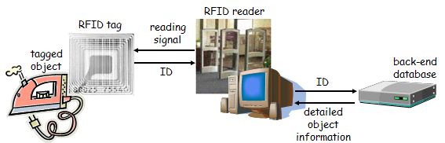
Privacy in RFID Systems
RFID = Radio-Frequency Identification
RFID system elements
RFID tag + RFID reader + back-end database
RFID tag = microchip + RF antenna
microchip stores data (few hundred bits)
tags can be active
have their own battery → expensive
or passive
powered up by the reader’s signal
reflect the RF signal of the reader modulated with stored data

Slide 15
RFID Applications today
proximity cards
electronic tickets for public transport systems (AFC)
access control to buildings
automated toll-payment transponders
anti-theft systems for cars
RFID transponder in ignition keys
payment tokens
contactless credit cards (e.g., Mastercard PayPassTM)
identification of animals
identification of books in libraries

Slide 16
RFID Applications in the near future
replacement of barcodes
advantages
no need for line-of-sight
hundreds of tags can be read in a second
unique identification of objects
easy management of objects throughout the entire supply chain (manufacturer → retailer → consumer)
standardization is on the way
EPC (Electronic Product Code) tag
main issue is price
today an EPC tag costs 13 cents
massive deployment is expected when price goes below 5 cents
e-passports
embedding RFID tags in Euro banknotes
anti-counterfeiting
detection of money laundering

Slide 17
RFID Applications in the future
shopping
fast check-out at point-of-sale terminals
terminal reads all tags in the shopping cart in a few seconds
payment can be speeded up using contactless credit cards
return items without receipt
no need to keep receipts of purchased items
tracking faulty or contaminated products
object IDs can serve as indices into purchase records
one can easily list all records that contain IDs belonging to a particular set of products and identify consumers that bought those products
smart household appliances
washing machine can select the appropriate program by reading the tags attached to the clothes
refrigerator can print shopping lists automatically or even order food on-line
interactive objects
consumers can interact with tagged objects through their mobile phones (acting as an RFID reader)
the mobile phone can download and display information about scanned objects (e.g., movie poster, furniture, etc.)

Slide 18
RFID
RFID tags respond to reader’s query automatically, without authenticating the reader
→ Clandestine scanning of tags is a plausible threat
Two particular problems:
Inventorying
Tracking
suitcase: Samsonite
watch: Casio
jeans: Lee Cooper
book: Applied Cryptography
shoes: Nike

Slide 19
Classification of Privacy Protection approaches
standard tags
“kill” command
“sleep” command
renaming
blocking
legislation
crypto enabled tags
tree-approach
synchronization approach
hash chain based approach

Slide 20
Dead tags
idea: permanently disable tags with a special “kill” command
part of the EPC specification
advantages:
simple
effective
disadvantages:
eliminates all post-purchase benefits of RFID for the consumer and for society
no return of items without receipt
no smart house-hold appliances
…
cannot be applied in some applications
library
e-passports
banknotes

Slide 21
“Sleep” tags
idea:
instead of killing the tag put it in sleep mode
tag can be re-activated if needed
advantages:
simple
effective
disadvantages:
difficult to manage in practice
tag re-activation must be password protected
how the consumers will manage hundreds of passwords for their tags?
passwords can be printed on tags, but then they need to be scanned optically or typed in by the consumer

Slide 22
Renaming tags
idea:
get rid of fixed names (identifiers)
use random pseudonyms and change them frequently
requirements:
only authorized readers should be able to determine the real identifier behind a pseudonym
standard tags cannot perform computations → next pseudonym to be used must be set by an authorized reader

Slide 23
Issues with Renaming
a possible implementation
pseudonym = {R|ID}_{K}
R is a random number
K is a key shared by all authorized readers
authorized readers can decrypt pseudonyms and determine real ID
authorized readers can generate new pseudonyms
for unauthorized readers, pseudonyms look like random bit strings
potential problems
tracking is still possible between two renaming operations
if someone can eavesdrop during the renaming operation, then she may be able to link the new pseudonym to the old one
no reader authentication → rogue reader can overwrite pseudonyms in tags (tags will be erroneously identified by authorized readers)

Slide 24
Renaming
a public key based implementation:
El Gamal scheme:
public key is (p, g, A), the cleartext is m
p large prime
g is a generator of the multiplicative group Z*_{p}
A=gª (mod p), where a is a secret value known only to Alice
select a random integer r, and compute R = g^{r} mod p
compute C = m⋅A^{r} mod p
the ciphertext is the pair (R, C)
one can re-encrypt a ciphertext (R, C) without decryption:
select a random integer r’, and compute R’ = Rg^{r’} mod p ( = g^{r+r’} mod p)
compute C’ = CA^{r’} mod p ( = mA^{r+r’} mod p)
(R’, C’) is a valid ciphertext of m
new tag pseudonyms can be computed by readers that know the public key
real tag ID can be computed only by readers that know the private key

Slide 25
Crypto-enabled tags
assume that tags can perform some crypto operations
→ tags can compute their own pseudonyms !
a solution that doesn’t scale:
next pseudonym = {R, S, ID}_{K}
R is a random number generated by the tag (ensures that pseudonyms look random and they are different)
S is some redundancy (ensures that the reader can determine if it used the right key to decrypt the pseudonym)
ID is the real identifier
K is a key shared by the tag and the reader
the reader tries all possible keys until it finds the right one
if there are many tags, then the verification may be too slow

Slide 26
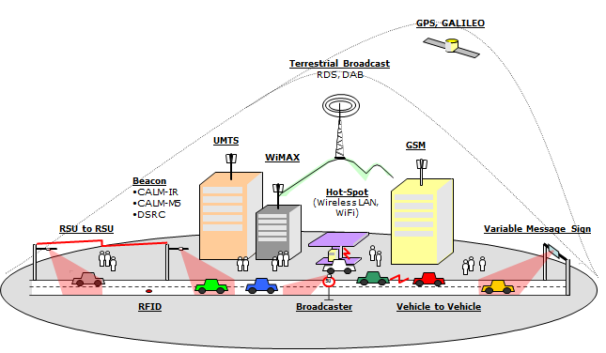
Vehicular Networks

Slide 27
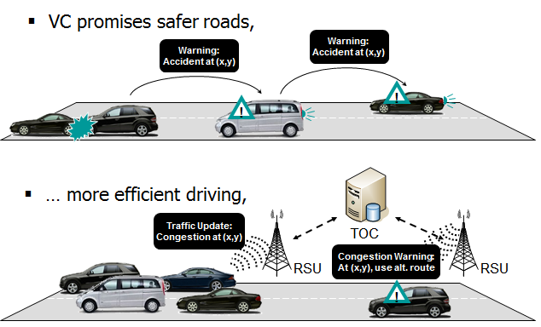
Vehicular Communication

Slide 28
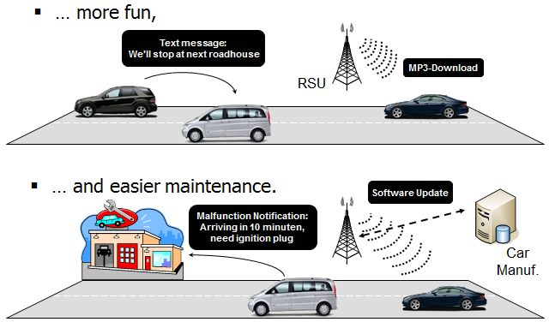
Vehicular Communication

Slide 29
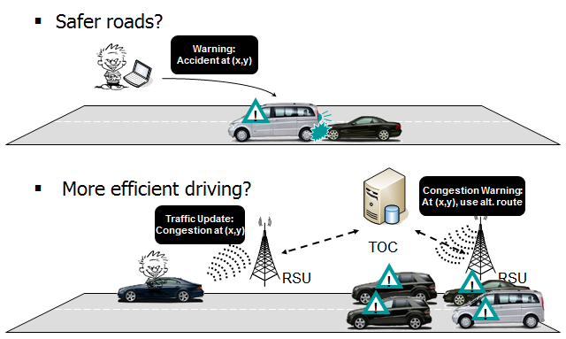
Security and Privacy

Slide 30
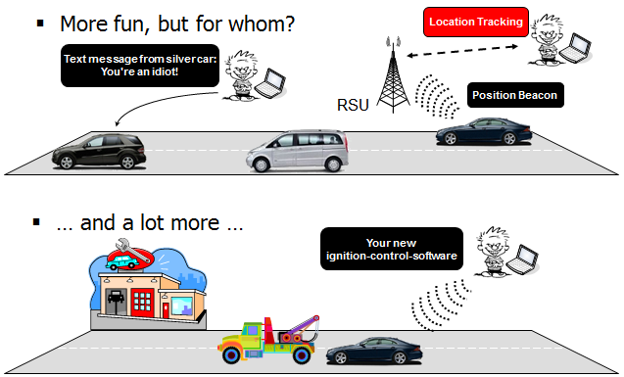
Security and Privacy

Slide 31
Location Privacy in Vehicular Networks
Vehicles continuously broadcast heart beat messages, containing their ID, position, speed, etc.
Tracking the physical location of vehicles is easy just by eavesdropping on the wireless channel
One possible solution is to change the vehicle identifier, or in other words, to use pseudonyms

Slide 32
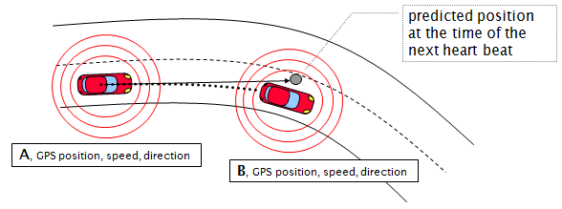
Adversary Model
Changing pseudonyms is ineffective against a global eavesdropper
Adversary is assumed to be able to monitor the communications only at a limited number of places and in a limited range

Slide 33
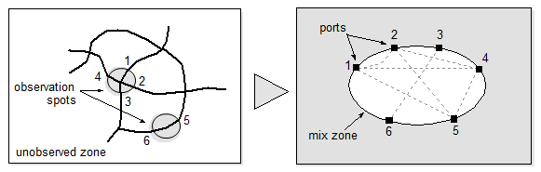
Concept of Mix-Zone
Unobserved zone functions as a mix zone where the vehicles change pseudonym and mix with each other
Note that the vehicles do not know where the mix zone is (this depends on where the adversary installs observation spots)
We assume that the vehicles change pseudonyms frequently so that each vehicle changes pseudonym while in the mix zone

Slide 34
Example of mix-zone

Slide 35
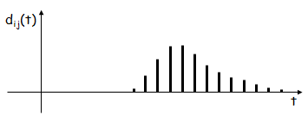
Model of the Mix-Zone
time is divided into discrete steps
p_{ij} = Pr{ exiting at j | entering at i }
D_{ij} is a random variable (delay) that represents the time that elapses between entering at i and exiting at j
d_{ij}(t) = Pr{ D_{ij} = t }
Pr{ exiting at j at t | entering at i at τ } = p_{ij} d_{ij}(t-τ)

Slide 36
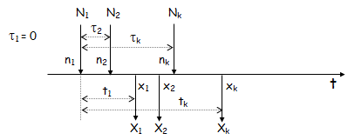
Observations
the adversary can observe the points (n_{i}, x_{i}) and the times (τ_{i}, t_{i}) of enter and exit events (N_{i}, X_{i})
by assumption, the nodes change pseudonyms inside the mix zone → there’s no easy way to determine which exit event corresponds to which enter event
each possible mapping between exit and enter events is represented by a permutation π of {1, 2, …, k}:

Slide 37
Another Privacy Metric
tracking game:
the adversary picks a vehicle v in the observed zone
she tracks v until it enters the mix zone at port s
then, she observes the exiting events until time T (where the probability that v leaves the mix zone until T is close to one)
for each exiting vehicle at port j and time t, the adversary computes q_{jt} = p_{sj}d_{sj}(t)
the adversary decides to the exiting vehicle v’ for which q_{jt} is maximal
this realizes a Bayesian decision (minimizes the error probability of the decision)
the adversary wins if v’ = v
the level of privacy achieved is characterized by the success probability of the adversary
if success probability is high, then level of privacy is low

Slide 38
Privacy Preserving Routing in Ad hoc Networks
Goal: unlinkability (make it very hard for a global observer to know who communicates with whom)
Some nodes may be compromised ➔ even the forwarding nodes should not know who the source and the destination are
We also want to hide the identity of the forwarding nodes from each other (because this information would be useful for the attacker)

Slide 39
Effective but inefficient solution
Route establishment: flooding the network with a route request
Source:
generates an asymmetric key-pair (K,K⁻¹), a secret key k₀, and a nonce n₀
Encrypts D, S, and K⁻¹ with the public key K_{D} of the destination
Encrypts k₀ and n₀ with K
Broadcasts the route request:

Slide 40

Effective but inefficient solution
F1 receives this route request
It verifies if it is the target of the request:
decrypts with its K⁻¹
If F1 is not the target:
Generates a secret key k₁ and a nonce n₁
Concatenates them to
Encrypts the result with K
Broadcasts

Slide 41


Effective but inefficient solution
D attempts to decrypt and it succeeds
D broadcasts a dummy request:
It decrypts and obtains the secret keys and the nonces of the forwarding nodes
It generates a link key for each link and sends a route reply:

Slide 42
Effective but inefficient solution
F_{i} receives route reply: decrypts it with k_{i}
If k_{i} works: checks if it received back its n_{i}
If this is the case:
F_{i} peels the outer layer off the route reply
Applies some padding to retain its original length
Re-broadcasts
Sending data:
Source encrypts the packet with k^{out}₀ and broadcasts it
Each node tries to decrypt it with its incoming link keys
If F_{i} succeeds to decrypt the packet with k_{i}^{in}: it re-encrypts it with k_{i}^{out}, and re-broadcasts it
Until the packet arrives to the destination

Slide 43
Improving Efficiency
Much computation from the nodes:
Solution: replace the public key encryption with symmetric key encryption
Source and destination share a secret key k_{SD} and a counter c_{SD}
Source computes a one-time hint for the destination: h(k_{SD},c_{SD})
Each node can pre-compute the hint of each possible source:
only a table lookup when processing route request messages

