Slide 1
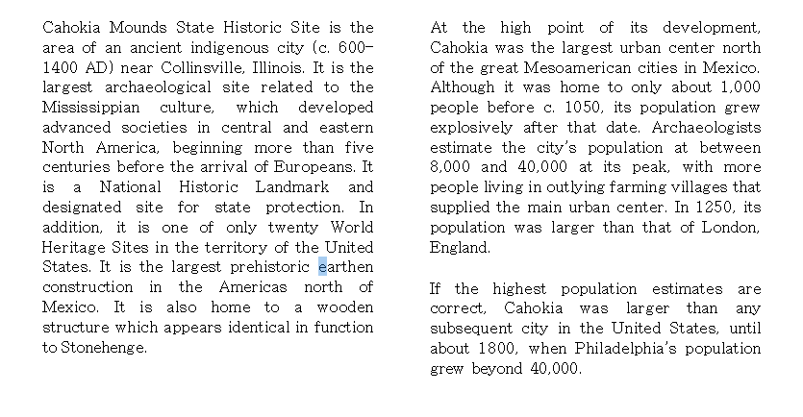
P1
Next
Start Time
Stop Time

Slide 2
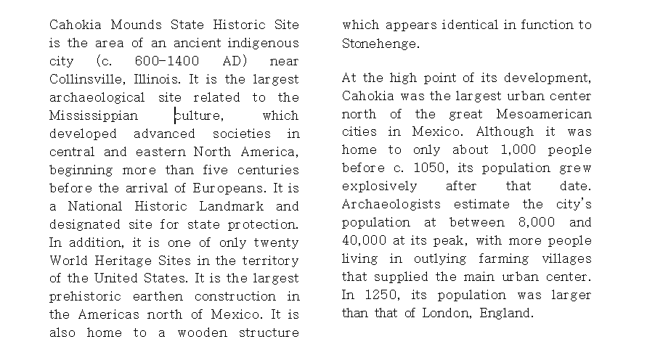
P2
Next
Start Time
Stop Time

Slide 3
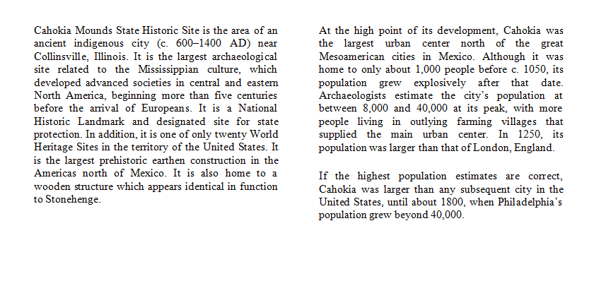
P3
Next
Start Time
Stop Time

Slide 4
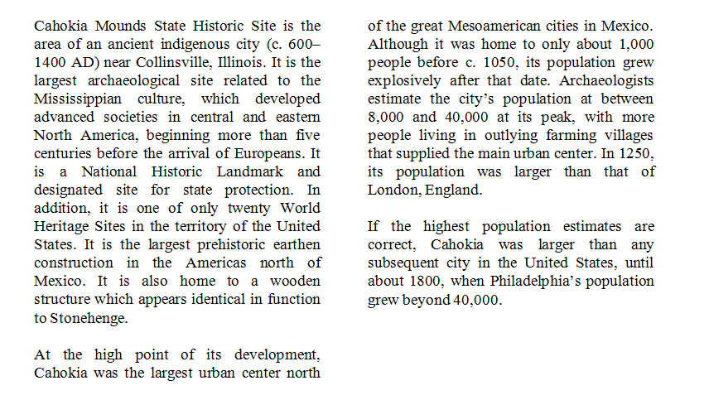
P4
Next
Start Time
Stop Time

Slide 5
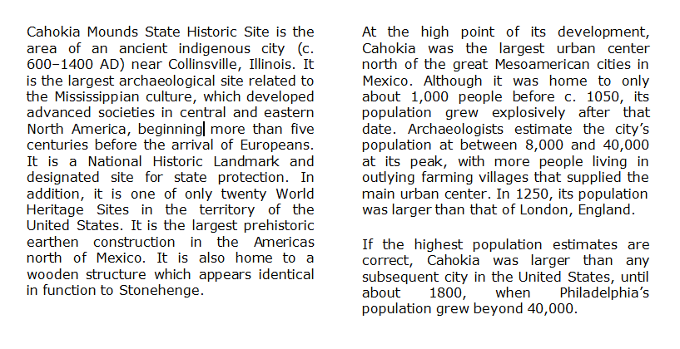
P5
Next
Start Time
Stop Time

Slide 6
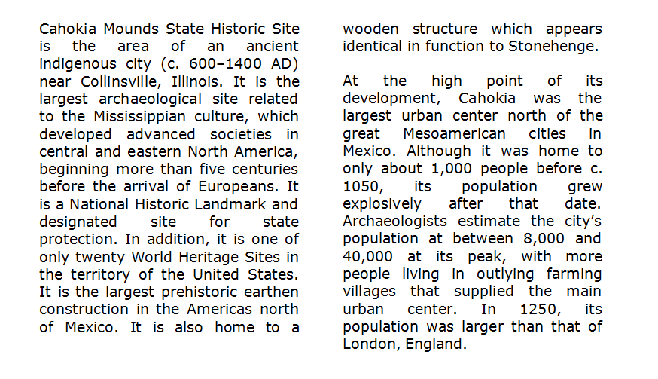
P6
Next
Start Time
Stop Time

