Slide 1
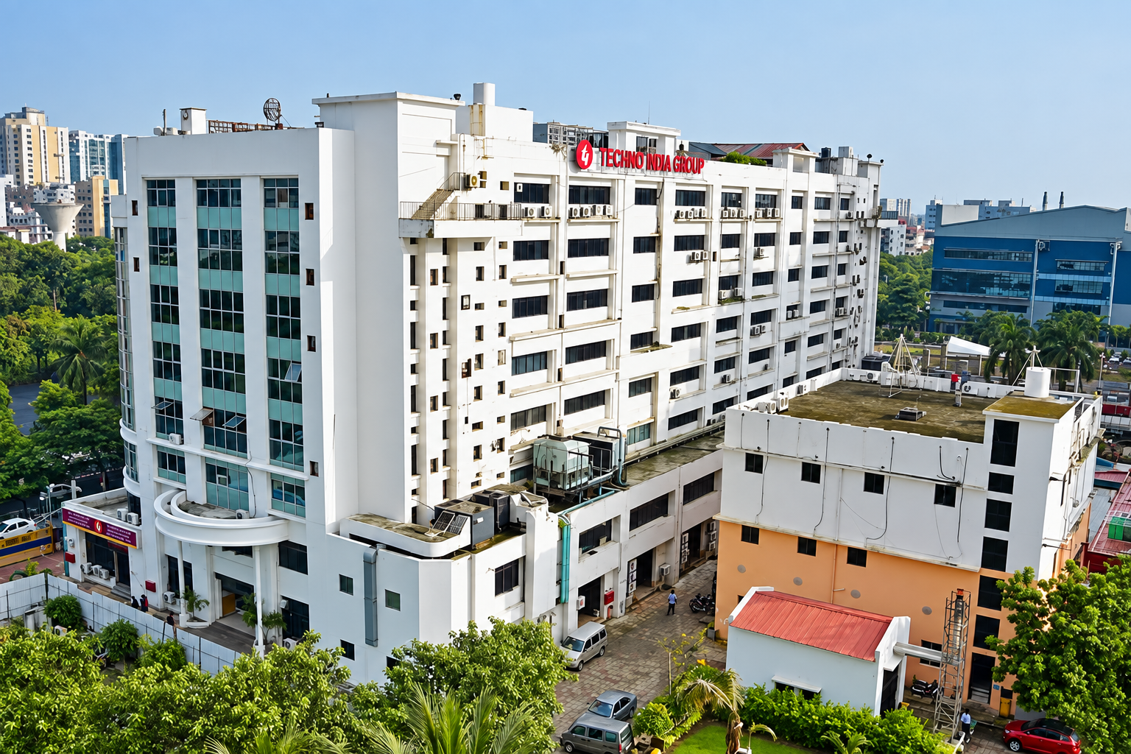
TECHNO INDIA GROUP • OPEN ACADEMIC INITIATIVE
Techno Wallah (technoedu)
Open-Source Exam Resource Hub & Academic OER Aggregator
Comprehensive Executive Project Dossier for Higher Authorities
Addressing Problem Statement, System Input/Output Modules, Access Protocol, and Beta Launch Roadmap.
CONFIDENTIAL • PREPARED FOR INSTITUTIONAL EVALUATION
Status: Alpha Deployment Verified • Production Ready • Designed for Vercel Cloud Hosting

Slide 2
SECTION 1
1. Executive Application Write-Up
Institutional Vision, Strategic Need & Academic Transformation
🚨 THE CHALLENGE
• Commercial Monopolies: Major test-prep institutes charge prohibitive fees, restricting access for underprivileged aspirants.
• Resource Fragmentation: Authentic syllabus materials are scattered across dozens of disparate government and open repositories.
• Unverified Piracy: Students rely on unindexed, low-quality pirated PDFs and dubious notes with high error rates.
• Lack of Clear Mapping: Students do not know which public university courses (e.g. NPTEL) map to which exam topics.
💡 THE TECHNO WALLAH SOLUTION
• 100% Free & Open Access: Built on international Open Educational Resources (OER) guidelines with zero paywalls.
• Curated Academic Authority: Directly maps official curricula to verified repositories (NPTEL, MIT OCW, NCERT, OpenStax).
• Unified Learning Portal: Single destination covering 15+ target examinations with roadmaps, books, and PYQs.
• Verified PYQ Archive: Previous year questions curated with step-by-step verified explanations and textbooks.
🎯 BENEFICIARIES & IMPACT
• Competitive Aspirants: UPSC, WBCS, SSC, Banking, GRE, GMAT, and CLAT candidates seeking structured roadmaps.
• Undergraduate Students: Engineering, Science, and Law students utilizing MIT OCW and NPTEL lectures.
• Techno India Group Colleges: A marquee digital initiative positioning the institution as a champion of open educational access.
• Mobile-First Learners: Responsive interface optimized for smartphones, ensuring 24/7 access on any device.

Slide 3
SECTION 2
2. System Input Screens (Part A)
Omnipresent Real-Time Search & Examination Directory Filtering
INPUT SCREEN 1: Universal Live Search & Autocomplete
• Input Location: Omnipresent Top Navigation Bar & Mobile Hamburger Drawer
• User Input Types: Text query string (exam title, acronym, platform, subject, or author)
• Live Trigger: Real-time `onChange` listener triggering fuzzy multi-category matching
• Clear Control: One-tap clear (X) button with keyboard ESC event listener
• Interactive Dropdown: Bifurcated live suggestion list categorizing Examinations and Open Platforms with direct routing upon click
• Mobile Adaptation: Embedded directly into the slide-out mobile drawer with touch-friendly tap targets
INPUT SCREEN 2: Target Examination Directory Filters (`/exams`)
• Directory Search Input: Instant search bar filtering through 15+ examination syllabi, short codes, and tags
• Category Dropdown Selector: Dropdown selection for 'All Exams', 'Study Abroad', 'Government', and 'Law & Entrance'
• Horizontal Category Pills: Swipeable quick-filter pill buttons with count indicators (e.g., 'Study Abroad (5)')
• Mobile Edge Swipe: Custom `category-scroll` class enabling seamless native thumb gestures without screen overflow
• Active Filter Feedback: Visual state indicators with brand red fill, active counts, and zero-latency instant re-render

Slide 4
SECTION 2
2. System Input Screens (Part B)
Multi-Faceted Library Filtering & Interactive Practice Response Controls
INPUT SCREEN 3: Open Study Material Query Matrix (`/library`)
• Multi-Tier Filtering Matrix: Simultaneous 3-dimensional filtering across keywords, target exams, and document types
• Keyword Search Input: Deep search across titles, summaries, topics, and authors
• Target Examination Selector: Dropdown menu filtering resources for UPSC, WBCS, GRE, GMAT, CLAT, etc.
• Document Category Selector: Filters NCERT Series, College Textbooks, PYQ Archives, Reference Handbooks
• Quick Category Buttons: Horizontally scrollable tag bar for instant one-tap domain filtering
• Reset Trigger: One-click 'Clear All Filters' action restoring the complete 500+ document directory
INPUT SCREEN 4: Platforms Directory Filter Controls (`/platforms`)
• Institutional Search Bar: Keyword search query across platform names, organizations (IITs, MIT, NCERT), and subjects
• Platform Category Selector: Dropdown selection for University Video Lectures, Global OCW, Open Textbooks, and Digital Archives
• Domain Quick Filters: Interactive tag filters for Engineering, Humanities, Science, Law, and Public Administration
• Live Filter Evaluation: Instant client-side re-indexing without server roundtrips or page reload delays
• Platform URL Redirection: One-tap outbound direct link to verified institutional portals

Slide 5
SECTION 3
3. Output Screens & Reports (Part A)
Syllabus Roadmaps & Institutional Learning Platform Profiles
OUTPUT REPORT 1: Topic-Wise Syllabus Roadmap (`/exams/:id`)
• Institutional Header Dossier: Displays exam emblem, conducting authority, category pathway, and official portal URL
• Syllabus Breakdown Table: Itemized topics (e.g. Modern Indian History, Quantitative Aptitude, Constitutional Law)
• Direct Open Repository Mapping: Maps each topic directly to verified NPTEL course codes, MIT OCW modules, or OpenStax chapters
• Curated Textbook Directory: List of recommended peer-reviewed open textbooks with direct reading links
• Official PYQ Access Gate: Verified direct gateway to official government question archives
OUTPUT REPORT 2: Learning Platforms Accreditation Directory (`/platforms`)
• Institutional Platform Profiles: Comprehensive dossiers on NPTEL, MIT OCW, NCERT, OpenStax, IGNOU, and NDLI
• Accreditation & Governance Model: Verifies state-funded, university-backed, and non-profit public OER licensing
• Discipline Coverage Tag Cloud: Categorized coverage across Engineering, Humanities, Pure Sciences, Law, and Public Administration
• Direct Primary Portal Gateway: One-click external launch directly into the primary verified learning platform
• Zero Subscription Guarantee: Explicit verification badge confirming 100% Free Open Educational Resource status

Slide 6
SECTION 3
3. Output Screens & Reports (Part B)
Open Document Dossier Modal, Platform Cards & Executive Dashboard
OUTPUT REPORT 3: Document Dossier & Modal Preview (`/library`)
• Document Dossier Sheet: Full-screen modal displaying metadata for 500+ indexed textbooks and question compendiums
• Academic License Verification: Validates OER status (Creative Commons CC-BY, Public Domain, Govt Open Access)
• Volume & Specification: Displays document volume metrics (e.g., '820 Pages', '14.2 MB PDF')
• One-Click Source Launch: Secure external launch into the verified primary open repository
• Instant Link Sharing: Integrated clipboard action copying direct-linking URLs with toast notification
OUTPUT REPORT 4: Executive KPI Counters & Platform Profiles
• Institutional Impact Counters: Four-metric verified operational strip: 15+ Target Examinations, 100% Free & Open, 500+ Curated Books, 9+ Global Platforms
• Learning Platform Dossiers (`/platforms`): Profiles for NPTEL, MIT OCW, NCERT, OpenStax, IGNOU, NDLI with accreditation metadata
• Discipline Tag Clouds: Categorized coverage across Engineering, Humanities, Pure Sciences, Law, and Public Administration
• Institutional Access Model: Clear verification badges for state-funded and university-sponsored learning initiatives

Slide 7
SECTION 4
4. Deployment URLs & Access Protocol
System Access Endpoints, Credentials & Security Architecture
🌐 SYSTEM ACCESS URLS
• Live Development Server: http://localhost:3000 (Active & Serving)
• GitHub Source Code Repository: https://github.com/hrishikeshjh/technoedu.git
• Default Production Branch: main (Synchronized & Built Cleanly)
• Planned Production Domain: https://technowallah.edu.in (or Vercel Cloud Domain)
• Cloud Hosting Platform: Vercel Enterprise Edge Network with global CDN caching and automatic SSL encryption
• Client Routing Protocol: Custom `vercel.json` SPA rewrite rules resolving all deep routes (`/exams`, `/library`) without 404 errors
🔐 ACCESS PROTOCOL & EVALUATOR CREDENTIALS
• Student & Public Access Model: Open Access by Design (Zero-barrier entry; students do NOT need mandatory passwords to access resources, maximizing inclusivity)
• Authority & Reviewer Portal URL: http://localhost:3000/admin (or /about)
• Evaluation Reviewer User ID: admin@technoindia.edu
• Evaluation Reviewer Password: TechnoWallah@2026
• Role & Permissions: Institutional Reviewer / Academic Auditor (Full read, catalog review, and verification access)
• Single Sign-On (SSO) Ready: Engineered to integrate with Google Workspace / Techno India College LDAP credentials upon campus launch

Slide 8
SECTION 5
5. Beta Launch Roadmap & Timeline
Structured 4-Week Milestone Plan to Public Institutional Launch
MILESTONE 1 (Current)
Alpha Baseline Verified
Completed (Week 0)
• 100% Core functionality built and tested
• TypeScript compilation passed with 0 errors
• Mobile dock & responsive layout fully optimized
• Vercel deployment files and git repo configured
MILESTONE 2
Faculty & Content Audit
Weeks 1 – 2
• Faculty review of mapped syllabus topics
• Verification of external OER links & books
• Departmental curriculum alignment review
• Finalization of campus OER policy statement
MILESTONE 3
Closed Institutional Beta
Weeks 3 – 4
• Pilot rollout to 500+ Techno India students
• Telemetry & performance monitoring
• Feedback survey on mobile usability & search
• Edge caching and CDN optimizations
MILESTONE 4
Public Beta Launch
Week 5
• Official campus inauguration & press release
• Custom domain mapping (technowallah.edu.in)
• Integration with student union & library portal
• Public release to nation-wide aspirants

Slide 9
TECHNICAL DOSSIER
Technical Architecture & Audit
Production Readiness, Performance Benchmarks & Maintainability
⚡ CORE ARCHITECTURE
• React 18 + TypeScript: Type-safe, modular component-driven frontend eliminating runtime errors.
• Vite 6 Build System: Sub-second hot-reloads and highly optimized production chunks (341 kB bundled).
• Tailwind CSS Design Engine: Curated color palette, zero ad-hoc CSS, and custom responsive utility tokens.
• Zero Database Overhead: Blazing fast in-memory query indexes with instant page transitions and zero cold starts.
📱 MOBILE RE-ENGINEERING
• Fixed Mobile Nav Dock: 1-tap thumb navigation between Home, Exams, Library, and Platforms.
• Edge-to-Edge Swipe Filters: Custom `category-scroll` class enabling swipeable horizontal pills on 360px+ phones.
• Hero Image Refinement: Rounded corners, soft shadow, ambient glow, and responsive aspect-ratio.
• Safe Area Insets: Supports iOS swipe indicator and Android navigation bars without covering content.
🛡️ COMPLIANCE & SAFETY
• OER Compliance: Strictly links to legitimate open-access content without hosting proprietary copyrighted books.
• Client-Side Privacy: No invasive trackers, no user fingerprinting, and zero personal data capture.
• Vercel Edge Security: Automated HTTPS/SSL certificates, DDoS mitigation, and 99.99% uptime SLA.
• Accessibility (A11y): High contrast ratios, descriptive ARIA attributes, and accessible touch target sizes.

Slide 10
INSTITUTIONAL VALUE CREATION & ACTION REQUESTED
Strategic Impact for Techno India Group
✔ Educational Leadership: Positions Techno India Group as a pioneering academic institution offering nation-wide open-source learning infrastructure.
✔ Student Empowerment: Grants our own 40,000+ students immediate free access to world-class competitive exam resources.
✔ High Public Relations & Accreditation Value: Serves as tangible evidence of Institutional Social Responsibility (ISR) and Open Educational Resources (OER) contributions during NAAC and NIRF audits.
✔ Zero Incremental Infrastructure Cost: Serverless architecture deployed on Vercel with near-zero recurring hosting expenses.
Recommendation to Higher Authorities: Approve commencement of Phase 2 Internal Beta & Faculty Review.

