Slide 1
EOR PROJECT
BY
HRISHIKESH NAMBIAR
16PE10003

Slide 2
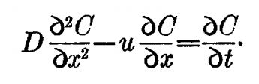
TRANSPORT EQUATION
Incompressible flow.
1-D flow[1].
Here u= Vw/(Sw*Ø) where Vw is the velocity.
D is diffusivity coefficient.
C is the concentration.
Neglecting Reaction.

Slide 3
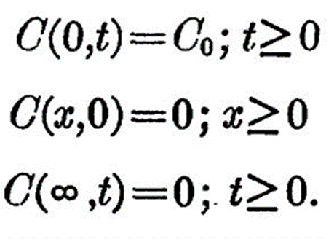
BOUNDARY CONDITIONS
Reference[1].

Slide 4
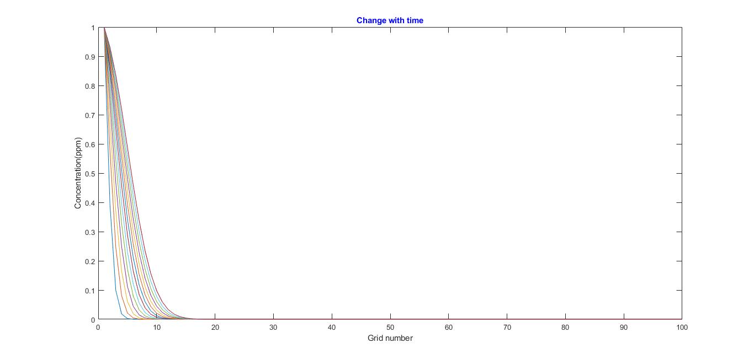
For time=500s D=0.01m^2/s Porosity=0.3 Sw=0.5 Velocity=0.001m/s

Slide 5
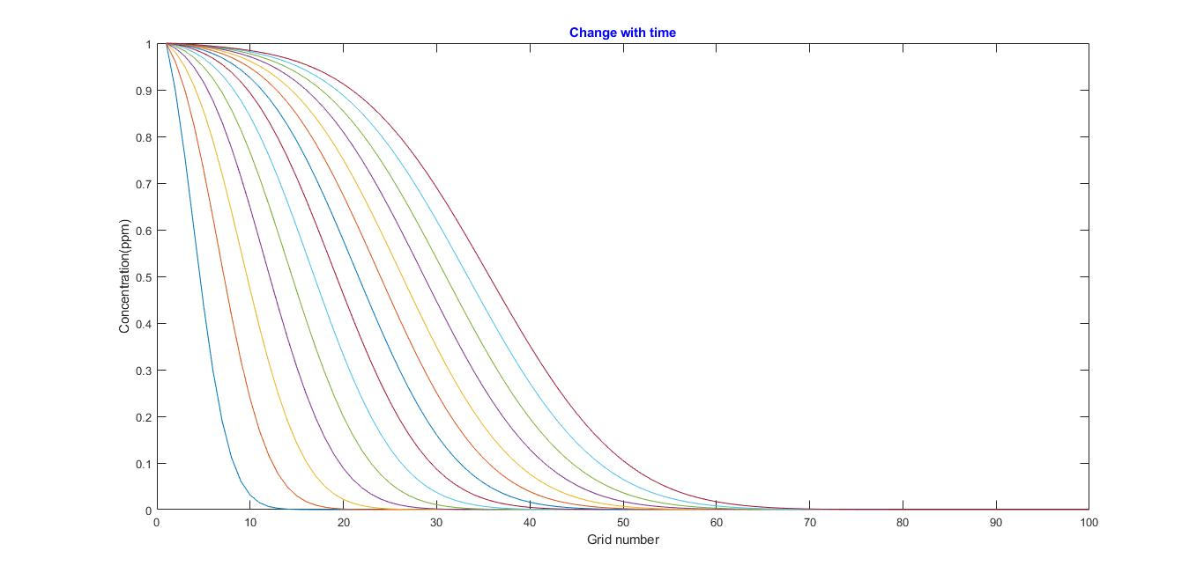
For time=5000s

Slide 6
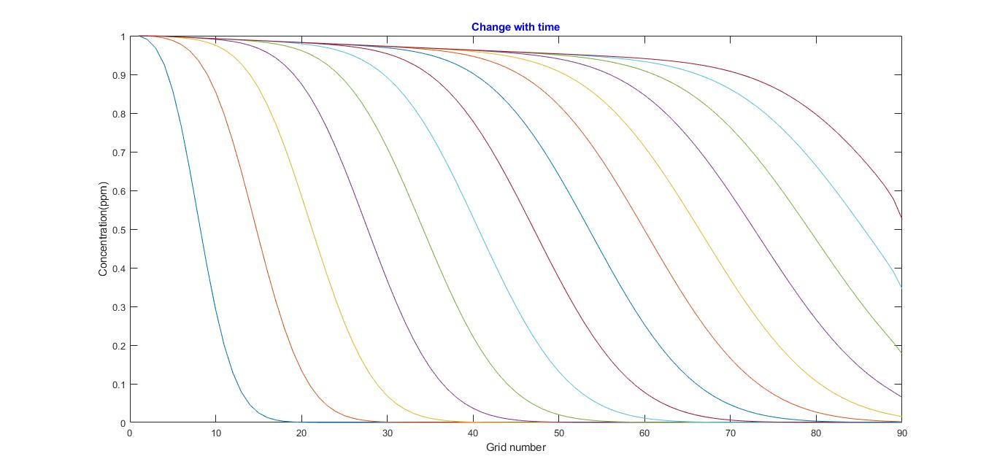
For time=10000s

Slide 7
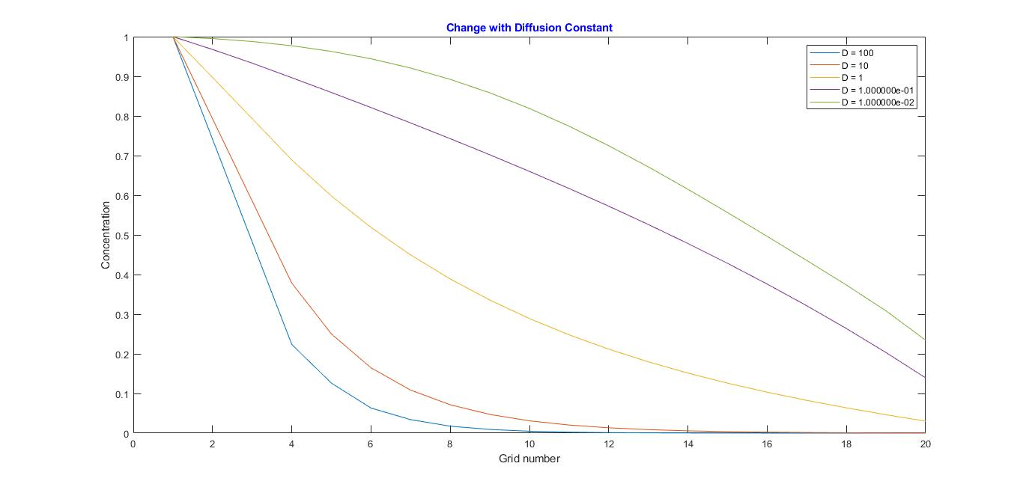

Slide 8
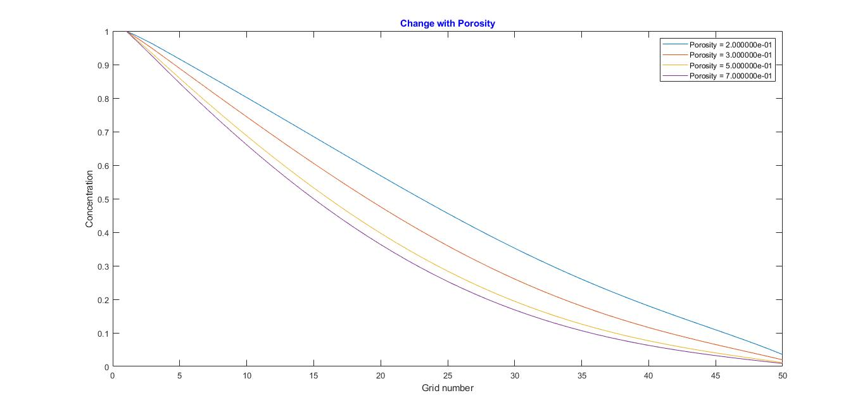

Slide 9
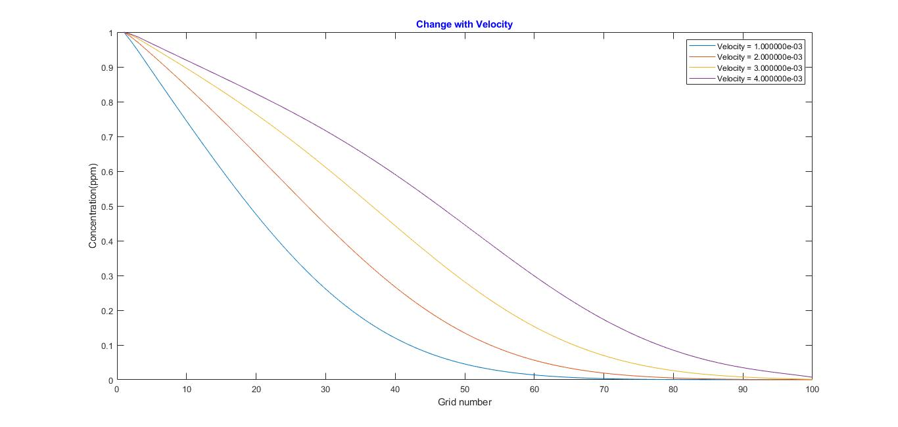

Slide 10
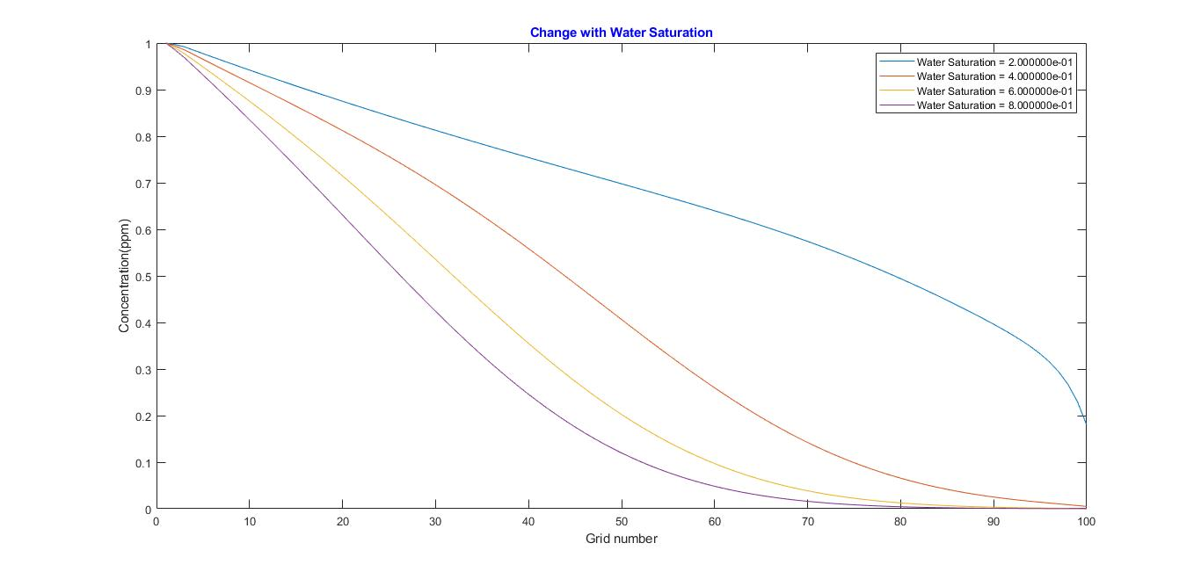

Slide 11

ANALYTICAL SOLUTION
From Akio Ogata and R. B. Banks[1]

Slide 12
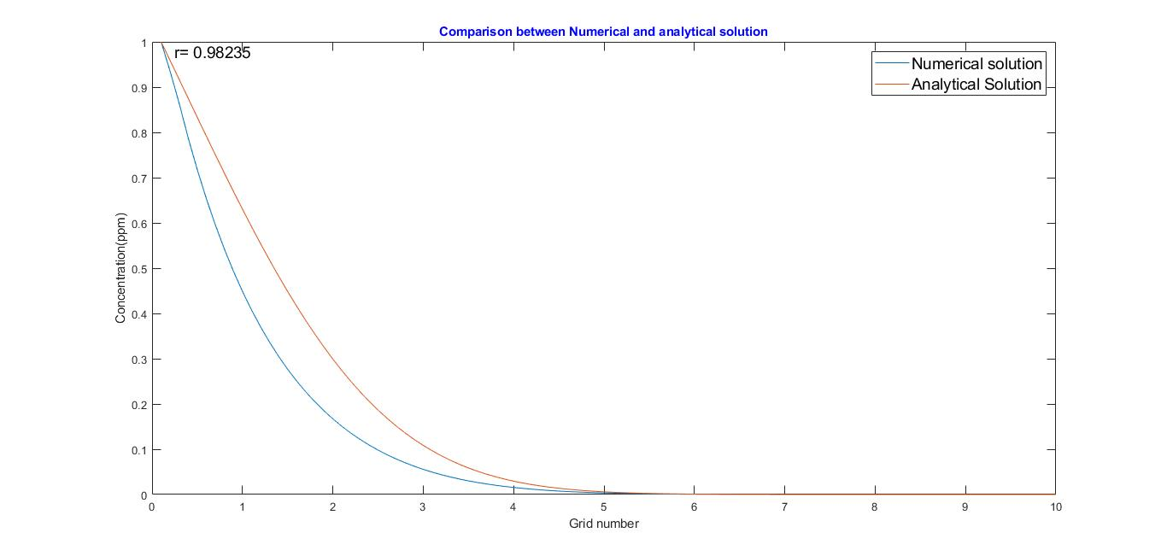
For time=200s D=0.01m^2/s Porosity=0.3 Sw=0.5 Velocity=0.001m/s Co=1ppm

Slide 13
REFERENCE
A SOLUTION OF THE DIFFERENTIAL EQUATION OF LONGITUDINAL DISPERSION IN POROUS MEDIA by Akio Ogata and R. B. Banks(1961).

Slide 14
THANK YOU

