Slide 1


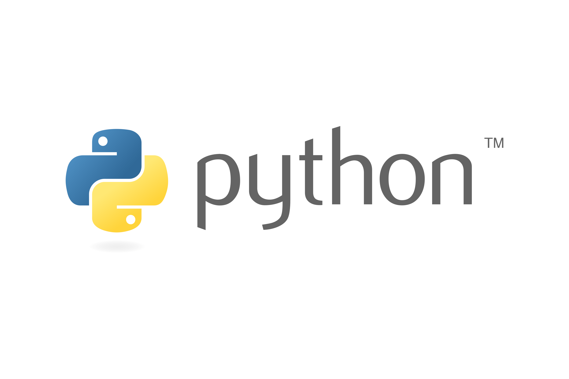


Installation

Slide 2
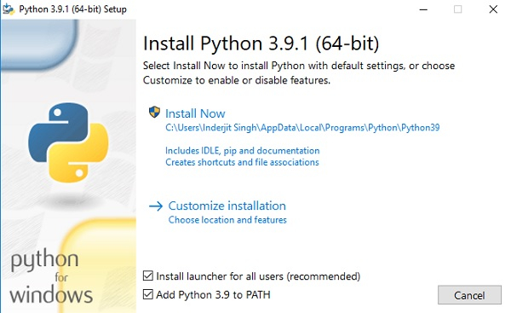
Python Installation
Go to www.python.org, All the available versions of Python will be listed. Select the version required by you and click on Download. Let’s suppose, we chose Python 3.11.0. version. Older versions are also available on the Microsoft store.
Run the installer. Make sure to select both the checkboxes at the bottom and then click Install New.

Slide 3
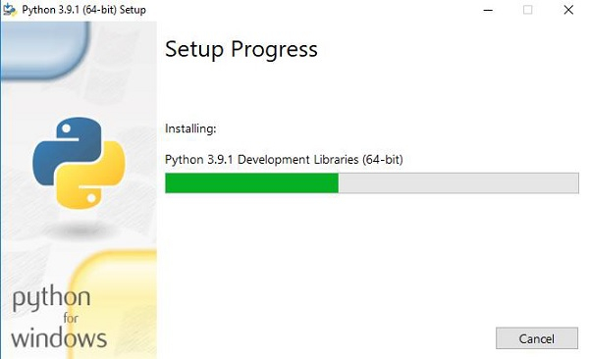
Python Installation
On clicking the Install Now, The installation process starts. Run the installer. Make sure to select both the checkboxes at the bottom and then click Install New.

Slide 4
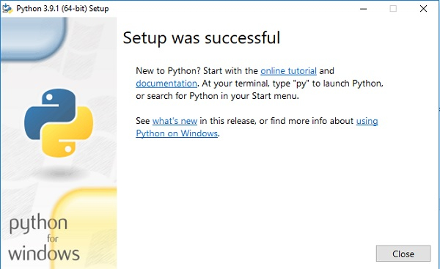
Python Installation
The installation process will take a few minutes to complete and once the installation is successful, the following screen is displayed.

Slide 5
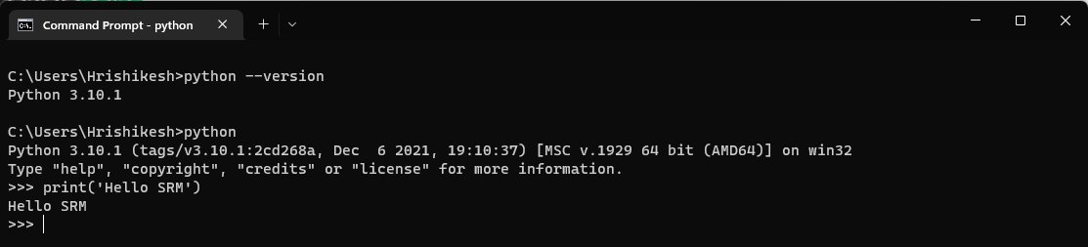
Python Installation
Verify Python is installed on Windows
To ensure that Python is successfully installed on your system. Follow the given steps −
Open the command prompt.
Type ‘python’ and press enter.
The version of the python which you have installed will be displayed if the python is successfully installed on your windows.

Slide 6
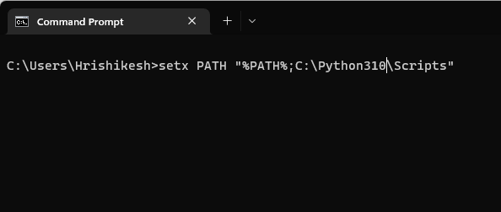
Python-pip
PIP is a package manager for Python packages
A package contains all the files you need for a module
Modules are Python code libraries you can include in your project
To add pip to PATH :

Slide 7
Jupyter Notebook
The Jupyter Notebook is the original web application for creating and sharing computational documents. It offers a simple, streamlined, document-centric experience.
Jupyter notebook is available in python-pip as a package.
To install Jupyter: pip install Jupyter
Once installed to open a Jupyter notebook use Jupyter-notebook

Slide 8
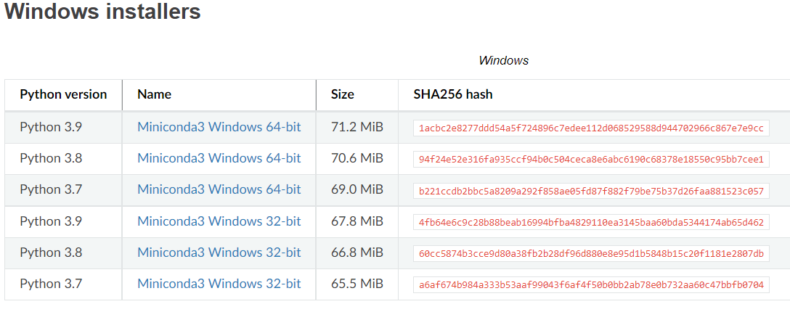
Conda Installation
Go to https://docs.conda.io/en/latest/miniconda.html, All the available versions of Miniconda will be listed. Select the required python version and click on the link to download.

Slide 9
Conda Installation
Go to https://docs.conda.io/en/latest/miniconda.html, All the available versions of Miniconda will be listed. Select the required python version and click on the link to download.

Slide 10
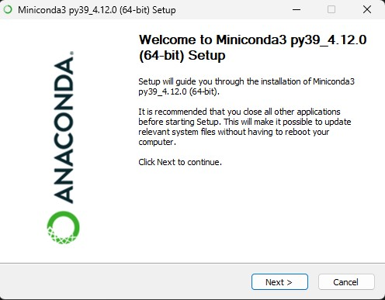
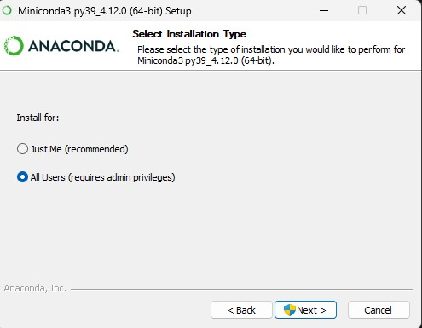
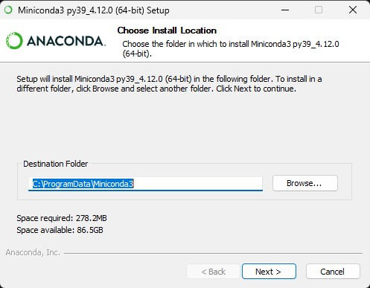
Conda Installation
Go to https://docs.conda.io/en/latest/miniconda.html, All the available versions of Miniconda will be listed. Select the required python version and click on the link to download.
Follow the installation process as shown in figures.

Slide 11
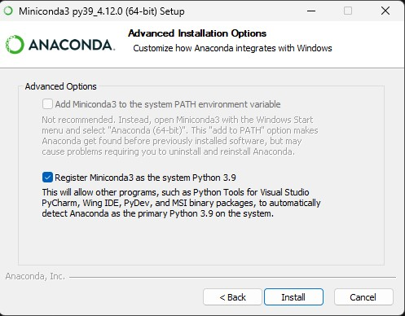
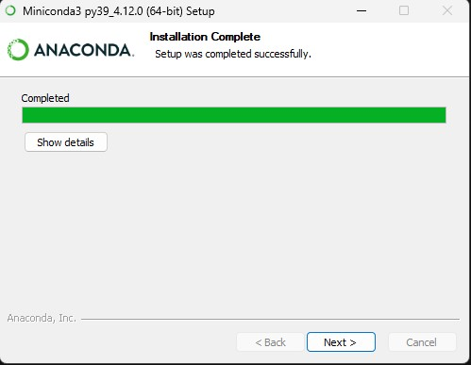
Conda Installation
Follow the installation process as shown in figures.

Slide 12
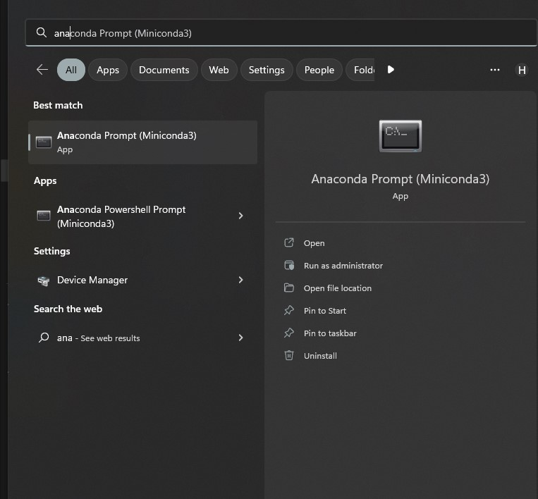
Conda Installation
Verify Conda is installed on Windows
To ensure that Conda is successfully installed on your system. Follow the given steps −
Open the windows search bar and type anaconda prompt.

Slide 13
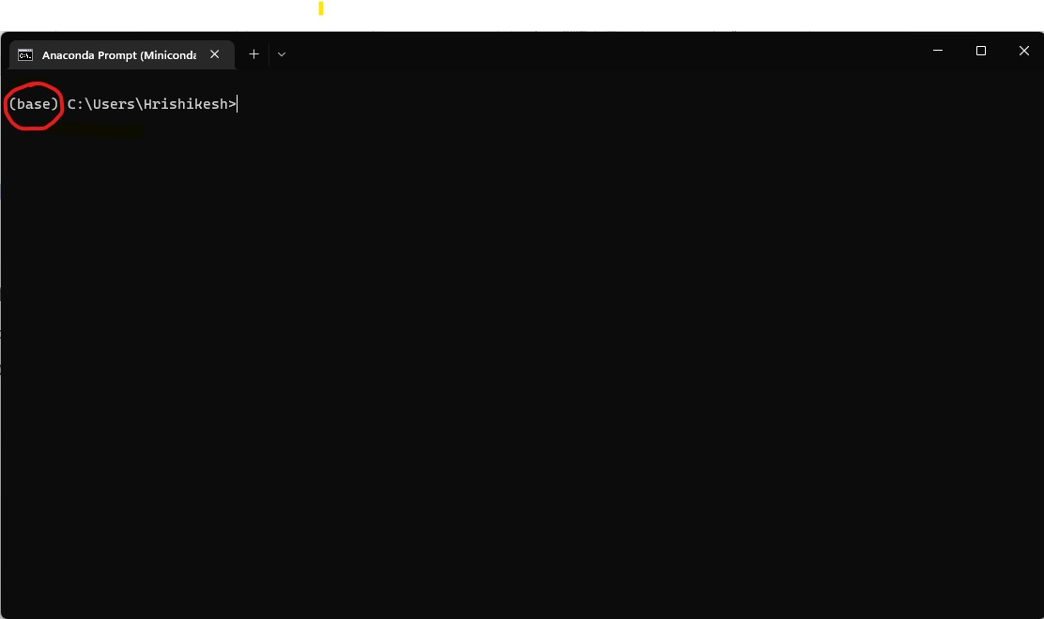
Conda Installation
Verify Conda is installed on Windows
Check whether the word base is printed in front of the path as shown in figure.

Slide 14
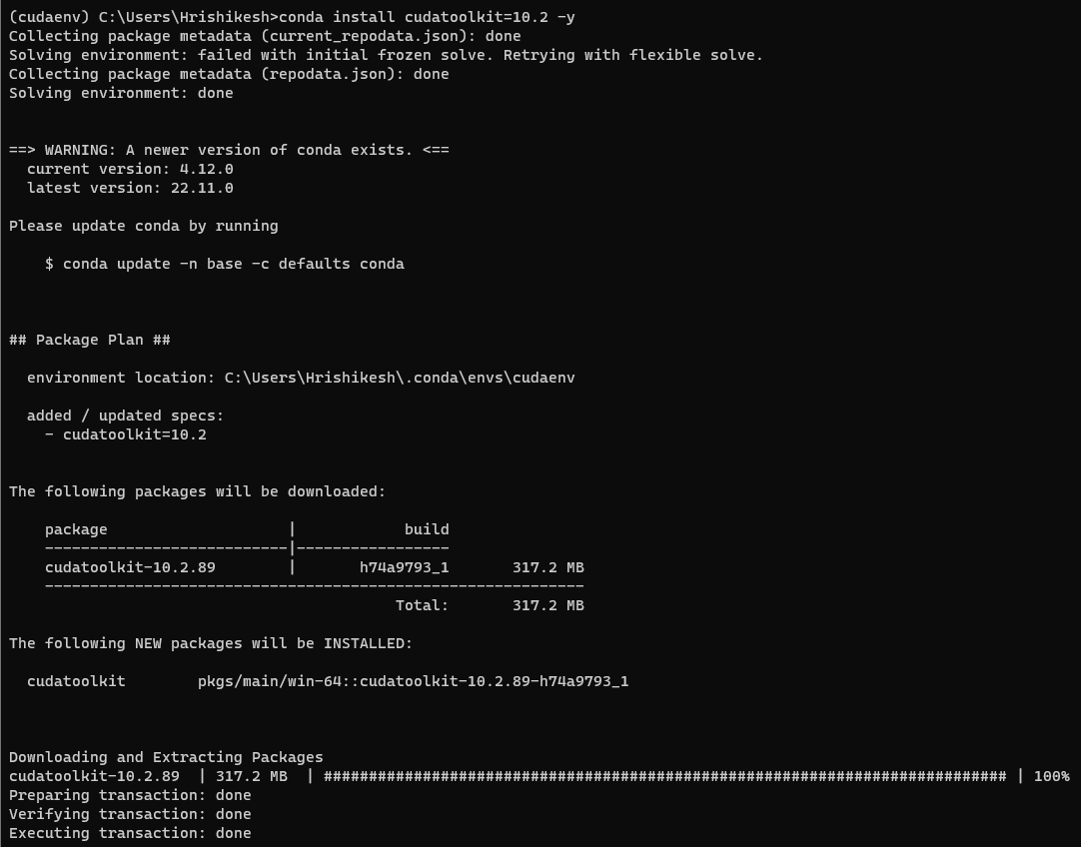
CUDA and cuDNN Installation
CUDA is Nvidia’s GPU computing platform
It helps in running high-performance programs that are computationally intensive
cuDNN is a GPU-accelerated library for running primitives of Deep Neural Networks.
It has highly optimized implementations for common operations like convolution, pooling, activation etc.

Slide 15
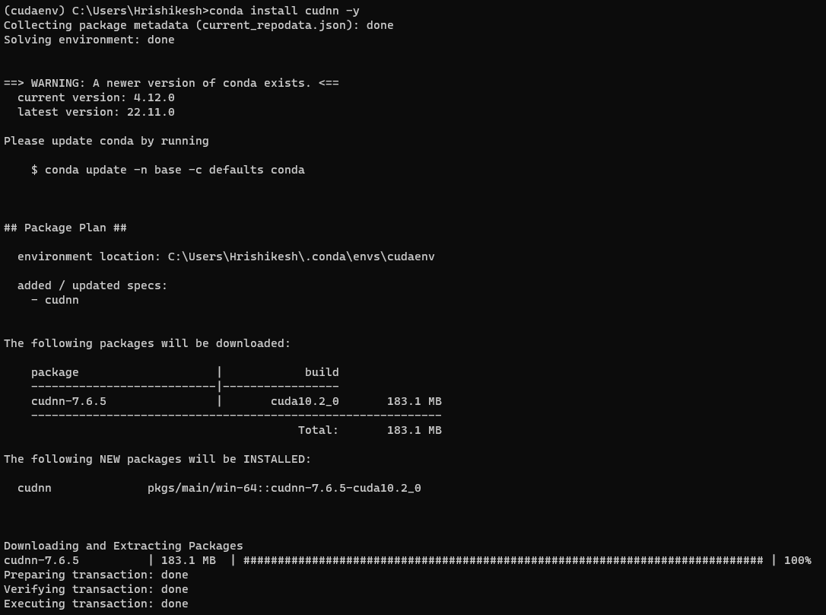
CUDA and cuDNN Installation

Slide 16
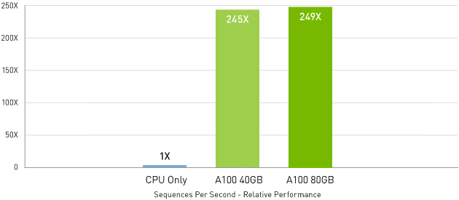
Up to 249X Higher AI Inference Performance Over CPUs

Slide 17
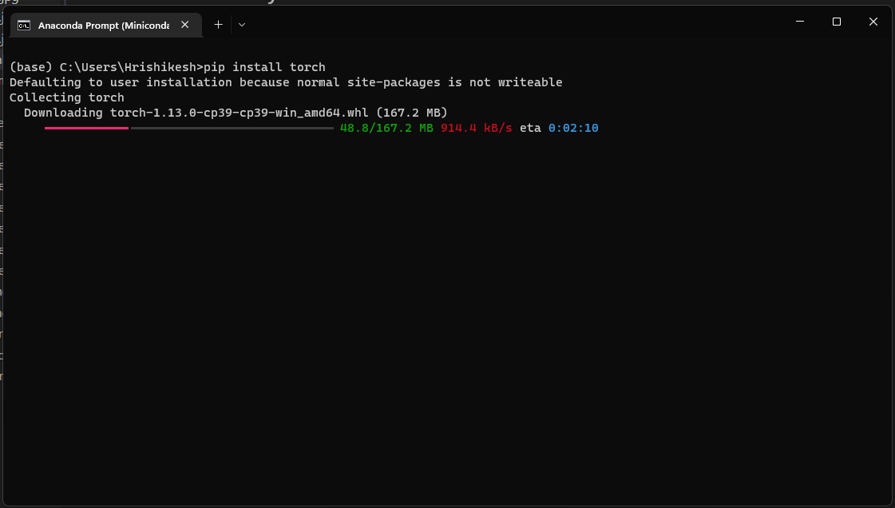
PyTorch Installation
PyTorch is an open source ML framework based on Python Torch library.
It is used to create Deep neural networks and is very much pythonic
It can be installed with Conda, pip etc.

Slide 18
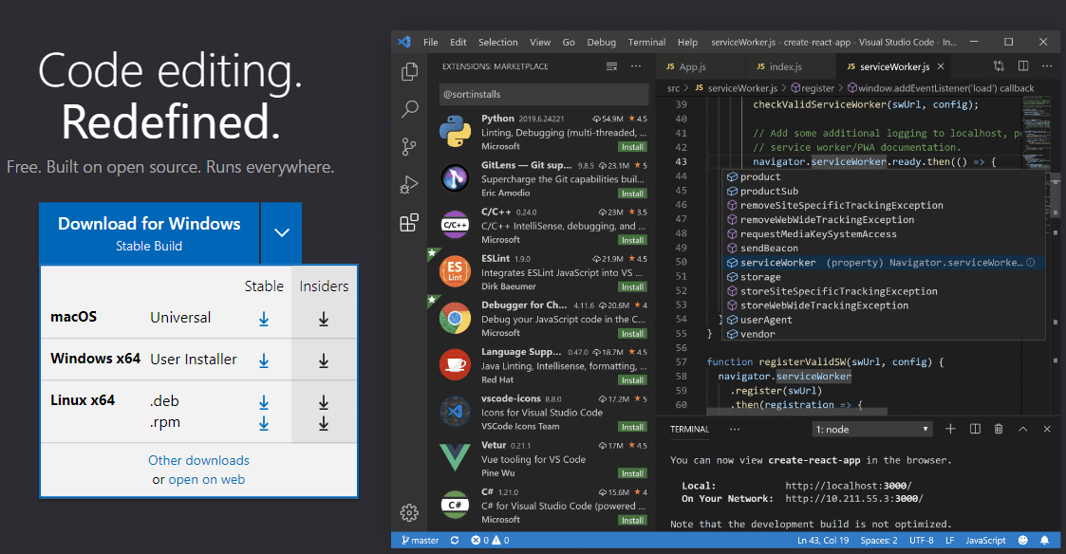
Visual Studio Code Installation
VS Code is a free code editor that makes software development easier
It has support for multiple languages like Python, Java, C++ etc.
Installation -> Goto https://code.visualstudio.com/, download the executable for your OS and run the installer.

Slide 19
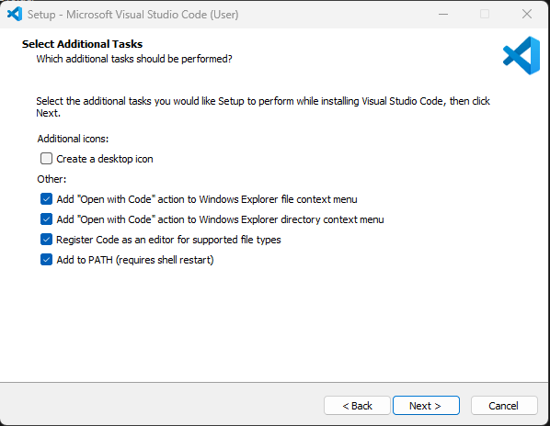
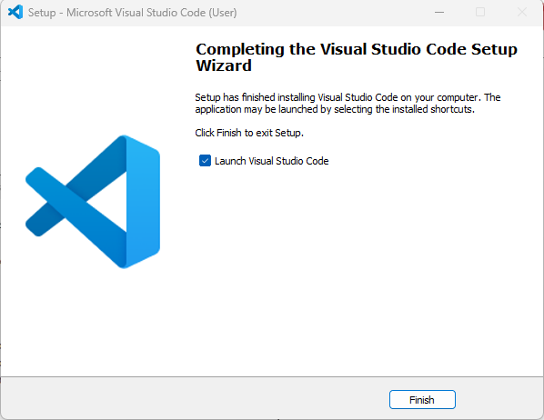
Visual Studio Code Installation

Slide 20
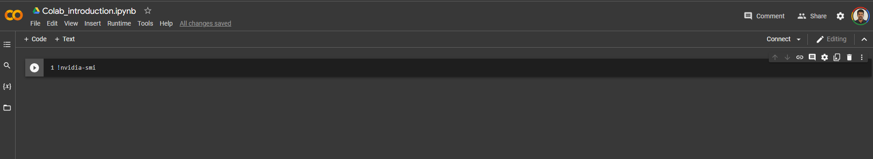
Google Colab
Colab allows anybody to write and execute arbitrary python code through the browser
Colab is a hosted Jupyter notebook service that requires no setup to use
Colab also offers access to computing resources including GPUs and TPUs in both free and paid tiers.
Most of the packages and libraries are pre-installed in colab runtimes and are usually hassle-free

Slide 21
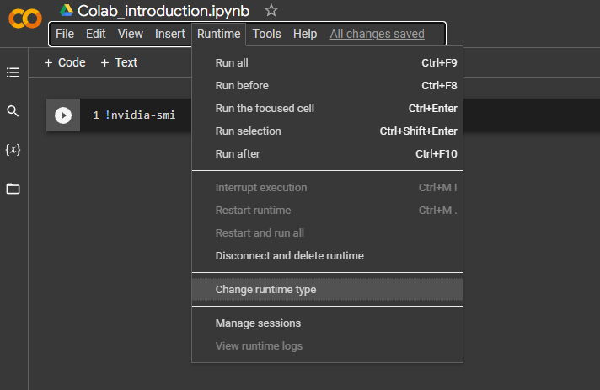
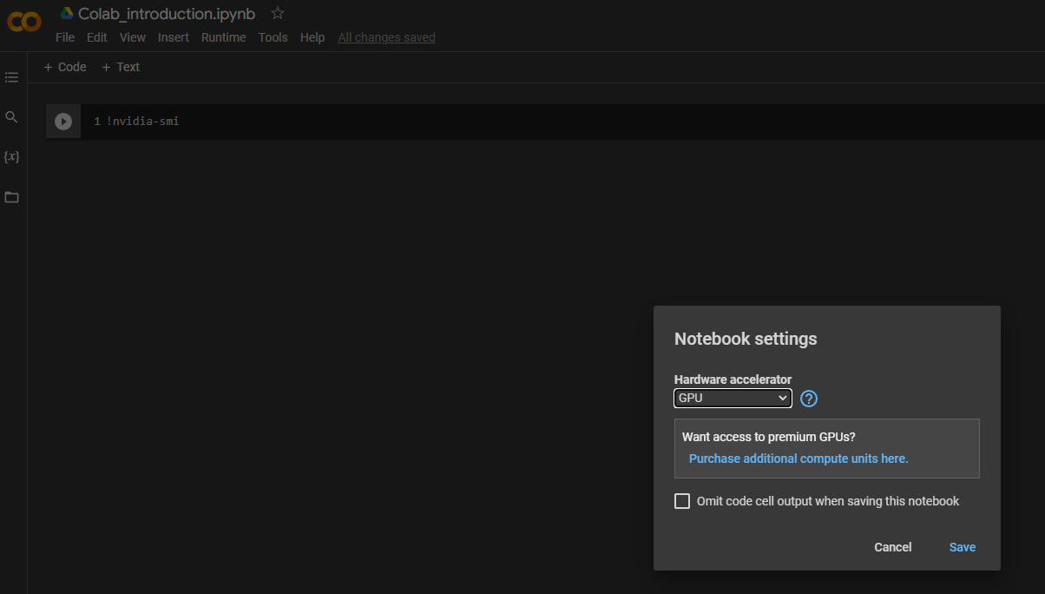
Google Colab

Slide 22
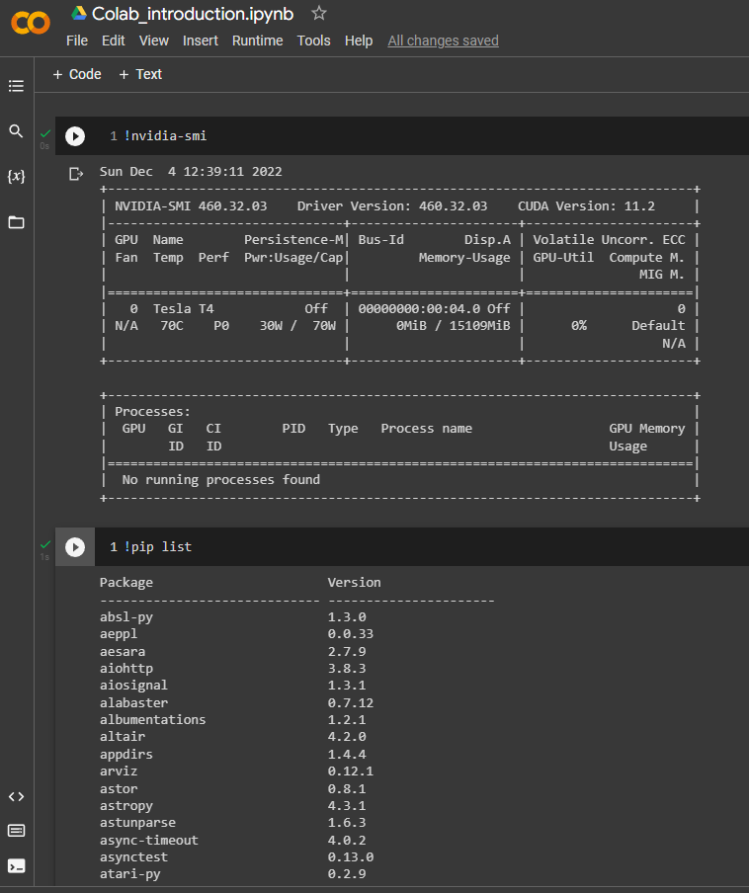
Google Colab
Colab comes with free computing tiers with low runtime durations and GPU cards with lower compute capabilities
Premium GPU cards like Tesla A100 runtimes are available in paid tiers.

