Slide 1

A Comparative Analysis of the Intra-City Distribution of Commercial Utilities of “Smart Cities” vis-à-vis Metropolises in India
A Project for the Applied Data Science Capstone Module

Slide 2
CONTENTS
Introduction
Proposition
Clientele
Methodology
Data Sources & Description
Results
Observations
Conclusion

Slide 3
Introduction
Urban spaces are engines of economic & socio-cultural activity.
2015: Government of India, Ministry of Housing & Urban Affairs launches “Smart Cities” Project.
20 Smart Cities Selected in Round – 1
None of the metros form part of Top-20. Instead, Tier-II cities: Bhubaneshwar, Pune & Jaipur top the list.
Study to determine geographical distribution of commercial amenities in top-3 “Smart Cities” vis-à-vis Mumbai, India’s largest metro.

Slide 4
Proposition
A fundamental proposition underlying this study is that the nature of commercial utilities available in a particular locality of a city is a function of the nature of amenities available in that particular micro-geography.
By extension, it is expected that the nature of the distribution of commercial utilities in these cities is analogous to & maps onto intra-city disparities & inequalities in terms of provision of necessary infrastructure.
The mapping of commercial utilities is provided by Four Square - therefore, the analysis of the distribution of commercial utilities provided herein is limited by the data provided by Four Square.
Limitation
Four Square is not able to provide adequate results for 2 of the cities – viz., Bhubaneshwar & Jaipur.

Slide 5
clientele
Local & Federal Governments, Municipal Corporations
Public Policy Experts.
Urban Planners & Architects.
NGO’s and Civic Society Groups

Slide 6

methodology
Obtain the list of cities from The Smart Cities official website.
Using the Beautiful Soup package, scrape the internet to obtain the list of pin codes for the cities.
Using the pgeocode library, obtain the latitude & longitude for each pin code.
Use the Four-Square API to obtain the list of top-100 venues at each latitude & longitude.
Segregate the venue categories per latitude & longitude.
Find the most frequent top-5 venue categories per latitude & longitude.
Use the KMM Algorithm to cluster localities using the top-5 most frequent venues.
Map the localities onto the cityscape using the Folium library.
Compare maps of the top – 3 cities with that of the metropolitan cities to derive learnings.

Slide 7
Data sources & DesCRIPTION
Sl. | Data Item | Source | Description
01. | List of Smart Cities | http://smartcities.gov.in/content/innerpage/cities-profile-of-20-smart-cities.php | Obtain the list of cities that shall be analysed as part of this study.
02. | Pin-Codes of localities | https://www.mapofindia.com/pincode/india | Obtain the list of pin-codes within that city.
03. | Latitude & Longitude of localities | PGeoCode Library | Mapping the pin-codes to the latitude & longitude
04. | List of Venues | Foursquare API | Obtain the Venue Data

Slide 8
Results - I
City | Bhubaneshwar | Pune | Jaipur | Mumbai
No. of Neighbourhoods | 308 | 762 | 562 | 182
Neighbourhoods Selected | 100 | 100 | 100 | 100
No. of Venues Returned | 5 | 454 | 172 | 1052
Neighbourhoods in Cluster 1 | - | 42 | - | 642
Neighbourhoods in Cluster 2 | - | 52 | - | 20
Neighbourhoods in Cluster 3 | - | 84 | - | 26
Neighbourhoods in Cluster 4 | - | 40 | - | 222
Neighbourhoods in Cluster 5 | - | 236 | - | 142

Slide 9
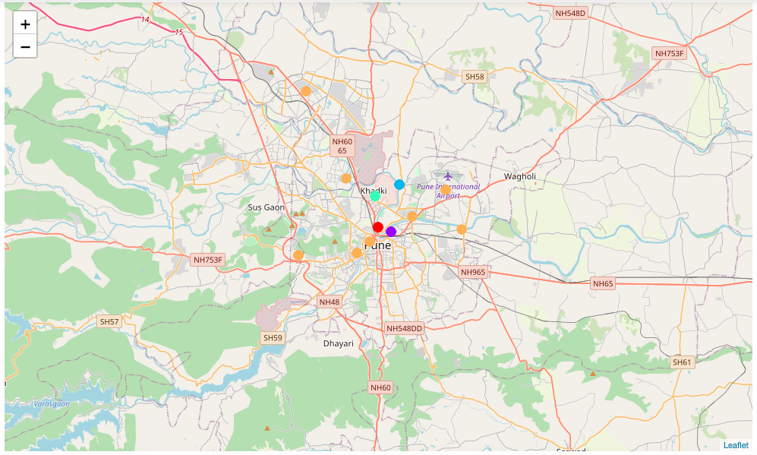
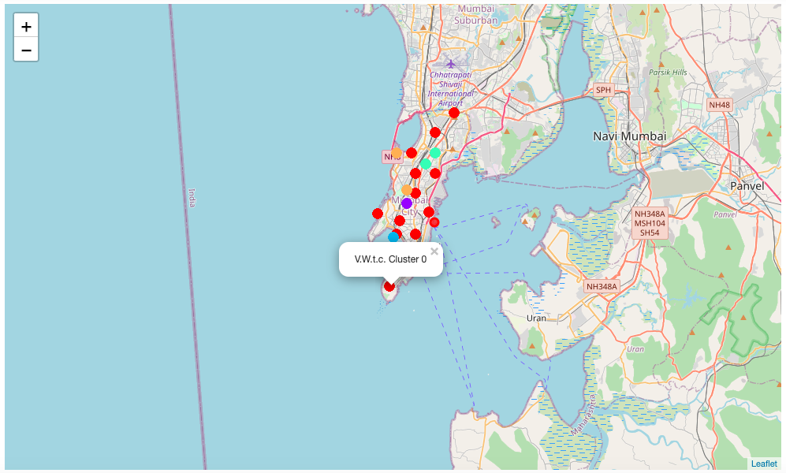
RESULTS - II
Pune
Mumbai
The plotting of the clusters onto the maps of the respective cities show the intra-city distribution.

Slide 10
Observations
In the city of Pune, the distribution of clusters is radial in nature. The city centre has a larger concentration of different types of clusters, whereas the city exteriors have similar sort of clusters. This suggests that the interior of the city has a larger variety of civic amenities, whereas the amenities available in the exterior parts are monotonic and uniform. That is to say, the city centre has a larger variety of amenities, whereas any part of the city exterior – in any direction from the city centre – will be uniform.
01
In the city of Mumbai, the distribution is linear in nature. This is analogous to the geography of the city itself. What is peculiar is that similar clusters appear across the length of the city – suggesting that certain amenities are available uniformly across the length of the city. Intersecting these uniform clusters are periodic unique clusters, that do not repeat. This distribution suggests that a basic set of amenities are available across the city, whereas some specific amenities are available in specific localities, that allow unique commercial utilities to emerge in those localities.
02

Slide 11
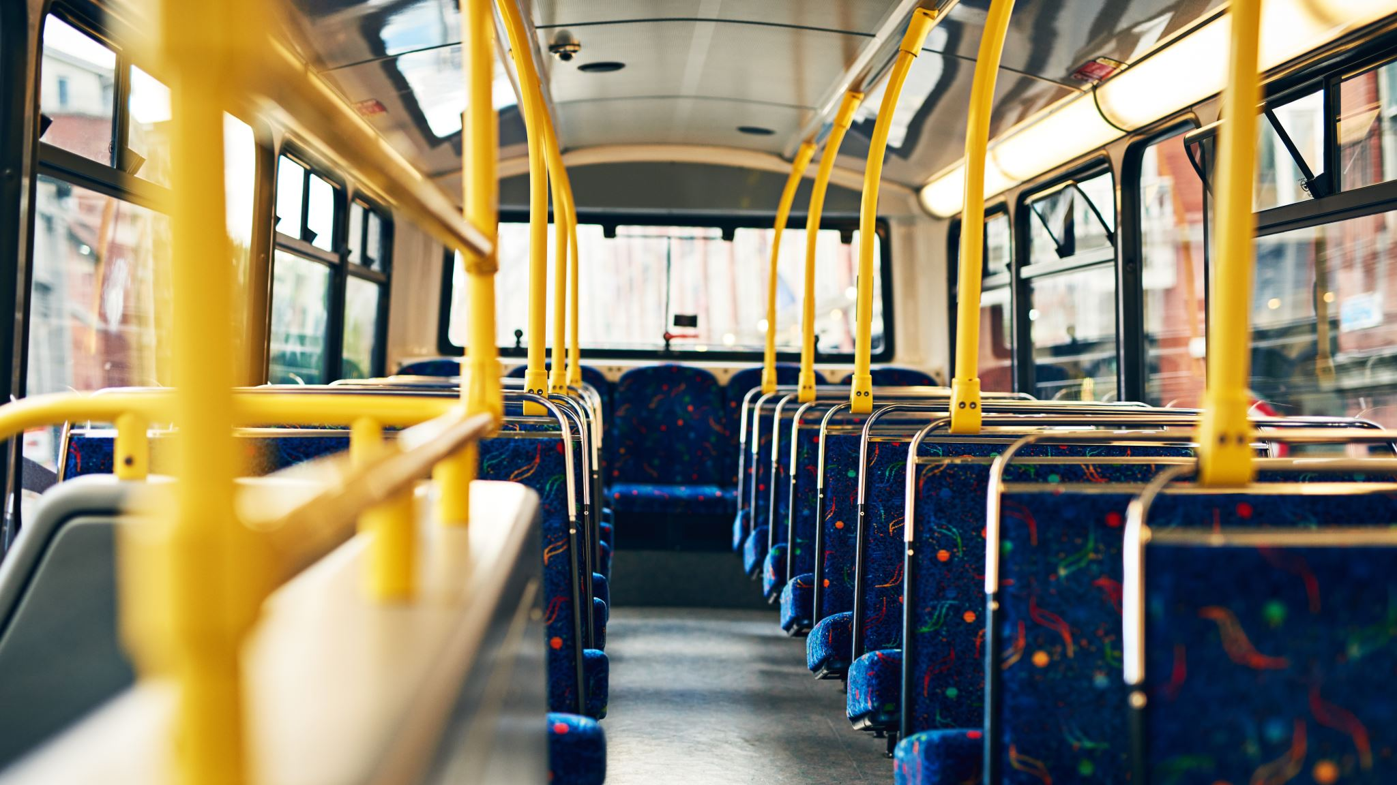
conclusion
The specific policy intervention suggested as a result of this study is:
In the city of Pune, the city centre is well-equipped with basic amenities. However, it is imperative to provide basic amenities in the city exteriors.
In the city of Mumbai, basic amenities are available across the entire length of the city. Specific amenities are available in specific localities. This distribution of unique amenities can be harnessed to develop clusters of specialization within the city.

