Slide 1
Developer’s Community
*Presented by*
Hrishikesh Pawar

Slide 2
Content
S. No. | Content | Slide No.
1 | Title of the Project | 3
2 | Introduction: Giving purpose of Your Project | 4
3 | A brief review of the work already done in the field (only best paper) | 6
4 | Expected outcome of the proposed work (Objectives) | 13
5 | Methodology/ Planning of work | 14
6 | Flow Chart | 15
7 | Conclusion | 16

Slide 3
Title :-
Developer’s Community
Community Build by developers for developers .

Slide 4
Introduction: Giving purpose of Our Project
This project is aimed to developing an online Developer’s Community. The entire project has been developed keeping in view to share the information throught online platform(web-app). Our project is aiming to create dev community across global platform . Through this application any person who is interested in technology can register himself and get the updates and information related to tech world . Moreover, if any general Developer wants to create online blog related with their expertise. He can also take the help of others developer(blog’s). Developers is having the authority to perform addition, deletion, and modification of their blogs if required. The project has been planned to be having the view of centralized storage of the database. The application for the storage of the data has been planned using mongodb and all the user interfaces have been designed using the React technology. We are Creating a web-app using the MERN(Mongodb ,Expressjs,React js ,node js). The application takes care of different modules and their associated reports, which are produced as per the applicable strategies and standards that are put forwarded by the administrative staff .

Slide 5
Facilities required for proposed work
Software/Hardware required for the development of the project.
Technologies :- HTML , CSS , REACT , EXPRESS JS , NODE JS, Postman(API)
Operating Environment :-The online blogging system web application will operate with the following Web Browsers: Microsoft Internet Explorer, Mozilla Firefox and Google Chrome.
Operating System :- Any Operating System
Software requirements : Http Server ,Visual Studio Code , Mongodb(Atlas)
Languages used: Javascript , Html, CSS
Internet Access

Slide 6
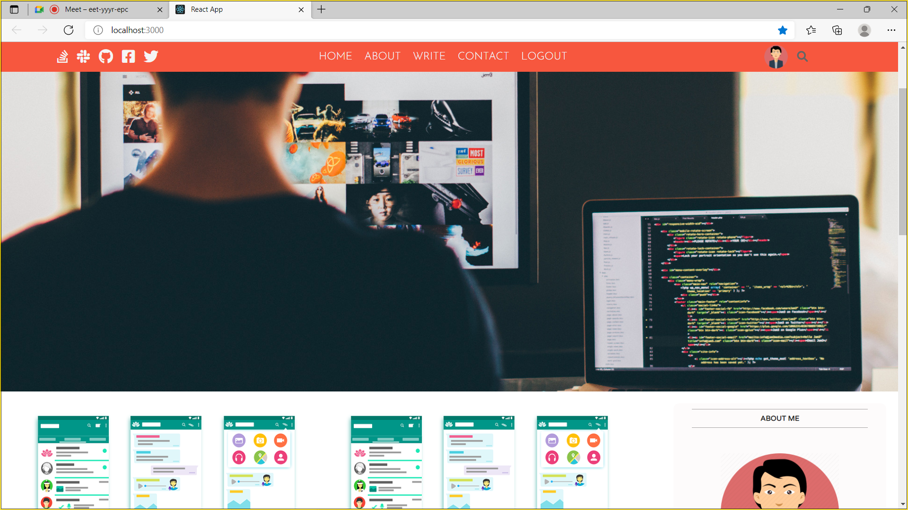
A brief review of the work already done in the field

Slide 7
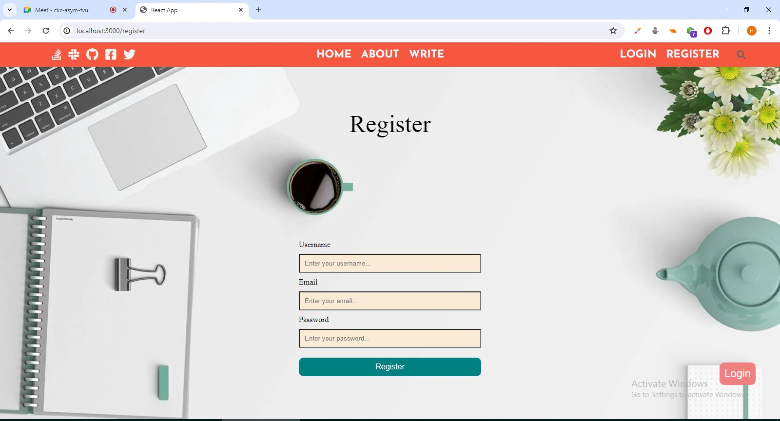

Slide 8
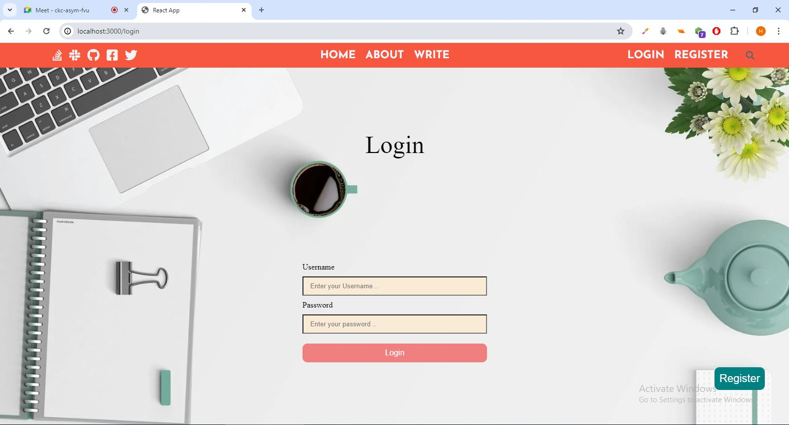

Slide 9
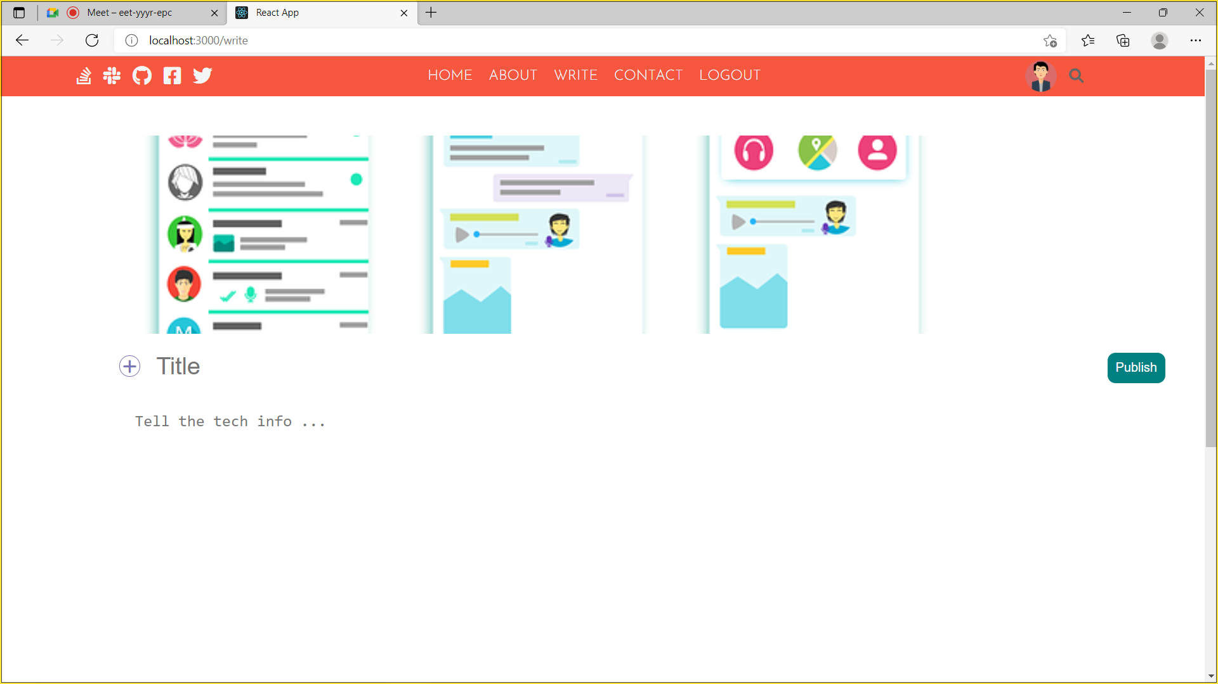

Slide 10
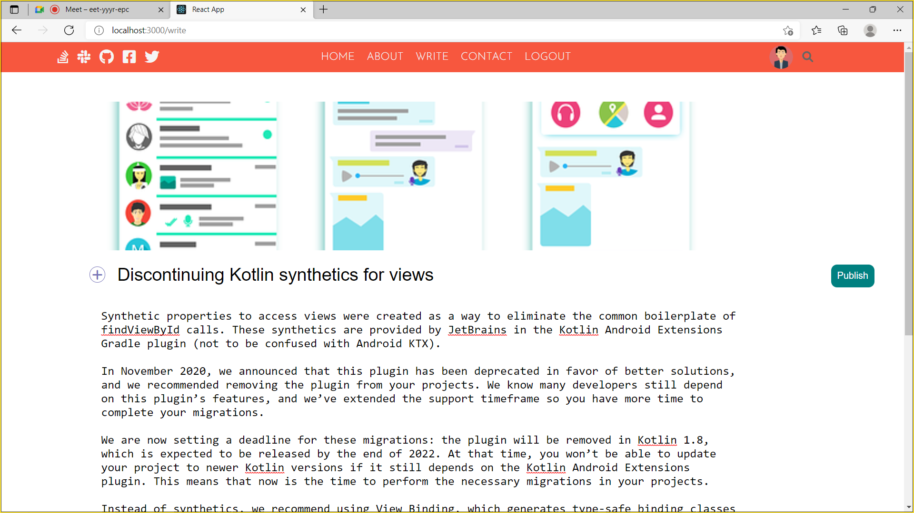

Slide 11
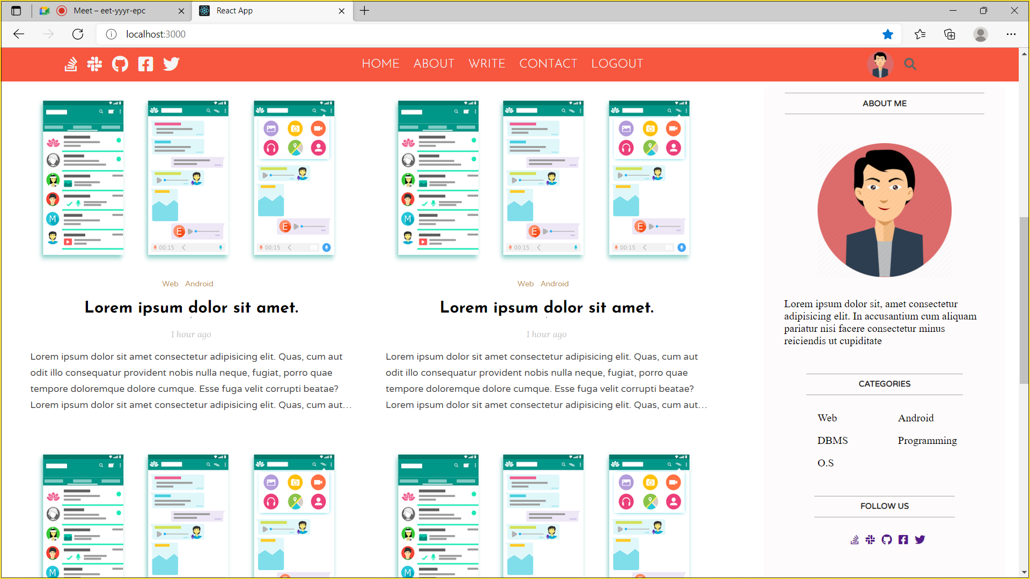

Slide 12
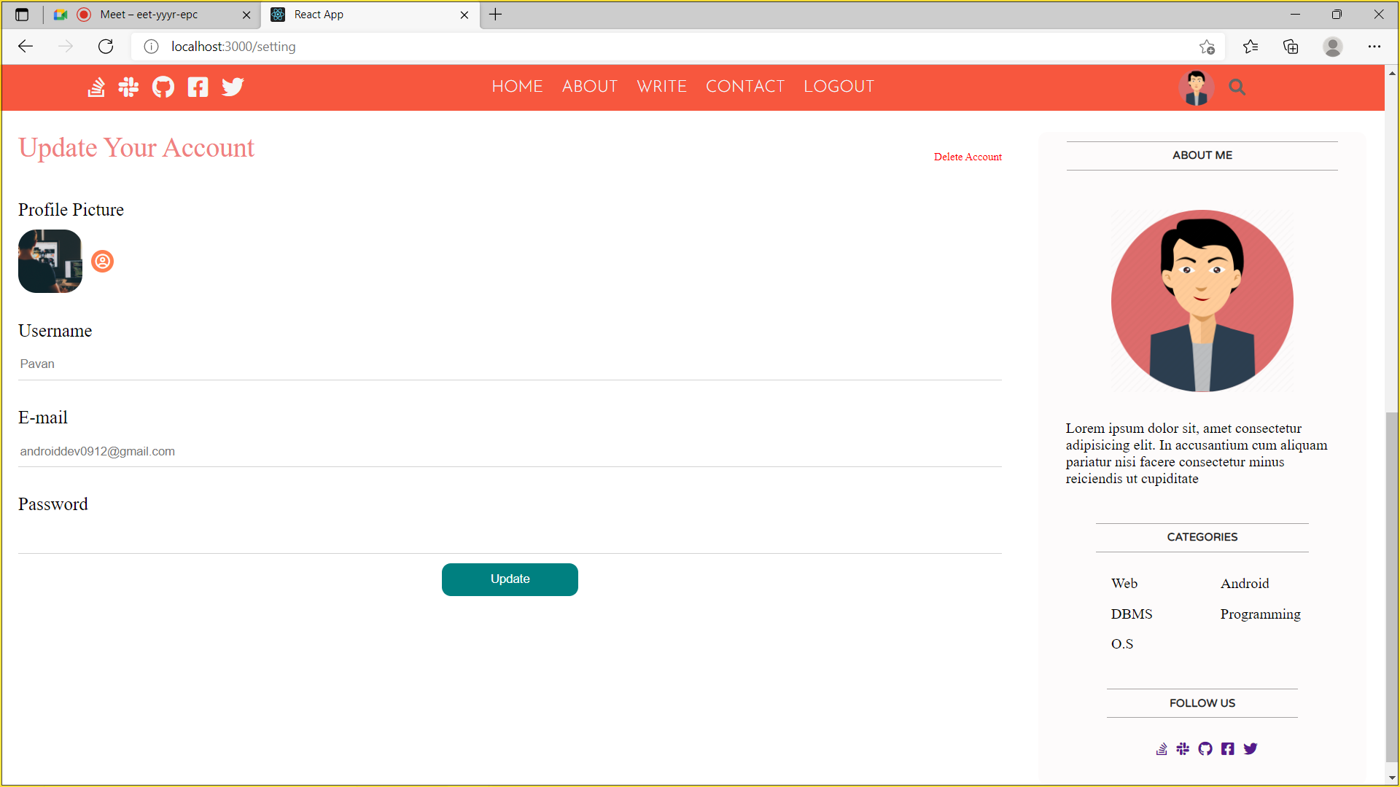

Slide 13
Expected outcome of the proposed work (Objectives)
The main objective of the Project on “Developer’s community” is to create global Developer Community for Tech beginner’s and for students too, so they can upgrade themselves and learn new tech things.
• Provides the searching facilities based on different categories
• “Dev’s community” also manage the Content details online for Entries details, Views details, Blogs.
• Shows the information and description of the Blogs.
• Share important news with users.
• Contribute to an existing conversation.
• Promote a product/service.

Slide 14
Methodology/ Planning of work
Firstly, user has two choices to login or register their selves.
2. After Registering into the blog the user will be redirected to the login page where he can log into the profile and share his ideas by using the developer’s community.
3. After Logging in into his profile he wiil get the options for writing the blog.
4. If the user wants to write a blog then by clicking write button he will be directed to write page, where he can write his content.
5. After writing his content he will be able to publish his blog by clicking Publish Button and after publishing the blog the user will be redirected to his own profile where he can see all his blogs that he has posted till date.
6. In the profile section, there are options provided for the users to log out
7. By clicking the log out button the user will be redirected to the log in page from where he can access his own account .

Slide 15
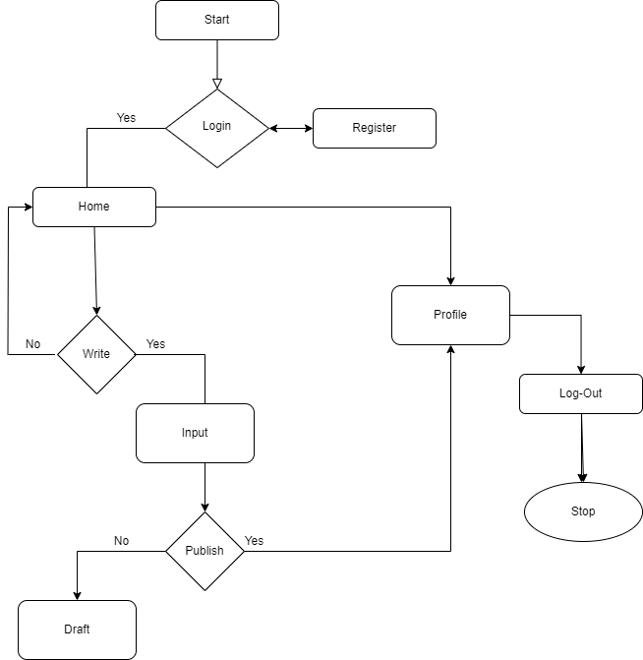
Flow Chart

Slide 16
Conclusion
This project was developed to fulfil the requirement of common blogging platform for educational purposes for students and Developer’s . However, there are lots of scope to improve the performance of the Online Blogging System in the area of user interface, database performance, and query processing time etc. So, there are many things for future enhancement of this project.
Web based interface for generate reports, like who has published more contents, who has commented most, the logged in time etc. •
Linking and integration of other online educational web sites.

Slide 17


