Slide 1
IST 707 Data Analytics Clustering Techniques
Unit 4

Slide 2
Understanding Clustering
Have you ever spent time watching a crowd? If so, you are likely to have seen some recurring personalities.
Perhaps a certain type of person, identified by a freshly pressed suit and a briefcase, comes to typify the "fat cat" business executive.
A 20-something wearing skinny jeans, a flannel shirt, and sunglasses might be dubbed a "hipster,"
While a woman unloading children from a minivan may be labeled a "soccer mom."
Brett Lantz - Machine Learning with R - 2019

Slide 3
Understanding Clustering
Clustering is an unsupervised machine learning task that automatically divides the data into clusters, or groups of similar items. It does this without having been told how the groups should look ahead of time.
As we may not even know what we’re looking for, clustering is used for knowledge discovery rather than prediction. It provides an insight into the natural groupings found within data.
Without advanced knowledge of what comprises a cluster, how can a computer know where one group end’s and another begins?
Brett Lantz - Machine Learning with R - 2019

Slide 4
Understanding Clustering
A clustering is guided by the principle that items inside a cluster should be very similar to each other, but very different from those outside.
Inter-cluster distances are maximized
Intra-cluster distances are minimized
Group the data such that related elements are placed together.
Brett Lantz - Machine Learning with R - 2019

Slide 5
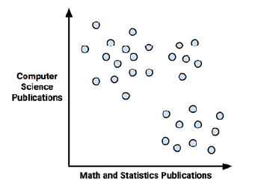
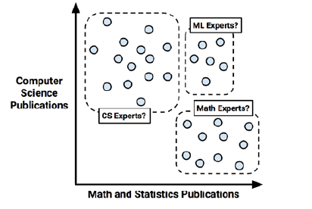
Understanding Clustering - Example
Clusters can be identified based on presumptions about the scholars in each group
Visualizing scholars by their math and computer science publication data
Brett Lantz - Machine Learning with R - 2019

Slide 6
Why is Cluster Analysis Used ?
The resulting clusters can then be used for action.
For instance, you might find clustering methods employed in applications such as:
Segmenting customers into groups with similar demographics buying patterns for targeted marketing campaigns
Detecting anomalous behavior, such as unauthorized network intrusions, by identifying patterns of use falling outside known clusters
Simplifying extremely large datasets by grouping similar feature values into a smaller number of homogeneous categories
Brett Lantz - Machine Learning with R - 2019

Slide 7
When is Clustering Appropriate?
Automatic cluster detection is a tool for undirected data mining, because the automatic cluster detection techniques find patterns in the data with no target variable.
Can be used to learn about the structure of complex data.
Clustering does not answer any question directly, but studying clusters can lead to valuable insights.
Linoff and Berry

Slide 8
When is Clustering Appropriate?
Automatic cluster detection is a form of modeling.
Clusters are detected in training data and the rules governing the clusters are captured in a model, which can be used to score previously unclassified data.
After cluster labels have been assigned, they often become input to directed data mining models. They may also serve as reporting dimensions.
Linoff and Berry

Slide 9
Requirements of Clustering in Data Mining
Scalability
Ability to explore large data set
Ability to deal with different types of attributes
Nominal, ordinal, numeric
When we calculate dist. measure between variables, can algorithm handle all different variable types?
Discovery of clusters with arbitrary shape
Spherical vs. other shapes
Easy to cluster using distance-based methods
Difficult to cluster because the two clusters are overlapped

Slide 10
Requirements of Clustering in Data Mining
Some domain knowledge required to determine input parameters
The number of desired clusters
Able to deal with noise and outliers
Insensitive to order of input records
High dimensionality
Sparse data
Interpretability and usability
Able to explain the patterns observed
These are the main aspects needed for effective clustering

Slide 11
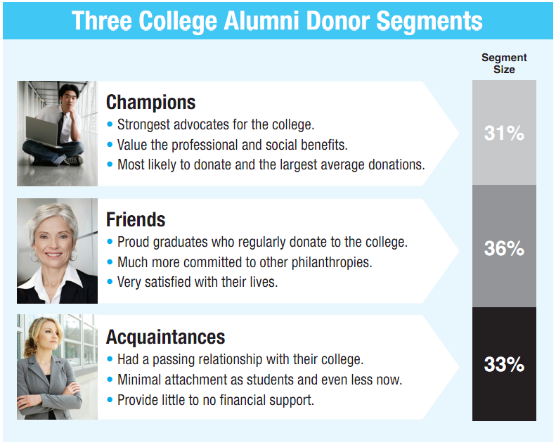
Clustering in the Real World

Slide 12
Where Can I Apply Clustering?
Customer Segmentation
Clustering helps marketers improve their customer base, work on target areas, and segment customers based on purchase history, interests, or activity monitoring. Here is a white paper on how telecom providers can cluster pre-paid customers to identify patterns in terms of money spent in recharging, sending SMS, and browsing the internet. The classification would help the company target specific clusters of customers for specific campaigns.
Insurance Fraud Detection
Machine learning has a critical role to play in fraud detection and has numerous applications in automobile, healthcare, and insurance fraud detection. Utilizing past historical data on fraudulent claims, it is possible to isolate new claims based on its proximity to clusters that indicate fraudulent patterns. Since insurance fraud can potentially have a multi-million dollar impact on a company, the ability to detect frauds is crucial. Check out this white paper on using clustering in automobile insurance to detect frauds.
Automatic Clustering of IT Alerts
Large enterprise IT infrastructure technology components such as network, storage, or database generate large volumes of alert messages. Because alert messages potentially point to operational issues, they must be manually screened for prioritization for downstream processes. Clustering of data can provide insight into categories of alerts and mean time to repair, and help in failure predictions.
https://dzone.com/articles/10-interesting-use-cases-for-the-k-means-algorithm

Slide 13
Where Can I Apply Clustering?
Rideshare Data Analysis
The publicly available Uber ride information dataset provides a large amount of valuable data around traffic, transit time, peak pickup localities, and more. Analyzing this data is useful not just in the context of Uber but also in providing insight into urban traffic patterns and helping us plan for the cities of the future. Here is an article with links to a sample dataset and a process for analyzing Uber data.
Cyber-Profiling Criminals
Cyber-profiling is the process of collecting data from individuals and groups to identify significant co-relations. The idea of cyber profiling is derived from criminal profiles, which provide information on the investigation division to classify the types of criminals who were at the crime scene. Here is an interesting white paper on how to cyber-profile users in an academic environment based on user data preferences.
Call Record Detail Analysis
A call detail record (CDR) is the information captured by telecom companies during the call, SMS, and internet activity of a customer. This information provides greater insights about the customer’s needs when used with customer demographics.
https://dzone.com/articles/10-interesting-use-cases-for-the-k-means-algorithm

Slide 14
Types of Clusterings
A clustering is a set of clusters
Important distinction between hierarchical and partitional sets of clusters
Partitional (flat) Clustering
A division data objects into non-overlapping subsets (clusters) such that each data object is in exactly one subset
Hierarchical clustering
A set of nested clusters organized as a hierarchical tree

Slide 15
Partitional Clustering
Original Points

Slide 16
Partitional Clustering
Original Points
A Partitional Clustering

Slide 17
Hierarchical Clustering
The Dendrogram shows the Process of Hierarchical Clustering .
Traditional Hierarchical Clustering
Traditional Dendrogram
Steps
Start with two nearest data examples p2 and p3 and merge into cluster.
Merge with p4 to get larger cluster
Continue process until all data examples are included.

Slide 18
The K-Means Clustering Method
Example
10
10
9
9
8
8
7
7
6
6
5
5
4
Assign each objects to most similar center
Update the cluster means
4
3
3
2
2
1
1
0
0
0
1
2
3
4
5
6
7
8
9
10
0
1
2
3
4
5
6
7
8
9
10
reassign
reassign
K=2
Arbitrarily choose K object as initial cluster center
Update the cluster means

Slide 19
Importance of Choosing Initial Centroids
A good clustering result

Slide 20
Importance of Choosing Initial Centroids

Slide 21
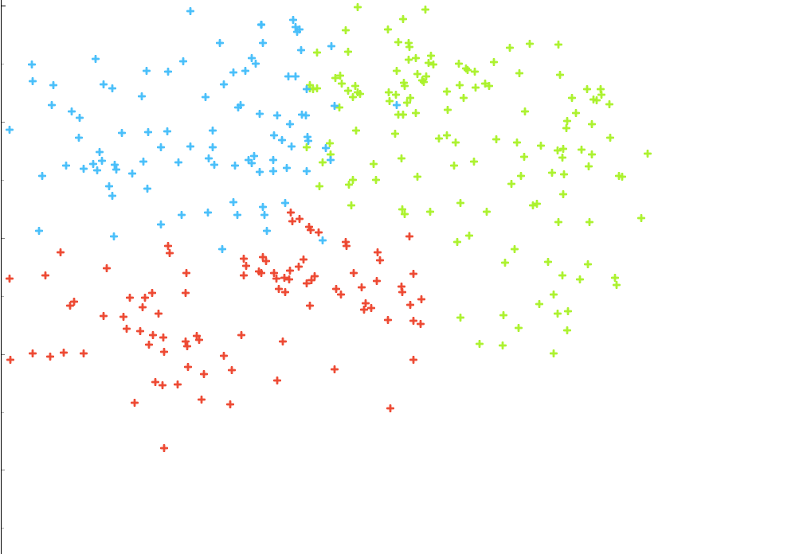
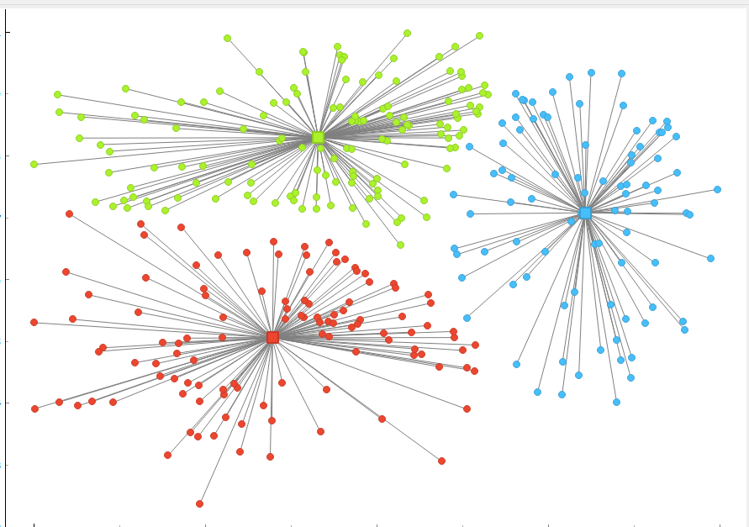
Interactive Example

Slide 22
Break

Slide 23
How Does K-Means Work Mathematically ? Similarity and Distance: two opposite concepts: A) Distance measures how far apart/different two examples are. B) Similarity measures how close/similar two examples are.

Slide 24
Euclidean distance
When q = 2, d is Euclidean distance:
j
c
a
i
b
Notes:
Euclidean distance: draw a straight line from A to B. The length of the line is the Euclidean distance between A and B.

Slide 25
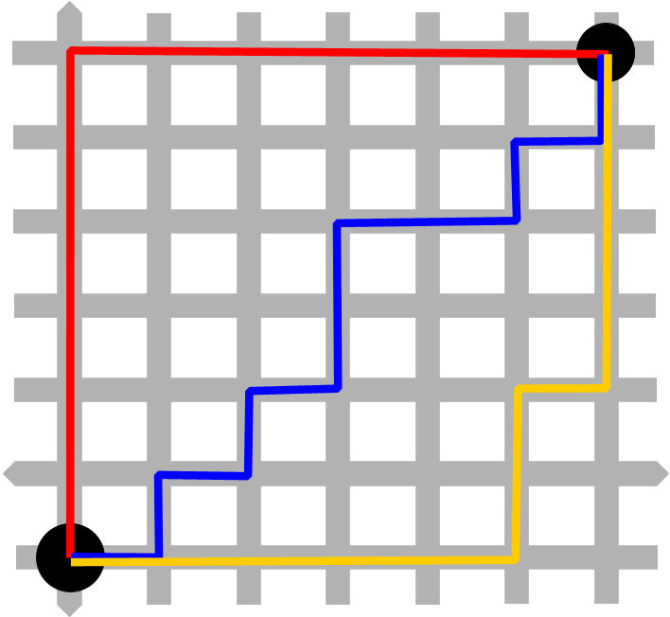
Manhattan Distance
https://upload.wikimedia.org/wikipedia/commons/d/de/Manhattan_distance_bgiu.png

Slide 26
Similarity - Vector space representation and Cosine similarity
Distance/similarity measures
Euclidean distance
X=(1,2)
Y=(4,2)
d
α
Cosine Similarity is a measurement that quantifies the similarity between two or more vectors. The cosine similarity is the cosine of the angle between vectors. The vectors are typically non-zero and are within an inner product space.
https://towardsdatascience.com/understanding-cosine-similarity-and-its-application-fd42f585296a

Slide 27
Cosine similarity
In the range of [0, 1]
“0” means two vectors are perpendicular to each other
“1” means same vector direction and length
Commonly used in information retrieval and text mining to compare document similarity
High-dimensional space
Each word in the vocabulary is a dimension

Slide 28
Major Clustering Approaches
Partitioning approach:
Construct various partitions and then evaluate them by some criterion, e.g., minimizing the sum of square errors
Typical methods: k-means, k-medoids, CLARANS, EM
Hierarchical approach:
Create a hierarchical decomposition of the set of data (or objects) using some criterion
Typical methods: Diana, Agnes, BIRCH, ROCK, CAMELEON
There many Algorithms Available for Clustering

Slide 29
Different Methods for Cluster Validation
Cluster Cohesion: Measures how closely related are objects in a cluster
SSE as a cohesion measure
Cluster Separation: Measure how distinct or well-separated a cluster is from other clusters
low inter-class similarity
Silhouette value is a measure of how similar an object is to its own cluster (cohesion) compared to other clusters (separation).
The silhouette ranges from −1 to +1, where a high value indicates that the object is well matched to its own cluster and poorly matched to neighboring clusters
cohesion
separation

Slide 30
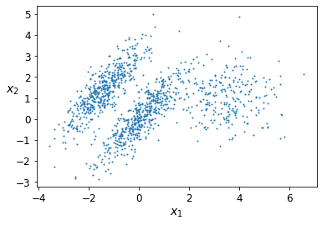
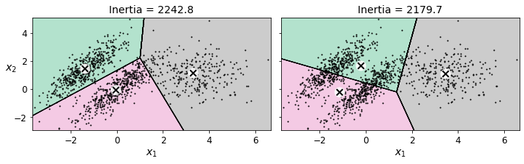
Comments on the K-Means Method
Strength: Relatively efficient:
Weakness
Need to specify k, the number of clusters, in advance. Can be challenging.
Sensitive noisy data and outliers
Not suitable to discover clusters with non-convex shapes

Slide 31
Importance of Normalization
Sometimes we need to normalize the distance measure so that we don’t cause problems

Slide 32
Potential Problem Type 1
Different variables might use different scales
Age: [0, 120]
Income: [0, 2M]
If averaging the difference on these two variables, income would weigh much more than age
Solution: normalize both variables to the same scale, e.g. [0, 1]
The dimensions with larger scales can dominate the distance measures while the dimension with smaller numbers will not be as impactful as they should be

Slide 33
Potential Problem Type 2
Lets say we have a collection of documents we want to analyze. Some documents are long, while others are short.
Different examples(documents)/vectors might differ greatly in length
E.g. for text documents, the vector lengths of long documents are much greater than the vector lengths short documents
The longer documents tend to me far away from the short documents bases on the raw Euclidian distance.

Slide 34
Class Discussion
Your management team wants to implement a Cluster based solutions. They would like to understand the risks and benefits of such a solution, and how it could be incorporated into everyday workflows.
Select one of the use 6 cases and develop the outline of a proposal. Please include:
Situation Appraisal.
Objectives.
Value.
Metrics.
Data Needed.

Slide 35
Where Can I Apply Clustering?
Customer Segmentation
Clustering helps marketers improve their customer base, work on target areas, and segment customers based on purchase history, interests, or activity monitoring. Here is a white paper on how telecom providers can cluster pre-paid customers to identify patterns in terms of money spent in recharging, sending SMS, and browsing the internet. The classification would help the company target specific clusters of customers for specific campaigns.
Insurance Fraud Detection
Machine learning has a critical role to play in fraud detection and has numerous applications in automobile, healthcare, and insurance fraud detection. Utilizing past historical data on fraudulent claims, it is possible to isolate new claims based on its proximity to clusters that indicate fraudulent patterns. Since insurance fraud can potentially have a multi-million dollar impact on a company, the ability to detect frauds is crucial. Check out this white paper on using clustering in automobile insurance to detect frauds.
Automatic Clustering of IT Alerts
Large enterprise IT infrastructure technology components such as network, storage, or database generate large volumes of alert messages. Because alert messages potentially point to operational issues, they must be manually screened for prioritization for downstream processes. Clustering of data can provide insight into categories of alerts and mean time to repair, and help in failure predictions.
https://dzone.com/articles/10-interesting-use-cases-for-the-k-means-algorithm

Slide 36
Where Can I Apply Clustering?
Rideshare Data Analysis
The publicly available Uber ride information dataset provides a large amount of valuable data around traffic, transit time, peak pickup localities, and more. Analyzing this data is useful not just in the context of Uber but also in providing insight into urban traffic patterns and helping us plan for the cities of the future. Here is an article with links to a sample dataset and a process for analyzing Uber data.
Cyber-Profiling Criminals
Cyber-profiling is the process of collecting data from individuals and groups to identify significant co-relations. The idea of cyber profiling is derived from criminal profiles, which provide information on the investigation division to classify the types of criminals who were at the crime scene. Here is an interesting white paper on how to cyber-profile users in an academic environment based on user data preferences.
Call Record Detail Analysis
A call detail record (CDR) is the information captured by telecom companies during the call, SMS, and internet activity of a customer. This information provides greater insights about the customer’s needs when used with customer demographics.
https://dzone.com/articles/10-interesting-use-cases-for-the-k-means-algorithm

