Slide 1
IST 722: Data Warehouse
SUPPLEMENT 2
Note: MATERIAL here is from a mix of sources as listed in References Slide(s)

Slide 2
02 Weekly Discussion
In Blackboard:
[1] What is the difference between Systems Architecture and Technical Architecture. Can you provide one example of each?

Slide 3
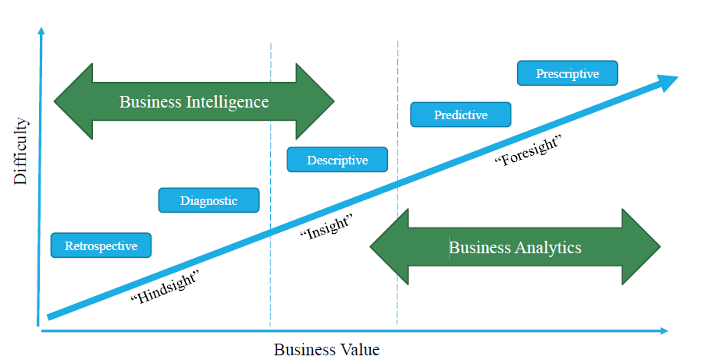
01 BI Analytics Scope

Slide 4
01 Data Warehouse defined
Subject-Oriented
Built around business entities and processes
Optimized to give answers to diverse questions
Used by all functional areas
Nonvolatile
Data always growing, Never removed!
Historical data. It happened! We do not rewrite history!
Integrated
Centralized in one place
Holds data retrieved from entire organization
"Single version of the truth"
Time-Variant
Flow of data through time
Data reflected as it was at that point in time

Slide 5
01 Data Warehouse Approaches
 | Inmon | Kimball
Technical Architecture | Hub and Spoke | Enterprise Bus
Data Marts | Normalized data warehouse is used to extract departmental data marts | The data warehouse is specified by the set of departmental data marts
Complexity | Medium to High | Low to Medium
Model | Spiral | Waterfall
Method | Data first | User first
Time to Deploy | Months to Years | Weeks to Months
Costs | Higher initial cost followed by Incremental costs that are lower | Lower initial cost followed by Incremental costs that are the same

Slide 6
01 SOFTWARE & Tools
Software
Microsoft Excel – Design and Analytics
Microsoft SQL Server 2018 – Database Engine and Analysis Services
Microsoft SQL Server Management Studio
Microsoft Visual Studio 2017 – SSIS and SSAS
Microsoft Power BI (Analytics)
SQL Review
https://www.youtube.com/playlist?list=PLA1261A156B60856E
Remote Lab
https://remotelab.ischool.syr.edu

Slide 7
02 Corporate Information Factory
The CIF is a
reference architecture.
Rectangles: Components
Blobs: Applications
Boxes: Processes
Cylinders: Data Stores

Slide 8
02 Maturity Model Adoption Curve
Transforming Data With Intelligence: The Gulf and Chasm represent the series of obstacles and challenges that early- and later-stage programs encounter during their BI journey, respectively. Companies in the Gulf struggle with sponsorship, funding, data quality, project scope, and spreadmarts. Companies in the Chasm struggle with the politics, logistics, and dynamics of delivering an enterprise BI environment.
(https://tdwi.org/blogs/tdwi-blog/2009/10/chasm-1.aspx)

Slide 9
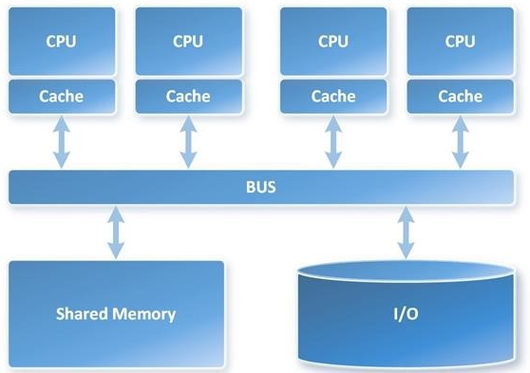
02 SMP System Architecture
Symmetric Multi-Processing (SMP)
Symmetric Multi-Processing (SMP) is a tightly coupled multiprocessor system
Single instance of the Operating System (OS), memory, I/O devices
Connected using a common bus
The primary parallel architecture employed in servers
https://cloudblogs.microsoft.com/sqlserver/2014/07/30/transitioning-from-smp-to-mpp-the-why-and-the-how/

Slide 10
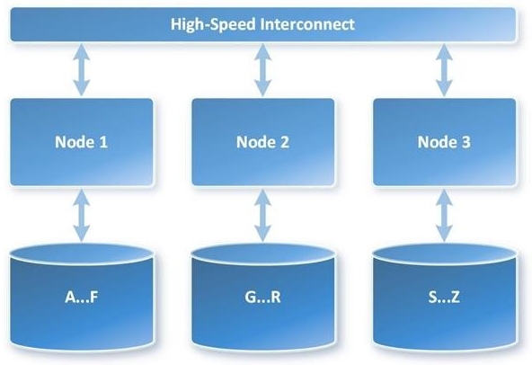
02 MPP System Architecture
MPP Parallel Data Warehouse (PDW)
Massively Parallel Processing (MPP) is the coordinated processing of a single task by multiple processors:
Each processor uses its own OS and memory and communicates via some form of messaging interface
MPP can be setup with a shared nothing or shared disk architecture
Shared nothing architecture:
no single point of contention across the system
nodes do not share memory or disk storage
https://cloudblogs.microsoft.com/sqlserver/2014/07/30/transitioning-from-smp-to-mpp-the-why-and-the-how/

Slide 11
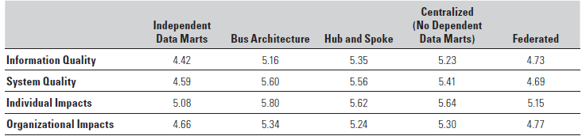
02 Success of the five architectures
Article: Which Data Warehouse Architecture Is Most Successful? – Thilini Ariyachandra and Hugh J. Watson
Conclusion
The bus, hub-and-spoke, and centralized architectures earned similar scores on the success metrics. This finding helps explain why these competing architectures have survived over time – they are equally successful for their intended purposes. In terms of information and system quality and individual and organizational impacts, no single architecture is dominant.

Slide 12
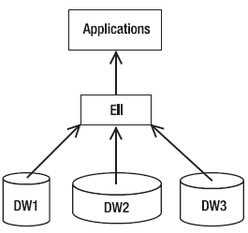
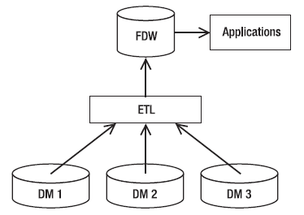
02 Federated data Warehouses
Federated data warehouse = several data warehouses plus a data retrieval layer
Granularity of the FDW data is the same as the highest of the granularities of sources
ETL that extracts data from the sources needs to be aware of the timing of the data
FDW ETL needs to match the frequency of the sources
Can use the EII approach here when integrating the data marts
Accommodates existing data warehouses, with shorter development time
Difficult to build a good-quality warehouse from diverse standards typical of DWs

Slide 13
02 Breakout 2
[5] Discuss 2 of 8 CIF product evaluations from 2.6:
[a] Informatica ILM
[b] PostgreSQL
[c] Pentaho Data Integration
[d] Birst
[e] Tableau Server
[f] Oracle Essbase
[g] Microsoft Dynamics GP
[h] IBM Informix

Slide 14
02 Assignment products
Part 3: On Your Own
Research the following product offerings:
Pentaho Data Integration
MemSQL
Microsoft Dynamics GP
Birst
Snaplogic
PostgreSQL
Informatica ILM

Slide 15
02 Assignment Questions
Part 3: On Your Own
For each of the product offerings, answer the following questions:
Website?
What does it do?
Is it a product (hardware/software), service (we do the work for you), or both?
Is it installed onsite, or is it in the cloud?
Is it systems or technical architecture?
If systems architecture, is it SMP, MPP, or Hadoop/MapReduce?
If technical architecture, which part of the corporate information factory does it aim to address? Data mart? IM&T/ETL? ODS/NDS/DDS? External world application? Cross-media storage? And so on.

Slide 16
02 Key Points
DW Architecture = Technical Architecture + System Architecture
Five common technical architectures in order of increasing complexity: Independent data marts, Centralized, Enterprise bus, Hub and Spoke, and Federated (with ETL or EII/EAI).
Four Types of Data Stores: Stage, NDS, ODS, DDS/MDS (multidimensional).
Four Reasons to Stage Data: Resource contention, Consolidation, Change detection, and Snapshotting
Corporate Information Factory (CIF) is a reference architecture (Inmon).
CIF components: Corporate Applications, ETL Processes, EDW (NDS + ODS), Data marts, Decision-Support Systems (DSS), and Cross-Media Storage.
System architecture comprises the software, platform, cloud, server, network and storage – that is the infrastructure on which the Data Warehouse sits.

Slide 17
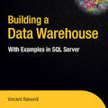
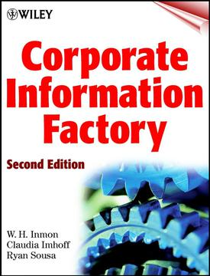
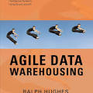
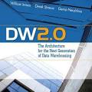
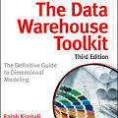
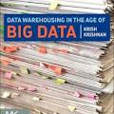


Reference books

Slide 18
Reference LINKS
https://www.1keydata.com/datawarehousing/datawarehouse.html
http://tdan.com/data-warehouse-design-inmon-versus-kimball/20300
https://www.kimballgroup.com/category/articles-design-tips/
https://www.slideshare.net/phanleson/building-the-data-ware-house-chapter-11
https://blog.chartio.com/posts/5-tips-for-selecting-the-right-data-warehouse
https://www.tutorialspoint.com/dwh/dwh_schemas.htm
http://www.bi-bestpractices.com/view-articles/4737
https://www.element61.be/en/resource/master-data-management-mdm-architecture-technology
https://tombreur.wordpress.com/2017/04/30/the-past-and-future-of-dimensional-modeling/
http://www.jamesserra.com/archive/2017/12/is-the-traditional-data-warehouse-dead/

