Slide 1


WEB APPLICATION
EMPLOYEE TRAVEL PORTAL

Slide 2


EMPLOYEE TRAVEL PORTAL
WEB APPLICATION

Slide 3
“What” is this portal all about:
This application is a user-friendly platform designed to enhance the entire process of managing employee travel within our organization. This innovative application provide a range of features to simplify planning, coordination, and expense management associated with business trips.

Slide 4

WHY DO U NEED AN APPLICATION ?

Slide 5

This Application Creates You A Portal Of Interesting Features That can offer various benefits to both employees and the organization as a whole.
Here are several reasons for having an Employee Travel Application:
Efficient Travel Planning
Cost Savings
Policy Compliance
Centralized Information
Real-time Updates
Data Analysis and Reporting
Paper Work To Digital

Slide 6

DISADVANTAGES OF MANUALLY OPERATING AN EMPLOYEES TRAVEL :
Lack of visibility into expenses
.
Manual expense reporting and reconciliation.
Policy compliance and enforcement.
Receipt management and documentation.
Lack of real-time analytics and spending insights.
Slow reimbursement process.

Slide 7
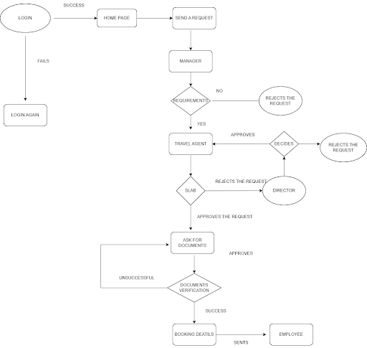
“How” does
this
intriguing Application work:

Slide 8
LOGIN PAGE
ENTER
LOGIN ID &
PASSWORD
Since the login id
Given is of an Employee
Employee home page is
Shown. (different roles provide
Different Home pages).

Slide 9
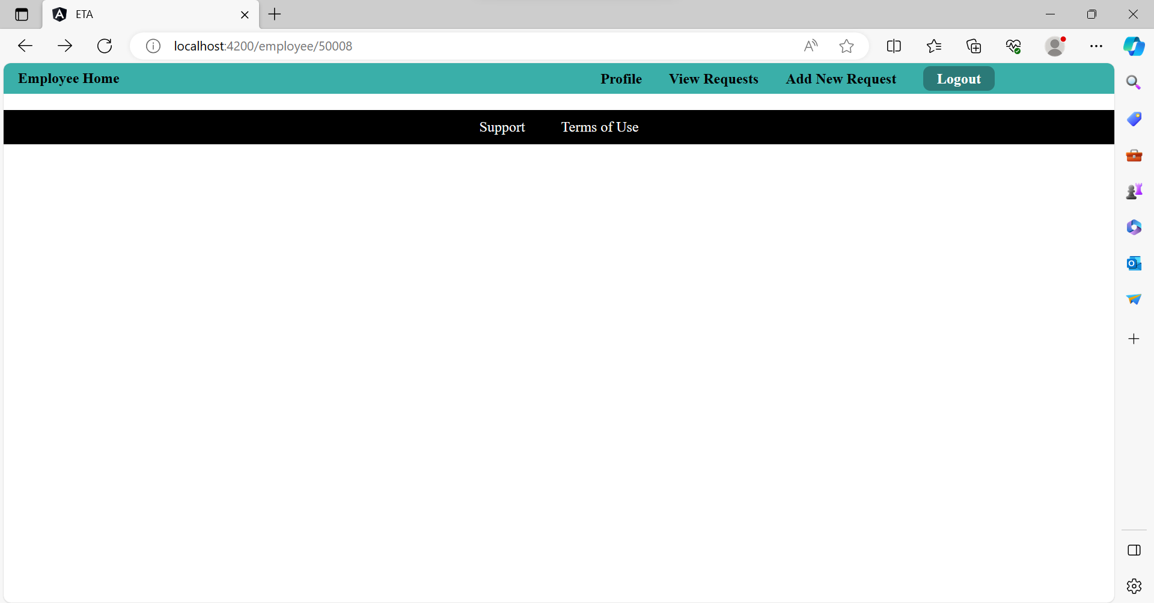
View employee details
EMPLOYEE
HOME
PAGE

Slide 10
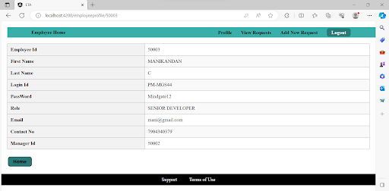
Employee Profile Page:

Slide 11
