Slide 1
SoftServe C# Course Demo2
Student name: Hristo Antov
Country: Bulgaria

Slide 2
Agenda
Overview
Human resource management system that supports HR’s in employees management
Easy access to information of each employee
Easy access to information about projects and teams
Easy access to make create, delete, update and edit operations
Code review
- Models
- Controllers
- Views
Web review
- How everything works

Slide 3
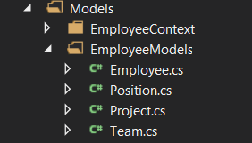
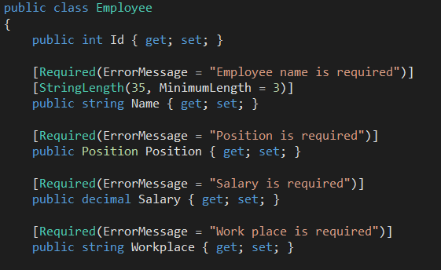
Code review: Models
Employee
- Contains properties of each employee with some validations and connections to other tables
Position
- Contains positions of each employee
Project
- Contains projects with description and connections to other tables
Team
- Contains teams with connection to other tables

Slide 4
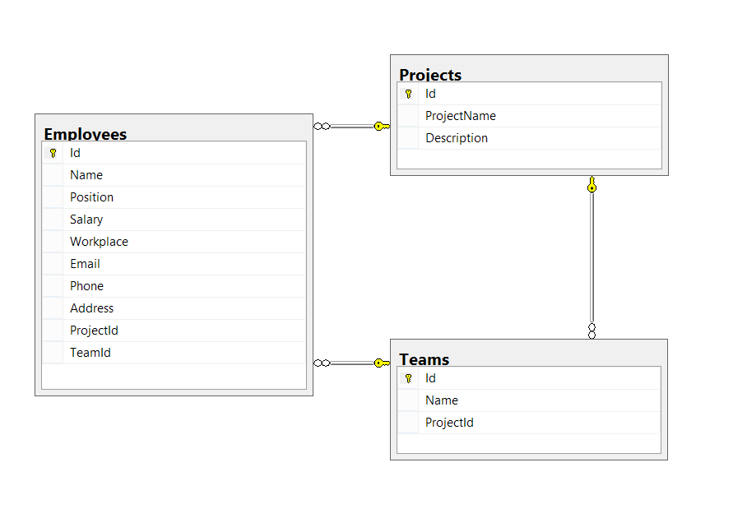
Database Diagram

Slide 5
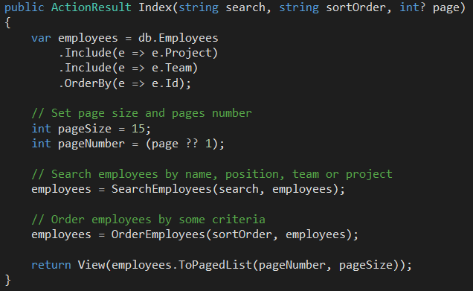
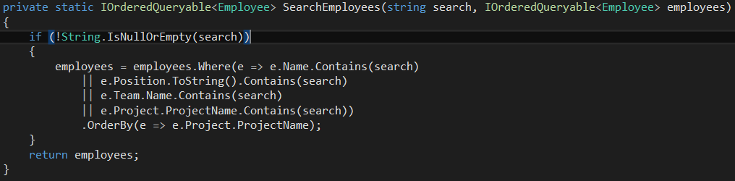
Code review: Controllers
Employee controller:
- Controller with basic actions and some useful methods
Team controller
- Controller with basic actions
Project controller
- Controller with basic actions

Slide 6
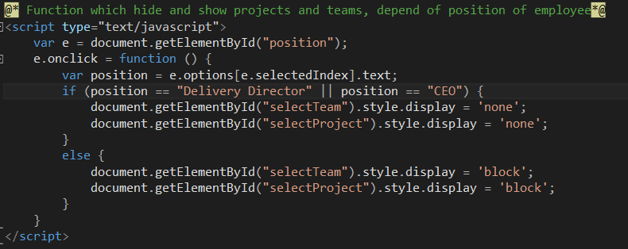
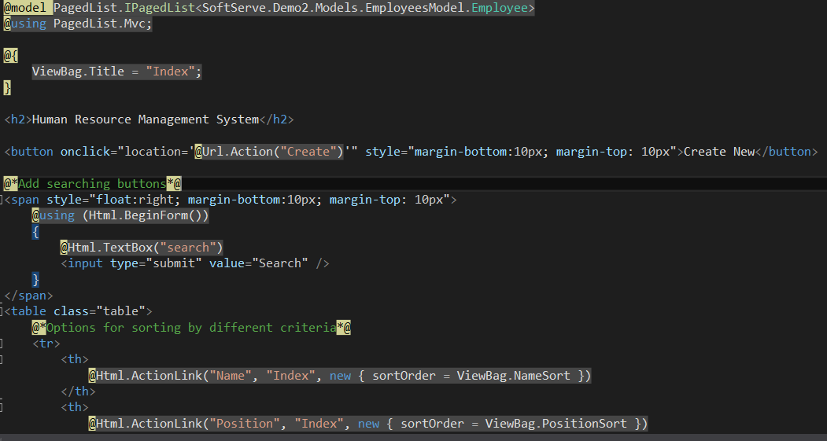
Code review: Views
Employees views
Projects views
Teams views

Slide 7
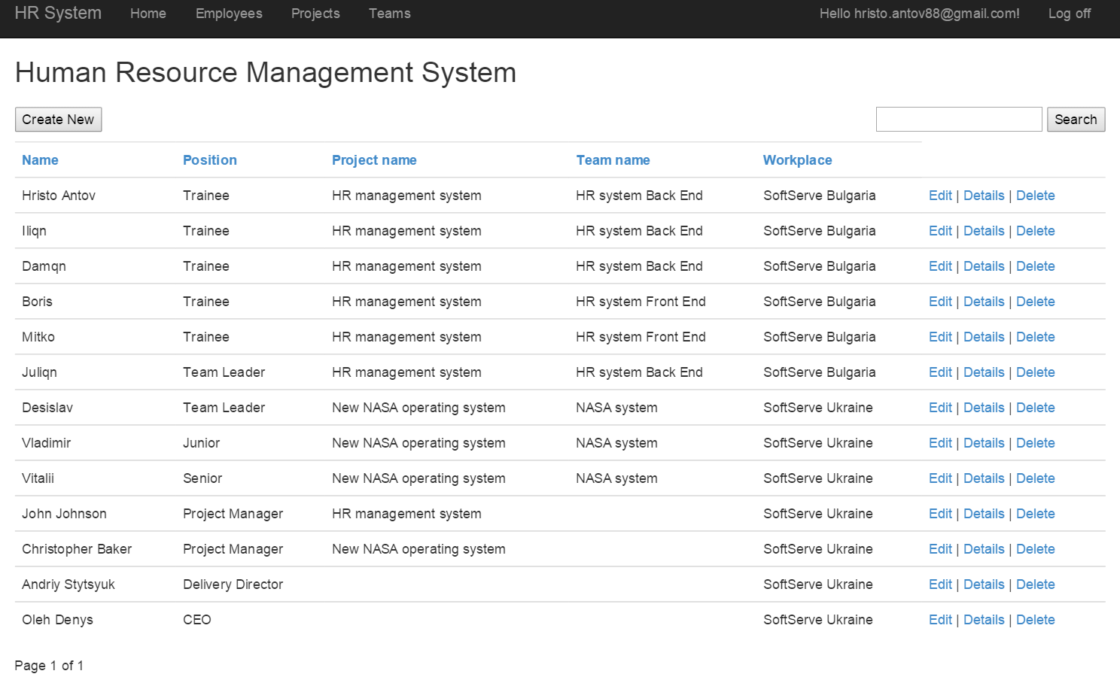
Web review

Slide 8
Questions?

Slide 9
Thank you!
US OFFICES | EUROPE OFFICES
Austin, TX Fort Myers, FL Lehi, UT Newport Beach, CA Waltham, MA | Bulgaria Germany Netherlands Poland Russia | Sweden Ukraine United Kingdom
 |  |  | www.softserveinc.com

