Slide 1
Lifecycle methods and
Introduction to React Hooks
-Hristijan Veleski, Software Engineer @ Grabit

Slide 2
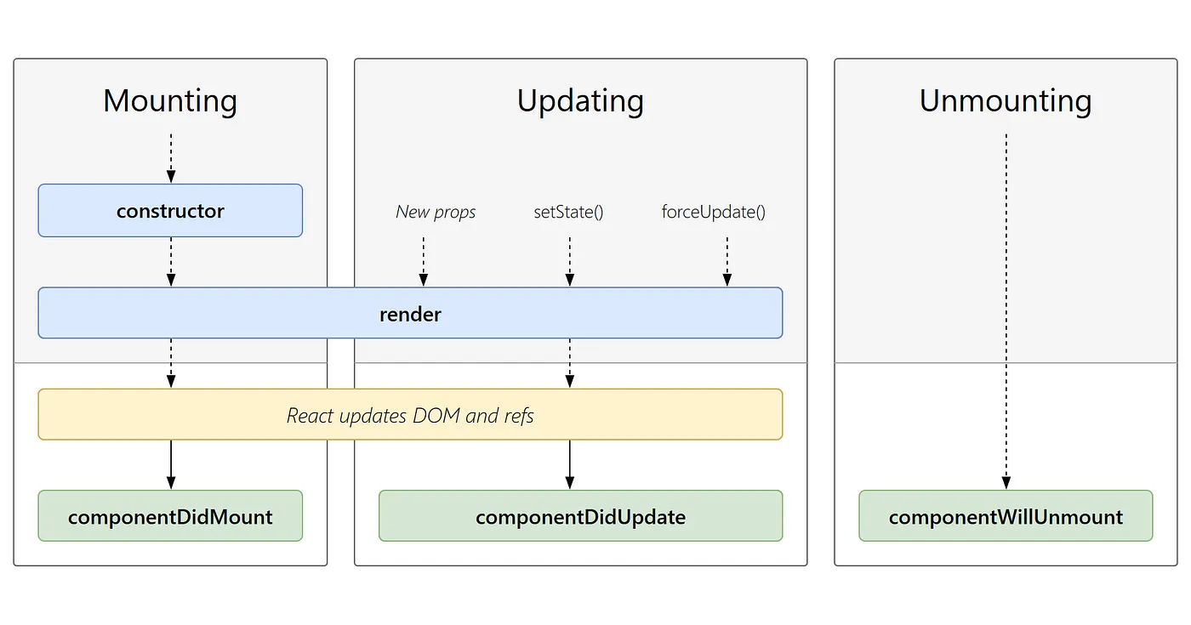
Lifecycle diagram
(Class based components)

Slide 3
Introduction to React Hooks
-useEffect
-useLayoutEffect
-useRef
-useState
-useReducer
-useMemo
-useCallback
-useContext

Slide 4
-useState
useState is a React hook that enables functional components to manage state. It allows you to declare state variables and update them, triggering component re-renders when the state changes.
It takes an initial state value and returns an array containing the current state and a function to update it.
Reference: https://react.dev/reference/react/useState

Slide 5
-useRef
The useRef hook allows you to persist a value between renders.
It can be used to store a mutable value that does not cause a re-render when updated.
It can be use to access a DOM element directly.
Reference:https://react.dev/reference/react/useRef

Slide 6
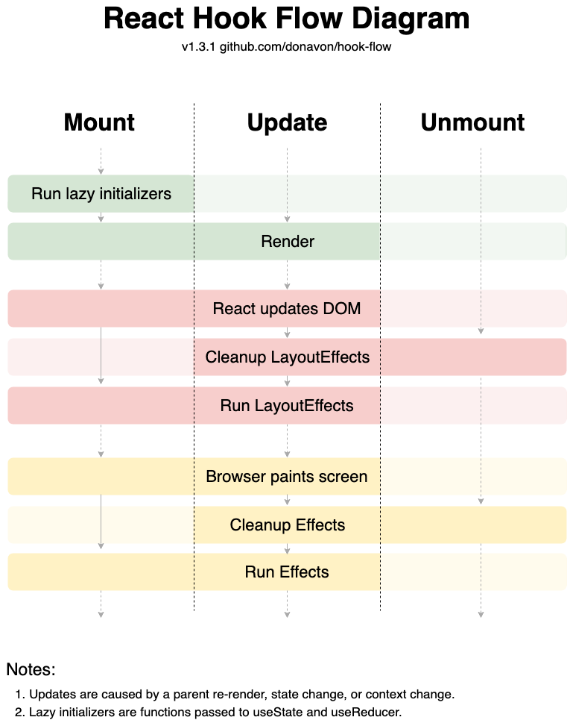

-useEffect
useEffect is a built-in hook that allows you to run some code after React renders (and re-renders) your component to the DOM.
It is used for side effects in functional components. It addresses the need to perform tasks like data fetching, subscriptions, or manually interacting with the DOM after a component renders.
Reference:https://react.dev/reference/react/useEffect

Slide 7

-useLayoutEffect
The useLayoutEffect Hook is a variation of the useEffect Hook that runs synchronously before the browser repaints the screen. It was designed to handle side effects that require immediate DOM layout updates.
useLayoutEffect ensures that any changes made within the hook are applied synchronously before the browser repaints the screen. While this might not seem ideal, it is highly encouraged in specific use cases, such as when measuring DOM elements, or animating or transitioning elements
Reference:https://react.dev/reference/react/useLayoutEffect

Slide 8
-useReducer
The useReducer Hook is used to store and update states, just like the useState Hook. It accepts a reducer function as its first parameter and the initial state as the second. useReducer returns an array that holds the current state value and a dispatch function to which you can pass an action and later invoke it.
Reference:https://react.dev/reference/react/useReducer

Slide 9

-useContext
useContext is a React hook that allows components to access values from the React context without prop drilling. It simplifies state management by providing a way to share values like themes, authentication status, or user preferences across components, avoiding the need to pass them explicitly through every level of the component tree. This helps improve code readability and maintainability by reducing the complexity of passing data down through multiple layers of components.
Reference:https://react.dev/reference/react/createContext
Reference:https://react.dev/reference/react/useContext

Slide 10
-useCallback
useCallback is a React hook that memoizes a callback function, preventing it from being recreated on every render. It's particularly useful in optimizing performance by ensuring that functions passed down to child components do not trigger unnecessary re-renders. This is valuable when dealing with callbacks in scenarios like event handlers or passing functions as props, helping to avoid unnecessary component updates and optimizing the overall application performance. useCallback is a tool for enhancing the efficiency of React components by memoizing callback functions and managing their dependencies.
Reference:https://react.dev/reference/react/useCallback

Slide 11
-useMemo
useMemo is a React hook that memoizes the result of a computation, preventing unnecessary recalculations. It's useful for optimizing performance by caching the result of expensive operations and only recomputing when the dependencies change. This helps avoid redundant calculations in scenarios like rendering, especially when dealing with complex data transformations or filtering.
Reference:https://react.dev/reference/react/useMemo

Slide 12
Appendices
[1]. Official documentation for React
https://react.dev/learn
[2]. Epic React course
https://epicreact.dev/

Slide 13

-useMemo
useMemo is a React hook that memoizes the result of a computation, preventing unnecessary recalculations. It's useful for optimizing performance by caching the result of expensive operations and only recomputing when the dependencies change. This helps avoid redundant calculations in scenarios like rendering, especially when dealing with complex data transformations or filtering. useMemo is beneficial for fine-tuning performance in React applications by optimizing the usage of computational resources.

