Slide 1

Customer Churn Prediction in the Telecommunications Industry
A supervised machine learning workflow for identifying customers with higher churn risk.
Hristijan Petreski
Faculty of Electrical Engineering and Information Technologies
May 2026

Slide 2
Why churn prediction matters
The useful model is not simply the most accurate one. It is the one that helps retention teams find customers before they leave.
Business framing
Modeling implication
Churn causes direct revenue loss.
Churn is the minority class.
Existing customers are usually cheaper to retain.
False negatives are costly.
Retention actions must be prioritized.
Recall and F1 matter alongside accuracy.
Customer churn prediction | 02

Slide 3
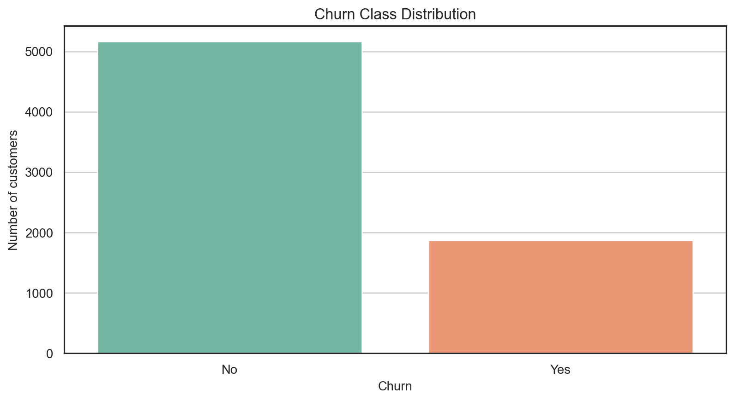
Dataset and target
Telco Customer Churn dataset after cleaning
7,043
7,032
11
original observations
cleaned observations
blank TotalCharges rows
26.58%
21
0 / 1
churn rate
original columns
target label
Because roughly one quarter of customers churned, a majority-class model can look acceptable by accuracy while failing the practical objective.
Customer churn prediction | 03

Slide 4
Workflow
A reproducible pipeline from raw customer table to selected model
01
Cleaning
02
EDA
03
Feature engineering
Convert TotalCharges, remove 11 missing rows
Inspect churn patterns across service and contract variables
Summarize services, tenure bands, payments, charges
04
Preprocessing
05
Model comparison
06
Tuning
Scale numeric fields and one-hot encode categoricals
Evaluate multiple classifiers on same split
Optimize Random Forest and Gradient Boosting for F1
Evaluation focus: precision, recall, F1-score, ROC-AUC
Customer churn prediction | 04

Slide 5
Exploratory findings
Churn risk is visibly connected to contract commitment, support services, payment behavior, and tenure.
Contract
Month-to-month customers churn more often
Month-to-month contracts show higher churn.
Customers without online security or technical support churn more.
Support
No tech support / online security increases risk
Electronic check payment is associated with higher churn.
Shorter-tenure customers are more vulnerable.
Payment
Electronic check users stand out as higher risk
These patterns motivated engineered variables such as service counts, automatic payment, contract indicators, and tenure groups.
Customer churn prediction | 05

Slide 6
Model comparison
The selected model balances precision and recall for the churn class
Model
Precision
Recall
F1
ROC-AUC
Logistic Regression
0.6361
0.5374
0.5826
0.8342
Decision Tree
0.4991
0.7754
0.6073
0.8173
Gaussian NB
0.4654
0.8102
0.5912
0.8088
Tuned Random Forest
0.5143
0.7701
0.6167
0.8333
Takeaway
The tuned Random Forest produced the best final F1-score while preserving high churn recall. That means more actual churners are detected, at the cost of more false positives.
Customer churn prediction | 06

Slide 7
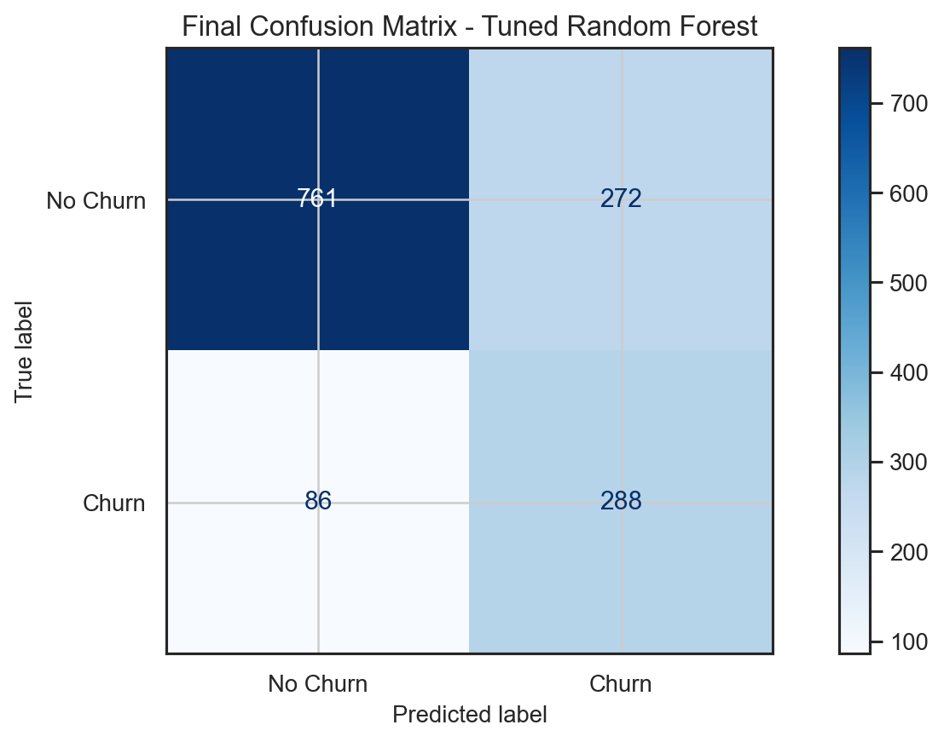
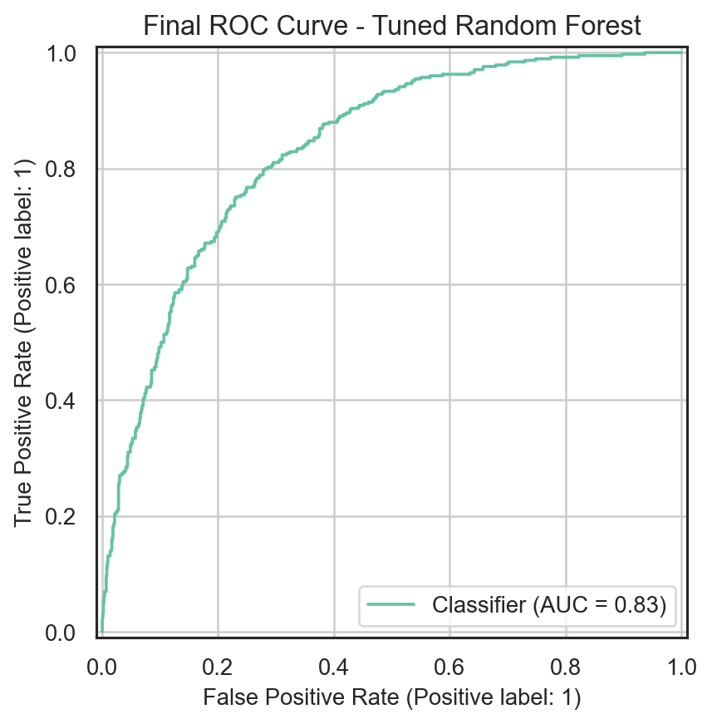
Final tuned Random Forest
The final model detects 77% of actual churners on the test set.
0.7456
0.5143
0.7701
accuracy
precision
recall
0.6167
0.8333
400
F1-score
ROC-AUC
trees
This is a retention-friendly trade-off when contacting extra at-risk customers is acceptable.
Customer churn prediction | 07

Slide 8
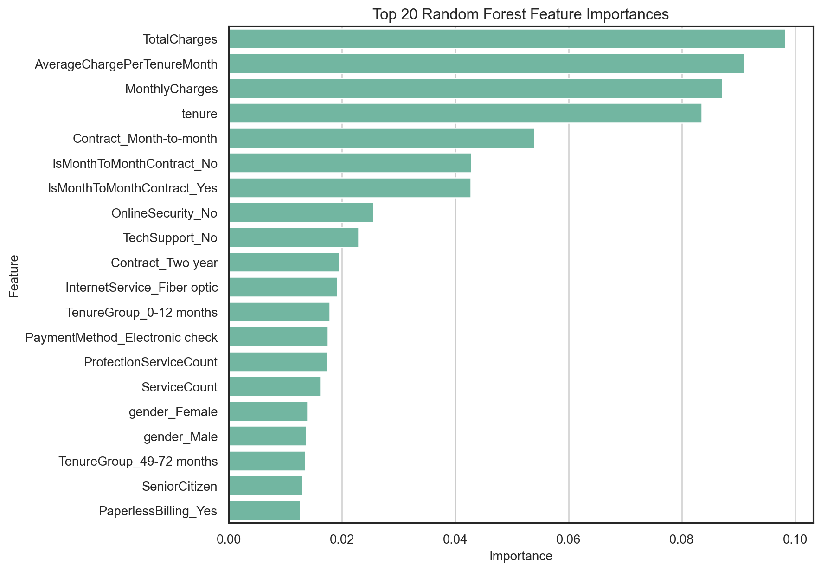
Interpretation and next steps
The strongest churn signals are interpretable and useful beyond prediction.
Consistent indicators
Contract type and tenure
Support and security services
Payment method
Billing intensity
Future improvements
Time-based customer behavior
Cost-sensitive threshold tuning
Calibration and scoring demo
Customer churn prediction | 08

