Slide 1

Can Machine Learning answer questions in Ornithology?
Hristo Georgiev
Supervisor: Dr Simon Rogers

Slide 2

Aims
Do birds develop regional variations of their song?
Is the frequency domain sufficient to answer the question?

Slide 3

What is Machine Learning?
Learn from data
Perform analysis or make predictions

Slide 4
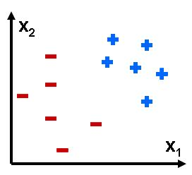
The Classification problem
training set
unseen examples
?
?
x1, x2 are features
'+', '-' are classes

Slide 5

k-Nearest Neighbours
nearest neighbour (k=1)
predict class
?

Slide 6
Logistic regression
decision boundary
predict class
?

Slide 7
Experiments
1
B
regions: A, B
species: 1, 2
comparisons: 1A-2A,2A-2B,1A-1B,2A-2B
hypothesise that: sim(1A-2A)>sim(1A-1B)
sim(1B-2B)>sim(2A-2B)
2
A
1
1
1
2
2
2
1
2
1

Slide 8
Load as a sequence of samples
Data set
A set of WAV recordings
Fast Fourier Transform
Fast Fourier Transform
A set of frequency components
Feature extraction
Scoring function
Feature selection
for each comparison pair
A reduced feature set
Binary classification
A set of predictions
}

Slide 9
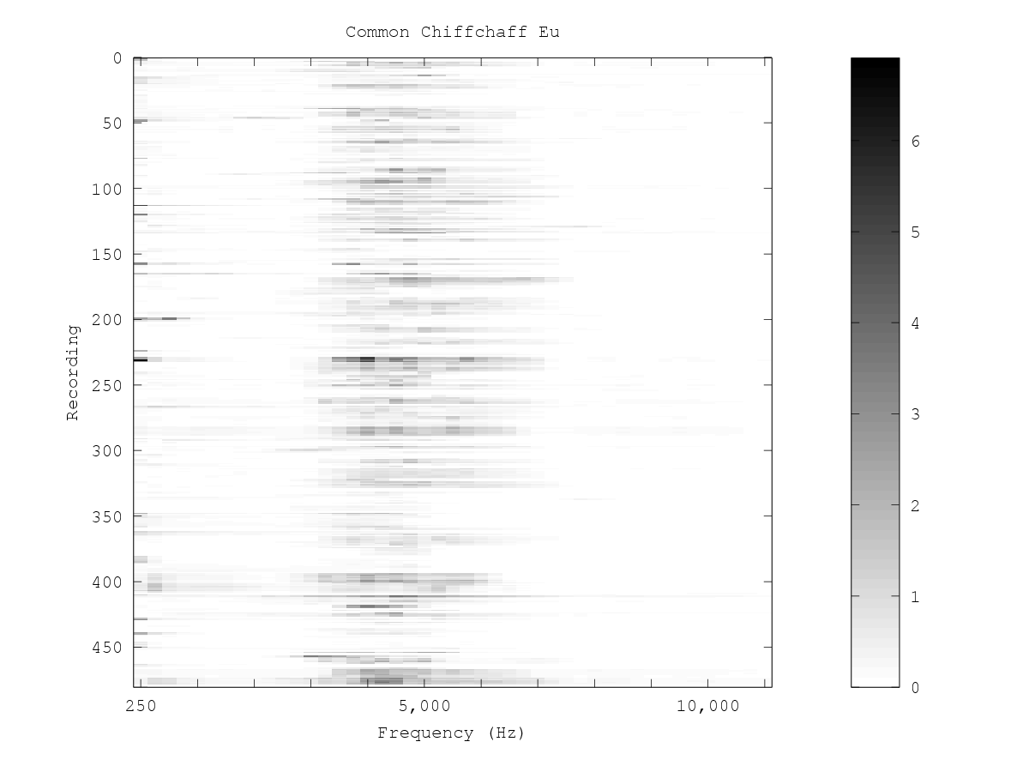

Dimensionality reduction (1)
Scoring function:
perform Logistic
Regression
FFT size/2
100 dimensions

Slide 10
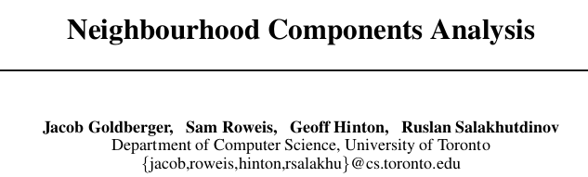
Dimensionality reduction (2)
perform kNN
100 dimensions
2 dimensions

Slide 11
Binary classification
A set of predictions
Test set
Performance score
(Accuracy, ROC area etc.)
A single-valued indicator of dissimilarity

Slide 12




Function of bird song (1)
Yes,the weather is really nice today
Check that chick out!
Information transmission:
Food calls
Alarm calls

Slide 13
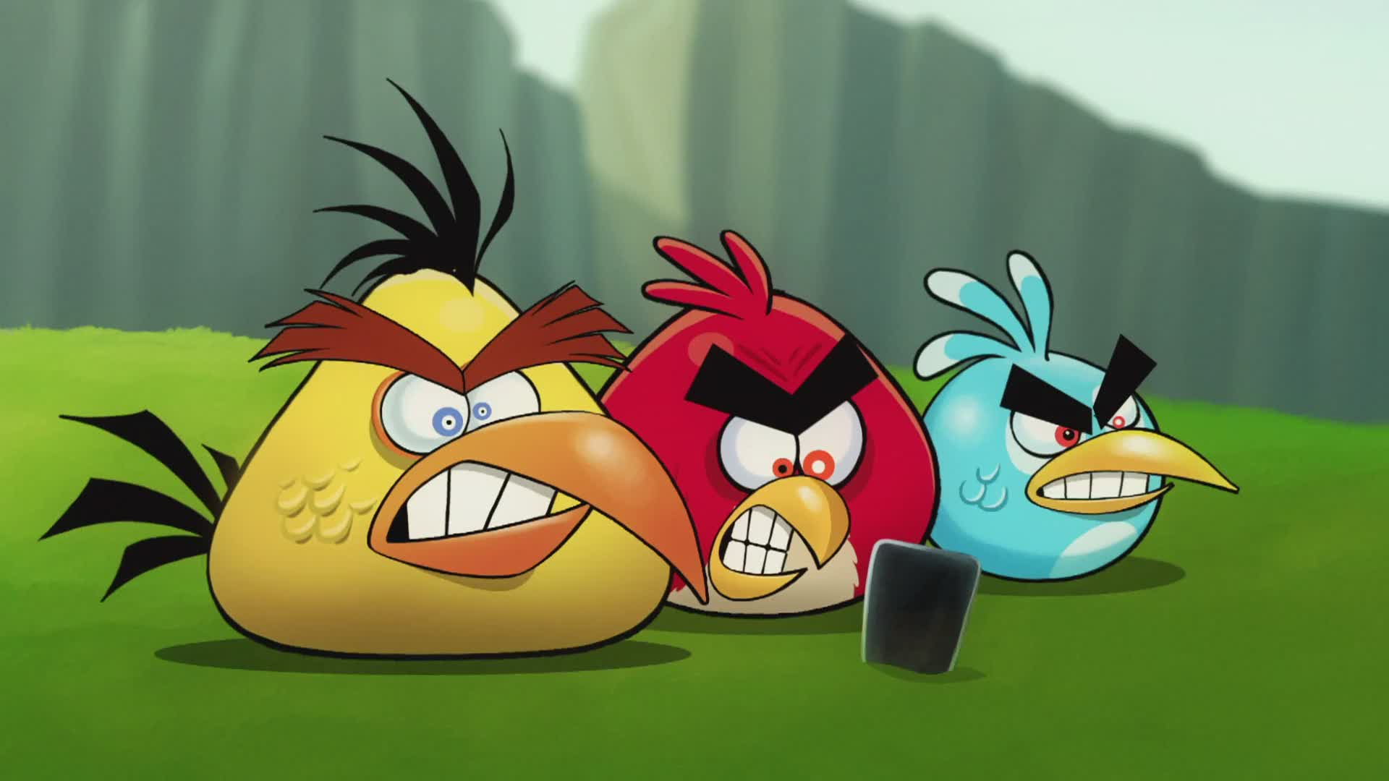
Function of bird song (2)
This means
WAR!

Slide 14

Function of bird song (3)

Slide 15



Function of bird song (4)

Slide 16

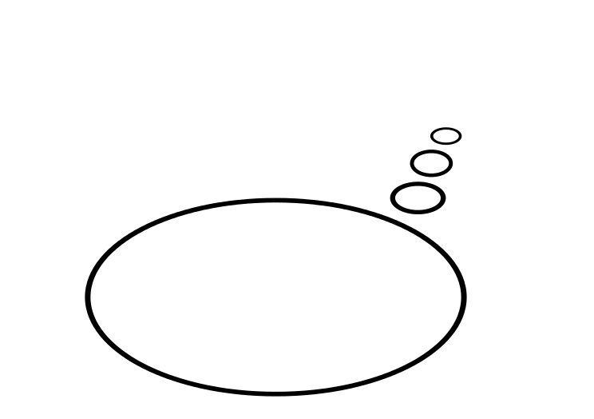
Habitat influences (open habitat)
It's so much fun to fly and sing at the same time!
mean freq.

Slide 17

Habitat influences (forest habitat)
We prefer singing near or on the ground!
'sound window'
mean freq.

Slide 18

Other factors (e.g. isolation)
the middle of
nowhere
the rest of
the world
There is less competition from related species here...

Slide 19
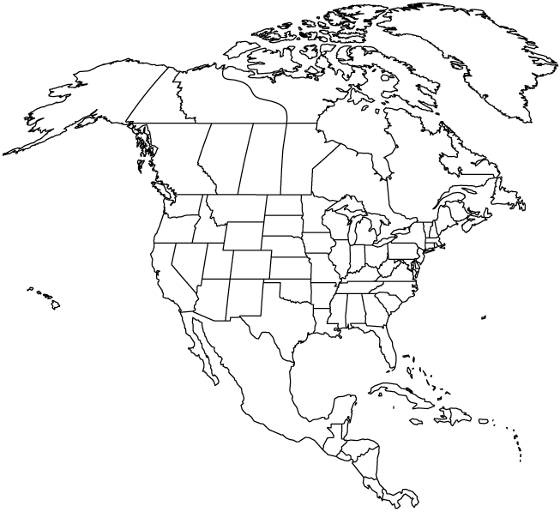

Experiments
1 – Fox Sparrow
2 – MacGillivray's Warbler
2
1a
2
2
1c
1a
2
1c
1a
1c
1b
1c

Slide 20
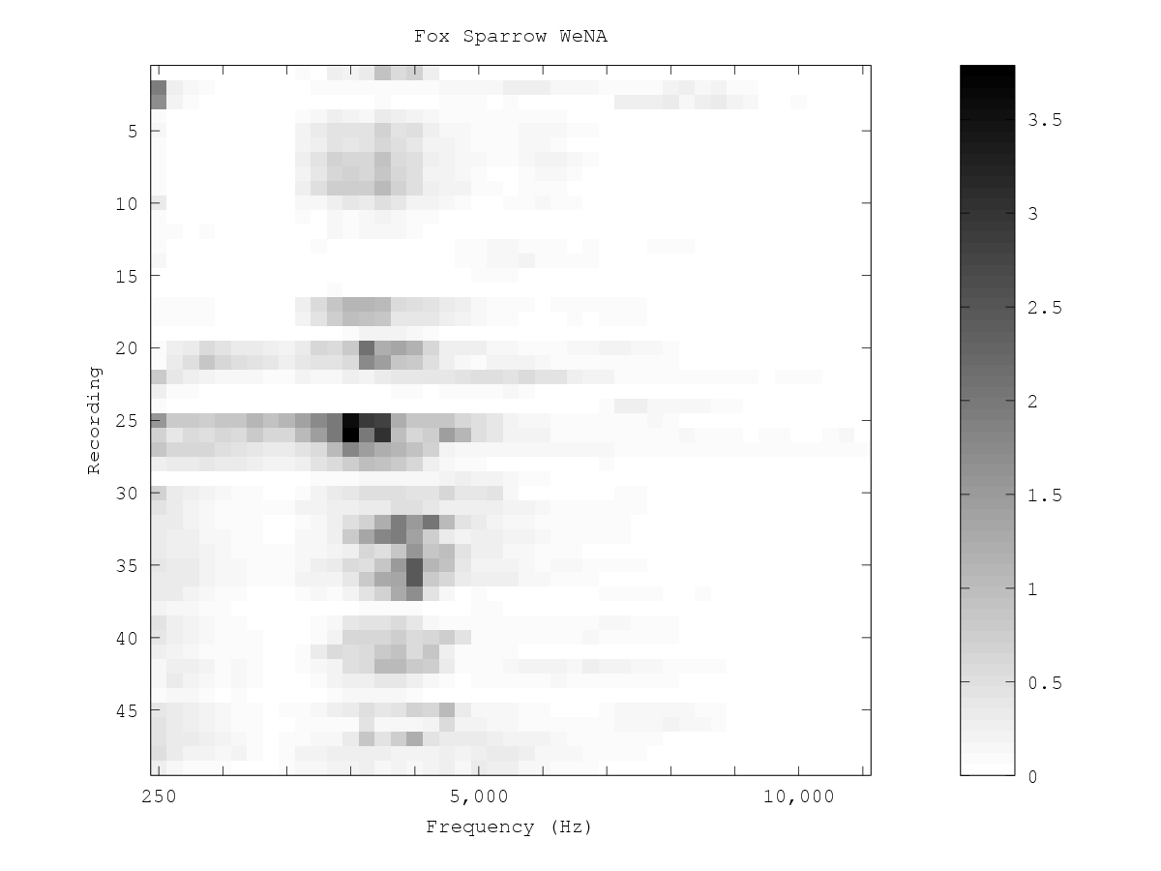
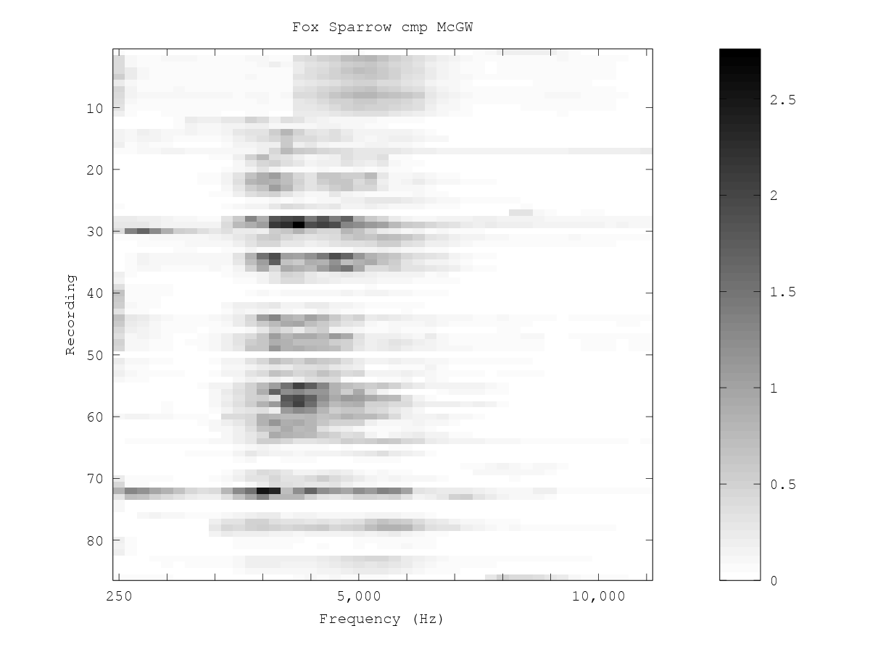
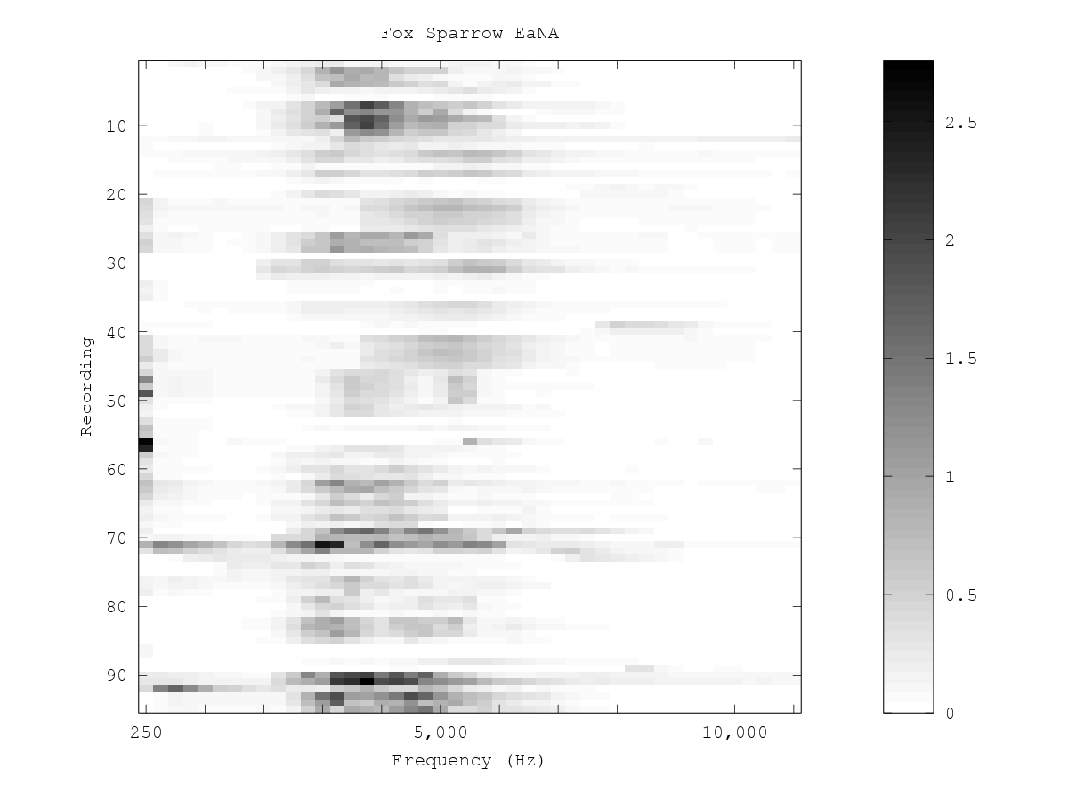
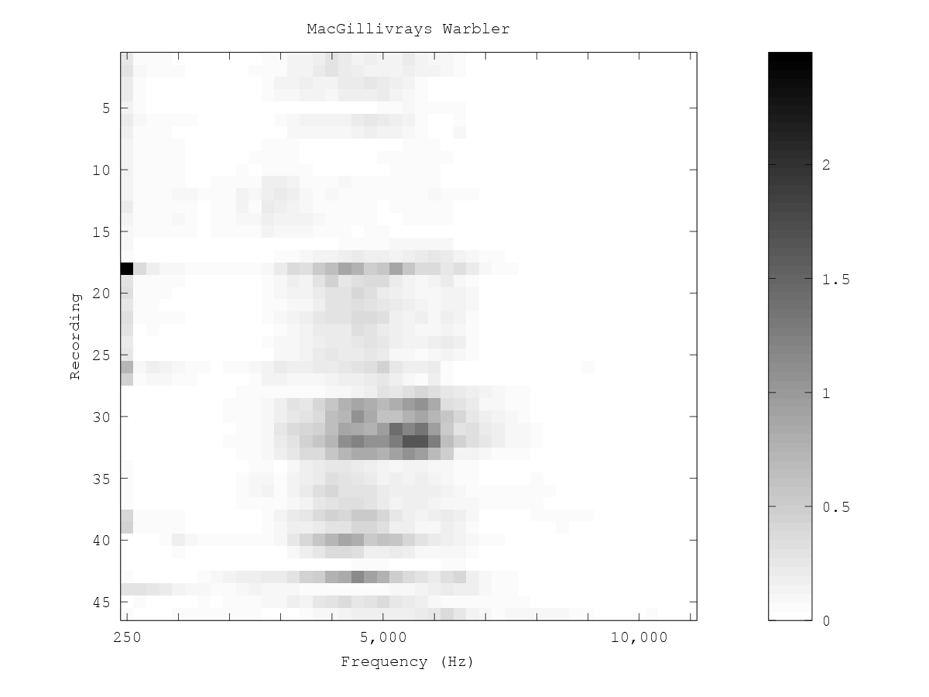
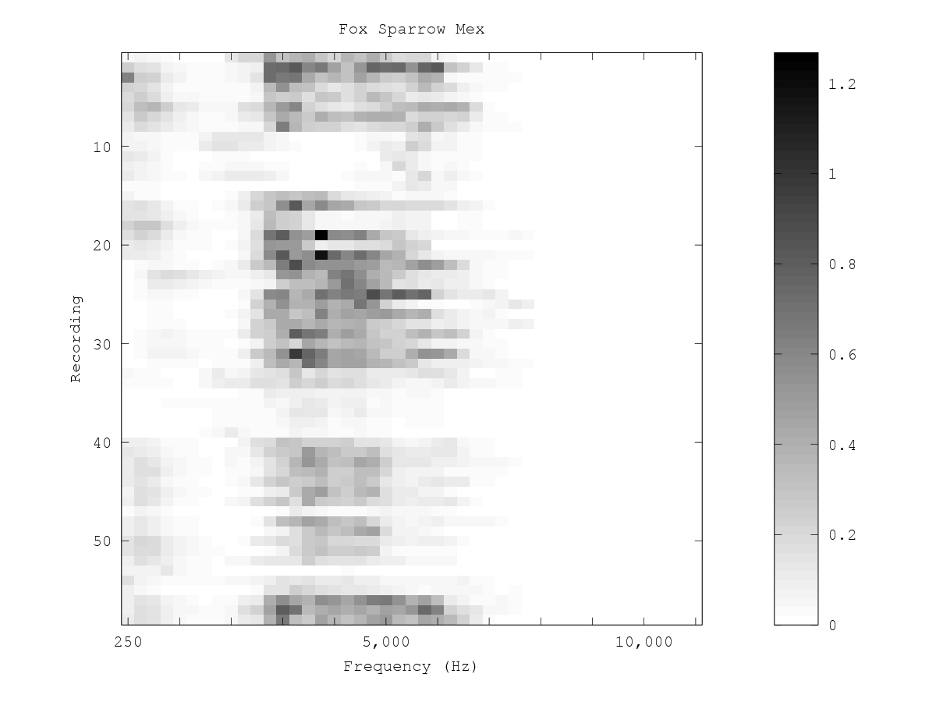
Results (best 100 features)
1a'
1a
1c
Class 1
2
1c
1b
Class 2
NCA:
LR:
0.28
0.23
0.19
0.21
0.07
0.02

Slide 21
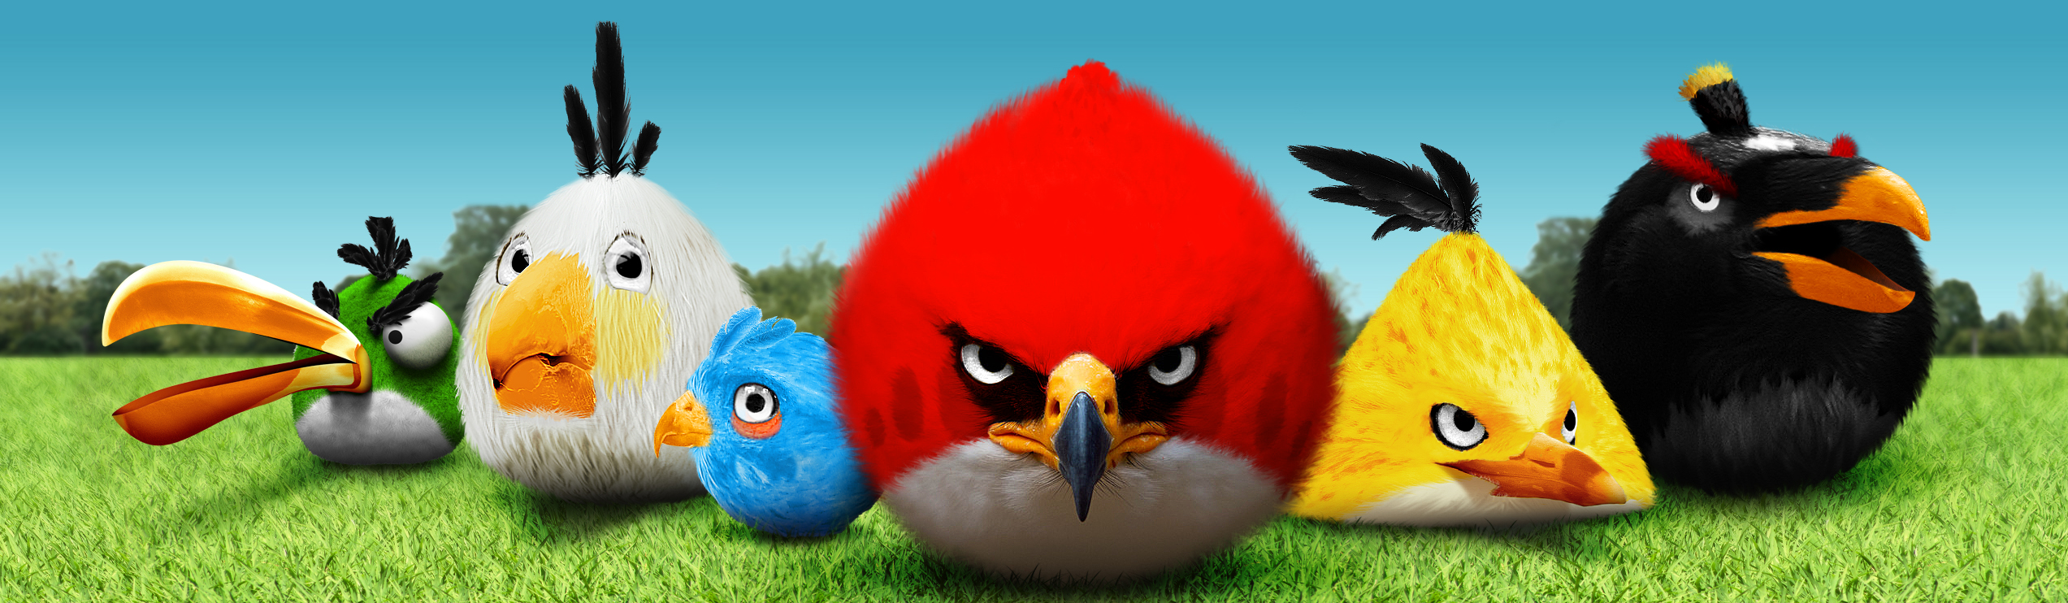
Thank you!
Questions?

