Slide 1
Goodreads
IT Talents Season 14
Final Project

Slide 2
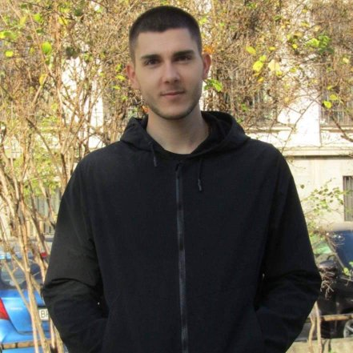
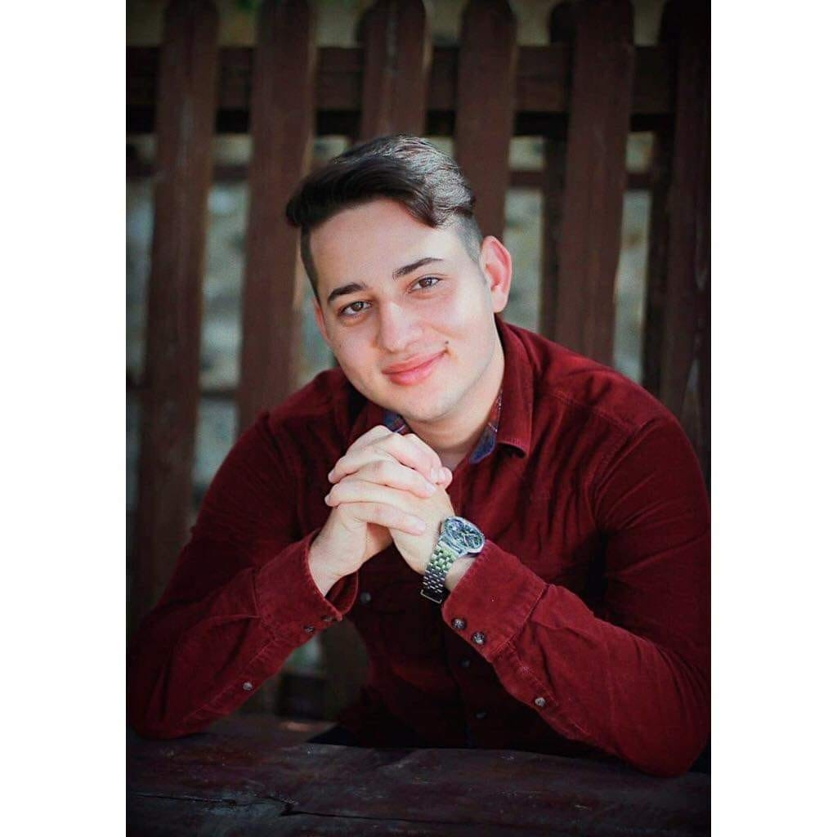
Who are we?
Александър Бузов
Христо Мангарудов
Cadets in IT Talents season 14

Slide 3
Goodreads Project
Main Functionalities:
Register
Login
Logout
Edit profile
Book search
Book browsing
Filter with all categories
Book review page including -
detailed book description
rating
comments
Add rating/review
Bookshelf with respective read,want to read and read shelves for user books

Slide 4










Goodreads Project
Used Technologies:

Slide 5
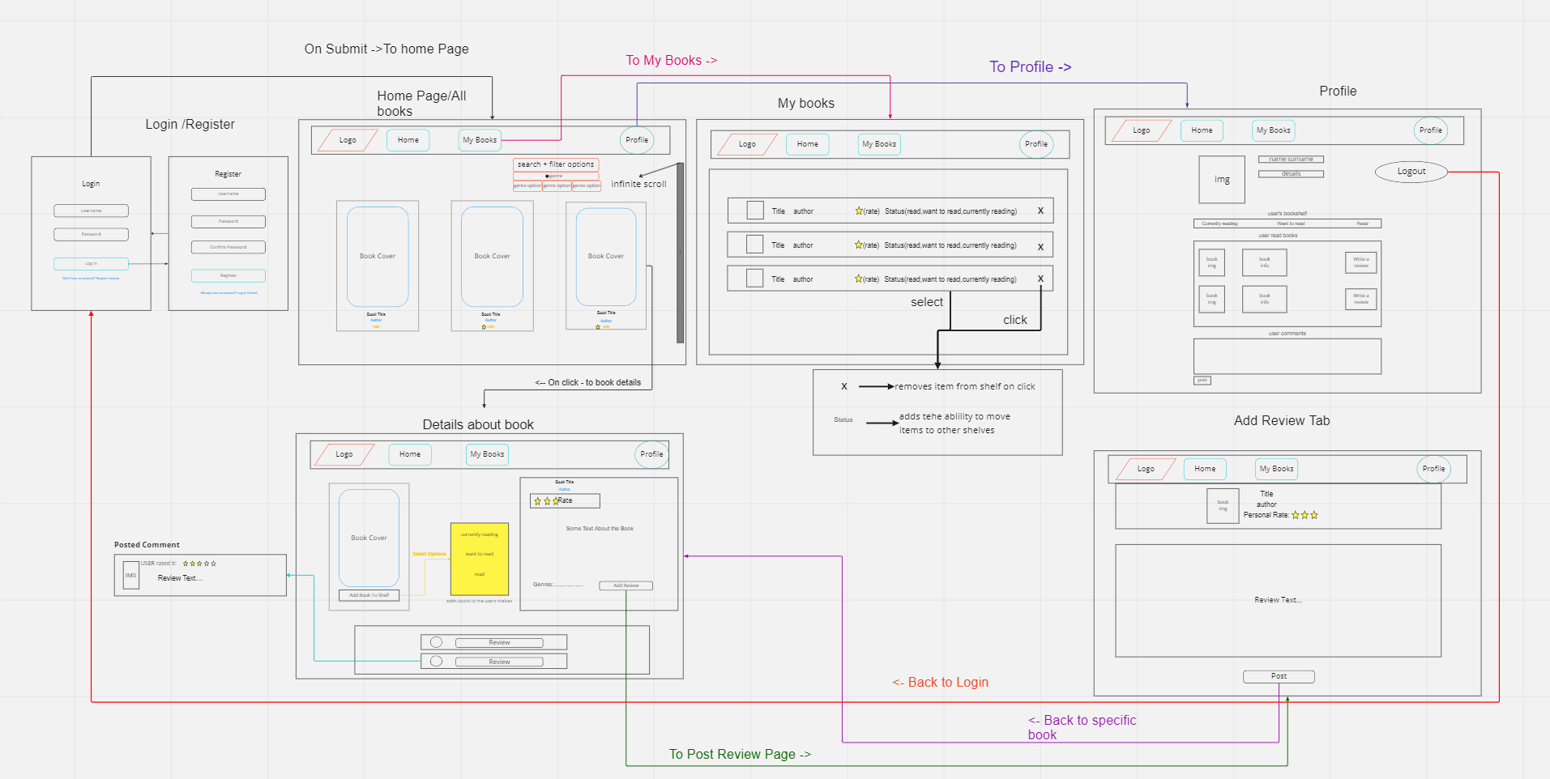
Link to miro wireframe: https://miro.com/app/board/uXjVPO7vrZw=/?share_link_id=438929078335

Slide 6
DEMO

Slide 7
Code review
&
Questions

Slide 8
Thank you for the attention

