Slide 1

DodoFlight
Hristo Vasilev

Slide 2
Overview
DodoFlight empowers the consumer to make an offer to the airline, not the other way around.
Notes:
One-sentence “wow!” explaining exactly, tactically what you do. There should be no question about what business you are in and who your customer is after this sixty-second description.

Slide 3
Status Quo
The major airline travel aggregator websites – Expedia, Priceline, etc. – supply aggregators
Airline Inventory Flow
Airline
Reservation
System
Global
Distribution
System
Online
Travel
Agency
Notes:
Explain the pain you solve or opportunity you exploit

Slide 4
Problem
Demand is heterogenous
Different willingness to pay
Various time flexibility
Diverse flight requirements
Disparate ability to pay
Notes:
Explain the pain you solve or opportunity you exploit

Slide 5
Opportunity
$160B airline passenger revenue
Gross bookings
Expedia.com - $30B
Priceline.com - $30B
Notes:
Explain the pain you solve or opportunity you exploit

Slide 6
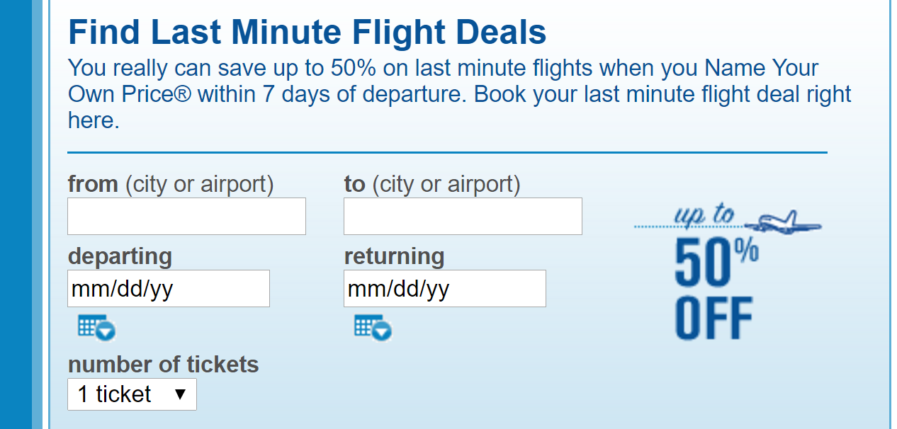
Competition
Priceline - Name Your Own Price®
Notes:
Assume that the audience knows as much, and maybe more, about the segment as you do. If you say “we have no competition,” it usually means that you’re either (a) clueless or (b) addressing a market that doesn’t exist.
The reason why you want to show what you can’t do is to build your crediblity. If you’ll admit how your competition is better than you, people are more likely to believe you when you discuss how you’re better than your competition.

Slide 7
Feedback
“I entered a "Name Your Own Price" bid into Priceline for a hotel and overbid due to changing stars and mistakenly leaving the same price. Right after the bid was accepted, I used Google to see that Hotels.com had the same hotel for 25% less. After spending over an hour on chat and telephone, as well as sending screen shots of the booking that was cheaper, they refused to lower the price and they also refused to cancel the reservation.”
D. of Charlotte, NC on May 17, 2017
Notes:
What makes you special? Why will you win? What are your unfair advantages? Why is the field tilted in your direction? It can be technology, relationships, founders.
“We’re smart, hardworking, and really believe” doesn’t cut it. Everybody says that. Hightly unlikely that it’s patents too.

Slide 8
Solution
Aggregate demand
Consumer
Convenience
Bargaining power
Airline
Reduce uncertainty (demand monitoring)
Maximize revenue (capacity optimization)
Notes:
Explain the pain you solve or opportunity you exploit

Slide 9
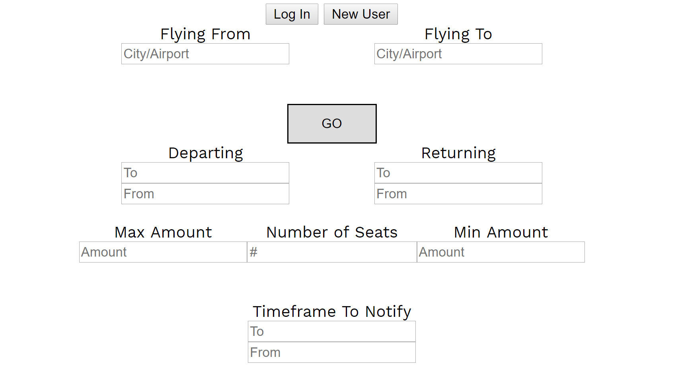
Interface
Notes:
This is the place to do a demo. Ten minutes is long enough. Try not to get sucked into a long demo so you can’t finish your presentation.

Slide 10
Business Model
Agency – an intermediary connecting a traveler with an airline
1.9% of booking value
Subscription fee for airlines
No cost of goods sold
(Pricing)
(Value of each customer)
(Customer acquisition cost)
Notes:
How will you make money? Don’t show multiple revenue streams and don’t try to make the point that you’re inventing a new way to make money. Take your best shot and run with it. The most important thing to explain is the assumptions in your business model and how they determined the financial projections in the previous slide.

Slide 11
Thank you
BLUE 1647
Kara
Jerliyah
Asha
Oscar
Notes:
How will you make money? Don’t show multiple revenue streams and don’t try to make the point that you’re inventing a new way to make money. Take your best shot and run with it. The most important thing to explain is the assumptions in your business model and how they determined the financial projections in the previous slide.

Slide 12

Thank you
Notes:
How will you make money? Don’t show multiple revenue streams and don’t try to make the point that you’re inventing a new way to make money. Take your best shot and run with it. The most important thing to explain is the assumptions in your business model and how they determined the financial projections in the previous slide.

