Slide 1
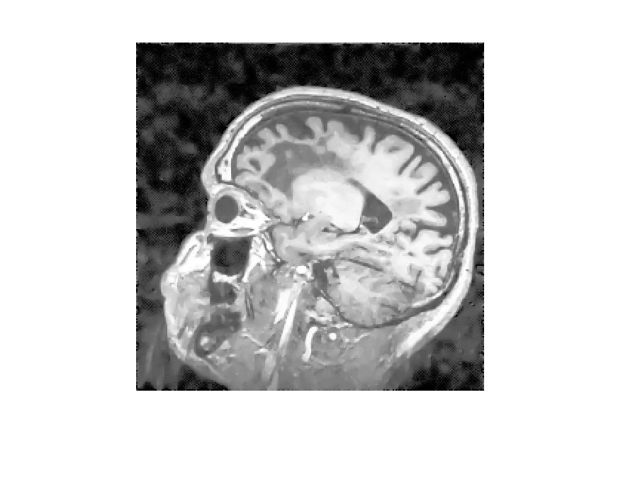
Location of Brain Tumor
Tumor

Slide 2
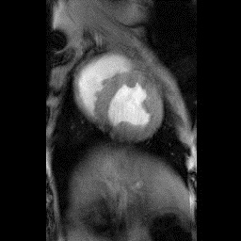
Heart Chambers
Heart chamber
Heart chamber

