Slide 1

DAYANANDA SAGAR COLLEGE OF ENGINEERING
DEPARTMENT OF ELECTRONICS AND COMMUNICATION
Mini Project Work (18EC6ICMPR)
Presentation on
AUTOMATED TEMPERATURE DETECTING ENTRANCE SYSTEM FOR COVID SAFETY
BATCH NO. - D16
USN NAME
1DS18EC731 Adarsh Ku. Panda
1DS18EC735 Himanshu Sarad
1DS18EC736 Hritambh Hritvij
1DS18EC747 Pradhumn Porwal
Under the guidance of
Prof. Kumar P
Assistant Professor, Dept. of ECE

Slide 2

CONTENTS
1. Introduction
2. Objective
3. Literature survey
4. Existing technology
5. Problem Statement
6. Block diagram and Implementation
7. Results
8. Conclusion
9. Future scope
10. References

Slide 3
INTRODUCTION
Temperature checking and Social distancing have become an integral part of post-covid society in malls,restaurants or offices.
In this project we attempt to simulate an automated temperature detection entrance system that regulates the entry of people inside a premises based on Government protocol.
We make use of a PIR sensor to detect the entrance of a person, when the project detect movement it will check the temperature of the person if the temperature is less than the set temperature the person is allowed entry otherwise the entry is denied. The number of people allowed inside the premises can also be controlled by this system.

Slide 4
OBJECTIVES
To allow automatic contactless temperature screening of a person at the entrance of a facility.
2. To control the number of persons allowed inside the facility at a given time.
3. To display the access status and people count status using an LCD.
4. To configure the temperature standards and people count as required.

Slide 5
LITERATURE SURVEY
The pandemic situation relies on a contact less temperature estimating and door (gate) access framework utilizing the MLX90614 sensor alongside Arduino.
Santosh Panchel has reported "Automatic opening and closing of door” implemented system using PIC(16F72) and PIR sensor.
Baina Kiran has reported "Motion Based Automatic Garage Door Opener" .This project gave an insight into designing of an automated door just by using IR sensors .This helped in reducing the cost spent in construction of automated doors.
In our project we propose an efficient temperature detection system that can function in an automated way using Arduino UNO.

Slide 6
LITERATURE SURVEY
While implementing the system some assumptions were made as follows:
It is assumed the PIR sensors are mounted in such a way that it will detect the arrival of a person.
There is a suitable delay between successive temperature measurement cycle.
The person stands close to sensor to perform the function.
The people are standing in a queue such that one person enters or leaves at one time.

Slide 7
EXISTING TECHNOLOGY
Security guards are employed to monitor temperature of people using a hand held temperature gun or IR thermometer.
Automatic door opening and closing system in public places.
Sensor- based automatic door control technologies include infrared, ultrasonic/radio, or other wireless sensing methods.

Slide 8
PROBLEM STATEMENT
Social distancing and temperature screening have become common in all public places.
The temperature screening is at present being done physically and there is a high possibility of cross disease.
Manual temperature screening requires human force and there is likewise a danger that the individual leading the temperature screening may get contaminated.
Solution:
This prototype attempts to assist in playing out a contact less temperature detecting entryway opening framework.
This decreases the reliance of individuals on the watch and guarantees the wellbeing of the watchmen and furthermore accelerates the cycle.

Slide 9
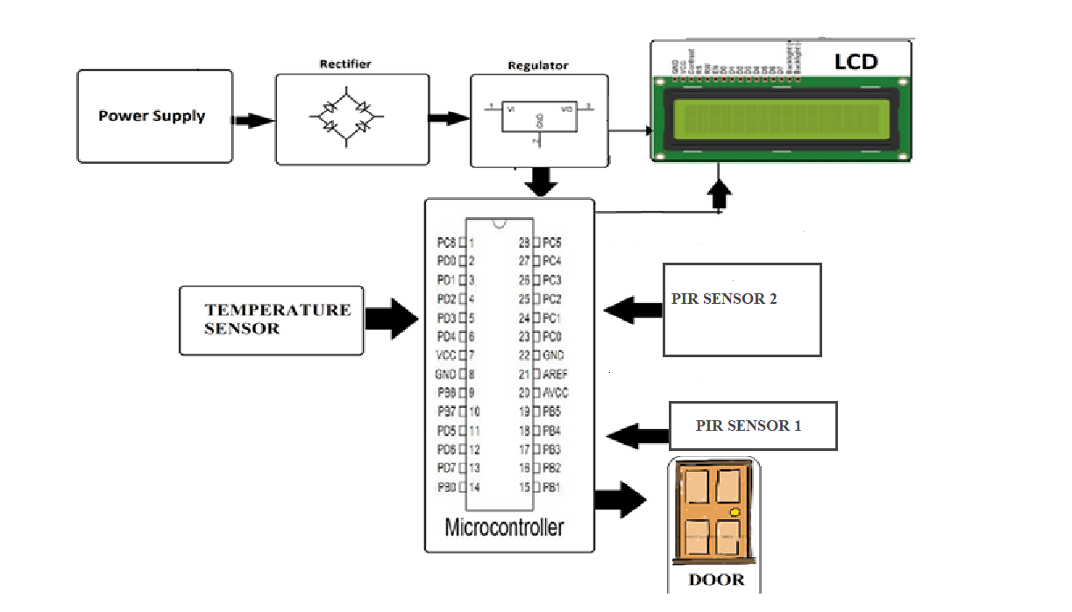
BLOCK DIAGRAM
Components Required: Block Diagram:
Ardruino UNO
mlx90614 sensor
PIR sensor
Servo Motor
LCD Display
Resistors
Capacitors
Cables and Connectors
Breadboard
Jumper Cables
Buzzer

Slide 10
IMPLEMENTATION
Working:
The PIR 1 sensor upon detecting movement at the gate sends feedback to the
mlx90614 sensor to check the temperature.
Incase the temperature of the person is above 37.2° C, the door remains closed and access is denied.
If the temperature is below 37.2° C, the arduino checks the people count inside the premises.
If the people count inside the premises is less than the maximum allowed capacity, the door opens and the user is granted access.
If a person is leaving the premises,the PIR 2 sensor detects its motion and the door opens.

Slide 11
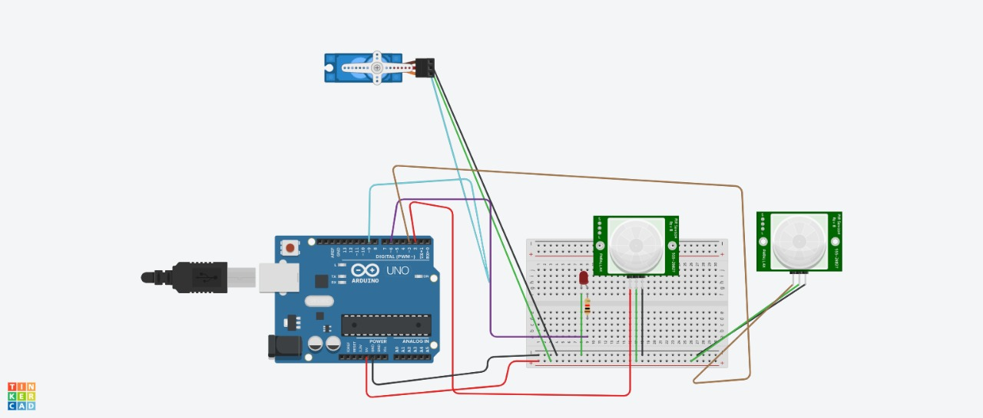
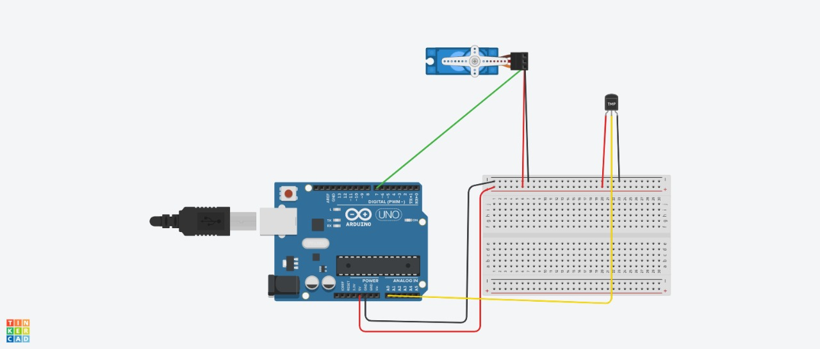
IMPLEMENTATION
Our prototype is divided into three sub-systems:
1. PIR sensor circuit
2. mlx90614 temperature sensor circuit
3. LCD display circuit
PIR Sensor Circuit:
Temperature Sensor Circuit

Slide 12
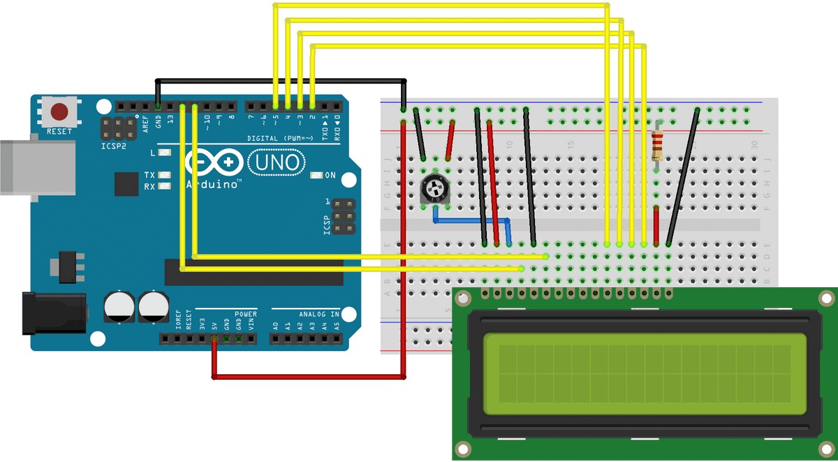
IMPLEMENTATION
LCD Circuit :

Slide 13
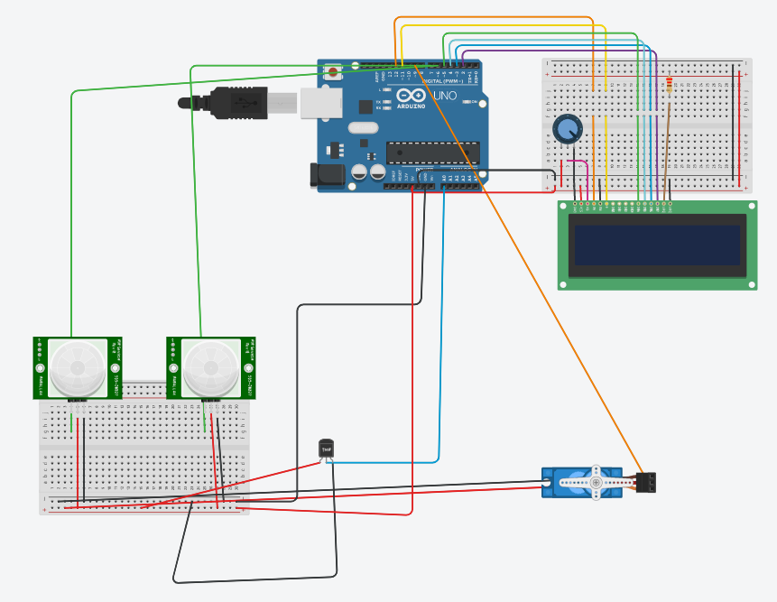
IMPLEMENTATION
Complete Circuit

Slide 14
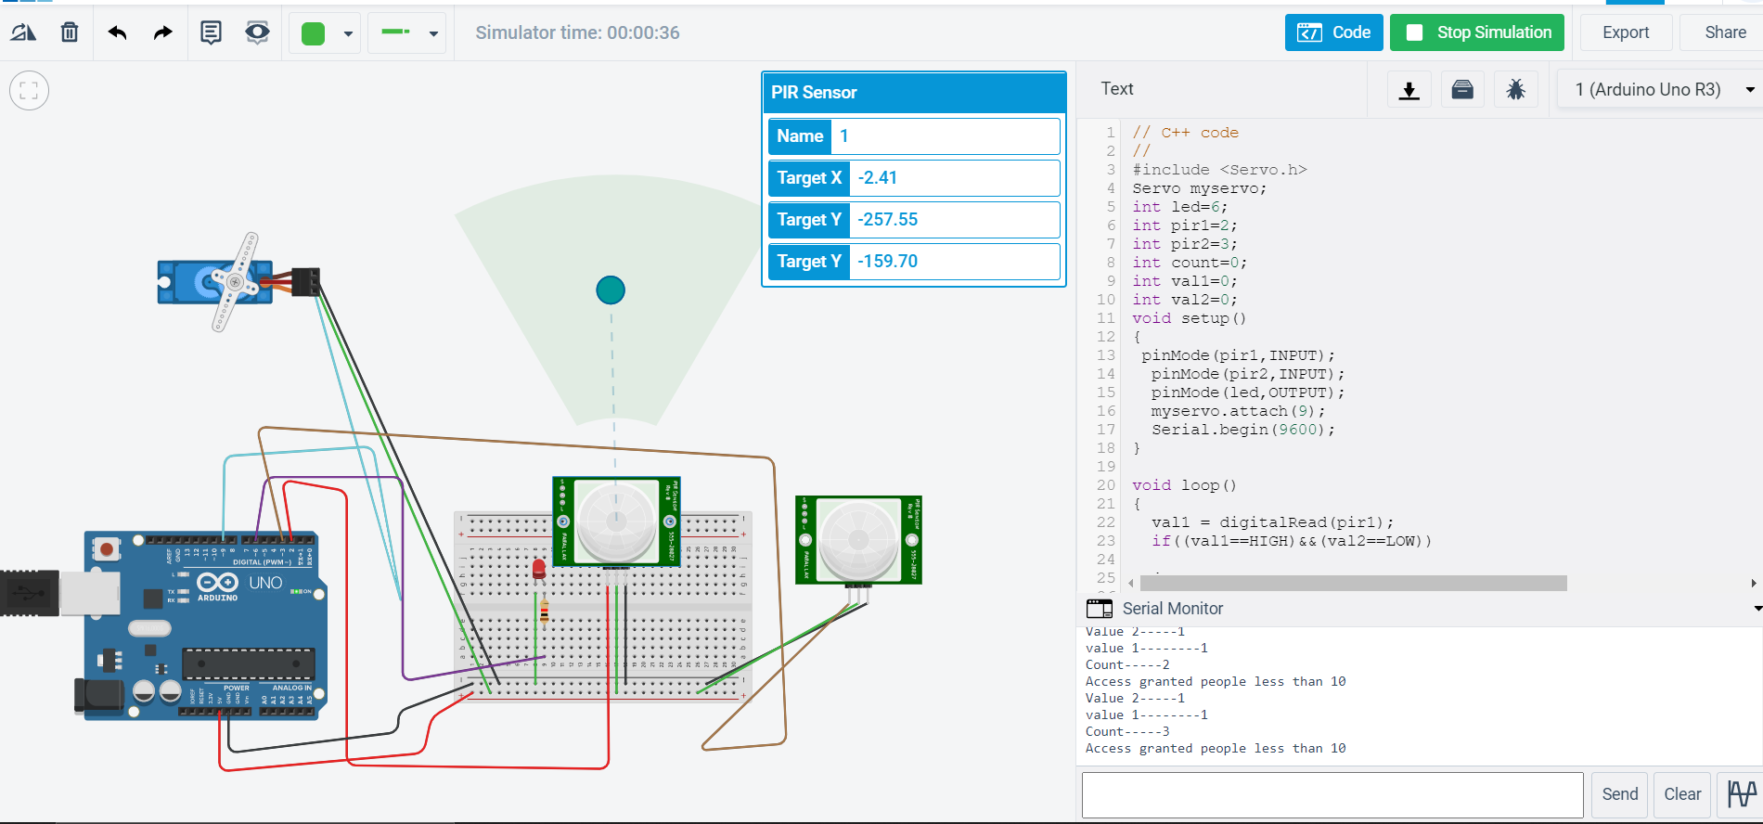
RESULTS
PIR sensor output

Slide 15
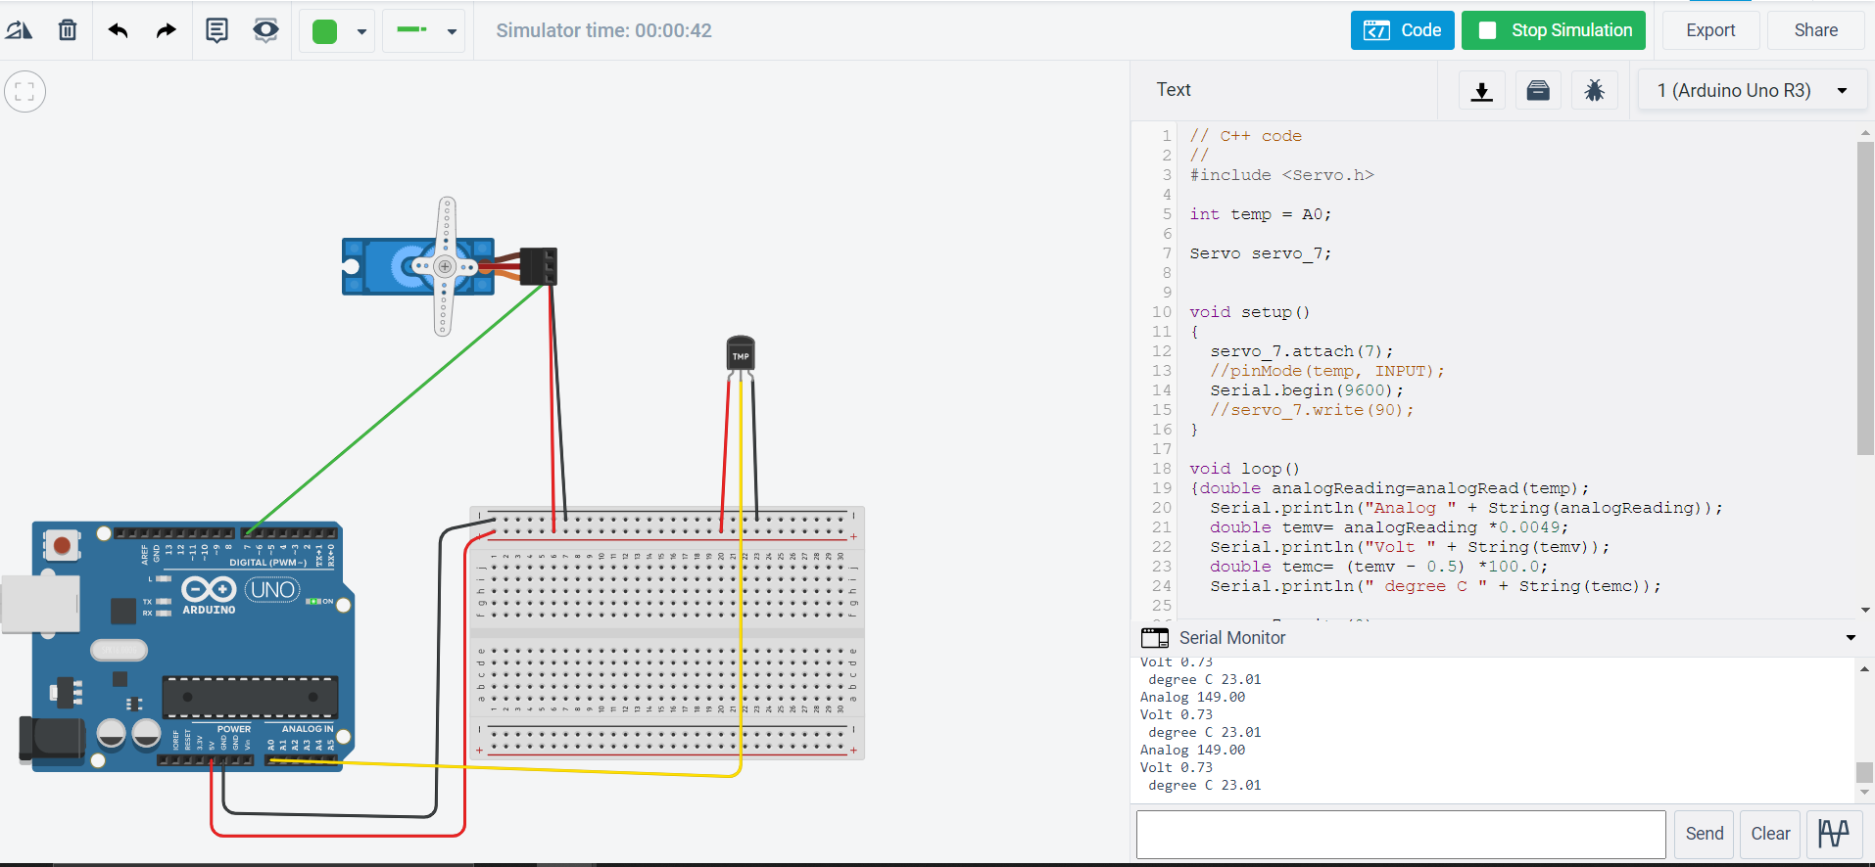
RESULTS
Temperature sensor output

Slide 16
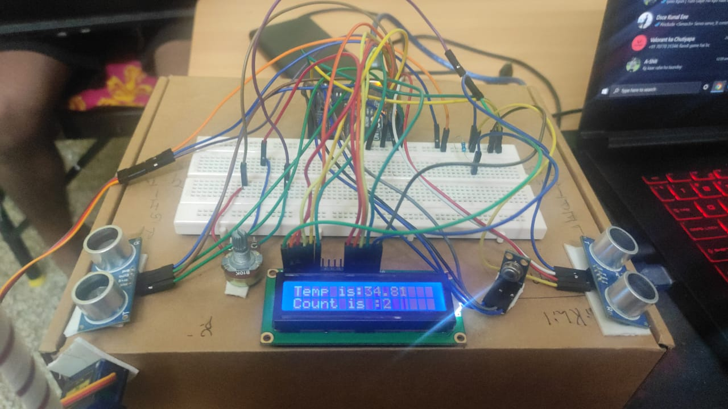
RESULTS
Hardware

Slide 17
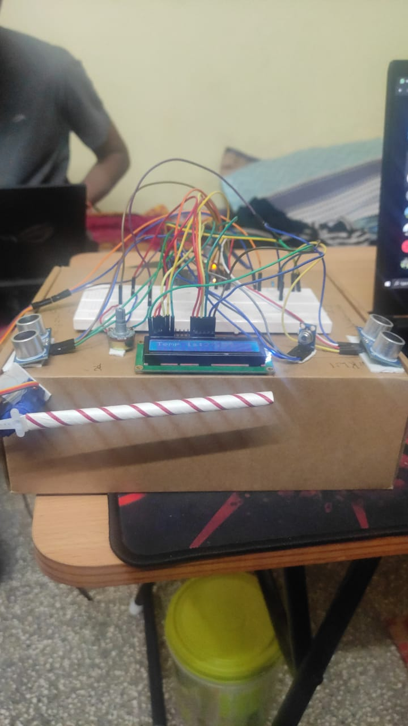
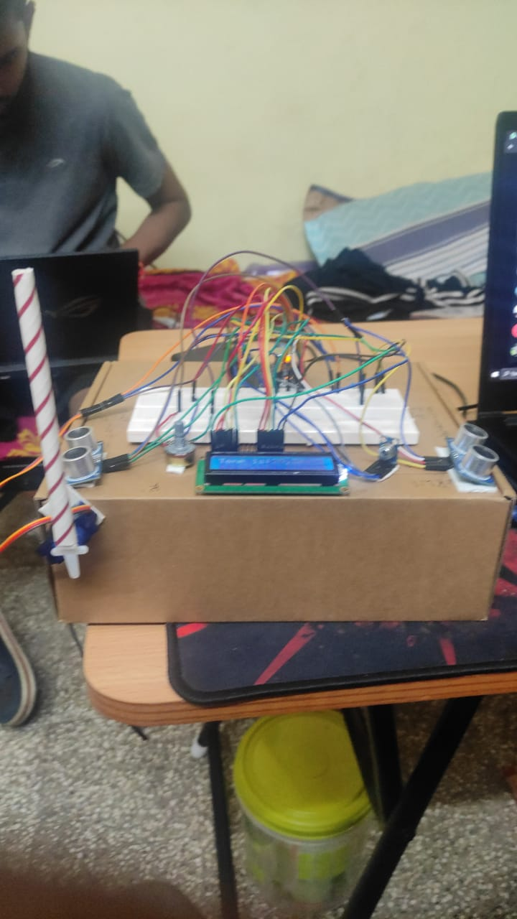
RESULTS

Slide 18
CONCLUSION
In the review , we have achieved the desired results from the PIR sensors that serve as human detection system and the mlx90614 sensor that serves as the temperature detection system. The above results were simulated using TinkerCAD platform.
The prototype was tested with different sets of data and expected output was observed.
This framework empowers a completely programmed contactless temperature evaluating for a door (gate) access that limits the dangers of spread of infection utilized in the current strategies for screening.
The manual framework wherein observing was required, required heaps of cash to keep up and were costly, utilizing the above prototype the users can reduce the expense and reliance on the manual framework.

Slide 19
FUTURE SCOPE
Our prototype can be extended to implement:
1. A face mask recognition system at the entrance by using Computer Vision.
2. An automatic hand sanitizer dispener before entry into the premises.
3. A social distance monitoring system using ultrasonic sensor.
The ultimate goal is to achieve a system with efficient preventive measures in this pandemic. Risk assessment using our prototype and its extensions along with proper security personnel scheduling will help us achieve this task.
A far fetched aim of this prototype is to research ways to extend this solution to environment sensing mechanisms for adaptive building air conditioning and ventilation airborne protection in order to reduce the spread of coronavirus indoors.

Slide 20
REFERENCES
[1] Swapnil Kumbhar , Kartikraj Patil , Shubham Lohar , Vyankatesh Bhongale, A. R. Patil, 2021, Thermal Controlled Contactless Smart Door System and Touchless Sanitizer, INTERNATIONAL JOURNAL OF ENGINEERING RESEARCH & TECHNOLOGY (IJERT) Volume 10, Issue 05 (May 2021)
[2] Goda Vasantharao et al., "Temperature Detection and Automatic Sanitization and Disinfection Tunnel-COVID 19", The International journal of analytical and experimental modal analysis, June/2020.
[3]Baina Kiran et al., "Motion Based Automatic Garage Door Opener" International Journal of Engineering Trends and Applications (IJETA) Volume 5 Issue 2, Mar-Apr 2018
[4] “IoT-based System for COVID-19 Indoor Safety Monitoring” by Nenad Petrović and Đorđe Kocić
https://www.researchgate.net/publication/343231422_IoT-based_System_for_COVID-19_Indoor_Safety_Monitoring
[5] D.S. Yawas et al "Development of an Automatic Door System" American Journal of Engineering Research (AJER) 2018

Slide 21
THANK YOU

