Slide 1
CY-6120: Software Security Practices
Module 5: Dynamic Analysis

Slide 2
Dynamic analysis is a method of evaluating software or systems by observing their behavior while they are running. It's also known as dynamic code analysis or dynamic program analysis.

Slide 3
You have used dynamic analysis before.
Where?

Slide 4
Testing
Unit Testing
Involves testing individual units or components of the software by executing them.
Checks for correct behavior by providing inputs and validating outputs.
Integration Testing
Tests the interactions between integrated units or components.
Also involves executing the code to ensure combined parts work together correctly.
Both unit testing and integration testing are forms of dynamic analysis because they require running the code to validate its functionality.

Slide 5
How Do We Know About Code Coverage Without Access to Source Code?
Code Coverage Metrics
Measure how much of the codebase is exercised during testing.
Typically expressed as a percentage of lines, branches, or functions executed.
Challenges Without Source Code
Traditional code coverage tools instrument the source code to track execution paths.
Without access to the source code, inserting instrumentation directly isn't possible.
Lack of source code limits the ability to map execution paths to specific code segments.

Slide 6
Partial Coverage
Binary Instrumentation
DynamoRIO, Intel PIN, or Valgrind can instrument binaries at runtime.
These tools insert instrumentation into the binary executable to monitor which parts of the code are executed.
May not provide as detailed information as source-level instrumentation.
Requires debug symbols for better accuracy.
Execution Profiling
Profilers: Use execution profilers that work at the binary level.
Collects information on function calls and execution frequency.
Offers less granular coverage data compared to source-level tools.
Symbolic Debugging Information
If the binary includes debugging symbols, some mapping between the executable and source code can be established.
Tools like objdump or nm to extract symbol information.

Slide 7
When to Use Dynamic Analysis, Static Analysis, Both, or Neither

Slide 8
When to Use Dynamic Analysis
Detecting Runtime Issues:
Memory Leaks and Errors: Tools like Valgrind detect memory leaks, buffer overflows, and invalid memory accesses.
Concurrency Problems: Identifying race conditions and deadlocks in multi-threaded applications.
Exception Handling: Ensuring that exceptions are properly caught and handled during execution.
Performance Profiling and Optimization:
Performance Bottlenecks: Profiling tools help identify slow functions or inefficient algorithms.
Resource Utilization: Monitoring CPU, memory, and I/O usage during runtime.
Security Testing:
Dynamic Application Security Testing (DAST): Tools like OWASP ZAP simulate attacks to find vulnerabilities like SQL injection or cross-site scripting (XSS).
Fuzz Testing: Feeding unexpected or random inputs to the application to uncover crashes or unexpected behavior.
Validating Functional Behavior:
Unit and Integration Testing

Slide 9
When to Use Dynamic Analysis
Advantages:
Real-World Scenarios: Observes how the application behaves in actual execution environments.
Detection of Complex Bugs: Finds issues that are not apparent through code inspection alone.
When to Prioritize Dynamic Analysis:
During testing phases to catch runtime errors before deployment.
For applications where performance and reliability are critical.
When dealing with multi-threaded or distributed systems.

Slide 10
When to Use Static Analysis
Early Detection of Code Issues:
Syntax and Semantic Errors: Identifying typos, incorrect use of language constructs, and potential bugs.
Code Smells and Anti-Patterns: Detecting poor coding practices that may lead to maintainability issues.
Security Vulnerability Identification:
Static Application Security Testing (SAST): Scanning source code for vulnerabilities like hardcoded credentials or insecure API usage.
Software Composition Analysis (SCA): Analyzing dependencies for known vulnerabilities (CVEs) in third-party libraries.
Enforcing Coding Standards:
Consistency: Ensuring the code adheres to style guidelines and best practices.
Automated Code Reviews: Integrating with development environments to provide immediate feedback.
Improving Maintainability:
Dead Code Detection: Finding and removing unused code.
Complexity Analysis: Identifying overly complex functions that may need refactoring.

Slide 11
When to Use Static Analysis
Advantages:
Early Intervention: Issues are caught during development before they become harder to fix.
Cost-Effective: Reduces the expense associated with fixing bugs found later in the lifecycle.
When to Prioritize Static Analysis:
Throughout the development process to maintain code quality.
In large projects where manual code reviews are impractical.
When regulatory compliance requires adherence to coding standards.

Slide 12
When to Use Both Static and Dynamic Analysis
Comprehensive Security Assessment:
Static Analysis: Finds vulnerabilities in the codebase and dependencies.
Dynamic Analysis: Identifies vulnerabilities that manifest during execution.
Quality Assurance:
Static Analysis: Ensures code quality and adherence to standards.
Dynamic Analysis: Validates that the application behaves correctly under various conditions.
Critical Systems Development:
Safety-Critical Applications: Aerospace, medical devices, automotive systems where failures can have severe consequences.
Continuous Integration and Deployment (CI/CD):
Automated Testing Pipelines: Incorporate both static and dynamic tests to catch issues at every stage.

Slide 13
When to Use Both Static and Dynamic Analysis
Advantages:
Maximum Coverage: Combining both methods provides a more thorough examination of potential issues.
Risk Mitigation: Reduces the likelihood of defects escaping into production.
When to Prioritize Both:
In environments where reliability and security are paramount.
When striving for high-quality software with minimal defects.
When development timelines allow for comprehensive testing.

Slide 14
When to Use Neither
Rapid Prototyping and Experimentation:
Focus on Concept Validation: Early-stage projects where the goal is to test ideas quickly.
Disposable Scripts or Tools:
One-Time Use Code: Simple automation scripts with limited scope and impact.
Resource Constraints:
Limited Time or Budget: Projects where the cost of analysis outweighs the benefits.
Hardware Limitations: Environments where analysis tools cannot be run due to technical restrictions.
Considerations:
Risk Acceptance: Understand and accept the risks associated with not performing analysis.
Impact Assessment: Ensure that potential failures will not lead to significant harm or loss.

Slide 15
Problems that appear during execution

Slide 16
Execution time problems
Runtime Errors and Exceptions
Null Pointer Dereferences: Occur when a program attempts to use an object reference that has not been initialized.
Example: Accessing methods or properties on a null object, leading to a NullReferenceException or segmentation fault.
Division by Zero: An error that arises when a number is divided by zero during program execution.
Example: Calculations where the divisor comes from user input or runtime data.
Invalid Type Casting: Happens when an object is cast to a type that it doesn't inherit from, causing a ClassCastException.
Example: Casting a parent class object to an unrelated child class.

Slide 17
Execution time problems
Memory Management Issues
Memory Leaks: Occur when a program allocates memory but fails to release it after use, leading to increased memory usage over time.
Example: Forgetting to free allocated memory in C/C++ programs or holding unnecessary references in languages with garbage collection.
Buffer Overflows: Happen when a program writes data beyond the boundaries of allocated memory buffers.
Example: Writing more data to an array than it can hold, which may lead to corrupted data or security vulnerabilities.
Dangling Pointers: Pointers that reference memory that has already been freed.
Example: Accessing a memory location after free() has been called in C/C++.

Slide 18
Execution time problems
Concurrency and Multithreading Issues
Race Conditions: Occur when the program's output depends on the sequence or timing of uncontrollable events like thread scheduling.
Example: Two threads modifying a shared variable simultaneously without proper synchronization.
Deadlocks: Happen when two or more threads are blocked forever, each waiting for the other to release a resource.
Example: Thread A holds Lock 1 and waits for Lock 2, while Thread B holds Lock 2 and waits for Lock 1.
Livelocks and Starvation: Situations where threads are active but unable to make progress due to resource contention.
Example: Multiple threads repeatedly give way to each other but none proceed with execution.

Slide 19
Execution time problems
Performance Bottlenecks
Inefficient Algorithms: Algorithms that have poor time complexity and cause slow execution.
Example: Using a quadratic time algorithm (O(n^2)) where a linear time algorithm (O(n)) is possible.
Resource Contention: Excessive use of CPU, memory, disk I/O, or network bandwidth that slows down the application.
Example: Multiple processes competing for limited resources, causing performance degradation.
Memory Thrashing: Occurs when there is excessive paging or swapping of memory to disk.
Example: Insufficient physical memory leading to constant reading and writing to disk.

Slide 20
Execution time problems
Input/Output and File Handling Errors
File Not Found Exceptions: Trying to access a file that does not exist or has been moved.
Example: Assuming a configuration file is present without checking its existence.
Network Errors: Timeouts, unreachable hosts, or dropped connections during network communication.
Example: Server downtime causing client requests to fail.
Permissions Issues: Inadequate permissions to read, write, or execute files or resources.
Example: Attempting to write to a read-only file system.

Slide 21
Execution time problems
Dynamic Dependency and Environment Issues
Missing Libraries or Modules: Required libraries or modules that are not present in the runtime environment.
Example: A Java program relying on a specific version of a library e.g. spring-boot that's not installed.
Incompatible Versions: Version mismatches between expected and actual runtime libraries.
Example: DLL hell in Windows applications where conflicting versions cause failures.
Configuration Errors: Incorrect or missing configuration settings that affect runtime behavior.
Example: Environment variables not set, leading to incorrect paths or parameters.

Slide 22
Execution time problems
Security Vulnerabilities at Runtime
Injection Attacks: Vulnerabilities exploited through user input at runtime.
Example: SQL injection occurring when dynamic queries are constructed without proper sanitization.
Cross-Site Scripting (XSS): Malicious scripts executed in a user's browser due to insufficient input validation.
Example: Displaying user comments without encoding, allowing script injection.
Authentication and Authorization Flaws: Failures in enforcing access controls during execution.
Example: Session management issues that allow unauthorized access.

Slide 23
Execution time problems
Undefined or Unpredictable Behavior
Uninitialized Variables: Using variables that haven't been assigned a value, leading to unpredictable results.
Example: Reading from an uninitialized variable that contains garbage data.
Arithmetic Overflows and Underflows: Numeric calculations exceeding the maximum or minimum limits representable.
Example: Integer overflow when adding large numbers.
Floating-Point Precision Errors: Loss of precision in calculations with floating-point numbers.
Example: Rounding errors accumulating in financial calculations.

Slide 24
Execution time problems - Others
Localization and Internationalization Issues
Character Encoding Problems, Locale-Specific Formatting Errors
Runtime Environment and Platform-Specific Issues
Platform Dependencies
Line ending differences between Windows (\r\n) and Unix (\n) systems causing parsing errors.
Heisenbugs - Bugs that change behavior or disappear when you try to study them.
https://en.wikipedia.org/wiki/Heisenbug#:~:text=In%20computer%20programming%20jargon%2C%20a,one%20attempts%20to%20study%20it.
External System Interactions
API Changes, Database Errors, Resource Unavailability

Slide 25
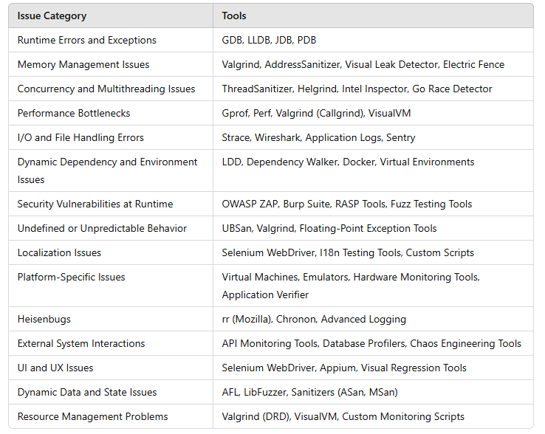
Tools for execution problems

Slide 26
Why Static Analysis Can't Detect These Issues
Lack of Runtime Context:
Static analysis doesn't execute code, so it can't account for actual input values, runtime states, or environmental conditions.
Inability to Predict Dynamic Behavior:
Execution paths that depend on user input, random numbers, or external systems are not fully analyzable statically.
Complex Interactions:
Concurrency issues and timing-dependent bugs require actual execution to manifest.
Dynamic Linking and Loading:
Modules or code loaded at runtime are not visible to static analysis tools.

Slide 27
Conclusion
Dynamic analysis is crucial because it allows developers to
Observe Actual Behavior:
See how the application performs in a real or simulated runtime environment.
Identify Hidden Issues:
Detect problems that are not apparent through code inspection alone.
Improve Reliability and Performance:
Ensure the application functions correctly under various conditions and loads.
Enhance Security:
Find vulnerabilities that could be exploited during execution.

