Slide 1
CY-6120: Software Security Practices
Module 5: Dynamic Analysis

Slide 2
Definition and Basic Concepts
Dynamic analysis is the process of evaluating a program by executing it and observing its behavior in a real-time environment.
Unlike static analysis, which examines code without running it, dynamic analysis lets us see how the code performs under actual operating conditions.
Key Characteristics:
Execution-Time Monitoring: Analyzes how a program operates during runtime.
Runtime Data Collection: Gathers information like memory usage, CPU load, network activity, and more.
Interaction with Real Environments: Observes the program's behavior with real inputs and external systems.

Slide 3
Definition and Basic Concepts
Why is it Important? - Detecting Runtime Issues such as
Memory Leaks: Where memory isn't properly released, leading to increased usage over time.
Race Conditions: Issues in multi-threaded applications where the timing of threads affects the outcome.
Unhandled Exceptions: Errors that cause the program to crash if not properly managed.
Performance Optimization:
Identifies bottlenecks and inefficient code paths.
Helps improve the speed and responsiveness of applications.
Security Assessment: Exposes vulnerabilities that can be exploited during execution, such as injection attacks or buffer overflows.

Slide 4
Types of dynamic analysis
Functional Testing Types
Unit Testing: Tests individual components or functions of the program
Integration Testing: Verifies interactions between different software components
System Testing: Evaluates the complete integrated system
Acceptance Testing: Validates software against user requirements
Security Analysis Types
Dynamic Application Security Testing (DAST): Simulates real-world attacks to identify vulnerabilities
Fuzzing: Injects invalid, malformed, or unexpected inputs to reveal software defects
Dynamic Symbolic Execution (DSE): Executes programs on concrete inputs while collecting path constraints
Dynamic Data-flow Analysis: Tracks information flow from sources to sinks

Slide 5
Types of dynamic analysis
Performance Analysis
Load Testing: Evaluates system behavior under expected load conditions
Stress Testing: Tests system behavior under extreme conditions
Endurance Testing: Assesses system performance over extended periods
Spike Testing: Analyzes system response to sudden workload increases
Code Analysis Types
Code Coverage Analysis: Identifies which parts of code are executed during testing
Invariant Inference: Observes program values and reports properties true across executions
Program Slicing: Reduces programs to minimum form while maintaining selected behaviors

Slide 6
Imagine buying a car without taking it for a test drive. You might know the specs, but until you feel how it handles on the road, you won't know if it's right for you. Reading a recipe gives you an idea, but cooking it lets you taste the final product and tweak it to perfection.

Slide 7
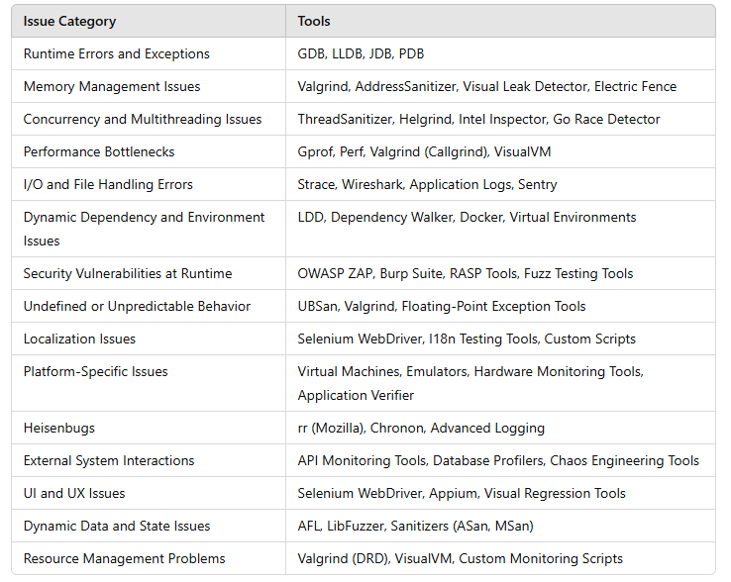
Tools of the trade

Slide 8
Valgrind
Primarily used for memory debugging, memory leak detection, and profiling.
Key Features
Memcheck: Detects memory management problems like use of uninitialized memory, improper frees, and memory leaks.
Callgrind: Performs detailed profiling to identify performance bottlenecks.
Helgrind: Detects data races in multithreaded programs.
Supported Languages:
Primarily C and C++, but can be used with any language that compiles to machine code (e.g., Fortran).
How It Works:
Runs the program on a synthetic CPU provided by Valgrind, which adds instrumentation code to monitor memory usage.

Slide 9
Valgrind
Pros:
Highly effective at detecting memory-related errors.
Provides detailed error messages with stack traces.
No need to recompile your program (though compiling with debug symbols improves output).
Cons:
Slows down program execution significantly (typically by 5-20 times).
Limited support on non-Linux platforms (available on Linux and macOS, but with limitations on macOS).

Slide 10
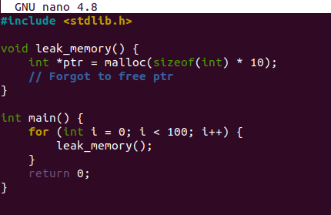
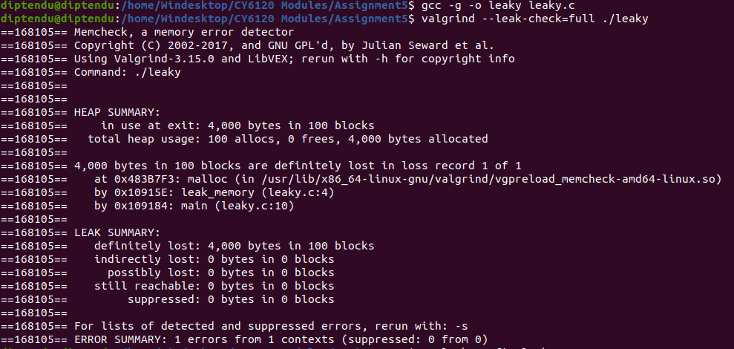
Valgrind

Slide 11
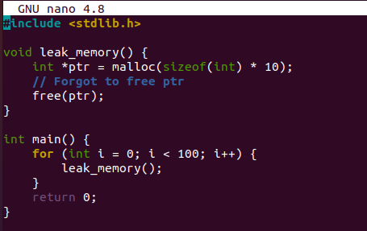
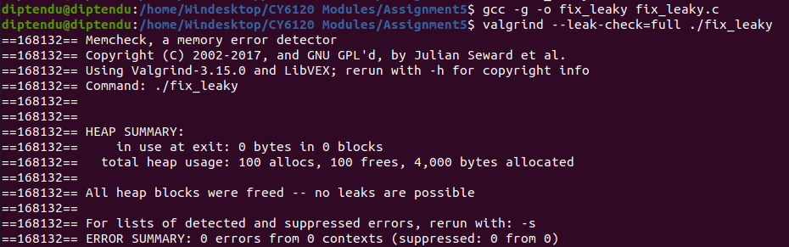
Valgrind

Slide 12
OWASP ZAP (Zed Attack Proxy)
An open-source web application security scanner. Cross-platform (written in Java).
Key Features:
Automated scanning for vulnerabilities like SQL injection, XSS, and more.
Manual testing tools such as intercepting proxy and fuzzers.
Supports scripting for advanced testing scenarios.
Pros:
User-friendly interface.
Active community and regular updates.
Ideal for both beginners and experienced security testers.
Cons:
Primarily focused on web applications.
May require configuration to avoid false positives.

Slide 13
American Fuzzy Lop (AFL)
A security-oriented fuzzer that uses genetic algorithms to efficiently increase code coverage.
Key Features:
Automatically discovers test cases that trigger new internal states in the targeted binary.
Helps find crashes, hangs, and potential security vulnerabilities.
Supported Languages: Works with any language that compiles to native code.
How It Works:
Instruments the program to monitor execution paths.
Mutates input data to explore new code paths.
Pros:
Effective at uncovering hidden bugs.
Low overhead compared to other fuzzers.
Cons:
Requires source code or binary instrumentation.
May require significant time to run for complex programs.

Slide 14
Advantages of Dynamic Analysis
Detecting Issues Not Found by Static Analysis
Runtime-Specific Bugs:
Memory Leaks and Corruptions: Static analysis might miss memory issues that only occur with certain execution paths or inputs.
Concurrency Problems: Detects race conditions and deadlocks that depend on thread scheduling and timing.
Real-World Inputs and Environments:
Input Validation: Tests how the program handles unexpected or malformed inputs.
Dynamic analysis can reveal how your application behaves when users 'think outside the box'—or just enter nonsense data.
Environmental Factors: Accounts for differences in hardware, OS, and resource availability.
It's one thing to run on your development machine; it's another to run on a client's aging server.

Slide 15
Advantages of Dynamic Analysis
Performance Optimization
Identifying Bottlenecks:
Profiling Execution: Pinpoints functions or methods that consume excessive time or resources.
Resource Utilization: Monitors memory, CPU, and I/O usage during runtime.
Improving User Experience:
Responsiveness: Ensures the application remains responsive under various load conditions.
Security Enhancements
Detecting Vulnerabilities During Execution:
Dynamic Application Security Testing (DAST): Simulates attacks to find vulnerabilities like SQL injection, XSS, and more.
Fuzz Testing: Inputs random data to uncover crashes and unexpected behavior.
Real-Time Threat Detection:
Monitors the application in real-time to detect and prevent attacks.
OpenRASP, Veracode runtime protection

Slide 16
Advantages of Dynamic Analysis
Validating Functional Behavior
Ensuring Correctness Under Real Conditions:
Integration Testing: Tests how different parts of the application work together.
User Acceptance Testing: Verifies the application meets user requirements in a live environment.

Slide 17
Disadvantages of Dynamic Analysis
Performance Overhead
Slower Execution:
Instrumented Code: Dynamic analysis tools often insert additional code or monitoring processes, which can slow down execution.
Impact on Development Cycle: Longer test times can slow down the development and testing processes.
Resource Consumption:
Increased Memory and CPU Usage: Tools may consume significant system resources, affecting other processes.
Environment Dependencies
Reproducibility Issues:
Environment-Specific Bugs: Bugs might only appear under certain system configurations, making them hard to reproduce.
Works on my machine, but not on yours
Setup Complexity:
Tool Configuration: Some tools require complex setup or are platform-specific.
Compatibility Issues: Not all tools support every programming language or operating system.

Slide 18
Disadvantages of Dynamic Analysis
False Positives and Negatives
False Positives:
Over-Reporting Issues: Tools might flag non-issues, leading to wasted time investigating.
False Negatives:
Missing Real Issues: Tools may fail to detect certain bugs, especially if the execution path isn't exercised.
Dependence on Test Coverage:
Incomplete Testing: Dynamic analysis only checks the code paths that are executed during testing.
Time and Resource Investment
Learning Curve:
Complexity of Tools: Some dynamic analysis tools require significant time to learn and use effectively.
Maintenance Effort:
Keeping Up with Changes: As the codebase evolves, tests and configurations may need constant updates.

Slide 19
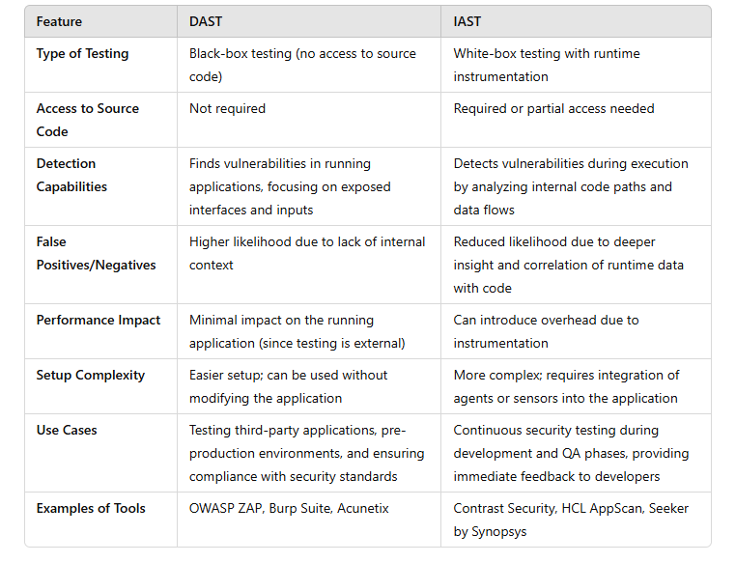
DAST vs IAST

Slide 20
DAST vs IAST
Imagine you're a food critic at a restaurant. You taste the dish (the running application) and evaluate it based on what you experience. You might find that it lacks seasoning or has an unexpected flavor (vulnerabilities), but you don't know exactly why because you don't see the recipe (the source code).
Now, imagine you're not only tasting the dish but also have the recipe in hand and can watch the chef prepare it. You can see if they added too much salt or skipped an ingredient. This gives you a deeper understanding of what's wrong and how to fix it.
DAST provides valuable insights from an external perspective, simulating how an attacker might interact with your application.
IAST offers a more in-depth analysis by combining runtime data with code insights, leading to more accurate and actionable results.

Slide 21
DAST vs IAST
When to Use DAST:
No Access to Source Code: Testing third-party applications or when the source code is unavailable.
Compliance Requirements: Meeting industry standards that require external security testing.
Post-Deployment Testing: Assessing applications in staging or production environments.
When to Use IAST:
During Development and QA: Integrating security testing into the development lifecycle.
Desire for Immediate Feedback: Providing developers with real-time insights into vulnerabilities as they code.
Complex Applications: Applications with complex data flows that require deeper analysis.

Slide 22
Identify the Runtime Issue from a Given Log Snippet!

Slide 23
Quiz
[2023-10-14 14:23:01] WARNING: Potential memory leak detected in module 'DataProcessor' at line 56.
[2023-10-14 14:23:01] DEBUG: Allocated 1024 bytes of memory.
[2023-10-14 14:23:01] DEBUG: Exiting function 'processData' without deallocating memory.
Notes:
The processData function in the DataProcessor module is allocating memory but not freeing it before exiting, leading to a memory leak.
Modify the processData function to ensure that all allocated memory is properly deallocated before the function exits.

Slide 24
Quiz
[2023-10-14 15:10:45] ERROR: Data inconsistency detected for user ID 1234.
[2023-10-14 15:10:45] DEBUG: Thread 5 updated 'balance' to $1000.
[2023-10-14 15:10:45] DEBUG: Thread 7 read 'balance' as $800.
Notes:
A race condition is occurring where multiple threads are accessing and modifying shared data (balance) without proper synchronization.
Implement synchronization mechanisms such as mutexes or locks to ensure that access to shared data is thread-safe.

Slide 25
Quiz
[2023-10-14 16:05:30] INFO: Calling function 'calculateDiscount'.
[2023-10-14 16:05:30] ERROR: Segmentation fault at address 0x00000000.
[2023-10-14 16:05:30] DEBUG: Pointer 'customerData' is NULL.
Notes:
The function calculateDiscount is attempting to access customerData, which is NULL, leading to a segmentation fault.
Add a null check before using customerData to ensure it's not NULL. Also, investigate why customerData is NULL and ensure it's properly initialized.

Slide 26
Quiz
[2023-10-14 17:20:00] WARNING: Failed to open file 'log.txt': Too many open files.
[2023-10-14 17:20:00] DEBUG: Opened file descriptor 1024.
[2023-10-14 17:20:00] DEBUG: Exiting function 'writeLog' without closing file descriptor.
Notes:
The writeLog function is not closing file descriptors after opening files, leading to a resource leak.
Ensure that every opened file descriptor is properly closed before the function exits.

Slide 27
Quiz
[2023-10-14 18:45:00] INFO: Processing request ID 5678.
[2023-10-14 18:45:10] DEBUG: Function 'generateReport' execution time: 9500ms.
[2023-10-14 18:45:10] DEBUG: Database query took 9000ms.
Notes:
The database query within generateReport is taking 9000ms, causing slow response times.
Optimize the database query (e.g., by adding indexes, rewriting the query).
Implement caching mechanisms.
Review database performance and consider scaling resources.

Slide 28
Memes

Slide 29


Slide 30
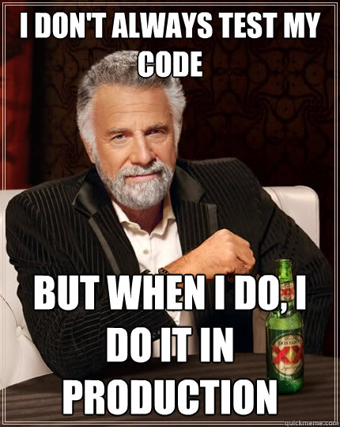
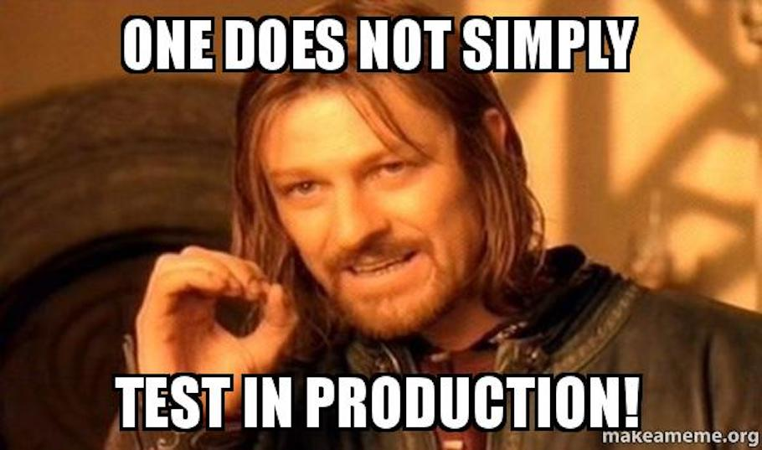

Slide 31
